Slide 1
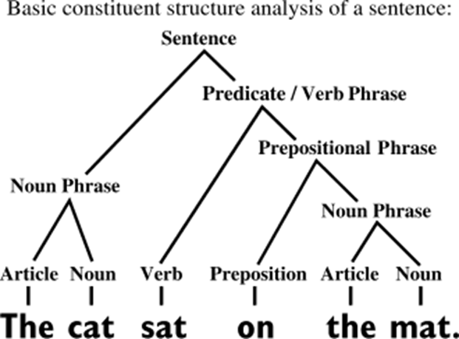
Basic linguistics: Syntax, semantics, morphology, and pragmatics.
syntax is the study of how words and morphemes combine to form larger units such as phrases and sentences.

Slide 2
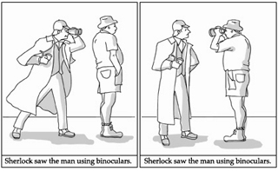
Basic linguistics: Syntax, semantics, morphology, and pragmatics.
Semantics focuses on the meaning of words, phrases, and sentences.
It explores how meaning is derived from language components.

Slide 3
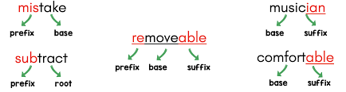
Basic linguistics: Syntax, semantics, morphology, and pragmatics.
- Morphology studies the structure of words and their formation.
- It analyzes morphemes, the smallest meaningful units of language.

Slide 4
Basic linguistics: Syntax, semantics, morphology, and pragmatics.
- Pragmatics examines how context influences meaning.
- It looks at speaker intent, listener interpretation, and situational factors.

Slide 5
Basic linguistics: Syntax, semantics, morphology, and pragmatics.
- Pragmatics examines how context influences meaning.
- It looks at speaker intent, listener interpretation, and situational factors.
Sentence: "It's cold in here.“
Semantics
Pragmatics
Literal meaning: The temperature in the room is low.
Contextual meaning: The speaker might be indirectly asking someone to close a window or turn up the heat.

Slide 6
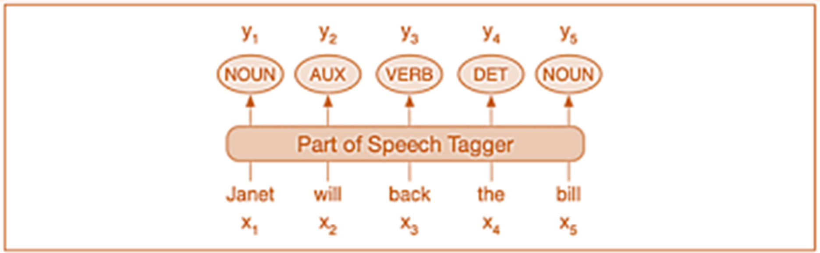
Language structure: POS tagging, dependency parsing, and constituency parsing.
POS - part-of-speech
also called grammatical tagging is the process of marking up a word in a text (corpus) as corresponding to a particular part of speech, based on both its definition and its context.

Slide 7
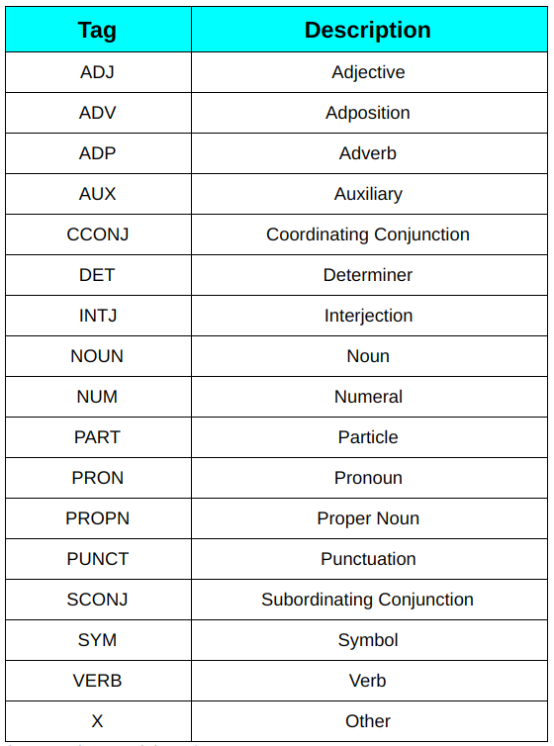
Language structure: POS tagging, dependency parsing, and constituency parsing.

Slide 8
Language structure: POS tagging, dependency parsing, and constituency parsing.
Russian
English
A fusional language with rich inflectional morphology (nouns, adjectives, verbs change form based on case, gender, number, tense, aspect, etc.).
POS tags often encode grammatical features like case (nominative, accusative, etc.), gender (masculine, feminine, neuter), and verb aspect (perfective vs. imperfective).
A less inflected language (analytic tendencies). Nouns lack grammatical gender, and verbs have fewer conjugated forms.
POS tags focus more on syntactic role (e.g., noun, verb) rather than morphological details.
impler tagsets (e.g., Penn Treebank uses 36 tags, focusing on syntax over morphology).
Tags like VB (verb base form), VBD (past tense), or NNP (proper noun).
Larger tagsets (e.g., Universal Dependencies (UD) for Russian includes ~50 tags with detailed morphological features).
Tags like VERB|Aspect=Perf|Mood=Ind|Number=Sing are common.

Slide 9
Language structure: POS tagging, dependency parsing, and constituency parsing.
Russian
English
A fusional language with rich inflectional morphology (nouns, adjectives, verbs change form based on case, gender, number, tense, aspect, etc.).
POS tags often encode grammatical features like case (nominative, accusative, etc.), gender (masculine, feminine, neuter), and verb aspect (perfective vs. imperfective).
A less inflected language (analytic tendencies). Nouns lack grammatical gender, and verbs have fewer conjugated forms.
POS tags focus more on syntactic role (e.g., noun, verb) rather than morphological details.
impler tagsets (e.g., Penn Treebank uses 36 tags, focusing on syntax over morphology).
Tags like VB (verb base form), VBD (past tense), or NNP (proper noun).
Larger tagsets (e.g., Universal Dependencies (UD) for Russian includes ~50 tags with detailed morphological features).
Tags like VERB|Aspect=Perf|Mood=Ind|Number=Sing are common.

Slide 10
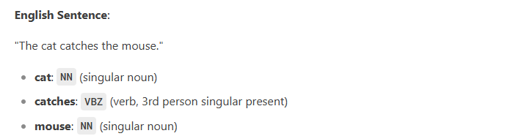
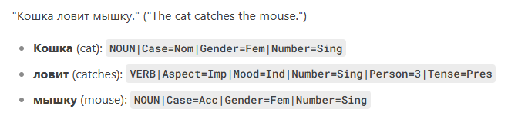


Language structure: POS tagging, dependency parsing, and constituency parsing.
Russian
English
Russian POS tagging is morphology-heavy (case, gender, aspect)
English focuses on syntactic roles with minimal inflectional detail.
Notes:
Mood – наклонение
Ind – indicative – изъявительное – Он бежит
Imp – imperative – повелительное – Бежать
«наряд (одежда)» — «наряд (распоряжение)»

Slide 11
