Slide 1
Bits, Bytes, and Integers
September 1, 2006
15-213
“The Class That Gives CMU Its Zip!”
Topics
  Representing information as bits
  Bit-level manipulations
    Boolean algebra
    Expressing in C
  Representations of Integers
    Basic properties and operations
    Implications for C
class02.ppt
15-213 F’06

Slide 2
Binary Representations
Base 2 Number Representation
  Represent 15213₁₀ as 11101101101101₂
  Represent 1.20₁₀ as 1.0011001100110011[0011]…₂
  Represent 1.5213 X 10⁴ as 1.1101101101101₂ X 2¹³
Electronic Implementation
  Easy to store with bistable elements
  Reliably transmitted on noisy and inaccurate wires
0
1
0
3.3V
2.8V
0.5V
0.0V

Slide 3
Encoding Byte Values
Byte = 8 bits
  Binary 00000000₂ to 11111111₂
  Decimal: 0₁₀ to 255₁₀
    First digit must not be 0 in C
  Hexadecimal 00₁₆ to FF₁₆
    Base 16 number representation
    Use characters ‘0’ to ‘9’ and ‘A’ to ‘F’
    Write FA1D37B₁₆ in C as 0xFA1D37B
      Or 0xfa1d37b
Decimal
Hex
Binary
0
0
0000
1
1
0001
2
2
0010
3
3
0011
4
4
0100
5
5
0101
6
6
0110
7
7
0111
8
8
1000
9
9
1001
A
10
1010
B
11
1011
C
12
1100
D
13
1101
E
14
1110
F
15
1111

Slide 4
Byte-Oriented Memory Organization
Programs Refer to Virtual Addresses
  Conceptually very large array of bytes
  Actually implemented with hierarchy of different memory types
  System provides address space private to particular “process”
    Program being executed
    Program can clobber its own data, but not that of others
Compiler + Run-Time System Control Allocation
  Where different program objects should be stored
  All allocation within single virtual address space

Slide 5
Machine Words
Machine Has “Word Size”
  Nominal size of integer-valued data
    Including addresses
  Most current machines use 32 bits (4 bytes) words
    Limits addresses to 4GB
      Users can access 3GB
    Becoming too small for memory-intensive applications
  High-end systems use 64 bits (8 bytes) words
    Potential address space ≈ 1.8 X 10¹⁹ bytes
    x86-64 machines support 48-bit addresses: 256 Terabytes
  Machines support multiple data formats
    Fractions or multiples of word size
    Always integral number of bytes

Slide 6
Word-Oriented Memory Organization
32-bit
Words
64-bit
Words
Bytes
Addr.
0000
Addr
=
??
0001
Addresses Specify Byte Locations
  Address of first byte in word
  Addresses of successive words differ by 4 (32-bit) or 8 (64-bit)
0000
0002
Addr
=
??
0003
0000
0004
Addr
=
??
0005
0004
0006
0007
0008
Addr
=
??
0009
0008
0010
Addr
=
??
0011
0008
0012
Addr
=
??
0013
0012
0014
0015

Slide 7
Data Representations
Sizes of C Objects (in Bytes)
  C Data Type Typical 32-bit Intel IA32 x86-64
    unsigned 4 4 4
    int 4 4 4
    long int 4 4 4
    char 1 1 1
    short 2 2 2
    float 4 4 4
    double 8 8 8
    long double – 10/12 10/12
    char * 4 4 8
      Or any other pointer

Slide 8
Byte Ordering
How should bytes within multi-byte word be ordered in memory?
Conventions
  Big Endian: Sun, PPC Mac
    Least significant byte has highest address
  Little Endian: x86
    Least significant byte has lowest address

Slide 9
Byte Ordering Example
Big Endian
  Least significant byte has highest address
Little Endian
  Least significant byte has lowest address
Example
  Variable x has 4-byte representation 0x01234567
  Address given by &x is 0x100
Big Endian
0x100
0x101
0x102
0x103
01
01
23
23
45
45
67
67
Little Endian
0x100
0x101
0x102
0x103
67
67
45
45
23
23
01
01

Slide 10
Reading Byte-Reversed Listings
Disassembly
  Text representation of binary machine code
  Generated by program that reads the machine code
Example Fragment
Address Instruction Code Assembly Rendition
8048365: 5b pop %ebx
8048366: 81 c3 ab 12 00 00 add $0x12ab,%ebx
804836c: 83 bb 28 00 00 00 00 cmpl $0x0,0x28(%ebx)
Deciphering Numbers
  Value: 0x12ab
  Pad to 4 bytes: 0x000012ab
  Split into bytes: 00 00 12 ab
  Reverse: ab 12 00 00

Slide 11
Examining Data Representations
Code to Print Byte Representation of Data
  Casting pointer to unsigned char * creates byte array
typedef unsigned char *pointer;
void show_bytes(pointer start, int len)
{
int i;
for (i = 0; i < len; i++)
printf("0x%p\t0x%.2x\n",
start+i, start[i]);
printf("\n");
}
Printf directives:
  %p: Print pointer
  %x: Print Hexadecimal

Slide 12
show_bytes Execution Example
int a = 15213;
printf("int a = 15213;\n");
show_bytes((pointer) &a, sizeof(int));
Result (Linux):
int a = 15213;
0x11ffffcb8 0x6d
0x11ffffcb9 0x3b
0x11ffffcba 0x00
0x11ffffcbb 0x00

Slide 13
Representing Integers
Decimal: 15213
Binary: 0011 1011 0110 1101
Hex: 3 B 6 D
int A = 15213;
int B = -15213;
long int C = 15213;
IA32, x86-64 A
Sun A
IA32 C
x86-64 C
Sun C
6D
00
6D
6D
00
3B
00
3B
3B
00
00
3B
00
00
3B
00
6D
00
00
6D
00
IA32, x86-64 B
Sun B
00
00
93
FF
00
C4
FF
FF
C4
FF
93
Two’s complement representation
(Covered later)

Slide 14
Representing Pointers
int B = -15213;
int *P = &B;
Sun P
IA32 P
x86-64 P
EF
D4
0C
FF
F8
89
FB
FF
EC
2C
BF
FF
FF
7F
00
00
Different compilers & machines assign different locations to objects

Slide 15
Representing Strings
char S[6] = "15213";
Strings in C
  Represented by array of characters
  Each character encoded in ASCII format
    Standard 7-bit encoding of character set
    Character “0” has code 0x30
      Digit i has code 0x30+i
  String should be null-terminated
    Final character = 0
Compatibility
  Byte ordering not an issue
Linux/Alpha S
Sun S
31
31
35
35
32
32
31
31
33
33
00
00

Slide 16
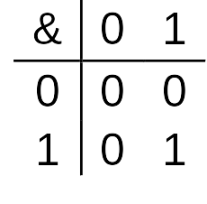
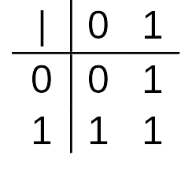
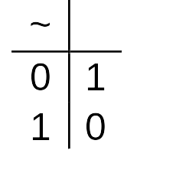
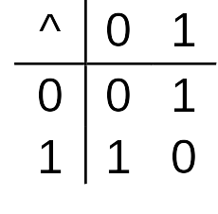
Boolean Algebra
Developed by George Boole in 19th Century
  Algebraic representation of logic
    Encode “True” as 1 and “False” as 0
And
  A&B = 1 when both A=1 and B=1
Or
  A|B = 1 when either A=1 or B=1
Not
  ~A = 1 when A=0
Exclusive-Or (Xor)
  A^B = 1 when either A=1 or B=1, but not both

Slide 17
Application of Boolean Algebra
Applied to Digital Systems by Claude Shannon
  1937 MIT Master’s Thesis
  Reason about networks of relay switches
    Encode closed switch as 1, open switch as 0
A&~B
Connection when
A&~B | ~A&B
A
~B
~A
B
~A&B
= A^B

Slide 18
General Boolean Algebras
Operate on Bit Vectors
  Operations applied bitwise
All of the Properties of Boolean Algebra Apply
01101001
& 01010101
01000001
01101001
| 01010101
01111101
01101001
^ 01010101
00111100
~ 01010101
10101010
01000001
01111101
00111100
10101010

Slide 19
Representing & Manipulating Sets
Representation
  Width w bit vector represents subsets of {0, …, w–1}
  a_{j} = 1 if j ∈ A
    01101001 { 0, 3, 5, 6 }
    76543210
    01010101 { 0, 2, 4, 6 }
    76543210
Operations
  & Intersection 01000001 { 0, 6 }
  | Union 01111101 { 0, 2, 3, 4, 5, 6 }
  ^ Symmetric difference 00111100 { 2, 3, 4, 5 }
  ~ Complement 10101010 { 1, 3, 5, 7 }

Slide 20
Bit-Level Operations in C
Operations &, |, ~, ^ Available in C
  Apply to any “integral” data type
    long, int, short, char, unsigned
  View arguments as bit vectors
  Arguments applied bit-wise
Examples (Char data type)
  ~0x41 --> 0xBE
    ~01000001₂ --> 10111110₂
  ~0x00 --> 0xFF
    ~00000000₂ --> 11111111₂
  0x69 & 0x55 --> 0x41
    01101001₂ & 01010101₂ --> 01000001₂
  0x69 | 0x55 --> 0x7D
    01101001₂ | 01010101₂ --> 01111101₂

Slide 21
Contrast: Logic Operations in C
Contrast to Logical Operators
  &&, ||, !
    View 0 as “False”
    Anything nonzero as “True”
    Always return 0 or 1
    Early termination
Examples (char data type)
  !0x41 --> 0x00
  !0x00 --> 0x01
  !!0x41 --> 0x01
  0x69 && 0x55 --> 0x01
  0x69 || 0x55 --> 0x01
  p && *p (avoids null pointer access)

Slide 22
Shift Operations
Left Shift: x << y
  Shift bit-vector x left y positions
      Throw away extra bits on left
    Fill with 0’s on right
Right Shift: x >> y
  Shift bit-vector x right y positions
    Throw away extra bits on right
  Logical shift
    Fill with 0’s on left
  Arithmetic shift
    Replicate most significant bit on right
Strange Behavior
  Shift amount > word size
Argument x
01100010
<< 3
00010000
00010000
00010000
Log. >> 2
00011000
00011000
00011000
Arith. >> 2
00011000
00011000
00011000
Argument x
10100010
<< 3
00010000
00010000
00010000
Log. >> 2
00101000
00101000
00101000
Arith. >> 2
11101000
11101000
11101000

Slide 23
Integer C Puzzles
  Assume 32-bit word size, two’s complement integers
  For each of the following C expressions, either:
    Argue that is true for all argument values
    Give example where not true
x < 0 ⇒ ((x*2) < 0)
ux >= 0
x & 7 == 7 ⇒ (x<<30) < 0
ux > -1
x > y ⇒ -x < -y
x * x >= 0
x > 0 && y > 0 ⇒ x + y > 0
x >= 0 ⇒ -x <= 0
x <= 0 ⇒ -x >= 0
(x|-x)>>31 == -1
ux >> 3 == ux/8
x >> 3 == x/8
x & (x-1) != 0
Initialization
int x = foo();
int y = bar();
unsigned ux = x;
unsigned uy = y;

Slide 24
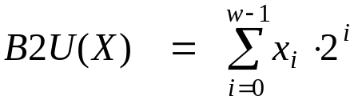
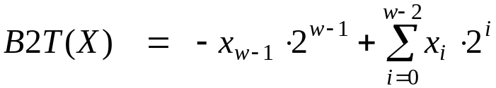
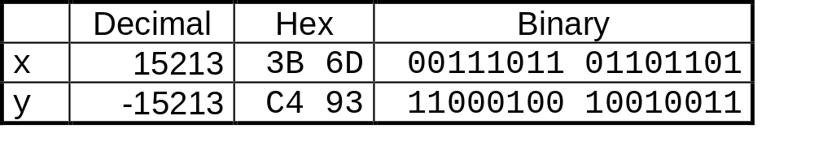
Encoding Integers
Unsigned
Two’s Complement
short int x = 15213;
short int y = -15213;
Sign
Bit
  C short 2 bytes long
Sign Bit
  For 2’s complement, most significant bit indicates sign
    0 for nonnegative
    1 for negative

Slide 25
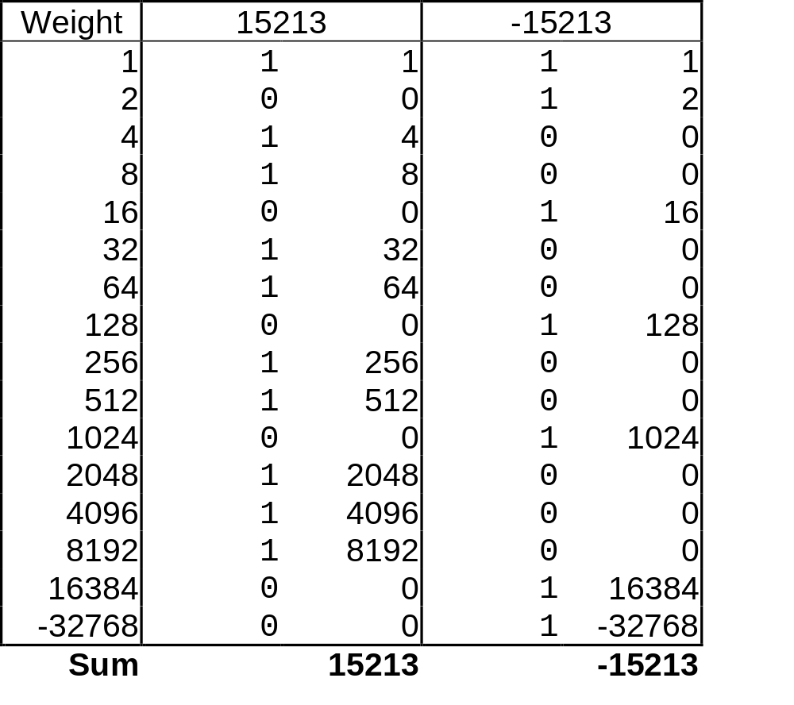
Encoding Example (Cont.)
x = 15213: 00111011 01101101
y = -15213: 11000100 10010011

Slide 26
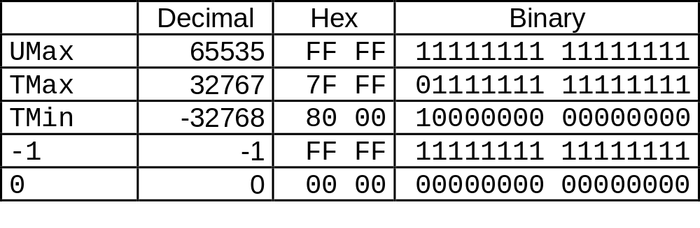
Numeric Ranges
Unsigned Values
  UMin = 0
    000…0
  UMax = 2^{w} – 1
    111…1
Two’s Complement Values
  TMin = –2^{w–1}
    100…0
  TMax = 2^{w–1} – 1
    011…1
Other Values
  Minus 1
    111…1
Values for W = 16

Slide 27
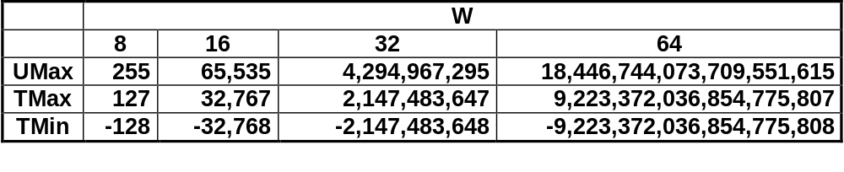
Values for Different Word Sizes
Observations
  |TMin | = TMax + 1
    Asymmetric range
  UMax = 2 * TMax + 1
C Programming
  #include <limits.h>
    K&R App. B11
  Declares constants, e.g.,
    ULONG_MAX
    LONG_MAX
    LONG_MIN
  Values platform-specific

Slide 28
Unsigned & Signed Numeric Values
X
B2U(X)
B2T(X)
Equivalence
  Same encodings for nonnegative values
Uniqueness
  Every bit pattern represents unique integer value
  Each representable integer has unique bit encoding
⇒ Can Invert Mappings
  U2B(x) = B2U⁻¹(x)
    Bit pattern for unsigned integer
  T2B(x) = B2T⁻¹(x)
    Bit pattern for two’s comp integer
0000
0
0
0001
1
1
0010
2
2
0011
3
3
0100
4
4
0101
5
5
0110
6
6
0111
7
7
1000
8
–8
1001
9
–7
1010
10
–6
1011
11
–5
1100
12
–4
1101
13
–3
1110
14
–2
1111
15
–1

Slide 29
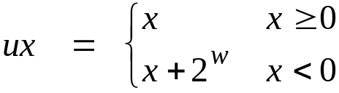
Relation between Signed & Unsigned
Two’s Complement
T2U
Unsigned
x
T2B
B2U
ux
X
Maintain Same Bit Pattern
w–1
0
ux
+
+
+
• • •
+
+
+
x
-
+
+
• • •
+
+
+
Large negative weight
→
Large positive weight

Slide 30
Signed vs. Unsigned in C
Constants
  By default are considered to be signed integers
  Unsigned if have “U” as suffix
    0U, 4294967259U
Casting
  Explicit casting between signed & unsigned same as U2T and T2U
    int tx, ty;
    unsigned ux, uy;
    tx = (int) ux;
    uy = (unsigned) ty;
  Implicit casting also occurs via assignments and procedure calls
    tx = ux;
    uy = ty;

Slide 31
Casting Surprises
Expression Evaluation
  If mix unsigned and signed in single expression, signed values implicitly cast to unsigned
  Including comparison operations <, >, ==, <=, >=
  Examples for W = 32
Constant₁ Constant₂ Relation Evaluation
  0 0U
  -1 0
  -1 0U
  2147483647 -2147483648
  2147483647U -2147483648
  -1 -2
  (unsigned) -1 -2
  2147483647 2147483648U
  2147483647 (int) 2147483648U
  0 0U == unsigned
  -1 0 < signed
  -1 0U > unsigned
  2147483647 -2147483648 > signed
  2147483647U -2147483648 < unsigned
  -1 -2 > signed
  (unsigned) -1 -2 > unsigned
  2147483647 2147483648U < unsigned
  2147483647 (int) 2147483648U > signed

Slide 32
Explanation of Casting Surprises
2’s Comp. → Unsigned
  Ordering Inversion
  Negative → Big Positive
UMax
UMax – 1
TMax + 1
Unsigned
Range
TMax
TMax
2’s Comp.
Range
0
0
–1
–2
TMin

Slide 33
Sign Extension
Task:
  Given w-bit signed integer x
  Convert it to w+k-bit integer with same value
Rule:
  Make k copies of sign bit:
  X ′ = x_{w–1} ,…, x_{w–1} , x_{w–1} , x_{w–2} ,…, x₀
k copies of MSB
w
X
• • •
• • •
X ′
• • •
• • •
k
w

Slide 34
Sign Extension Example
short int x = 15213;
int ix = (int) x;
short int y = -15213;
int iy = (int) y;
Decimal
Hex
Binary
x
15213
3B 6D
00111011 01101101
ix
15213
00 00 3B 6D
00000000 00000000 00111011 01101101
y
-15213
C4 93
11000100 10010011
iy
-15213
FF FF C4 93
11111111 11111111 11000100 10010011
  Converting from smaller to larger integer data type
  C automatically performs sign extension

Slide 35
Why Should I Use Unsigned?
Don’t Use Just Because Number Nonzero
  Easy to make mistakes
    unsigned i;
    for (i = cnt-2; i >= 0; i--)
    a[i] += a[i+1];
  Can be very subtle
    #define DELTA sizeof(int)
    int i;
    for (i = CNT; i-DELTA >= 0; i-= DELTA)
    . . .
Do Use When Performing Modular Arithmetic
  Multiprecision arithmetic
Do Use When Need Extra Bit’s Worth of Range
  Working right up to limit of word size

Slide 36
Negating with Complement & Increment
Claim: Following Holds for 2’s Complement
  ~x + 1 == -x
Complement
  Observation: ~x + x == 1111…11₂ == -1
Increment
  ~x + x + (-x + 1) == -1 + (-x + 1)
  ~x + 1 == -x
Warning: Be cautious treating int’s as integers
  OK here
x
1
0
0
1
1
1
0
1
+
~x
0
1
1
0
0
0
1
0
-1
1
1
1
1
1
1
1
1

Slide 37
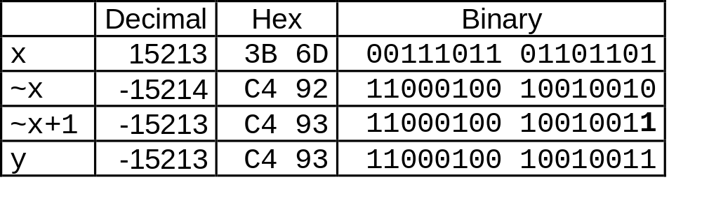
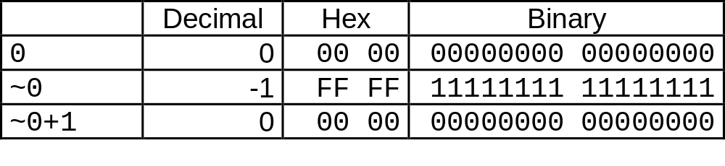
Comp. & Incr. Examples
x = 15213
0

Slide 38

Unsigned Addition
u
• • •
Operands: w bits
+
v
• • •
True Sum: w+1 bits
u + v
• • •
Discard Carry: w bits
UAdd_{w}(u , v)
• • •
Standard Addition Function
  Ignores carry output
Implements Modular Arithmetic
  s = UAdd_{w}(u , v) = u + v mod 2^{w}

Slide 39
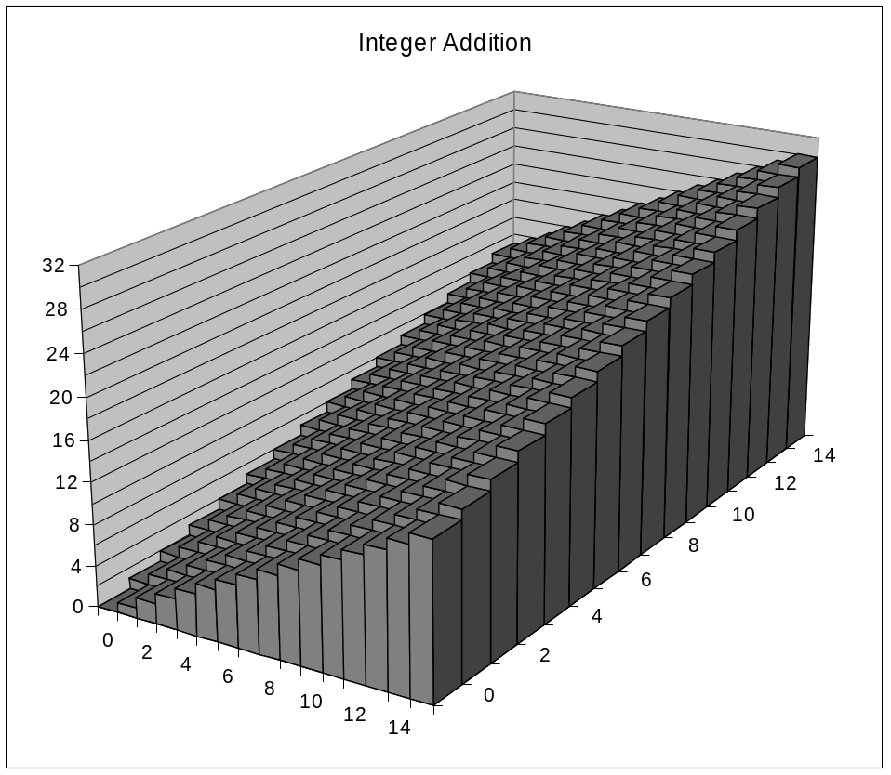
Visualizing Integer Addition
Integer Addition
  4-bit integers u, v
  Compute true sum Add₄(u , v)
  Values increase linearly with u and v
  Forms planar surface
Add₄(u , v)
v
u

Slide 40
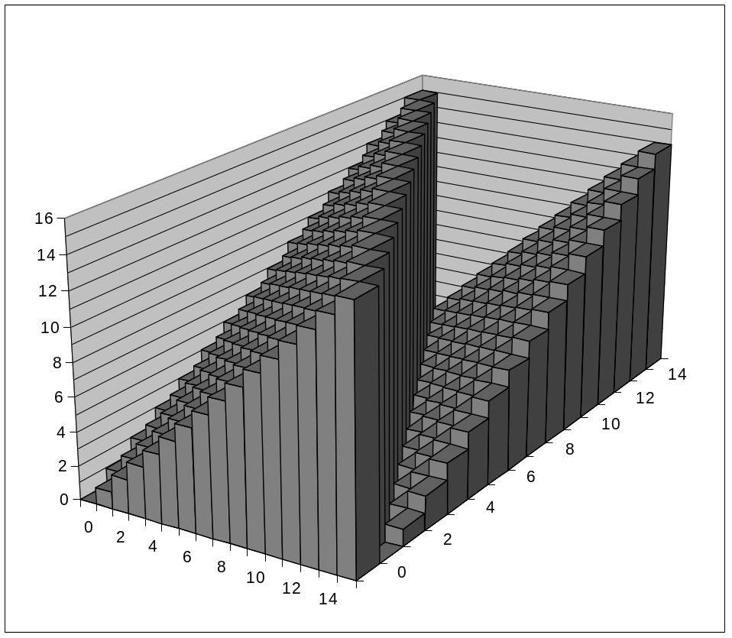
Visualizing Unsigned Addition
Wraps Around
  If true sum ≥ 2^{w}
  At most once
Overflow
UAdd₄(u , v)
True Sum
2^{w+1}
Overflow
2^{w}
v
0
Modular Sum
u

Slide 41
Mathematical Properties
Modular Addition Forms an Abelian Group
  Closed under addition
    0 ≤ UAdd_{w}(u , v) ≤ 2^{w} –1
  Commutative
    UAdd_{w}(u , v) = UAdd_{w}(v , u)
  Associative
    UAdd_{w}(t, UAdd_{w}(u , v)) = UAdd_{w}(UAdd_{w}(t, u ), v)
  0 is additive identity
    UAdd_{w}(u , 0) = u
  Every element has additive inverse
    Let UComp_{w} (u ) = 2^{w} – u
    UAdd_{w}(u , UComp_{w} (u )) = 0

Slide 42
Two’s Complement Addition
u
• • •
Operands: w bits
+
v
• • •
True Sum: w+1 bits
u + v
• • •
Discard Carry: w bits
TAdd_{w}(u , v)
• • •
TAdd and UAdd have Identical Bit-Level Behavior
  Signed vs. unsigned addition in C:
  int s, t, u, v;
  s = (int) ((unsigned) u + (unsigned) v);
  t = u + v
  Will give s == t

Slide 43

Characterizing TAdd
Functionality
  True sum requires w+1 bits
  Drop off MSB
  Treat remaining bits as 2’s comp. integer
True Sum
0 111…1
2^{w}–1
PosOver
TAdd Result
0 100…0
2^{w –1}
011…1
0 000…0
0
000…0
PosOver
1 100…0
–2^{w –1}
100…0
TAdd(u , v)
1 000…0
–2^{w}
NegOver
> 0
v
< 0
(NegOver)
< 0
> 0
u
(PosOver)
NegOver

Slide 44
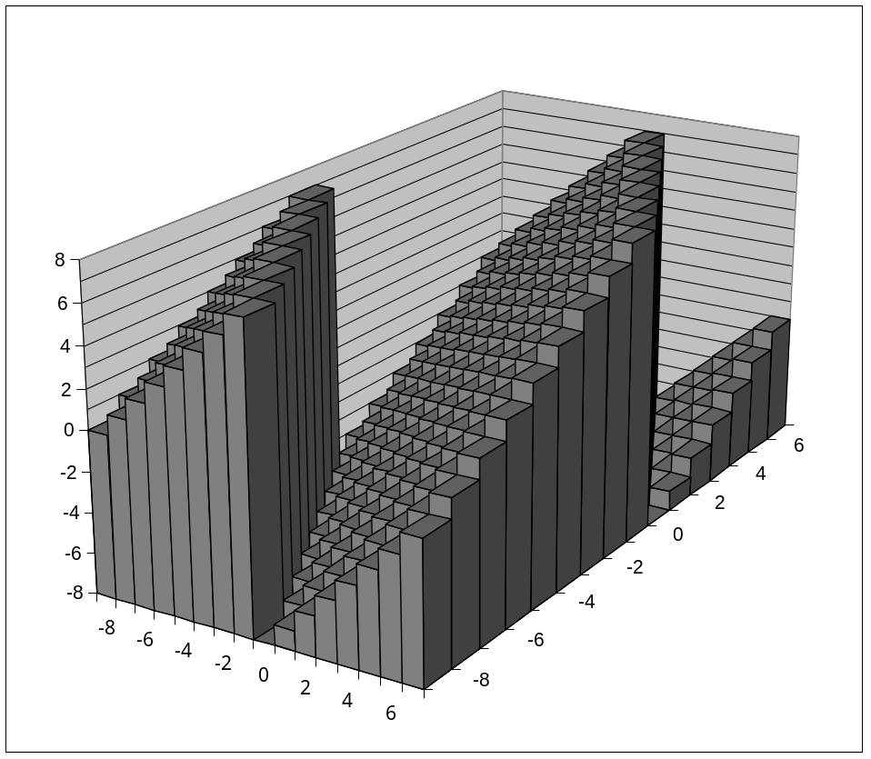
Visualizing 2’s Comp. Addition
NegOver
Values
  4-bit two’s comp.
  Range from -8 to +7
Wraps Around
  If sum ≥ 2^{w–1}
    Becomes negative
    At most once
  If sum < –2^{w–1}
    Becomes positive
    At most once
TAdd₄(u , v)
v
u
PosOver

Slide 45
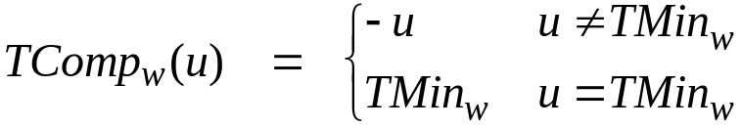
Mathematical Properties of TAdd
Isomorphic Algebra to UAdd
  TAdd_{w}(u , v) = U2T(UAdd_{w}(T2U(u ), T2U(v)))
    Since both have identical bit patterns
Two’s Complement Under TAdd Forms a Group
  Closed, Commutative, Associative, 0 is additive identity
  Every element has additive inverse

Slide 46
Multiplication
Computing Exact Product of w-bit numbers x, y
  Either signed or unsigned
Ranges
  Unsigned: 0 ≤ x * y ≤ (2^{w} – 1) ² = 2^{2w} – 2^{w+1} + 1
    Up to 2w bits
  Two’s complement min: x * y ≥ (–2^{w–1})*(2^{w–1}–1) = –2^{2w–2} + 2^{w–1}
    Up to 2w–1 bits
  Two’s complement max: x * y ≤ (–2^{w–1}) ² = 2^{2w–2}
    Up to 2w bits, but only for (TMin_{w})²
Maintaining Exact Results
  Would need to keep expanding word size with each product computed
  Done in software by “arbitrary precision” arithmetic packages

Slide 47
Unsigned Multiplication in C
u
• • •
Operands: w bits
*
v
• • •
True Product: 2*w bits
u · v
• • •
• • •
Discard w bits: w bits
UMult_{w}(u , v)
• • •
Standard Multiplication Function
  Ignores high order w bits
Implements Modular Arithmetic
  UMult_{w}(u , v) = u · v mod 2^{w}

Slide 48
Signed Multiplication in C
u
• • •
Operands: w bits
*
v
• • •
True Product: 2*w bits
u · v
• • •
• • •
Discard w bits: w bits
TMult_{w}(u , v)
• • •
Standard Multiplication Function
  Ignores high order w bits
  Some of which are different for signed vs. unsigned multiplication
  Lower bits are the same

Slide 49
Power-of-2 Multiply with Shift
Operation
  u << k gives u * 2^{k}
  Both signed and unsigned
Examples
  u << 3 == u * 8
  u << 5 - u << 3 == u * 24
  Most machines shift and add faster than multiply
    Compiler generates this code automatically
k
u
• • •
Operands: w bits
*
2^{k}
0
•••
0
1
0
•••
0
0
True Product: w+k bits
u · 2^{k}
• • •
0
•••
0
0
Discard k bits: w bits
UMult_{w}(u , 2^{k})
•••
0
•••
0
0
TMult_{w}(u , 2^{k})

Slide 50
Compiled Multiplication Code
C Function
int mul12(int x)
{
return x*12;
}
Compiled Arithmetic Operations
Explanation
leal (%eax,%eax,2), %eax
sall $2, %eax
t <- x+x*2
return t << 2;
  C compiler automatically generates shift/add code when multiplying by constant

Slide 51
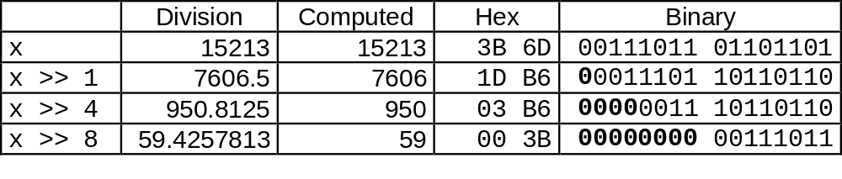
Unsigned Power-of-2 Divide with Shift
Quotient of Unsigned by Power of 2
  u >> k gives ⎣ u / 2^{k} ⎦
  Uses logical shift
k
u
•••
•••
Binary Point
Operands:
/
2^{k}
0
•••
0
1
0
•••
0
0
Division:
u / 2^{k}
0
•••
•••
.
•••
Result:
⎣ u / 2^{k} ⎦
0
•••
•••

Slide 52
Compiled Unsigned Division Code
C Function
unsigned udiv8(unsigned x)
{
return x/8;
}
Compiled Arithmetic Operations
Explanation
shrl $3, %eax
# Logical shift
return x >> 3;
  Uses logical shift for unsigned
For Java Users
  Logical shift written as >>>

Slide 53
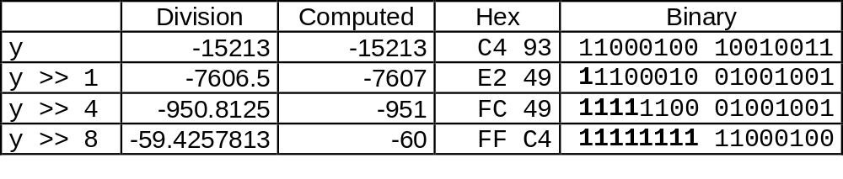
Signed Power-of-2 Divide with Shift
Quotient of Signed by Power of 2
  x >> k gives ⎣ x / 2^{k} ⎦
  Uses arithmetic shift
  Rounds wrong direction when u < 0
k
x
•••
•••
Binary Point
Operands:
/
2^{k}
0
•••
0
1
0
•••
0
0
Division:
x / 2^{k}
0
•••
•••
.
•••
Result:
RoundDown(x / 2^{k})
0
•••
•••

Slide 54
Correct Power-of-2 Divide
Quotient of Negative Number by Power of 2
  Want ⎡ x / 2^{k} ⎤ (Round Toward 0)
  Compute as ⎣ (x+2^{k}-1)/ 2^{k} ⎦
    In C: (x + (1<<k)-1) >> k
    Biases dividend toward 0
Case 1: No rounding
k
Dividend:
u
1
•••
0
•••
0
0
+2^{k} –1
0
•••
0
0
1
•••
1
1
Binary Point
1
•••
1
•••
1
1
Divisor:
/
2^{k}
0
•••
0
1
0
•••
0
0
⎡ u / 2^{k} ⎤
.
0
1
•••
1
1
1
•••
1
•••
1
1
    Biasing has no effect

Slide 55
Correct Power-of-2 Divide (Cont.)
Case 2: Rounding
k
Dividend:
x
1
•••
•••
+2^{k} –1
0
•••
0
0
1
•••
1
1
1
•••
•••
Incremented by 1
Binary Point
Divisor:
/
2^{k}
0
•••
0
1
0
•••
0
0
⎡ x / 2^{k} ⎤
.
0
1
•••
1
1
1
•••
•••
    Biasing adds 1 to final result
Incremented by 1

Slide 56
Compiled Signed Division Code
C Function
int idiv8(int x)
{
return x/8;
}
Compiled Arithmetic Operations
Explanation
testl %eax, %eax
js L4
L3:
sarl $3, %eax
ret
L4:
addl $7, %eax
jmp L3
if x < 0
x += 7;
# Arithmetic shift
return x >> 3;
  Uses arithmetic shift for int
For Java Users
  Arith. shift written as >>

Slide 57
Properties of Unsigned Arithmetic
Unsigned Multiplication with Addition Forms Commutative Ring
  Addition is commutative group
  Closed under multiplication
    0 ≤ UMult_{w}(u , v) ≤ 2^{w} –1
  Multiplication Commutative
    UMult_{w}(u , v) = UMult_{w}(v , u)
  Multiplication is Associative
    UMult_{w}(t, UMult_{w}(u , v)) = UMult_{w}(UMult_{w}(t, u ), v)
  1 is multiplicative identity
    UMult_{w}(u , 1) = u
  Multiplication distributes over addtion
    UMult_{w}(t, UAdd_{w}(u , v)) = UAdd_{w}(UMult_{w}(t, u ), UMult_{w}(t, v))

Slide 58
Properties of Two’s Comp. Arithmetic
Isomorphic Algebras
  Unsigned multiplication and addition
    Truncating to w bits
  Two’s complement multiplication and addition
    Truncating to w bits
Both Form Rings
  Isomorphic to ring of integers mod 2^{w}
Comparison to Integer Arithmetic
  Both are rings
  Integers obey ordering properties, e.g.,
    u > 0 ⇒ u + v > v
    u > 0, v > 0 ⇒ u · v > 0
  These properties are not obeyed by two’s comp. arithmetic
    TMax + 1 == TMin
    15213 * 30426 == -10030 (16-bit words)

Slide 59
Integer C Puzzles Revisited
x < 0 ⇒ ((x*2) < 0)
ux >= 0
x & 7 == 7 ⇒ (x<<30) < 0
ux > -1
x > y ⇒ -x < -y
x * x >= 0
x > 0 && y > 0 ⇒ x + y > 0
x >= 0 ⇒ -x <= 0
x <= 0 ⇒ -x >= 0
(x|-x)>>31 == -1
ux >> 3 == ux/8
x >> 3 == x/8
x & (x-1) != 0
Initialization
int x = foo();
int y = bar();
unsigned ux = x;
unsigned uy = y;

