Slide 1
Machine-Level Programming II:
Control Flow
Sept. 13, 2006
15-213
“The course that gives CMU its Zip!”
Topics
  Condition Codes
    Setting
    Testing
  Control Flow
    If-then-else
    Varieties of Loops
    Switch Statements
  x86-64 features
    conditional move
    different loop implementation
class05.ppt
15-213, F’06

Slide 2
Condition Codes
Single Bit Registers
  CF Carry Flag SF Sign Flag
  ZF Zero Flag OF Overflow Flag
Implicitly Set By Arithmetic Operations
  addl Src,Dest addq Src,Dest
  C analog: t = a + b (a = Src, b = Dest)
  CF set if carry out from most significant bit
    Used to detect unsigned overflow
  ZF set if t == 0
  SF set if t < 0
  OF set if two’s complement overflow
    (a>0 && b>0 && t<0)
    || (a<0 && b<0 && t>=0)
Not set by lea, inc, or dec instructions

Slide 3
Setting Condition Codes (cont.)
Explicit Setting by Compare Instruction
  cmpl Src2,Src1 cmpq Src2,Src1
  cmpl b,a like computing a-b without setting destination
  CF set if carry out from most significant bit
    Used for unsigned comparisons
  ZF set if a == b
  SF set if (a-b) < 0
  OF set if two’s complement overflow
    (a>0 && b<0 && (a-b)<0) || (a<0 && b>0 && (a-b)>0)

Slide 4
Setting Condition Codes (cont.)
Explicit Setting by Test instruction
  testl Src2,Src1
  testq Src2,Src1
  Sets condition codes based on value of Src1 & Src2
    Useful to have one of the operands be a mask
  testl b,a like computing a&b without setting destination
  ZF set when a&b == 0
  SF set when a&b < 0

Slide 5
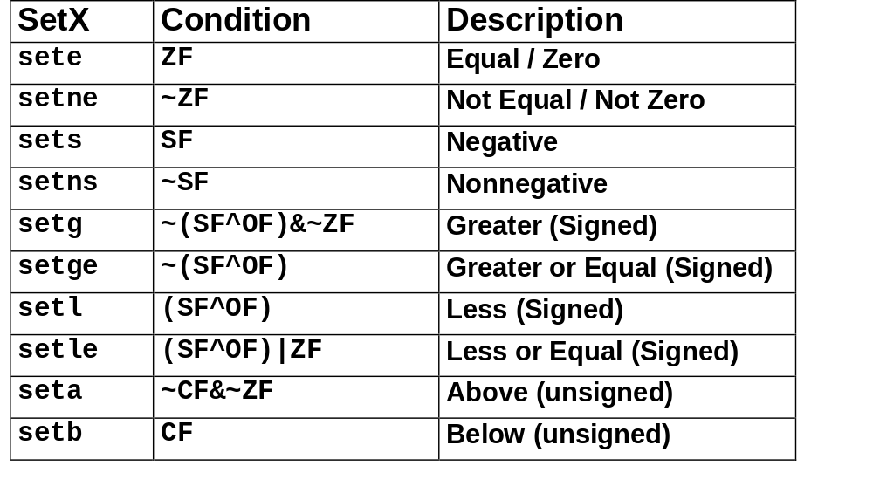
Reading Condition Codes
SetX Instructions
  Set single byte based on combinations of condition codes

Slide 6
Reading Condition Codes (Cont.)
SetX Instructions
  Set single byte based on combinations of condition codes
  One of 8 addressable byte registers
    Embedded within first 4 integer registers
    Does not alter remaining 3 bytes
    Typically use movzbl to finish job
%eax
%ah
%al
%edx
%dh
%dl
%ecx
%ch
%cl
%ebx
%bh
%bl
%esi
%edi
int gt (int x, int y)
{
return x > y;
}
%esp
%ebp
Body
movl 12(%ebp),%eax # eax = y
cmpl %eax,8(%ebp) # Compare x : y
setg %al # al = x > y
movzbl %al,%eax # Zero rest of %eax
Note inverted ordering!

Slide 7
Reading condition codes: x86-64
SetX Instructions
  Set single byte based on combinations of condition codes
    Does not alter remaining 7 bytes
  x86-64 arguments
    x in %rdi
    y in %rsi
int gt (long x, long y)
{
return x > y;
}
long lgt (long x, long y)
{
return x > y;
}
Body (same for both)
(32-bit instructions set high order 32 bits to 0)
xorl %eax, %eax # eax = 0
cmpq %rsi, %rdi # Compare x : y
setg %al # al = x > y

Slide 8
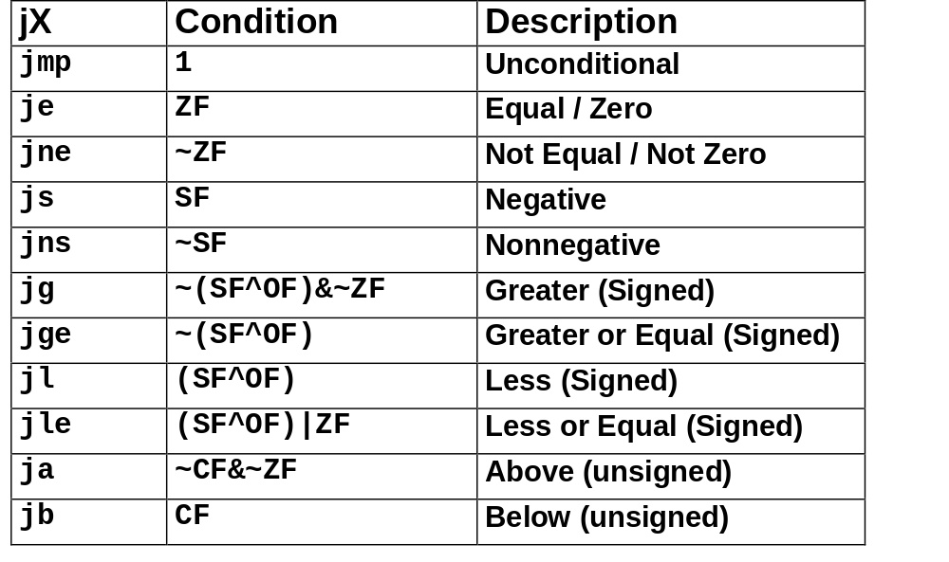
Jumping
jX Instructions
  Jump to different part of code depending on condition codes

Slide 9
Conditional Branch Example
int absdiff(
int x, int y)
{
int result;
if (x > y) {
result = x-y;
} else {
result = y-x;
}
return result;
}
absdiff:
pushl %ebp
movl %esp, %ebp
movl 8(%ebp), %edx
movl 12(%ebp), %eax
cmpl %eax, %edx
jle .L7
subl %eax, %edx
movl %edx, %eax
.L8:
leave
ret
.L7:
subl %edx, %eax
jmp .L8
Set
Up
Body1
Finish
Body2

Slide 10
Conditional Branch Example (Cont.)
int goto_ad(int x, int y)
{
int result;
if (x<=y) goto Else;
result = x-y;
Exit:
return result;
Else:
result = y-x;
goto Exit;
}
  C allows “goto” as means of transferring control
    Closer to machine-level programming style
  Generally considered bad coding style
# x in %edx, y in %eax
cmpl %eax, %edx # Compare x:y
jle .L7 # <= Goto Else
subl %eax, %edx # x-= y
movl %edx, %eax # result = x
.L8: # Exit:
Body1
.L7: # Else:
subl %edx, %eax # result = y-x
jmp .L8 # Goto Exit
Body2

Slide 11
General Conditional Expression Translation
C Code
val = Test ? Then-Expr ? Else-Expr;
val = x>y ? x-y : y-x;
Goto Version
  Test is expression returning integer
    = 0 interpreted as false
    ≠0 interpreted as true
  Create separate code regions for then & else expressions
  Execute appropriate one
nt = !Test;
if (nt) goto Else;
val = Then-Expr;
Done:
. . .
Else:
val = Else-Expr;
goto Done;

Slide 12
Conditionals: x86-64
int absdiff(
int x, int y)
{
int result;
if (x > y) {
result = x-y;
} else {
result = y-x;
}
return result;
}
absdiff: # x in %edi, y in %esi
movl %edi, %eax # v = x
movl %esi, %edx # ve = y
subl %esi, %eax # v -= y
subl %edi, %edx # ve -= x
cmpl %esi, %edi # x:y
cmovle %edx, %eax # v=ve if <=
ret
  Conditional move instruction
    cmovC src, dest
    Move value from src to dest if condition C holds
    More efficient than conditional branching
      Simple & predictable control flow

Slide 13
General Form with Conditional Move
C Code
val = Test ? Then-Expr ? Else-Expr;
  Both values get computed
  Overwrite then-value with else-value if condition doesn’t hold
Conditional Move Version
val = Then-Expr;
vale = Else-Expr;
val = vale if !Test;

Slide 14
Limitations of Conditional Move
val = Then-Expr;
vale = Else-Expr;
val = vale if !Test;
int xgty = 0, xltey = 0;
int absdiff_se(
int x, int y)
{
int result;
if (x > y) {
xgty++; result = x-y;
} else {
xltey++; result = y-x;
}
return result;
}
Don’t use when:
  Then-Expr or Else-Expr has side effect
  Then-Expr or Else-Expr requires significant computation

Slide 15
Implementing Loops
IA32
  All loops translated into form based on “do-while”
x86-64
  Also make use of “jump to middle”
Why the Difference
  IA32 compiler developed for machine where all operations costly
  x86-64 compiler developed for machine where unconditional branches incur (almost) no overhead

Slide 16
“Do-While” Loop Example
C Code
Goto Version
int fact_do(int x)
{
int result = 1;
do {
result *= x;
x = x-1;
} while (x > 1);
return result;
}
int fact_goto(int x)
{
int result = 1;
loop:
result *= x;
x = x-1;
if (x > 1)
goto loop;
return result;
}
  Use backward branch to continue looping
  Only take branch when “while” condition holds

Slide 17
“Do-While” Loop Compilation
Registers
  %edx x
  %eax result
Goto Version
Assembly
int
fact_goto(int x)
{
int result = 1;
loop:
result *= x;
x = x-1;
if (x > 1)
goto loop;
return result;
}
fact_goto:
pushl %ebp # Setup
movl %esp,%ebp # Setup
movl $1,%eax # eax = 1
movl 8(%ebp),%edx # edx = x
L11:
imull %edx,%eax # result *= x
decl %edx # x--
cmpl $1,%edx # Compare x : 1
jg L11 # if > goto loop
movl %ebp,%esp # Finish
popl %ebp # Finish
ret # Finish

Slide 18
General “Do-While” Translation
C Code
Goto Version
do
Body
while (Test);
loop:
Body
if (Test)
goto loop
  Body can be any C statement
    Typically compound statement:
  Test is expression returning integer
    = 0 interpreted as false ≠0 interpreted as true
{
Statement₁;
Statement₂;
…
Statement_{n};
}

Slide 19
“While” Loop Example #1
C Code
First Goto Version
int fact_while(int x)
{
int result = 1;
while (x > 1) {
result *= x;
x = x-1;
};
return result;
}
int fact_while_goto(int x)
{
int result = 1;
loop:
if (!(x > 1))
goto done;
result *= x;
x = x-1;
goto loop;
done:
return result;
}
  Is this code equivalent to the do-while version?
  Must jump out of loop if test fails

Slide 20
Alternative “While” Loop Translation
C Code
Second Goto Version
int fact_while(int x)
{
int result = 1;
while (x > 1) {
result *= x;
x = x-1;
};
return result;
}
int fact_while_goto2(int x)
{
int result = 1;
if (!(x > 1))
goto done;
loop:
result *= x;
x = x-1;
if (x > 1)
goto loop;
done:
return result;
}
  Historically used by GCC
  Uses same inner loop as do-while version
  Guards loop entry with extra test

Slide 21
General “While” Translation
C Code
while (Test)
Body
Do-While Version
Goto Version
if (!Test)
goto done;
do
Body
while(Test);
done:
if (!Test)
goto done;
loop:
Body
if (Test)
goto loop;
done:

Slide 22
New Style “While” Loop Translation
C Code
Goto Version
int fact_while(int x)
{
int result = 1;
while (x > 1) {
result *= x;
x = x-1;
};
return result;
}
int fact_while_goto3(int x)
{
int result = 1;
goto middle;
loop:
result *= x;
x = x-1;
middle:
if (x > 1)
goto loop;
return result;
}
  Recent technique for GCC
    Both IA32 & x86-64
  First iteration jumps over body computation within loop

Slide 23
Jump-to-Middle While Translation
C Code
while (Test)
Body
  Avoids duplicating test code
  Unconditional goto incurs no performance penalty
  for loops compiled in similar fashion
Goto Version
goto middle;
loop:
Body
middle:
if (Test)
goto loop;

Slide 24
Jump-to-Middle Example
int fact_while(int x)
{
int result = 1;
while (x > 1) {
result *= x;
x--;
};
return result;
}
  Most common strategy for recent IA32 & x86-64 code generation
# x in %edx, result in %eax
jmp L34 # goto Middle
L35: # Loop:
imull %edx, %eax # result *= x
decl %edx # x--
L34: # Middle:
cmpl $1, %edx # x:1
jg L35 # if >, goto Loop

Slide 25
“For” Loop Example
/* Compute x raised to nonnegative power p */
int
ipwr_for(int x, unsigned p)
{
int result;
for (result = 1; p != 0; p = p>>1) {
if (p & 0x1)
result *= x;
x = x*x;
}
return result;
}
Algorithm
  Exploit property that p = p₀ + 2p₁ + 4p₂ + … 2^{n–1}p_{n–1}
  Gives: x^{p} = z₀ · z₁ ² · (z₂ ²) ² · … · (…((z_{n –1}²) ² )…) ²
    z_{i} = 1 when p_{i} = 0
    z_{i} = x when p_{i} = 1
  Complexity O(log p)
Example
3¹⁰ = 3² * 3⁸
= 3² * ((3²) ²) ²
n–1 times

Slide 26
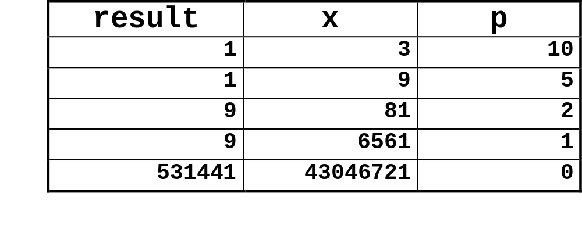
ipwr Computation
/* Compute x raised to nonnegative power p */
int
ipwr_for(int x, unsigned p)
{
int result;
for (result = 1; p != 0; p = p>>1) {
if (p & 0x1)
result *= x;
x = x*x;
}
return result;
}

Slide 27
“For” Loop Example
int result;
for (result = 1;
p != 0;
p = p>>1)
{
if (p & 0x1)
result *= x;
x = x*x;
}
General Form
for (Init; Test; Update )
Body
Init
Test
Update
result = 1
p != 0
p = p >> 1
{
if (p & 0x1)
result *= x;
x = x*x;
}
Body

Slide 28
“For”→ “While”→ “Do-While”
For Version
While Version
for (Init; Test; Update )
Body
Init;
while (Test ) {
Body
Update ;
}
Do-While Version
Init;
if (!Test)
goto done;
do {
Body
Update ;
} while (Test)
done:
Goto Version
Init;
if (!Test)
goto done;
loop:
Body
Update ;
if (Test)
goto loop;
done:

Slide 29
“For” Loop Compilation #1
Goto Version
result = 1;
if (p == 0)
goto done;
loop:
if (p & 0x1)
result *= x;
x = x*x;
p = p >> 1;
if (p != 0)
goto loop;
done:
Init;
if (!Test)
goto done;
loop:
Body
Update ;
if (Test)
goto loop;
done:
Init
Test
Body
result = 1
p != 0
{
if (p & 0x1)
result *= x;
x = x*x;
}
Update
p = p >> 1

Slide 30
“For”→ “While” (Jump-to-Middle)
For Version
While Version
for (Init; Test; Update )
Body
Init;
while (Test ) {
Body
Update ;
}
Goto Version
Init;
goto middle;
loop:
Body
Update ;
middle:
if (Test)
goto loop;
done:

Slide 31
“For” Loop Compilation #2
Goto Version
result = 1;
goto middle;
loop:
if (p & 0x1)
result *= x;
x = x*x;
p = p >> 1;
middle:
if (p != 0)
goto loop;
done:
Init;
if (!Test)
goto done;
loop:
Body
Update ;
if (Test)
goto loop;
done:
Init
Test
Body
result = 1
p != 0
{
if (p & 0x1)
result *= x;
x = x*x;
}
Update
p = p >> 1

Slide 32
Switch Statements
Implementation Options
  Series of conditionals
    Organize in tree structure
    Logarithmic performance
  Jump Table
    Lookup branch target
    Constant time
    Possible when cases are small integer constants
  GCC
    Picks one based on case structure

Slide 33
Switch Statement Example
long switch_eg
(long x, long y, long z)
{
long w = 1;
switch(x) {
case 1:
w = y*z;
break;
case 2:
w = y/z;
/* Fall Through */
case 3:
w += z;
break;
case 5:
case 6:
w -= z;
break;
default:
w = 2;
}
return w;
}
Features
  Multiple case labels
  Fall through cases
  Missing cases

Slide 34
Jump Table Structure
Switch Form
Jump Table
Jump Targets
switch(x) {
case val_0:
Block 0
case val_1:
Block 1
• • •
case val_n-1:
Block n–1
}
jtab:
Targ0
Targ0:
Code Block
0
Targ1
Targ2
Targ1:
Code Block
1
•
•
•
Targ2:
Code Block
2
Targn-1
Approx. Translation
•
•
•
target = JTab[x];
goto *target;
Targn-1:
Code Block
n–1

Slide 35
Switch Statement Example (IA32)
long switch_eg
(long x, long y, long z)
{
long w = 1;
switch(x) {
. . .
}
return w;
}
switch_eg:
pushl %ebp # Setup
movl %esp, %ebp # Setup
pushl %ebx # Setup
movl $1, %ebx # w = 1
movl 8(%ebp), %edx # edx = x
movl 16(%ebp), %ecx # ecx = z
cmpl $6, %edx # x:6
ja .L61 # if > goto default
jmp *.L62(,%edx,4) # goto JTab[x]
Setup:

Slide 36
Assembly Setup Explanation
Table Structure
  Each target requires 4 bytes
  Base address at .L62
Jumping
  jmp .L61
  Jump target is denoted by label .L61
  jmp *.L62(,%edx,4)
  Start of jump table denoted by label .L62
  Register %edx holds x
  Must scale by factor of 4 to get offset into table
  Fetch target from effective Address .L61 + x*4
    Only for 0 ≤ x ≤ 6

Slide 37
Jump Table
Table Contents
.section .rodata
.align 4
.L62:
.long .L61 # x = 0
.long .L56 # x = 1
.long .L57 # x = 2
.long .L58 # x = 3
.long .L61 # x = 4
.long .L60 # x = 5
.long .L60 # x = 6
switch(x) {
case 1: // .L56
w = y*z;
break;
case 2: // .L57
w = y/z;
/* Fall Through */
case 3: // .L58
w += z;
break;
case 5:
case 6: // .L60
w -= z;
break;
default: // .L61
w = 2;
}

Slide 38
Code Blocks (Partial)
.L61: // Default case
movl $2, %ebx # w = 2
movl %ebx, %eax # Return w
popl %ebx
leave
ret
.L57: // Case 2:
movl 12(%ebp), %eax # y
cltd # Div prep
idivl %ecx # y/z
movl %eax, %ebx # w = y/z
# Fall through
.L58: // Case 3:
addl %ecx, %ebx # w+= z
movl %ebx, %eax # Return w
popl %ebx
leave
ret
switch(x) {
. . .
case 2: // .L57
w = y/z;
/* Fall Through */
case 3: // .L58
w += z;
break;
. . .
default: // .L61
w = 2;
}

Slide 39
Code Blocks (Rest)
.L60: // Cases 5&6:
subl %ecx, %ebx # w –= z
movl %ebx, %eax # Return w
popl %ebx
leave
ret
.L56: // Case 1:
movl 12(%ebp), %ebx # w = y
imull %ecx, %ebx # w*= z
movl %ebx, %eax # Return w
popl %ebx
leave
ret
switch(x) {
case 1: // .L56
w = y*z;
break;
. . .
case 5:
case 6: // .L60
w -= z;
break;
. . .
}

Slide 40
x86-64 Switch Implementation
  Same general idea, adapted to 64-bit code
  Table entries 64 bits (pointers)
  Cases use revised code
switch(x) {
case 1: // .L50
w = y*z;
break;
. . .
}
Jump Table
.section .rodata
.align 8
.L62:
.quad .L55 # x = 0
.quad .L50 # x = 1
.quad .L51 # x = 2
.quad .L52 # x = 3
.quad .L55 # x = 4
.quad .L54 # x = 5
.quad .L54 # x = 6
.L50: // Case 1:
movq %rsi, %r8 # w = y
imulq %rdx, %r8 # w *= z
movq %r8, %rax # Return w
ret

Slide 41
IA32 Object Code
Setup
  Label .L61 becomes address 0x8048630
  Label .L62 becomes address 0x80488dc
Assembly Code
switch_eg:
. . .
ja .L61 # if > goto default
jmp *.L62(,%edx,4) # goto JTab[x]
Disassembled Object Code
08048610 <switch_eg>:
. . .
8048622: 77 0c ja 8048630
8048624: ff 24 95 dc 88 04 08 jmp *0x80488dc(,%edx,4)

Slide 42
IA32 Object Code (cont.)
Jump Table
  Doesn’t show up in disassembled code
  Can inspect using GDB
  gdb asm-cntl
  (gdb) x/7xw 0x80488dc
    Examine 7 hexadecimal format “words” (4-bytes each)
    Use command “help x” to get format documentation
  0x80488dc:
  0x08048630
  0x08048650
  0x0804863a
  0x08048642
  0x08048630
  0x08048649
  0x08048649

Slide 43
Disassembled Targets
8048630: bb 02 00 00 00 mov $0x2,%ebx
8048635: 89 d8 mov %ebx,%eax
8048637: 5b pop %ebx
8048638: c9 leave
8048639: c3 ret
804863a: 8b 45 0c mov 0xc(%ebp),%eax
804863d: 99 cltd
804863e: f7 f9 idiv %ecx
8048640: 89 c3 mov %eax,%ebx
8048642: 01 cb add %ecx,%ebx
8048644: 89 d8 mov %ebx,%eax
8048646: 5b pop %ebx
8048647: c9 leave
8048648: c3 ret
8048649: 29 cb sub %ecx,%ebx
804864b: 89 d8 mov %ebx,%eax
804864d: 5b pop %ebx
804864e: c9 leave
804864f: c3 ret
8048650: 8b 5d 0c mov 0xc(%ebp),%ebx
8048653: 0f af d9 imul %ecx,%ebx
8048656: 89 d8 mov %ebx,%eax
8048658: 5b pop %ebx
8048659: c9 leave
804865a: c3 ret

Slide 44
Matching Disassembled Targets
8048630: bb 02 00 00 00 mov
8048635: 89 d8 mov
8048637: 5b pop
8048638: c9 leave
8048639: c3 ret
804863a: 8b 45 0c mov
804863d: 99 cltd
804863e: f7 f9 idiv
8048640: 89 c3 mov
8048642: 01 cb add
8048644: 89 d8 mov
8048646: 5b pop
8048647: c9 leave
8048648: c3 ret
8048649: 29 cb sub
804864b: 89 d8 mov
804864d: 5b pop
804864e: c9 leave
804864f: c3 ret
8048650: 8b 5d 0c mov
8048653: 0f af d9 imul
8048656: 89 d8 mov
8048658: 5b pop
8048659: c9 leave
804865a: c3 ret
0x08048630
0x08048650
0x0804863a
0x08048642
0x08048630
0x08048649
0x08048649

Slide 45
x86-64 Object Code
Setup
  Label .L61 becomes address 0x0000000000400716
  Label .L62 becomes address 0x0000000000400990
Assembly Code
switch_eg:
. . .
ja .L55 # if > goto default
jmp *.L56(,%rdi,8) # goto JTab[x]
Disassembled Object Code
0000000000400700 <switch_eg>:
. . .
40070d: 77 07 ja 400716
40070f: ff 24 fd 90 09 40 00 jmpq *0x400990(,%rdi,8)

Slide 46
x86-64 Object Code (cont.)
Jump Table
  Can inspect using GDB
  gdb asm-cntl
  (gdb) x/7xg 0x400990
    Examine 7 hexadecimal format “giant words” (8-bytes each)
    Use command “help x” to get format documentation
  0x400990:
  0x0000000000400716
  0x0000000000400739
  0x0000000000400720
  0x000000000040072b
  0x0000000000400716
  0x0000000000400732
  0x0000000000400732

Slide 47
Sparse Switch Example
/* Return x/111 if x is multiple
&& <= 999. -1 otherwise */
int div111(int x)
{
switch(x) {
case 0: return 0;
case 111: return 1;
case 222: return 2;
case 333: return 3;
case 444: return 4;
case 555: return 5;
case 666: return 6;
case 777: return 7;
case 888: return 8;
case 999: return 9;
default: return -1;
}
}
  Not practical to use jump table
    Would require 1000 entries
  Obvious translation into if-then-else would have max. of 9 tests

Slide 48
Sparse Switch Code (IA32)
movl 8(%ebp),%eax # get x
cmpl $444,%eax # x:444
je L8
jg L16
cmpl $111,%eax # x:111
je L5
jg L17
testl %eax,%eax # x:0
je L4
jmp L14
. . .
  Compares x to possible case values
  Jumps different places depending on outcomes
. . .
L5:
movl $1,%eax
jmp L19
L6:
movl $2,%eax
jmp L19
L7:
movl $3,%eax
jmp L19
L8:
movl $4,%eax
jmp L19
. . .

Slide 49
Sparse Switch Code Structure
444
<
>
=
111
4
777
<
>
<
>
=
=
1
7
0
222
555
888
≠
=
≠
<
>
=
=
≠
=
-1
0
2
5
8
333
666
999
≠
=
≠
=
≠
=
-1
3
-1
6
-1
9
  Organizes cases as binary tree
  Logarithmic performance

Slide 50
Summarizing
C Control
  if-then-else
  do-while
  while, for
  switch
Assembler Control
  Conditional jump
  Conditional move
  Indirect jump
Compiler
  Must generate assembly code to implement more complex control
Standard Techniques
  IA32 loops converted to do-while form
  x86-64 loops use jump-to-middle
  Large switch statements use jump tables
Conditions in CISC
  CISC machines generally have condition code registers

