Slide 1
Verifying Programs with BDDs
Sept. 22, 2006
15-213
“The course that gives CMU its Zip!”
Topics
  Representing Boolean functions with Binary Decision Diagrams
  Application to program verification
class08-bdd.ppt
15-213, F’06

Slide 2
Verification Example
int abs(int x) {
int mask = x>>31;
return (x ^ mask) + ~mask + 1;
}
int test_abs(int x) {
return (x < 0) ? -x : x;
}
Do these functions produce identical results?
How could you find out?
How about exhaustive testing?

Slide 3
More Examples
int addXY(int x, int y)
{
return x+y;
}
?
=
int addYX(int x, int y)
{
return y+x;
}
int mulXY(int x, int y)
{
return x*y;
}
?
=
int mulYX(int x, int y)
{
return y*x;
}

Slide 4
How Can We Verify Programs?
Testing
  Exhaustive testing not generally feasible
  Currently, programs only tested over small fraction of possible cases
Formal Verification
  Mathematical “proof” that code is correct
  Did Pythagoras show that a² + b² = c² by testing?
a
c
b

Slide 5
Bit-Level Program Verification
int abs(int x) {
int mask = x>>31;
return (x ^ mask) + ~mask + 1;
}
x₀
abs
y₀
x₀
x₁
y₁
x₁
x₂
y₂
x₂
•
•
•
•
•
•
•
•
•
abs_{i}
•
•
•
•
•
•
•
•
•
y_{i}
x₃₁
y₃₁
x₃₁
  View computer word as 32 separate bit values
  Each output becomes Boolean function of inputs

Slide 6
Extracting Boolean Representation
Straight-Line Evaluation
int bitOr(int x, int y)
{
return ~(~x & ~y);
}
x
y
v1 = ~x
int test_bitOr(int x, int y)
{
return x | y;
}
v2 = ~y
v3 = v1 & v2
v4 = ~v3
Do these functions produce identical results?
v5 = x | y
t = v4 == v5

Slide 7
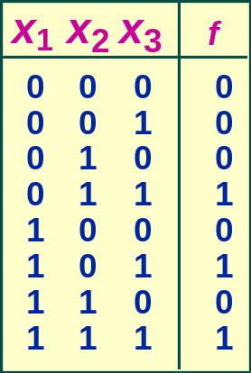
Tabular Function Representation
  List every possible function value
Complexity
  Function with n variables

Slide 8
Algebraic Function Representation
x₂ · x₃
x₁ · x₃
  f(x₁, x₂, x₃) = (x₁ + x₂) · x₃
  Boolean Algebra
Complexity
  Representation
  Determining properties of function
    E.g., deciding whether two expressions are equivalent

Slide 9
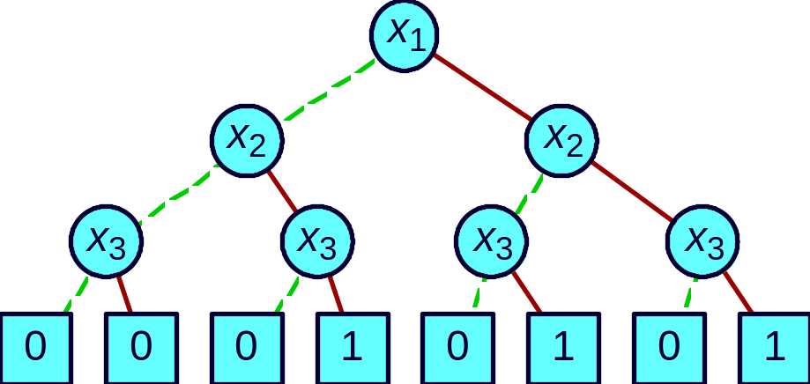
Tree Representation
Truth Table
Decision Tree
  Vertex represents decision
  Follow green (dashed) line for value 0
  Follow red (solid) line for value 1
  Function value determined by leaf value
Complexity

Slide 10
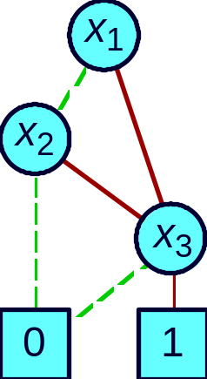
Ordered Binary Decision Diagrams
Initial Tree
Reduced Graph
(x₁ + x₂) · x₃
Canonical representation of Boolean function
  Two functions equivalent if and only if graphs isomorphic
    Can be tested in linear time
  Desirable property: simplest form is canonical.

Slide 11

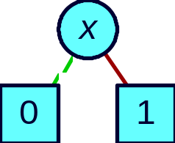

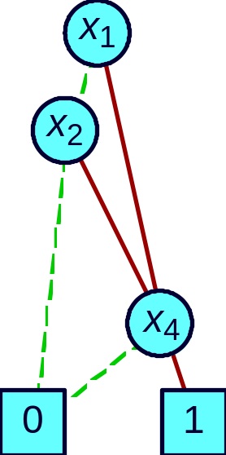
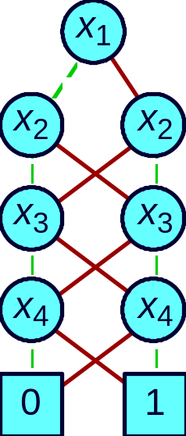
Example Functions
Constants
Variable
Unique unsatisfiable function
Treat variable
as function
Unique tautology
Typical Function
Odd Parity
(x₁ + x₂ ) · x₄
No vertex labeled x₃
  independent of x₃
Many subgraphs shared
Linear
representation

Slide 12
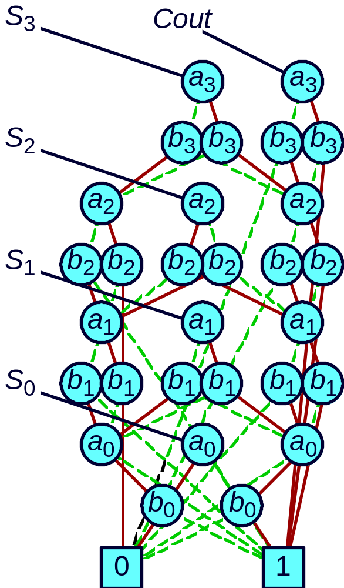
More Complex Functions
Functions
  Add 4-bit words a and b
  Get 4-bit sum S
  Carry output bit Cout
Shared Representation
  Graph with multiple roots
  31 nodes for 4-bit adder
  571 nodes for 64-bit adder
  Linear growth!

Slide 13
Symbolic Execution
(3-bit word size)
x
x₂
x₁
x₀
0
1
0
1
0
1
y
y₂
y₁
y₀
0
1
0
1
0
1
v1 = ~x
x₂
x₁
x₀
1
0
1
0
1
0
v2 = ~y
y₂
y₁
y₀
1
0
1
0
1
0

Slide 14
Symbolic Execution (cont.)
v3 = v1 & v2
x₂
x₁
x₀
y₂
y₁
y₀
1
0
1
0
1
0
v4 = ~v3
x₂
x₁
x₀
y₂
y₁
y₀
0
1
0
1
0
1
v5 = x | y
x₂
x₁
x₀
y₂
y₁
y₀
0
1
0
1
0
1
t = v4 == v5
1

Slide 15
Counterexample Generation
Straight-Line Evaluation
int bitOr(int x, int y)
{
return ~(~x & ~y);
}
x
y
v1 = ~x
int bitXor(int x, int y)
{
return x ^ y;
}
v2 = ~y
v3 = v1 & v2
v4 = ~v3
Find values of x & y for which these programs produce different results
v5 = x ^ y
t = v4 == v5

Slide 16
Symbolic Execution
v4 = ~v3
x₂
x₁
x₀
y₂
y₁
y₀
t = v4 == v5
0
1
0
1
0
1
x₂
v5 = x ^ y
x₂
x₁
x₀
y₂
y₂
y₂
y₁
y₁
y₀
y₀
x₁
0
1
0
1
0
1
y₁
x = 111
y = 001
x₀
y₀
1
0

Slide 17
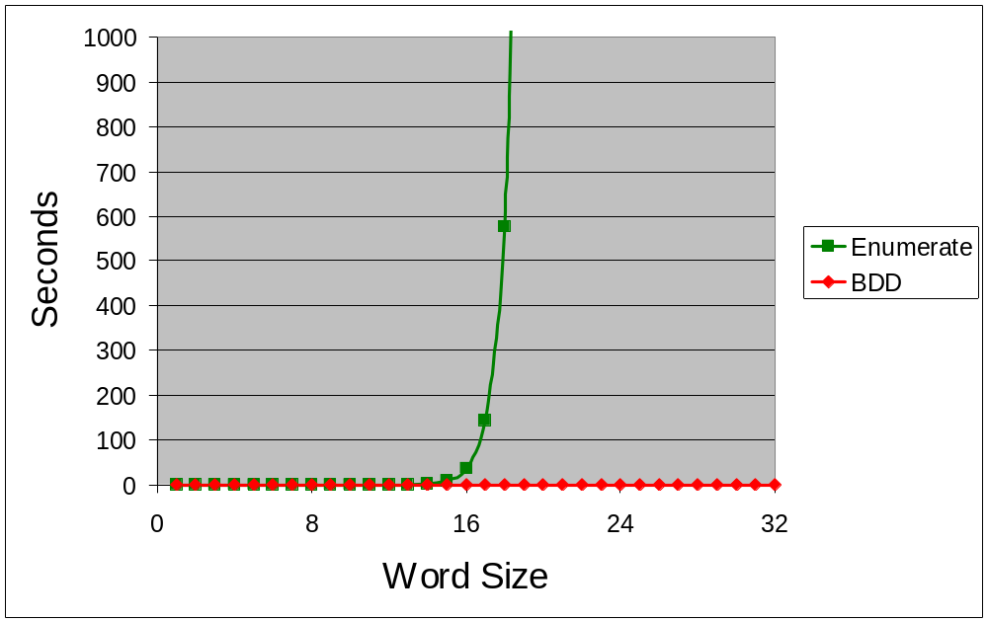
Performance: Good
int addXY(int x, int y)
{
return x+y;
}
int addYX(int x, int y)
{
return y+x;
}

Slide 18
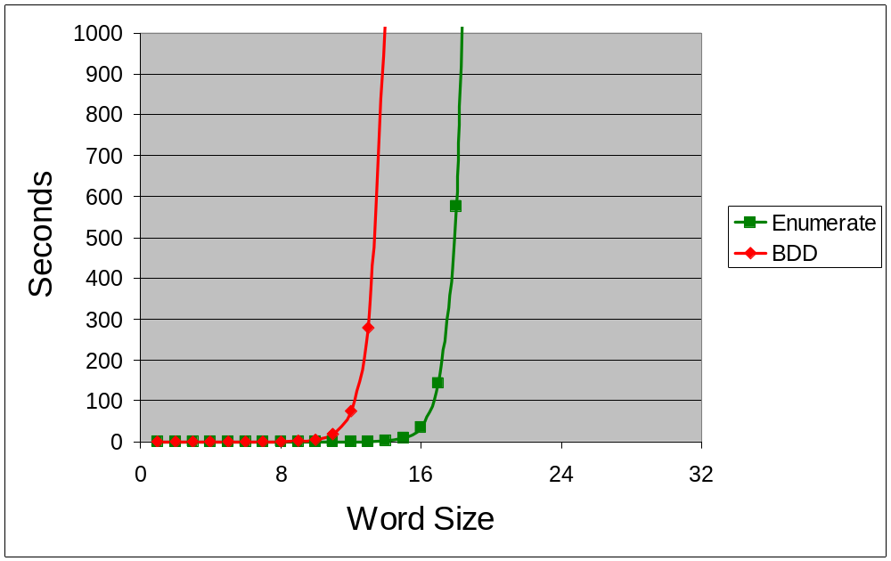
Performance: Bad
int mulXY(int x, int y)
{
return x*y;
}
int mulYX(int x, int y)
{
return y*x;
}

Slide 19
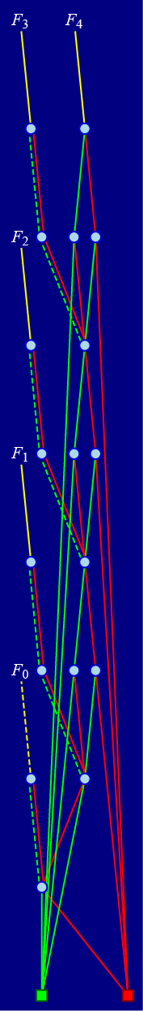
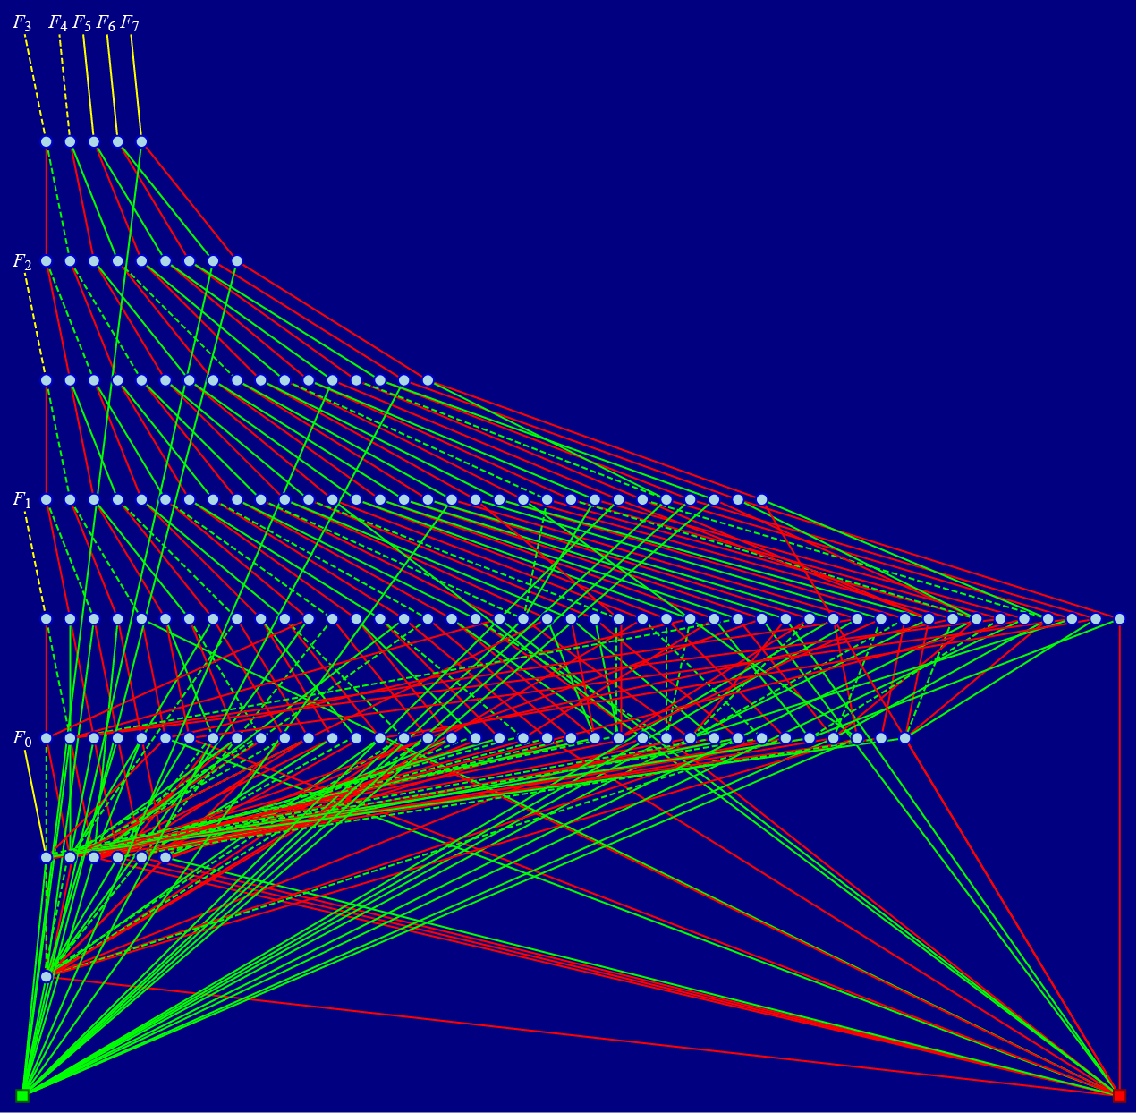
Why Is Multiplication Slow?
  Multiplication function intractable for BDDs
    Exponential growth, regardless of variable ordering
Node Counts
Bits | Add | Mult
4 | 21 | 155
8 | 41 | 14560
Add-4
Multiplication-4

Slide 20
What if Multiplication were Easy?
int factorK(int x, int y)
{
int K = XXXX...X;
int rangeOK =
1 < x && x <= y;
int factorOK =
x*y == K;
return
!(rangeOK && factorOK);
}
int one(int x, int y)
{
return 1;
}

Slide 21
Dealing with Conditionals
r
defined
r
value
int abs(int x)
{
int r;
if (x < 0)
r = -x;
else
r = x;
return r;
}
Context
x
1
0
0
t1 = x<0
1
0
0
v1 = -x
t1
0
0
r = v1
t1
t1
t1?v1:0
r = x
!t1
1
t1?v1:x
v2 = r
1
1
t1?v1:x
During Evaluation, Keep Track of:
  Current Context: Under what condition would code be evaluated
  Definedness (for each variable)
    Has it been assigned a value

Slide 22
Dealing with Loops
int ilog2(unsigned x)
{
int r = -1;
while (x) {
r++; x >>= 1;
}
return r;
}
Unrolled
int ilog2(unsigned x)
{
int r = 31;
if (x) {
r++; x >>= 1;
} else return r;
if (x) {
r++; x >>= 1;
} else return r;
. . .
if (x) {
r++; x >>= 1;
} else return r;
error();
}
Unroll
  Turn into bounded sequence of conditionals
    Default limit = 33
  Signal runtime error if don’t complete within limit

Slide 23
Evaluation
Strengths
  Provides 100% guarantee of correctness
  Performance very good for simple arithmetic functions
Weaknesses
  Important integer functions have exponential blowup
  Not practical for programs that build and operate on large data structures

Slide 24
Some History
Origins
  Lee 1959, Akers 1976
    Idea of representing Boolean function as BDD
  Hopcroft, Fortune, Schmidt 1978
    Recognized that ordered BDDs were like finite state machines
    Polynomial algorithm for equivalence
  Bryant 1986
    Proposed as useful data structure + efficient algorithms
  McMillan 1987
    Developed symbolic model checking
    Method for verifying complex sequential systems
  Bryant 1991
    Proved that multiplication has exponential BDD
    No matter how variables are ordered

