Slide 1
Code Optimization I
September 22, 2006
15-213
“The course that gives CMU its Zip!”
Topics
  Machine-Independent Optimizations
    Basic optimizations
    Optimization blockers
class08.ppt

Slide 2
Harsh Reality
There’s more to performance than asymptotic complexity
Constant factors matter too!
  Easily see 10:1 performance range depending on how code is written
  Must optimize at multiple levels:
    algorithm, data representations, procedures, and loops
Must understand system to optimize performance
  How programs are compiled and executed
  How to measure program performance and identify bottlenecks
  How to improve performance without destroying code modularity and generality

Slide 3
Optimizing Compilers
Provide efficient mapping of program to machine
  register allocation
  code selection and ordering (scheduling)
  dead code elimination
  eliminating minor inefficiencies
Don’t (usually) improve asymptotic efficiency
  up to programmer to select best overall algorithm
  big-O savings are (often) more important than constant factors
    but constant factors also matter
Have difficulty overcoming “optimization blockers”
  potential memory aliasing
  potential procedure side-effects

Slide 4
Limitations of Optimizing Compilers
Operate under fundamental constraint
  Must not cause any change in program behavior under any possible condition
  Often prevents it from making optimizations when would only affect behavior under pathological conditions.
Behavior that may be obvious to the programmer can be obfuscated by languages and coding styles
  e.g., Data ranges may be more limited than variable types suggest
Most analysis is performed only within procedures
  Whole-program analysis is too expensive in most cases
Most analysis is based only on static information
  Compiler has difficulty anticipating run-time inputs
When in doubt, the compiler must be conservative

Slide 5
Machine-Independent Optimizations
Optimizations that you or the compiler should do regardless of processor / compiler
Code Motion
  Reduce frequency with which computation performed
    If it will always produce same result
    Especially moving code out of loop
void set_row(double *a, double *b,
long i, long n)
{
long j;
for (j = 0; j < n; j++)
a[n*i+j] = b[j];
}
long j;
int ni = n*i;
for (j = 0; j < n; j++)
a[ni+j] = b[j];

Slide 6
Compiler-Generated Code Motion
void set_row(double *a, double *b,
long i, long n)
{
long j;
for (j = 0; j < n; j++)
a[n*i+j] = b[j];
}
long j;
long ni = n*i;
double *rowp = a+ni;
for (j = 0; j < n; j++)
*rowp++ = b[j];
Where are the FP operations?
set_row:
xorl %r8d, %r8d # j = 0
cmpq %rcx, %r8 # j:n
jge .L7 # if >= goto done
movq %rcx, %rax # n
imulq %rdx, %rax # n*i outside of inner loop
leaq (%rdi,%rax,8), %rdx # rowp = A + n*i*8
.L5: # loop:
movq (%rsi,%r8,8), %rax # t = b[j]
incq %r8 # j++
movq %rax, (%rdx) # *rowp = t
addq $8, %rdx # rowp++
cmpq %rcx, %r8 # j:n
jl .L5 # if < goot loop
.L7: # done:
rep ; ret # return

Slide 7
Reduction in Strength
  Replace costly operation with simpler one
  Shift, add instead of multiply or divide
    16*x --> x << 4
    Utility machine dependent
    Depends on cost of multiply or divide instruction
    On Pentium IV, integer multiply requires 10 CPU cycles
  Recognize sequence of products
int ni = 0;
for (i = 0; i < n; i++) {
for (j = 0; j < n; j++)
a[ni + j] = b[j];
ni += n;
}
for (i = 0; i < n; i++)
for (j = 0; j < n; j++)
a[n*i + j] = b[j];

Slide 8
Share Common Subexpressions
  Reuse portions of expressions
  Compilers often not very sophisticated in exploiting arithmetic properties
/* Sum neighbors of i,j */
up = val[(i-1)*n + j ];
down = val[(i+1)*n + j ];
left = val[i*n + j-1];
right = val[i*n + j+1];
sum = up + down + left + right;
int inj = i*n + j;
up = val[inj - n];
down = val[inj + n];
left = val[inj - 1];
right = val[inj + 1];
sum = up + down + left + right;
3 multiplications: i*n, (i–1)*n, (i+1)*n
1 multiplication: i*n
leaq 1(%rsi), %rax # i+1
leaq -1(%rsi), %r8 # i-1
imulq %rcx, %rsi # i*n
imulq %rcx, %rax # (i+1)*n
imulq %rcx, %r8 # (i-1)*n
addq %rdx, %rsi # i*n+j
addq %rdx, %rax # (i+1)*n+j
addq %rdx, %r8 # (i-1)*n+j
imulq %rcx, %rsi # i*n
addq %rdx, %rsi # i*n+j
movq %rsi, %rax # i*n+j
subq %rcx, %rax # i*n+j-n
leaq (%rsi,%rcx), %rcx # i*n+j+n

Slide 9
Optimization Blocker #1: Procedure Calls
Procedure to Convert String to Lower Case
  Extracted from 213 lab submissions, Fall, 1998
void lower(char *s)
{
int i;
for (i = 0; i < strlen(s); i++)
if (s[i] >= 'A' && s[i] <= 'Z')
s[i] -= ('A' - 'a');
}

Slide 10
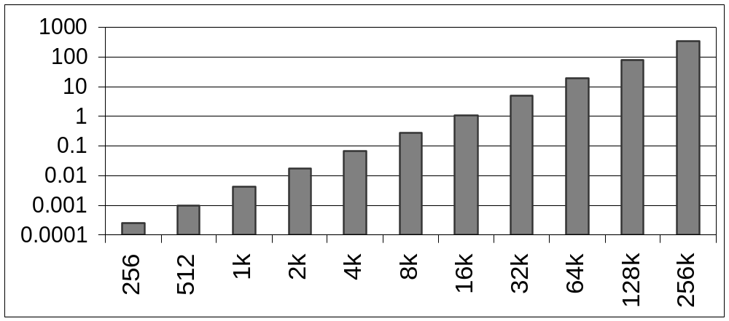
Lower Case Conversion Performance
  Time quadruples when double string length
  Quadratic performance
CPU Seconds
String Length

Slide 11
Convert Loop To Goto Form
void lower(char *s)
{
int i = 0;
if (i >= strlen(s))
goto done;
loop:
if (s[i] >= 'A' && s[i] <= 'Z')
s[i] -= ('A' - 'a');
i++;
if (i < strlen(s))
goto loop;
done:
}
  strlen executed every iteration

Slide 12
Calling Strlen
/* My version of strlen */
size_t strlen(const char *s)
{
size_t length = 0;
while (*s != '\0') {
s++;
length++;
}
return length;
}
Strlen performance
  Only way to determine length of string is to scan its entire length, looking for null character.
Overall performance, string of length N
  N calls to strlen
  Require times N, N-1, N-2, …, 1
  Overall O(N²) performance

Slide 13
Improving Performance
void lower(char *s)
{
int i;
int len = strlen(s);
for (i = 0; i < len; i++)
if (s[i] >= 'A' && s[i] <= 'Z')
s[i] -= ('A' - 'a');
}
  Move call to strlen outside of loop
  Since result does not change from one iteration to another
  Form of code motion

Slide 14
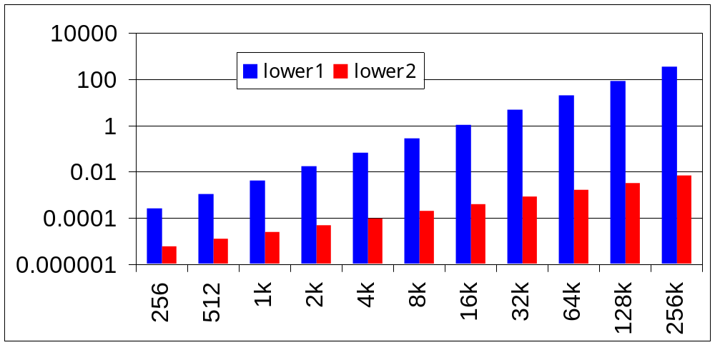
Lower Case Conversion Performance
  Time doubles when double string length
  Linear performance of lower2
CPU Seconds
String Length

Slide 15
Optimization Blocker: Procedure Calls
Why couldn’t compiler move strlen out of inner loop?
  Procedure may have side effects
    Alters global state each time called
  Function may not return same value for given arguments
    Depends on other parts of global state
    Procedure lower could interact with strlen
Warning:
  Compiler treats procedure call as a black box
  Weak optimizations near them
Remedies:
  Use of inline functions
  Do your own code motion
int lencnt = 0;
size_t strlen(const char *s)
{
size_t length = 0;
while (*s != '\0') {
s++; length++;
}
lencnt += length;
return length;
}

Slide 16
Memory Matters
/* Sum rows is of n X n matrix a
and store in vector b */
void sum_rows1(double *a, double *b, long n) {
long i, j;
for (i = 0; i < n; i++) {
b[i] = 0;
for (j = 0; j < n; j++)
b[i] += a[i*n + j];
}
}
# sum_rows1 inner loop
.L53:
addsd (%rcx), %xmm0 # FP add
addq $8, %rcx
decq %rax
movsd %xmm0, (%rsi,%r8,8) # FP store
jne .L53
  Code updates b[i] on every iteration
  Why couldn’t compiler optimize this away?

Slide 17
Memory Aliasing
/* Sum rows is of n X n matrix a
and store in vector b */
void sum_rows1(double *a, double *b, long n) {
long i, j;
for (i = 0; i < n; i++) {
b[i] = 0;
for (j = 0; j < n; j++)
b[i] += a[i*n + j];
}
}
Value of B:
double A[9] =
{ 0, 1, 2,
4, 8, 16},
32, 64, 128};
double B[3] = A+3;
sum_rows1(A, B, 3);
init: [4, 8, 16]
i = 0: [3, 8, 16]
i = 1: [3, 22, 16]
i = 2: [3, 22, 224]
  Code updates b[i] on every iteration
  Must consider possibility that these updates will affect program behavior

Slide 18
Removing Aliasing
/* Sum rows is of n X n matrix a
and store in vector b */
void sum_rows2(double *a, double *b, long n) {
long i, j;
for (i = 0; i < n; i++) {
double val = 0;
for (j = 0; j < n; j++)
val += a[i*n + j];
b[i] = val;
}
}
# sum_rows2 inner loop
.L66:
addsd (%rcx), %xmm0 # FP Add
addq $8, %rcx
decq %rax
jne .L66
  No need to store intermediate results

Slide 19
Unaliased Version
/* Sum rows is of n X n matrix a
and store in vector b */
void sum_rows2(double *a, double *b, long n) {
long i, j;
for (i = 0; i < n; i++) {
double val = 0;
for (j = 0; j < n; j++)
val += a[i*n + j];
b[i] = val;
}
}
Value of B:
double A[9] =
{ 0, 1, 2,
4, 8, 16},
32, 64, 128};
double B[3] = A+3;
sum_rows1(A, B, 3);
init: [4, 8, 16]
i = 0: [3, 8, 16]
i = 1: [3, 27, 16]
i = 2: [3, 27, 224]
  Aliasing still creates interference

Slide 20
Optimization Blocker: Memory Aliasing
Aliasing
  Two different memory references specify single location
  Easy to have happen in C
    Since allowed to do address arithmetic
    Direct access to storage structures
  Get in habit of introducing local variables
    Accumulating within loops
    Your way of telling compiler not to check for aliasing

Slide 21
Machine-Independent Opt. Summary
Code Motion
  Compilers are good at this for simple loop/array structures
  Don’t do well in the presence of procedure calls and memory aliasing
Reduction in Strength
  Shift, add instead of multiply or divide
    Compilers are (generally) good at this
    Exact trade-offs machine-dependent
  Keep data in registers (local variables) rather than memory
    Compilers are not good at this, since concerned with aliasing
    Compilers do know how to allocate registers (no need for register declaration)
Share Common Subexpressions
  Compilers have limited algebraic reasoning capabilities

