Slide 1
Cache Memories
October 6, 2006
15-213
“The course that gives CMU its Zip!”
Topics
  Generic cache memory organization
  Direct mapped caches
  Set associative caches
  Impact of caches on performance
  The memory mountain
class12.ppt

Slide 2
Cache Memories
Cache memories are small, fast SRAM-based memories managed automatically in hardware.
  Hold frequently accessed blocks of main memory
CPU looks first for data in L1, then in L2, then in main memory.
Typical system structure:
CPU chip
register file
L2
tags
L1
cache
ALU
memory bus
SRAM Port
system bus
main
memory
L2 data
bus interface
I/O
bridge

Slide 3
Inserting an L1 Cache Between the CPU and Main Memory
The transfer unit between the CPU register file and the cache is a 4-byte block.
The tiny, very fast CPU register file has room for four 4-byte words.
line 0
The small fast L1 cache has room for two 4-word blocks.
line 1
The transfer unit between the cache and main memory is a 4-word block (16 bytes).
...
block 10
a b c d
The big slow main memory has room for many 4-word blocks.
block 21
p q r s
...
block 30
w x y z
...

Slide 4
General Organization of a Cache
Cache is an array
of sets.
Each set contains
one or more lines.
Each line holds a
block of data.
t tag bits
per line
B = 2^{b} bytes
per cache block
valid
tag
0
1
• • •
B–1
E lines
per set
set 0:
• • •
valid
tag
0
1
• • •
B–1
valid
tag
0
1
• • •
B–1
S = 2^{s} sets
set 1:
• • •
valid
tag
0
1
• • •
B–1
• • •
valid
tag
0
1
• • •
B–1
set S-1:
• • •
valid
tag
0
1
• • •
B–1
1 valid bit per line
Cache size: C = B x E x S data bytes

Slide 5
Addressing Caches
Address A:
t bits
s bits
b bits
m-1
0
v
tag
0
1
• • •
B–1
set 0:
• • •
<tag>
<set index>
<block offset>
v
tag
0
1
• • •
B–1
v
tag
0
1
• • •
B–1
set 1:
• • •
v
tag
0
1
• • •
B–1
• • •
The word at address A is in the cache if
the tag bits in one of the <valid> lines in
set <set index> match <tag>.
The word contents begin at offset
<block offset> bytes from the beginning
of the block.
v
tag
0
1
• • •
B–1
set S-1:
• • •
v
tag
0
1
• • •
B–1

Slide 6
Addressing Caches
Address A:
t bits
s bits
b bits
m-1
0
v
tag
0
1
• • •
B–1
set 0:
• • •
<tag>
<set index>
<block offset>
v
tag
0
1
• • •
B–1
v
tag
0
1
• • •
B–1
set 1:
• • •
v
tag
0
1
• • •
B–1
• • •
Locate the set based on
<set index>
Locate the line in the set based on
<tag>
Check that the line is valid
Locate the data in the line based on
<block offset>
v
tag
0
1
• • •
B–1
set S-1:
• • •
v
tag
0
1
• • •
B–1

Slide 7
Direct-Mapped Cache
Simplest kind of cache, easy to build
(only 1 tag compare required per access)
Characterized by exactly one line per set.
set 0:
valid
tag
cache block
E=1 lines per set
set 1:
valid
tag
cache block
• • •
set S-1:
valid
tag
cache block
Cache size: C = B x S data bytes

Slide 8
Accessing Direct-Mapped Caches
Set selection
  Use the set index bits to determine the set of interest.
set 0:
valid
tag
cache block
selected set
set 1:
valid
tag
cache block
• • •
set S-1:
valid
tag
cache block
t bits
s bits
b bits
0 0 0 0 1
m-1
tag
set index
block offset
0

Slide 9
Accessing Direct-Mapped Caches
Line matching and word selection
  Line matching: Find a valid line in the selected set with a matching tag
  Word selection: Then extract the word
=1?
(1) The valid bit must be set
0
1
2
3
4
5
6
7
selected set (i):
1
0110
w₀
w₁
w₂
w₃
(2) The tag bits in the cache line must match the tag bits in the address
= ?
If (1) and (2), then cache hit
t bits
s bits
b bits
0110
i
100
m-1
tag
set index
block offset
0

Slide 10
Accessing Direct-Mapped Caches
Line matching and word selection
  Line matching: Find a valid line in the selected set with a matching tag
  Word selection: Then extract the word
0
1
2
3
4
5
6
7
selected set (i):
1
0110
w₀
w₁
w₂
w₃
(3) If cache hit,
block offset selects starting byte.
t bits
s bits
b bits
0110
i
100
m-1
tag
set index
block offset
0

Slide 11
Direct-Mapped Cache Simulation
M=16 byte addresses, B=2 bytes/block,
S=4 sets, E=1 entry/set
Address trace (reads):
0 [0000₂],
1 [0001₂],
7 [0111₂],
8 [1000₂],
0 [0000₂]
t=1
s=2
b=1
x
xx
x
miss
hit
miss
miss
miss
v
tag
data
0
?
?
1
1
1
0
1
0
M[0-1]
M[8-9]
M[0-1]
1
0
M[6-7]

Slide 12
Set Associative Caches
Characterized by more than one line per set
valid
tag
cache block
E=2
lines per set
set 0:
valid
tag
cache block
valid
tag
cache block
set 1:
valid
tag
cache block
• • •
valid
tag
cache block
set S-1:
valid
tag
cache block
E-way associative cache

Slide 13
Accessing Set Associative Caches
Set selection
  identical to direct-mapped cache
set 0:
valid
tag
cache block
valid
tag
cache block
selected set
set 1:
valid
tag
cache block
valid
tag
cache block
• • •
valid
tag
cache block
set S-1:
valid
tag
cache block
t bits
s bits
b bits
0 0 0 0 1
m-1
tag
set index
block offset
0

Slide 14
Accessing Set Associative Caches
Line matching and word selection
  must compare the tag in each valid line in the selected set.
=1?
(1) The valid bit must be set
0
1
2
3
4
5
6
7
1
1001
selected set (i):
1
0110
w₀
w₁
w₂
w₃
(2) The tag bits in one of the cache lines must match the tag bits in the address
= ?
If (1) and (2), then cache hit
t bits
s bits
b bits
0110
i
100
m-1
tag
set index
block offset
0

Slide 15
Accessing Set Associative Caches
Line matching and word selection
  Word selection is the same as in a direct mapped cache
0
1
2
3
4
5
6
7
1
1001
selected set (i):
1
0110
w₀
w₁
w₂
w₃
(3) If cache hit,
block offset selects starting byte.
t bits
s bits
b bits
0110
i
100
m-1
tag
set index
block offset
0

Slide 16
2-Way Associative Cache Simulation
M=16 byte addresses, B=2 bytes/block,
S=2 sets, E=2 entry/set
Address trace (reads):
0 [0000₂],
1 [0001₂],
7 [0111₂],
8 [1000₂],
0 [0000₂]
t=2
s=1
b=1
xx
x
x
miss
hit
miss
miss
hit
v
tag
data
0
?
?
1
00
M[0-1]
1
10
M[8-9]
0
1
01
M[6-7]
0
0

Slide 17
Why Use Middle Bits as Index?
High-Order
Bit Indexing
Middle-Order
Bit Indexing
4-line Cache
00
0000
0000
01
0001
0001
10
0010
0010
11
0011
0011
0100
0100
0101
0101
High-Order Bit Indexing
  Adjacent memory lines would map to same cache entry
  Poor use of spatial locality
Middle-Order Bit Indexing
  Consecutive memory lines map to different cache lines
  Can hold S*B*E-byte region of address space in cache at one time
0110
0110
0111
0111
1000
1000
1001
1001
1010
1010
1011
1011
1100
1100
1101
1101
1110
1110
1111
1111

Slide 18
Maintaining a Set-Associate Cache
How to decide which cache line to use in a set?
  Least Recently Used (LRU), Requires ⎡lg₂(E!)⎤ extra bits
  Not recently Used (NRU)
  Random
Virtual vs. Physical addresses:
  The memory system works with physical addresses, but it takes time to translate a virtual to a physical address. So most L1 caches are virtually indexed, but physically tagged.

Slide 19
Multi-Level Caches
Options: separate data and instruction caches, or a unified cache
Unified
L2
Cache
Memory
Processor
Regs
L1
d-cache
disk
L1
i-cache
size:
speed:
$/Mbyte:
line size:
200 B
3 ns
8 B
8-64 KB
3 ns
32 B
1-4MB SRAM
6 ns
$100/MB
32 B
128 MB DRAM
60 ns
$1.50/MB
8 KB
30 GB
8 ms
$0.05/MB
larger, slower, cheaper

Slide 20
What about writes?
Multiple copies of data exist:
  L1
  L2
  Main Memory
  Disk
What to do when we write?
  Write-through
  Write-back
    need a dirty bit
    What to do on a write-miss?
What to do on a replacement?
  Depends on whether it is write through or write back

Slide 21
Intel Pentium III Cache Hierarchy
Processor Chip
Regs.
L1 Data
1 cycle latency
16 KB
4-way assoc
Write-through
32B lines
L2 Unified
128KB--2 MB
4-way assoc
Write-back
Write allocate
32B lines
Main
Memory
Up to 4GB
L1 Instruction
16 KB, 4-way
32B lines

Slide 22
Cache Performance Metrics
Miss Rate
  Fraction of memory references not found in cache
  (misses / references)
  Typical numbers:
    3-10% for L1
    can be quite small (e.g., < 1%) for L2, depending on size, etc.
Hit Time
  Time to deliver a line in the cache to the processor (includes time to determine whether the line is in the cache)
  Typical numbers:
    1-2 clock cycle for L1
    5-20 clock cycles for L2
Miss Penalty
  Additional time required because of a miss
    Typically 50-200 cycles for main memory (Trend: increasing!)
Aside for architects:
Increasing cache size?
Increasing block size?
Increasing associativity?

Slide 23
Writing Cache Friendly Code
Repeated references to variables are good
(temporal locality)
Stride-1 reference patterns are good (spatial locality)
Examples:
  cold cache, 4-byte words, 4-word cache blocks
int sum_array_rows(int a[M][N])
{
int i, j, sum = 0;
for (i = 0; i < M; i++)
for (j = 0; j < N; j++)
sum += a[i][j];
return sum;
}
int sum_array_cols(int a[M][N])
{
int i, j, sum = 0;
for (j = 0; j < N; j++)
for (i = 0; i < M; i++)
sum += a[i][j];
return sum;
}
Miss rate =
1/4 = 25%
Miss rate =
100%

Slide 24
The Memory Mountain
Read throughput (read bandwidth)
  Number of bytes read from memory per second (MB/s)
Memory mountain
  Measured read throughput as a function of spatial and temporal locality.
  Compact way to characterize memory system performance.

Slide 25
Memory Mountain Test Function
/* The test function */
void test(int elems, int stride) {
int i, result = 0;
volatile int sink;
for (i = 0; i < elems; i += stride)
result += data[i];
sink = result; /* So compiler doesn't optimize away the loop */
}
/* Run test(elems, stride) and return read throughput (MB/s) */
double run(int size, int stride, double Mhz)
{
double cycles;
int elems = size / sizeof(int);
test(elems, stride); /* warm up the cache */
cycles = fcyc2(test, elems, stride, 0); /* call test(elems,stride) */
return (size / stride) / (cycles / Mhz); /* convert cycles to MB/s */
}

Slide 26
Memory Mountain Main Routine
/* mountain.c - Generate the memory mountain. */
#define MINBYTES (1 << 10) /* Working set size ranges from 1 KB */
#define MAXBYTES (1 << 23) /* ... up to 8 MB */
#define MAXSTRIDE 16 /* Strides range from 1 to 16 */
#define MAXELEMS MAXBYTES/sizeof(int)
int data[MAXELEMS]; /* The array we'll be traversing */
int main()
{
int size; /* Working set size (in bytes) */
int stride; /* Stride (in array elements) */
double Mhz; /* Clock frequency */
init_data(data, MAXELEMS); /* Initialize each element in data to 1 */
Mhz = mhz(0); /* Estimate the clock frequency */
for (size = MAXBYTES; size >= MINBYTES; size >>= 1) {
for (stride = 1; stride <= MAXSTRIDE; stride++)
printf("%.1f\t", run(size, stride, Mhz));
printf("\n");
}
exit(0);
}

Slide 27
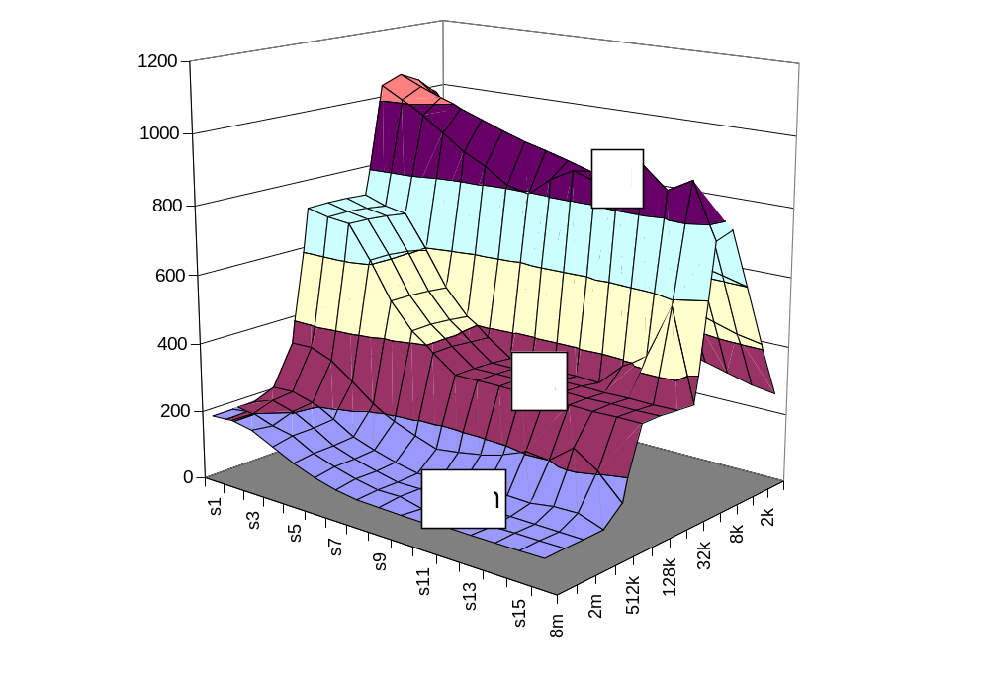
The Memory Mountain
Pentium III
550 MHz
16 KB on-chip L1 d-cache
16 KB on-chip L1 i-cache
512 KB off-chip unified
L2 cache
Throughput (MB/sec)
Slopes of
Spatial
Locality
Ridges of
Temporal
Locality
Working set size
(bytes)
Stride (words)

Slide 28
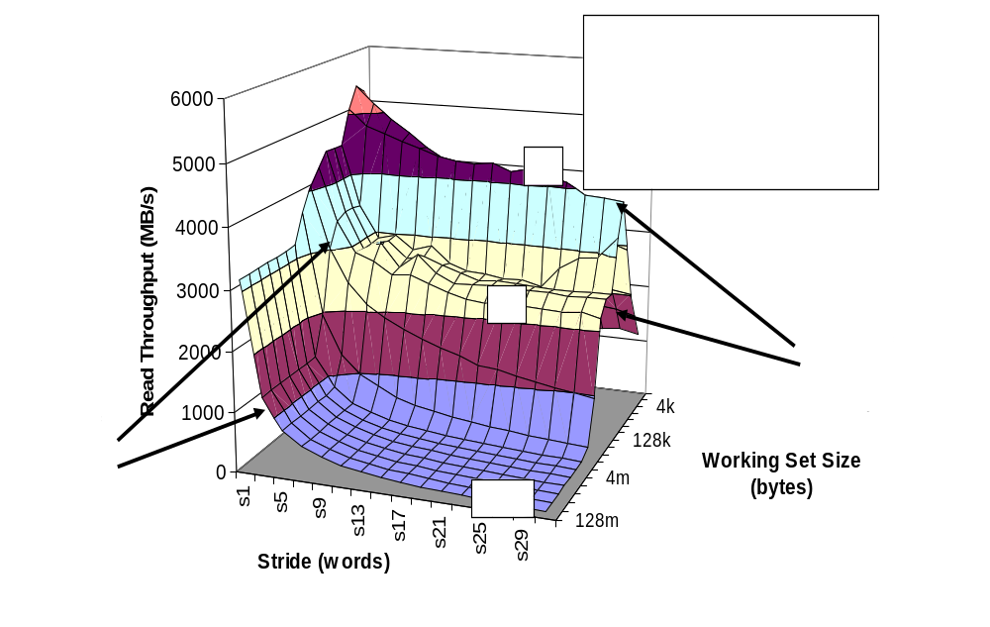
X86-64 Memory Mountain

Slide 29
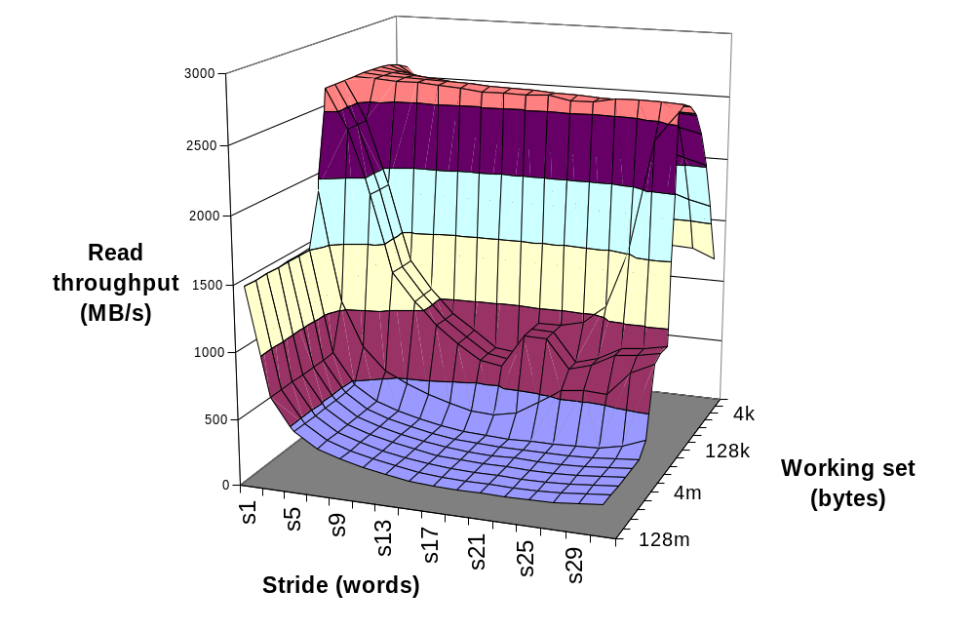
Opteron Memory Mountain
L1
L2
Mem

Slide 30
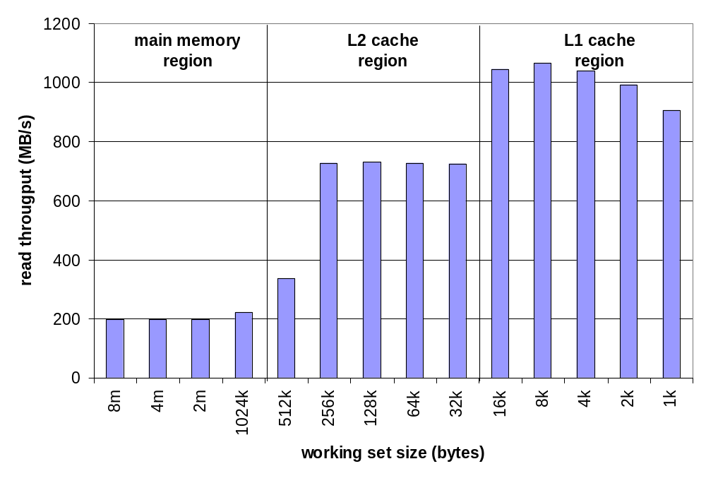
Ridges of Temporal Locality
Slice through the memory mountain with stride=1
  illuminates read throughputs of different caches and memory

Slide 31
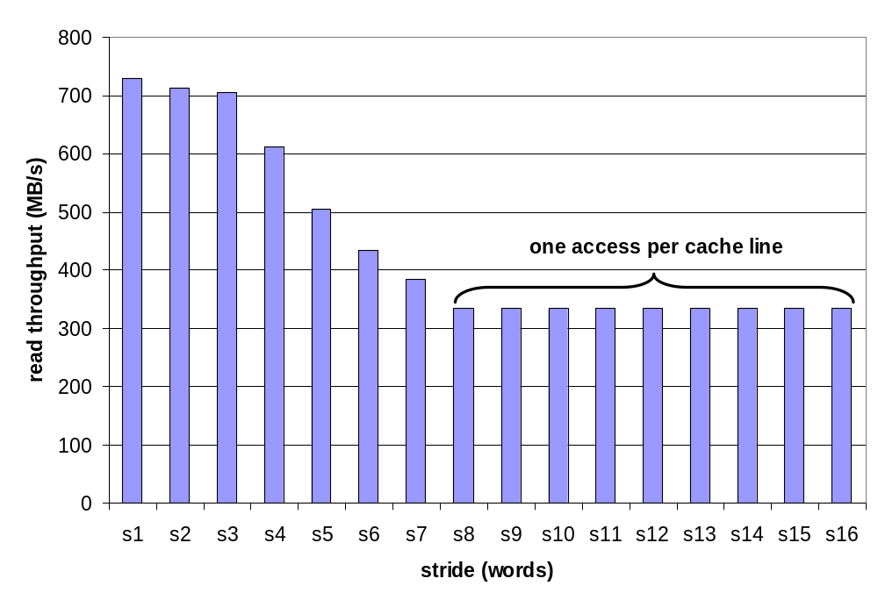
A Slope of Spatial Locality
Slice through memory mountain with size=256KB
  shows cache block size.

Slide 32
Matrix Multiplication Example
Major Cache Effects to Consider
  Total cache size
    Exploit temporal locality and keep the working set small
    (e.g., use blocking)
  Block size
    Exploit spatial locality
Description:
  Multiply N x N matrices
  O(N3) total operations
  Accesses
    N reads per source element
    N values summed per destination
      but may be able to hold in register
Variable sum
held in register
/* ijk */
for (i=0; i<n; i++) {
for (j=0; j<n; j++) {
sum = 0.0;
for (k=0; k<n; k++)
sum += a[i][k] * b[k][j];
c[i][j] = sum;
}
}

Slide 33
Miss Rate Analysis for Matrix Multiply
Assume:
  Line size = 32B (big enough for four 64-bit words)
  Matrix dimension (N) is very large
    Approximate 1/N as 0.0
  Cache is not even big enough to hold multiple rows
Analysis Method:
  Look at access pattern of inner loop
k
j
j
i
k
i
A
B
C

Slide 34
Layout of C Arrays in Memory (review)
C arrays allocated in row-major order
  each row in contiguous memory locations
Stepping through columns in one row:
  for (i = 0; i < N; i++)
    sum += a[0][i];
  accesses successive elements
  if block size (B) > 4 bytes, exploit spatial locality
    compulsory miss rate = 4 bytes / B
Stepping through rows in one column:
  for (i = 0; i < n; i++)
    sum += a[i][0];
  accesses distant elements
  no spatial locality!
    compulsory miss rate = 1 (i.e. 100%)

Slide 35
Matrix Multiplication (ijk)
/* ijk */
for (i=0; i<n; i++) {
for (j=0; j<n; j++) {
sum = 0.0;
for (k=0; k<n; k++)
sum += a[i][k] * b[k][j];
c[i][j] = sum;
}
}
Inner loop:
(*,j)
(i,j)
(i,*)
A
B
C
Row-wise
Column-
wise
Fixed
Misses per Inner Loop Iteration:
  A B C
  0.25 1.0 0.0

Slide 36
Matrix Multiplication (jik)
/* jik */
for (j=0; j<n; j++) {
for (i=0; i<n; i++) {
sum = 0.0;
for (k=0; k<n; k++)
sum += a[i][k] * b[k][j];
c[i][j] = sum
}
}
Inner loop:
(*,j)
(i,j)
(i,*)
A
B
C
Row-wise
Column-
wise
Fixed
Misses per Inner Loop Iteration:
  A B C
  0.25 1.0 0.0

Slide 37
Matrix Multiplication (kij)
/* kij */
for (k=0; k<n; k++) {
for (i=0; i<n; i++) {
r = a[i][k];
for (j=0; j<n; j++)
c[i][j] += r * b[k][j];
}
}
Inner loop:
(i,k)
(k,*)
(i,*)
A
B
C
Fixed
Row-wise
Row-wise
Misses per Inner Loop Iteration:
  A B C
  0.0 0.25 0.25

Slide 38
Matrix Multiplication (ikj)
/* ikj */
for (i=0; i<n; i++) {
for (k=0; k<n; k++) {
r = a[i][k];
for (j=0; j<n; j++)
c[i][j] += r * b[k][j];
}
}
Inner loop:
(i,k)
(k,*)
(i,*)
A
B
C
Fixed
Row-wise
Row-wise
Misses per Inner Loop Iteration:
  A B C
  0.0 0.25 0.25

Slide 39
Matrix Multiplication (jki)
/* jki */
for (j=0; j<n; j++) {
for (k=0; k<n; k++) {
r = b[k][j];
for (i=0; i<n; i++)
c[i][j] += a[i][k] * r;
}
}
Inner loop:
(*,k)
(*,j)
(k,j)
A
B
C
Column -
wise
Fixed
Column-
wise
Misses per Inner Loop Iteration:
  A B C
  1.0 0.0 1.0

Slide 40
Matrix Multiplication (kji)
/* kji */
for (k=0; k<n; k++) {
for (j=0; j<n; j++) {
r = b[k][j];
for (i=0; i<n; i++)
c[i][j] += a[i][k] * r;
}
}
Inner loop:
(*,k)
(*,j)
(k,j)
A
B
C
Column-
wise
Fixed
Column-
wise
Misses per Inner Loop Iteration:
  A B C
  1.0 0.0 1.0

Slide 41
Summary of Matrix Multiplication
for (i=0; i<n; i++) {
for (j=0; j<n; j++) {
sum = 0.0;
for (k=0; k<n; k++)
sum += a[i][k] * b[k][j];
c[i][j] = sum;
}
}
ijk (& jik):
  2 loads, 0 stores
  misses/iter = 1.25
for (k=0; k<n; k++) {
for (i=0; i<n; i++) {
r = a[i][k];
for (j=0; j<n; j++)
c[i][j] += r * b[k][j];
}
}
kij (& ikj):
  2 loads, 1 store
  misses/iter = 0.5
for (j=0; j<n; j++) {
for (k=0; k<n; k++) {
r = b[k][j];
for (i=0; i<n; i++)
c[i][j] += a[i][k] * r;
}
}
jki (& kji):
  2 loads, 1 store
  misses/iter = 2.0

Slide 42
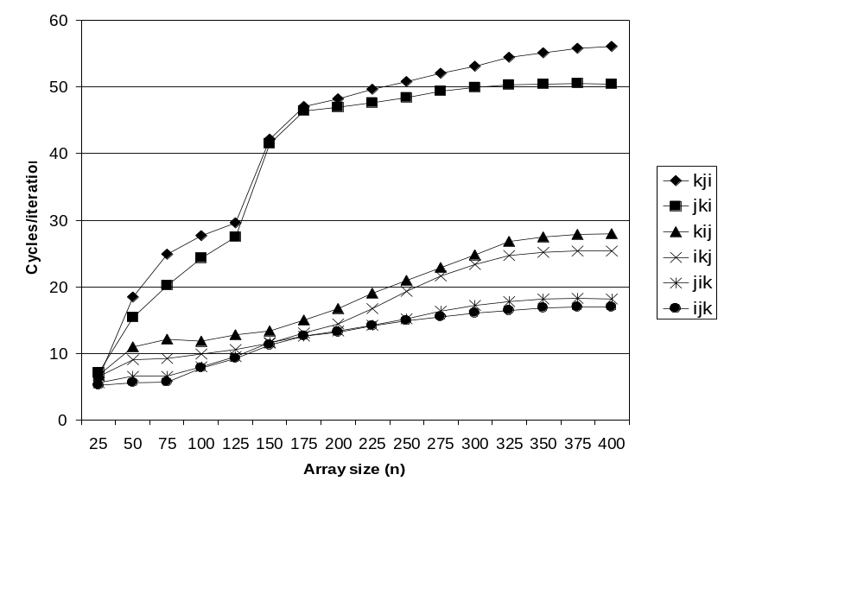
Pentium Matrix Multiply Performance
Miss rates are helpful but not perfect predictors.
    Code scheduling matters, too.
kji & jki
kij & ikj
jik & ijk

Slide 43
Improving Temporal Locality by Blocking
Example: Blocked matrix multiplication
  “block” (in this context) does not mean “cache block”.
  Instead, it mean a sub-block within the matrix.
  Example: N = 8; sub-block size = 4
A₁₁ A₁₂
A₂₁ A₂₂
B₁₁ B₁₂
B₂₁ B₂₂
C₁₁ C₁₂
C₂₁ C₂₂
X
=
Key idea: Sub-blocks (i.e., A_{xy}) can be treated just like scalars.
C₁₁ = A₁₁B₁₁ + A₁₂B₂₁ C₁₂ = A₁₁B₁₂ + A₁₂B₂₂
C₂₁ = A₂₁B₁₁ + A₂₂B₂₁ C₂₂ = A₂₁B₁₂ + A₂₂B₂₂

Slide 44
Blocked Matrix Multiply (bijk)
for (jj=0; jj<n; jj+=bsize) {
for (i=0; i<n; i++)
for (j=jj; j < min(jj+bsize,n); j++)
c[i][j] = 0.0;
for (kk=0; kk<n; kk+=bsize) {
for (i=0; i<n; i++) {
for (j=jj; j < min(jj+bsize,n); j++) {
sum = 0.0
for (k=kk; k < min(kk+bsize,n); k++) {
sum += a[i][k] * b[k][j];
}
c[i][j] += sum;
}
}
}
}

Slide 45
Blocked Matrix Multiply Analysis
  Innermost loop pair multiplies a 1 X bsize sliver of A by a bsize X bsize block of B and accumulates into 1 X bsize sliver of C
  Loop over i steps through n row slivers of A & C, using same B
for (i=0; i<n; i++) {
for (j=jj; j < min(jj+bsize,n); j++) {
sum = 0.0
for (k=kk; k < min(kk+bsize,n); k++) {
sum += a[i][k] * b[k][j];
}
c[i][j] += sum;
}
Innermost
Loop Pair
kk
jj
jj
kk
i
i
A
B
C
row sliver accessed
bsize times
Update successive
elements of sliver
block reused n times in succession

Slide 46
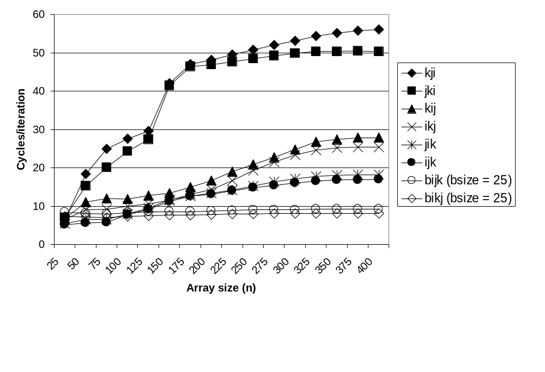
Pentium Blocked Matrix
Multiply Performance
Blocking (bijk and bikj) improves performance by a factor of two over unblocked versions (ijk and jik)
  relatively insensitive to array size.

Slide 47
Concluding Observations
Programmer can optimize for cache performance
  How data structures are organized
  How data are accessed
    Nested loop structure
    Blocking is a general technique
All systems favor “cache friendly code”
  Getting absolute optimum performance is very platform specific
    Cache sizes, line sizes, associativities, etc.
  Can get most of the advantage with generic code
    Keep working set reasonably small (temporal locality)
    Use small strides (spatial locality)

