Slide 1
CODE OF EMPLOYEE DISCIPLINE
(COED)
16e-BM/MAS/HDCV/FSOFT v1.2

Slide 2
Coverage:
Objectives of the orientation
Purpose & Importance of the COED
Scope
Employee Code of Ethics
Specific Guidelines
Discipline Management
Responsibilities
Notes:
Go thru table of contents

Slide 3

OBJECTIVES
To understand and uphold the Company’s policies on Code of Employee Discipline in accordance with due process requirements
To understand the company’s disciplinary processes & procedures
To ensure compliance to the set guidelines at all times
Notes:
FPT believes that a professional, trustworthy, responsible and well-disciplined workforce contributes to a harmonious and productive work environment and to the success of the organization.
FPT expects each employee to observe reasonable standards of conduct in the performance of his work, in his relationship with fellow employees and in his dealings with the public which are consistent with the corporate objectives, values as well as that of the local government policies and regulations.
The FPT Code of Employee Discipline is meant to protect the interest of FPT and its employees from actions and decisions that can be deemed to be unlawful or unjust and unreasonable. This Code is established for the proper conduct of all and to make sure that a clear standard/basis for discipline and due process are in place. It is not meant to curtail employee rights or movements.
It is FPT’s policy to process workplace disciplinary matters in a manner which ensures fairness in the treatment of individuals at all levels in the Company and the protection of Company resources and assets.
PURPOSE
The purpose of this Code is to provide guidance to all employees of the expected personal conduct and to emphasize the importance of discipline in the entire organization.
Disciplinary action measures are generally imposed to correct, reform or rehabilitate the employee and to maintain a general standard of discipline in the Company. These shall be progressively applied depending upon the nature and seriousness of the offense and the entire performance record of the employee.
It is every employee’s basic and fundamental obligation to follow this Policy during the entire course of their employment with FPT. This Code is intended to provide guidance on the established disciplinary actions whenever there are violations committed against the established guidelines and procedures.

Slide 4

PURPOSE & IMPORTANCE OF COED
Always emphasize the importance of discipline in the entire organization.
Provide guidance to all employees of the expected personal conduct and standards of behavior expected of them in the workplace as well as the possible actions that may be taken against employees who are proven, by means of a fair procedure, to have transgressed any part of this Code.
Protect the interest of FPT and its employees from actions and decisions that can be deemed to be unlawful or unjust and unreasonable.
Notes:
FPT believes that a professional, trustworthy, responsible and well-disciplined workforce contributes to a harmonious and productive work environment and to the success of the organization.
FPT expects each employee to observe reasonable standards of conduct in the performance of his work, in his relationship with fellow employees and in his dealings with the public which are consistent with the corporate objectives, values as well as that of the local government policies and regulations.
The FPT Code of Employee Discipline is meant to protect the interest of FPT and its employees from actions and decisions that can be deemed to be unlawful or unjust and unreasonable. This Code is established for the proper conduct of all and to make sure that a clear standard/basis for discipline and due process are in place. It is not meant to curtail employee rights or movements.
It is FPT’s policy to process workplace disciplinary matters in a manner which ensures fairness in the treatment of individuals at all levels in the Company and the protection of Company resources and assets.
PURPOSE
The purpose of this Code is to provide guidance to all employees of the expected personal conduct and to emphasize the importance of discipline in the entire organization.
Disciplinary action measures are generally imposed to correct, reform or rehabilitate the employee and to maintain a general standard of discipline in the Company. These shall be progressively applied depending upon the nature and seriousness of the offense and the entire performance record of the employee.
It is every employee’s basic and fundamental obligation to follow this Policy during the entire course of their employment with FPT. This Code is intended to provide guidance on the established disciplinary actions whenever there are violations committed against the established guidelines and procedures.

Slide 5

SCOPE
The code shall apply to all FPT Software employees:
while inside Company premises whether On or Off-duty;
while outside Company premises On duty or while attending Company organized or work-related activities;
while they are outside Company premises even during Off-duty, provided that the incident is work-related, or even if not work-related, the same results to damage or prejudice to the Company
Notes:
An FPT SOFTWARE PHILIPPINES CORP. employee should:
Exercise corporate citizenship and FPT’s interest by conducting business affairs in fairness, honesty and in compliance with the law.
Protect with zeal and caution confidential knowledge or data on products, business strategies, processes, systems or other important information during or even after employment with FPT.
Uphold FPT’s interest and not grant undue personal favors, especially in the matters of awarding contracts or in hiring and similar activities.
Engage only in such private activities or businesses that are consistent with his responsibilities as an employee, and are not detrimental to the interest of FPT.
Exercise utmost discretion in accepting personal favors from individual or entities seeking or doing business with FPT and refuse any gift that might be considered as bribery of any form.
Utilize Company property, funds, equipment and time solely for the purpose required by FPT.
Exercise utmost caution in ensuring safety of employees and Company property.
Seek clearance from Management prior to engaging in outside work or assuming simultaneous positions in other companies.
Accept the responsibility to ensure that the Code of Ethics is being enforced and complied at all times.

Slide 6
CODE OF EMPLOYEE DISCIPLINE- CONTRACT
CONFIDENTIALITY
Company records and / or personal information about customers and other employees, including proprietary information, trade secrets and intellectual property to which the Company holds rights, the employee must not discuss this information with anyone else without proper authority.
OWNERSHIP OF INTELLECTUAL PROPERTY
All intellectual property, including inventions and copyrights conceived, developed and/or made by the employee, whether done singularly or with others during his/her employment with FPT, shall be the property of the Company.
RESTRAINT OF TRADE / NON-COMPETE CLAUSE / OTHER JOBS / BUSINESS INTERESTS
Employees are discouraged from engaging in personal businesses within the company premises or getting involved in businesses especially those that directly or indirectly conflicts with the interest of the company.
PERFORMANCE REVIEWS
All employees’ performance will be reviewed against the set goals and targets based on their job role which will be used as basis for further recommendation (e.g. Dev Plans, Promotions, Merits, etc.)

Slide 7
CODE OF EMPLOYEE DISCIPLINE
USE OF COMPANY RESOURCES
All employees are expected to use any company resources (e.g. Telephones, Laptops, Business machines, Equipment/Devices, Time, etc) strictly for business purposes only.
Vending, selling during official work hours or collecting for any purpose are not allowed.
BUSINESS GIFTS & GRATUITIES
Employees are discouraged from accepting or seeking favors or gifts from customers /suppliers whether actual or potential.
Any employee who is given a gift of any sort by a business contact should disclose the fact of the gift and its nature to immediate superior.

Slide 8
CODE OF EMPLOYEE DISCIPLINE
ANTI-SEXUAL HARASSMENT
Sexual Harassment can be in a form of the following: Physical Harassment, Hostile Environment. The CODI (Committee on Decorum Investigation) will handle cases related to violation of the Anti-Sexual Harassment Policy
SMOKING AT WORK
Smoking is strictly prohibited in company premises.
ALCOHOL & DRUGS
FPT Software is considered as a drug-free workplace
Employees who report for work under the influence of drugs and alcohol will be dealt with under the Code of Conduct.

Slide 9
EMPLOYEE CODE OF ETHICS
An FPT SOFTWARE PHILIPPINES CORP. employee should:
Exercise corporate citizenship and FPT’s interest by conducting business affairs in fairness, honesty and in compliance with the law.
Protect with zeal and caution confidential knowledge or data on products, business strategies, processes, systems or other important information during or even after employment with FPT.
Uphold FPT’s interest and not grant undue personal favors, especially in the matters of awarding contracts or in hiring and similar activities.
Engage only in such private activities or businesses that are consistent with his responsibilities as an employee; and are not detrimental to the interest of FPT.
Notes:
An FPT SOFTWARE PHILIPPINES CORP. employee should:
Exercise corporate citizenship and FPT’s interest by conducting business affairs in fairness, honesty and in compliance with the law.
Protect with zeal and caution confidential knowledge or data on products, business strategies, processes, systems or other important information during or even after employment with FPT.
Uphold FPT’s interest and not grant undue personal favors, especially in the matters of awarding contracts or in hiring and similar activities.
Engage only in such private activities or businesses that are consistent with his responsibilities as an employee, and are not detrimental to the interest of FPT.
Exercise utmost discretion in accepting personal favors from individual or entities seeking or doing business with FPT and refuse any gift that might be considered as bribery of any form.
Utilize Company property, funds, equipment and time solely for the purpose required by FPT.
Exercise utmost caution in ensuring safety of employees and Company property.
Seek clearance from Management prior to engaging in outside work or assuming simultaneous positions in other companies.
Accept the responsibility to ensure that the Code of Ethics is being enforced and complied at all times.

Slide 10
EMPLOYEE CODE OF ETHICS
Exercise utmost discretion in accepting personal favors from individual or entities seeking or doing business with FPT and refuse any gift that might be considered as bribery of any form.
Utilize Company property, funds, equipment and time solely for the purpose required by FPT.
Exercise utmost caution in ensuring safety of employees and Company property.
Seek clearance from Management prior to engaging in outside work or assuming simultaneous positions in other companies.
Accept the responsibility to ensure that the Code of Employee Discipline is being enforced and complied at all times.
Notes:
An FPT SOFTWARE PHILIPPINES CORP. employee should:
Exercise corporate citizenship and FPT’s interest by conducting business affairs in fairness, honesty and in compliance with the law.
Protect with zeal and caution confidential knowledge or data on products, business strategies, processes, systems or other important information during or even after employment with FPT.
Uphold FPT’s interest and not grant undue personal favors, especially in the matters of awarding contracts or in hiring and similar activities.
Engage only in such private activities or businesses that are consistent with his responsibilities as an employee, and are not detrimental to the interest of FPT.
Exercise utmost discretion in accepting personal favors from individual or entities seeking or doing business with FPT and refuse any gift that might be considered as bribery of any form.
Utilize Company property, funds, equipment and time solely for the purpose required by FPT.
Exercise utmost caution in ensuring safety of employees and Company property.
Seek clearance from Management prior to engaging in outside work or assuming simultaneous positions in other companies.
Accept the responsibility to ensure that the Code of Ethics is being enforced and complied at all times.

Slide 11
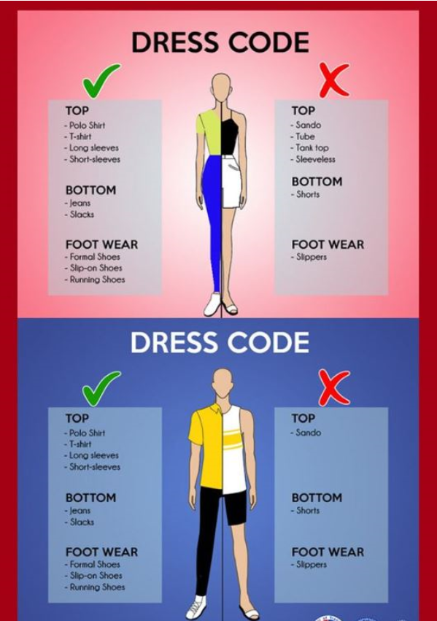
DRESSCODE POLICY
TOP
Polo, T-shirts
Decent sleeveless, blouses which do not reveal too much skin
BOTTOM
Slacks, capri, jeans (not tattered)
Leggings but paired with long top
Skirts/Dresses at which you can sit comfortably
FOOTWEAR
sandals, closed shoes
TOP
Tube, spaghetti and halter tops unless paired with cardigans
Tops that reveal too much skin, see through without inner lining
BOTTOM
Too short and very tight skirts/dresses that ride halfway up the thigh
FOOTWEAR
All kinds of slippers
To set the standards by providing employees guidance on what is appropriate, decent and yet comfortable to wear when reporting for work.
Help foster internal pride among FPT employees and at the same time, enable employees to project a professional image to our customers, potential employees and company visitors while experiencing the advantage of a more casual and relaxed clothing.
TOP
Polo shirts
T-shirts
Long sleeves
BOTTOM
Slacks/pants,
Jeans (not tattered)
FOOTWEAR
Closed footwear
Athletic/rubber/ leather shoes
TOP
Sleeveless
Muscle shirts
BOTTOM
Tattered jeans
Shorts
FOOTWEAR
All kinds of slippers includer rubber or even leather made slippers
Notes:
Proper dress code should be observed inside the company premises during regular work hours.
Employees engaged in wellness and sports programs are encouraged to change back to proper attire when going back to work.
Wearing of Shorts and Slippers are not allowed within work premises.
Employees, OJTs & FPT-assigned contractors are required to dress appropriately when reporting for work.

Slide 12
DRESSCODE POLICY
Orange Mondays – every Monday of the month (encouraged)
Client / VIP Visits – need to wear Orange shirts
Dress down Fridays – can wear shorts but still no slippers. Wearing of FPT shirts (summer outing/Department shirt) are also encouraged to wear on this day)
If client visit falls on a Friday, client visit policy applies
TOP
Polo, T-shirts
Decent sleeveless, blouses which do not reveal too much skin
BOTTOM
Slacks, capri, jeans (not tattered)
Leggings but paired with long top
Skirts/Dresses at which you can sit comfortably
FOOTWEAR
sandals, closed shoes
TOP
Tube, spaghetti and halter tops unless paired with cardigans
Tops that reveal too much skin, see through without inner lining
BOTTOM
Too short and very tight skirts/dresses that ride halfway up the thigh
FOOTWEAR
All kinds of slippers
TOP
Polo shirts
T-shirts
Long sleeves
BOTTOM
Slacks/pants,
Jeans (not tattered)
FOOTWEAR
Closed footwear
Athletic/rubber/ leather shoes
TOP
Sleeveless
Muscle shirts
BOTTOM
Tattered jeans
Shorts
FOOTWEAR
All kinds of slippers includer rubber or even leather made slippers
Notes:
Orange Mondays – every 1st and 3rd Monday of the month (encouraged)
Client Visits – need to wear Orange shirts
Dress down Fridays – can wear shorts but still no slippers
If client visit falls on a Friday, client visit policy applies

Slide 13
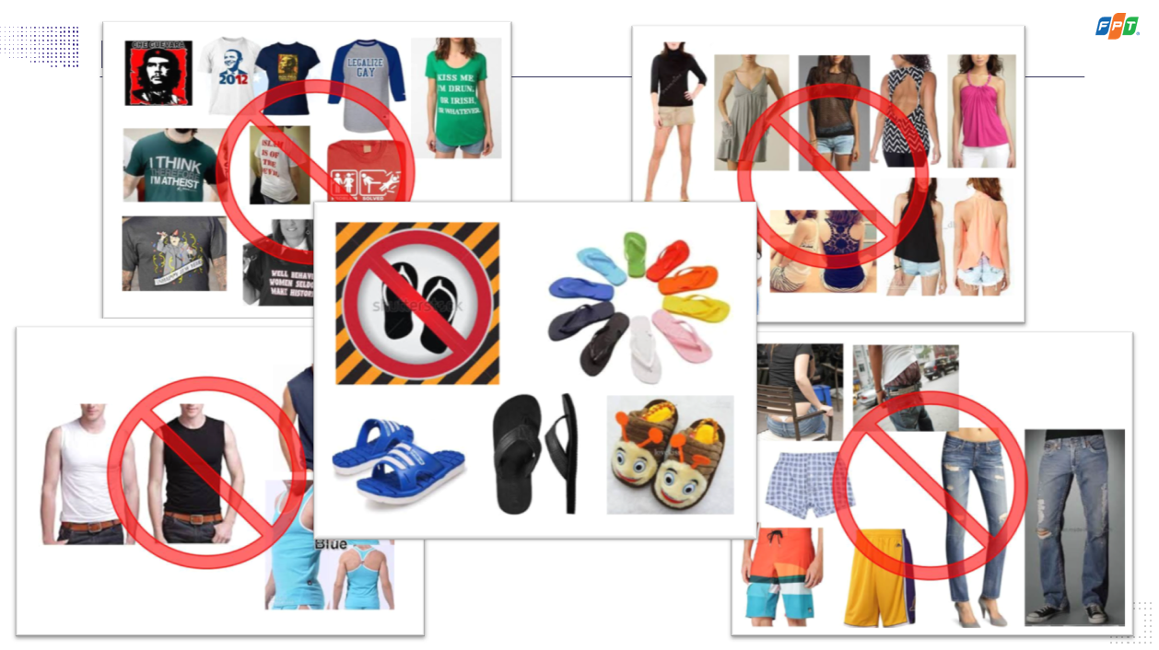

Slide 14

DISCIPLINE MANAGEMENT
It is a process for dealing with job-related behavior that does not meet expected and communicated performance standards.
The purpose herewith is to assist the employee to understand that a performance problem or opportunity for improvement exists.
Notes:
8.0 BASIC DISCIPLINARY MANAGEMENT
The key to effective disciplinary management is to carefully and objectively scrutinize each case/incident report as well as ensure that you have all the facts and evidence relevant to the case. Should you have sufficient information, these then must be evaluated based on existing company policies and the FPT Code of Employee Discipline. Under our labor laws, due process must be observed in all disciplinary and /or termination cases.
8.1 DISCIPLINARY MANAGEMENT PROCESS
This pertains to a process for dealing with job-related behavior that does not meet expected and communicated performance standards. The purpose herewith is to assist the employee to understand that a performance problem or opportunity for improvement exists.

Slide 15
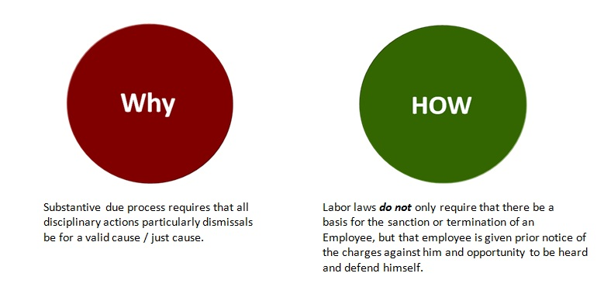
DUE PROCESS & TWIN NOTICE RULE
Due process is the legal requirement that the state must respect all legal rights that are owed to a person. Due process balances the power of law of the land and protects the individual person from it.
Need to satisfy the TWIN NOTICE RULE
Notes:
Due process, in relation to employment termination proceedings, is composed of two aspects. One, there must be a just or authorized cause for the dismissal or any administrative disciplinary acton (substantive due process). Two, the requirements of procedural due process must be complied with. The separate procedural due process requirements for just causes and authorized causes for employment termination are discussed below.
Just causes:
* 1. Serious misconduct
* 2. Willful disobedience or insubordination
* 3. Gross and habitual neglect of duties
* 4. Fraud or willful breach of trust
* 5. Loss of trust and confidence
* 6. Commission of a crime or offense
* 7. Analogous causes Authorized causes:
* 1. Installation of labor-saving devices
* 2. Redundancy
* 3. Retrenchment or downsizing
* 4. Closure or Cessation of Operation
* 5. Disease DUE PROCESS IN AUTHORIZED CAUSES
The requirements of procedural due process depend on the ground relied upon for the dismissal. For authorized causes, due process requires the service of a written notice to both the employee and the appropriate Regional Office of the Department of Labor and Employment (DOLE) at least thirty (30) days before the effectivity of the termination, specifying the ground or grounds for termination.
For just causes of termination, procedural due process requires two written notices and an ample opportunity to be heard.
DUE PROCESS IN JUST CAUSES
There are two written notices that must be complied with in order for a dismissal, based on just cause, to be valid. Note that “valid dismissal” is used in a general context, as the failure to comply with the requirements of procedural due process does not make the dismissal “illegal,” but entitles the employee to the payment of damages (discussed in a separate post). It is also important to emphasize that the twin notices must be WRITTEN. A verbal notice is equivalent to no notice.
(a) FIRST WRITTEN NOTICE. The first written notice should contain:
1. The specific causes or grounds for termination as provided for under Article 297 of the Labor Code, as amended, and company policies, if any;
2. Detailed narration of the facts and circumstances that will serve as basis for the charge against the employee. A general description of the charge will not suffice; and
3. A directive that the employee is given opportunity to submit a written explanation within a reasonable period.
“Reasonable period” should be construed as a period of at least five (5) calendar days from receipt of the notice to give the employee an opportunity to study the accusation, consult or be represented by a lawyer or union officer, gather data and evidence, and decide on the defenses against the complaint.

Slide 16

PROGRESSIVE DISCIPLINE
Disciplinary action is imposed in progressively increasing weight, after the employee has been given the opportunity to be heard or after due process.
Types of Disciplinary Action:
Written Warning
  First written warning
  Final written warning
2. Suspension
  May vary in duration
  depending on the nature of case
3. Dismissal
Notes:
8.5 PROGRESSIVE DISCIPLINE
It is FPT’s obligation to ensure that in disciplinary action cases, all employees are afforded fair and ample opportunity to be heard based on the established principles and proceedings of the Code.
FPT SOFTWARE PHILIPPINES CORP Disciplinary Management enforces the Progressive Discipline where disciplinary action is imposed in progressively increasing weight, after he has been given the opportunity to be heard or after due process.
Progressive Discipline is a system of discipline where the penalties increase upon repeat occurrences. The stage chosen for a particular infraction will depend on a variety of factors that include the severity of the infraction, the previous work history of the employee and how the choice will affect others in the organization.
Progressive disciplinary action may be applied in the following forms:
Written Warning – serves as a written notice to the employee that the repetition of the same offense shall result in a heavier penalty such as suspension or dismissal. Supporting documents or report of the violation must be attached to the disciplinary action form.
Suspension – compulsory and temporary absence from work on a no-pay status as a result of a repeated violation of this Code. This may also be applied to a more serious infraction that requires drastic action to prevent further damage to company property and/or to the employees. Implementing suspension as a disciplinary action should be done only after thorough evaluation of the full merits of the case. This has to be imposed within one month from the date the notice of disciplinary action is issued to the employee. Suspension of more than one day can be made in a staggered basis.
Dismissal - the most serious form of employee discipline, which only becomes necessary when all attempts to correct the misdemeanor have failed, except in cases where the penalty of dismissal is specifically prescribed, as per this Code. This must be resorted to only after thorough and factual investigation has been done in consultation with HR Senior Manager and Business Area Managers.
Depending on the history, circumstances and gravity of the offense/situation, progressive disciplinary action may be applied in the above applicable disciplinary actions.
The progressive discipline process, as stated above, does not apply to grave offenses where the penalty of dismissal is proper under this Code or any material and relevant laws, decrees, company policy, rule and regulations, directive, orders and the like.

Slide 17

PRESCRIPTIVE PERIOD
This pertains to the time where disciplinary actions shall have been written off or lapsed and repeated violation of the same offense after this period shall be treated as first violation.
Six (6) months
  first written warning
  final written warning
One (1) year
  for suspension cases
Notes:
8.3 PRESCRIPTIVE PERIOD
Except as otherwise qualified or provided for herein in any other policy or regulation, disciplinary actions shall have a prescriptive period or shall be written off after the lapse of:
Six (6) months – for penalties ranging from corrective counseling to written warning
One (1) year - for suspension
Notwithstanding the foregoing provisions, however, all past offenses of the associate concerned shall be taken into consideration and shall not be deemed as written off for the purpose of determining his or her guilt for gross and habitual neglect of duty, inefficiency or incompetence. In such cases, his or her offenses and infractions may be used as basis to determine if he or she should be dismissed.

Slide 18
AGGRAVATING VS MITIGATING FACTORS
AGGRAVATING FACTORS
Circumstances relating to the commission of a crime or violation that makes it more grave than the average instance of that crime.
MITIGATING FACTORS
Circumstances relating to the commission of a crime or violation that may be considered to reduce the blameworthiness of the defendant.
Remorse
Infraction was an isolated incident
Provocation
Calls for a tougher or more serious penalty.
Conduct was premeditated or intentional
Employee’s position / level
Employee record such as length of service, Performance, feedback from peers. history of offenses
Calls for a lesser sentence or less serious penalty.
Examples:
Admission
Examples:

Slide 19
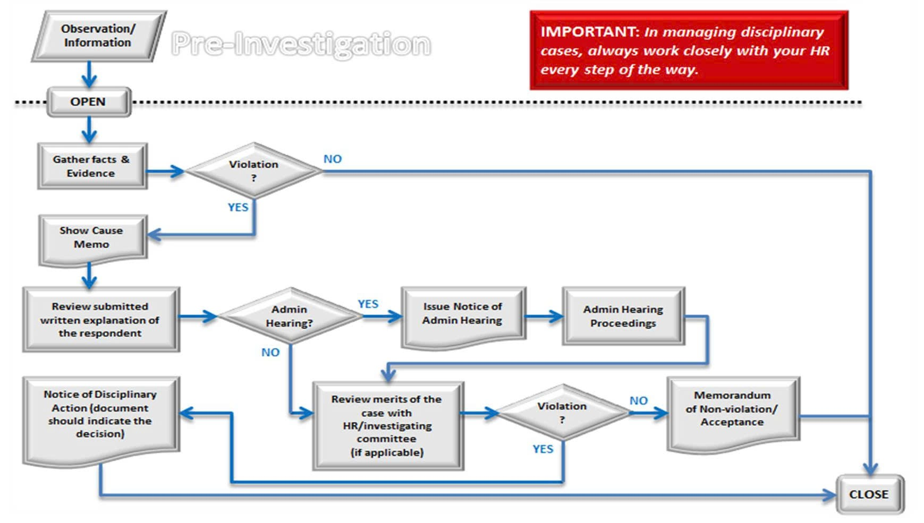
DISCIPLINARY MANAGEMENT PROCESS

Slide 20

BASIC DISCIPLINARY MANAGEMENT
The key to effective disciplinary management is to carefully and objectively scrutinize each case/incident report as well as ensure that you have all the facts and evidence relevant to the case. Should you have sufficient information, these then must be evaluated based on existing company policies and the FPT Code of Employee Discipline. Under our labor laws, due process must be observed in all disciplinary and /or termination cases.

Slide 21

TIME & ATTENDANCE
WORK HOURS refers to the period when work starts and ends.
ON-THE-DOT means exactly at the right time (no flex)
SEMI-FLEXIBLE TIME refers to the time allowance an employee may start and end his work hours in a given day which is determined to be at most, plus two hour(s) before and after the regular shift schedule
TARDINESS refers to the failure to report on the correct or usual or expected start of work hours. Employees who report to work after the latest start time of their applicable work schedules / shifts are considered tardy.
INCIDENT refers to an occurrence, an event

Slide 22
TIME & ATTENDANCE
ABSENCE WITHOUT OFFICIAL LEAVE (AWOL)
Incidence is reckoned on per day basis within a calendar year
1st incidence – Written Warning
2nd incidence – Suspension – 3 days
3rd incidence – Suspension – 6 days
4th incidence – Suspension – 9 days
5th incidence – Dismissal
ABANDONEMENT OF WORK
Failure to report for work for five (5) days without prior approval from the immediate superior will result to dismissal.

Slide 23
RESPONSIBILITIES
MANAGER
Act as role-models for these standards, visibly demonstrating support and regularly encouraging employee compliance.
HUMAN RESOURCE
HR should serve as a resource to all employees in ensuring the general practice and implementation of the Code.
EMPLOYEE
Is expected to study, understand and follow FPT’s Code of Discipline
Ensure that all their employees receive guidance, training and communication on the Code and to all existing applicable policies of FPT relevant to their immediate duties and responsibilities.
Remain alert to call out and conduct disciplinary action to behaviors which are inappropriate in the workplace including but not limited to harassment, violence, threats of violence, offensive language or other behavior not in accordance with the company policy.
Report such violations to the respective HR and/or appropriate personnel (encourage employee to report any violations of the code).
Have the duty and responsibility to exercise their management skills in a fair, equitable and consistent manner in line with the company’s goals and objectives.
In instances of violation, HR shall be an internal resource to both the Management and the employee in ensuring impartiality in upholding the process.
HR must be available for advice and guidance and to assist the Managers through the investigation, planning and remedial action, if necessary.
It is the primary responsibility of HR to ensure that the requisite due process requirements and appropriate procedures (including but not limited to the proper documentation of the administrative case and proceedings) are complied with before any disciplinary action or dismissal is meted out.
The HR Business Partner serves as an advisor/partner to line managers. The latter in turn are encouraged to work closely with their HR Business Partners at the onset of the disciplinary process
Should seek clarification for unclear provisions and processes
Should be aware that he is given the right to exercise his rights for due process
Should commit and cooperate to resolve any issue related to this Code…
Must act professionally in dealing with the issue related to this Code of Employee Discipline
Is responsible to report any misconduct he is aware of
Notes:
RESPONSIBILITY
5.1 HUMAN RESOURCE TEAM
It is the primary responsibility of the Human Resource (“HR”) and the Management personnel to ensure that this Code is properly promulgated, disseminated and clearly understood by all FPT employees and consistently implemented throughout the entire organization.
It is also HR’s responsibility to:
Initiate review and update with managers the content of this Code and make the necessary amendments or additions, as often as needed.
Provide guidance to managers and employees in the proper interpretation and understanding of this policy and refer to legal counsel any need for clarification and guidance.
5.2 LINE MANAGEMENT
Although it is both the management’s as well as the employees’ responsibility to contribute to a positive work environment by ensuring consistent compliance to the company policies, as a manager, it is management’s primary responsibility to:
Act as role-models for these standards, visibly demonstrating support and regularly encouraging employee compliance.
Ensure that all their employees receive guidance, training and communication on the Code and to all existing applicable policies of FPT relevant to their immediate duties and responsibilities.
Remain alert to call out and conduct disciplinary action to behaviours which are inappropriate in the workplace including but not limited to harassment, violence, threats of violence, offensive language or other behaviour not in accordance with the company policy.
Report such violations to the respective HR and/or appropriate personnel (encourage employee to report any violations of the code).
Management personnel have the duty and responsibility to exercise their management skills in a fair, equitable and consistent manner in line with the company’s goals and objectives.
In their authority to discipline, Management personnel must consider carefully any disciplinary action that are accorded to erring employees to ensure fair and consistent implementation of the Policy.
Immediate Line/Department Managers shall collaborate with HR for cases as a result of violations or potential violations against this Code for advice, guidance and assistance in planning of remedial action.
Area Managers (or Up-line Managers) shall make the final decision for cases that will lead to termination.
Work with HR to investigate further and address any inappropriate conduct or behaviour which are not in accordance to the Company Code of Conduct.
5.3 HR OFFICER/BUSINESS PARTNER
HR should serve as a resource to all employees in ensuring the general practice and implementation of the Code.
In instances of violation, HR shall be an internal resource to both the Management and the employee in ensuring impartiality in upholding the process.
HR must be available for advice and guidance and to assist the Managers through the investigation, planning and remedial action, if necessary.
It is the primary responsibility of HR to ensure that the requisite due process requirements and appropriate procedures (including but not limited to the proper documentation of the administrative case and proceedings) are complied with before any disciplinary action or dismissal is meted out.
The HR Business Partner serves as an advisor/partner to line managers. The latter in turn are encouraged to work closely with their HR Business Partners at the onset of the disciplinary process
5.4 FPT EMPLOYEE
Is expected to study, understand and follow FPT’s Code of Discipline
Should seek clarification for unclear provisions and processes
Should be aware that he is given the right to exercise his rights for due process
Should commit and cooperate to resolve any issue related to this Code…
Must act professionally in dealing with the issue related to this Code of Employee Discipline
Is responsible to report any misconduct he is aware of

Slide 24


CODE OF EMPLOYEE DISCIPLINE DOCUMENTS
Code of Employee Discipline Policy
Table of Offenses
Code of Employee Discipline Acknowledgement Template
OTHER POLICIES & GUIDELINES
Information Security Policies
Training Agreements
Other Rules & Regulations prescribed by FPT.
  PEZA guidelines
  Finance-related policies
  established work-specific processes, etc.

Slide 25
TABLE OF OFFENSES
Attendance
      Tardiness
      Abandonment of Work
  Inefficiency/ Incompetence
  Abuse of Company Time
  Insubordination
  Negligence
  Violations against Co-employee & Others
  Disruption of work
  Abuse of Authority
  Morality
Disruption of work
Abuse of Authority
Morality
  Harassment
      Sexual Harassment
  Involving public order, work ethics, and decorum
    Gambling and betting
    Dishonesty
    Sabotage
Environment, Health, Safety and Security
    Health/ Medical
    Liquor/ Drug/ Firearms
    Unauthorized Entry
Workplace safety & security
Violations Against Property & Resources
    Against Company Image
    Against Property & Information
    Against IT Resources

Slide 26

Q & A

Slide 27
Thank you!

