Slide 1


EMPLOYEE BENEFITS
2026
Makati, April 15th 2026

Slide 2
TOPICS
Compensation
Statutory Benefits (SSS, Pag-ibig, Philhealth)
Paid Leaves
Medical Benefits
Life and Accident Benefits

Slide 3


COMPENSATION

Slide 4
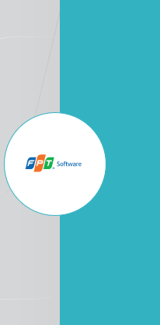
Basic Wage
Annual Salary ( 5 days a week with 2 days off)
Annual Salary ( 261 days)=Monthly Rate x 12 Month
Daily Rate = Monthly rate x 12 divide by 261 days
Hourly Rate = Daily rate divide by 8

Slide 5
“De Minimis” Allowance
De Minimis- allowances where withholding tax is not applied/non-taxable part of compensation.
Rice Allowance
Laundry Allowance
Clothing Allowance

Slide 6
Payroll Schedule
5th and 20th day of each month
Withholding taxes will be deducted from the employee’s bi-monthly payroll earnings
Government mandated contributions:
- SSS (bi-monthly)
- Philhealth (bi-monthly)
- HDMF/Pagibig (every 20th)
SSS Loan (bi-monthly)

Slide 7
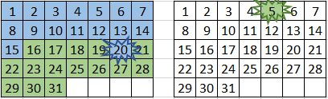
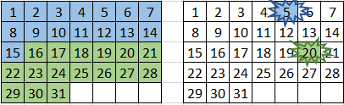
Payroll Pointers
For 20th pay day, payroll period is from 1 to 15th
For 5th pay day, payroll period is from 16 to 30^{th /} 31st
Salary adjustments from 1-15 will be credited on the 5th pay day of the succeeding month
Salary adjustments from 16-30/31 will be credited on the 20th pay day of the succeeding month
Except for new hires' first payout:
cut of 5 days before 15 and end of the month

Slide 8
13th Month Pay
Employees who have worked for the Company for a full year are entitled to a full month’s pay (less deductions for unauthorized or unjustified leaves and absences) using the employee’s most recent basic pay as basis.
Those who worked for less than a year shall receive a prorated amount.
The minimum 13th month pay is not less than 1/12 of the total basic salary earned by an employee within a calendar year.
The 13th month pay will be paid out no later than the 24th of December, as specified by law.

Slide 9

STATUATORY BENEFITS
GOVERNMENT MANDATED BENEFITS

Slide 10
SOCIAL SECURITY SYSTEM Benefit
Employee’s SSS contributions are deducted from their salaries and withheld by their respective employers on a monthly basis. Employers have a share in the monthly contribution.
Sickness - a daily cash allowance paid for the number of days a member is unable to work due to sickness or injury.

Slide 11
SOCIAL SECURITY SYSTEM Benefit
Maternity - a daily cash allowance granted to a female member who was unable to work due to childbirth or miscarriage. One hundred and five (105) days for female workers with pay and an option to extend for an additional thirty (30) days without pay. This also grants extension of fifteen (15) days for solo mothers, and for other purposes. Moreover, a female worker entitled to maternity leave may, at her option, allocate up to seven days of the paid leave to the child’s father, in addition to the benefits granted to him under the Paternity Leave Act of 1996 if he is married to the female worker. In case of absence of the father, the benefit may be allocated to an alternate caregiver who’s currently employed, who may be a relative within the fourth civil degree of consanguinity or the current partner of the female worker sharing the same household.

Slide 12
SOCIAL SECURITY SYSTEM Benefit
Disability - a cash benefit granted either as a monthly pension or a lump sum amount - to a member who becomes permanently disabled, either partially or totally.
Retirement - a cash benefit granted - either as a monthly pension or a lump sum amount - to a member who can no longer work due to old age.
Death - A cash benefit granted - either as a monthly pension or a lump sum amount - to the beneficiaries of a deceased member.
Funeral - A cash benefit given to whoever pays the burial expenses of the deceased member or pensioner. (pensioner-refers to retiree or partial/total disability pensioner)

Slide 13
MEMBER LOAN
What is a salary loan?
  A cash loan granted to an employed, currently paying self-employed or a voluntary member. It is intended to meet a member's short-term credit needs.
Who may qualify for a salary loan?
  - An employed, currently paying, self-employed or voluntary member (SE/VM) who has 6 posted monthly contributions for the last 12 months prior to filing of application.
  - For one-month loan, the member-borrower must have 36 posted monthly contributions, prior to the month of filing of application.
  - For two-month loan, the member-borrower must have 72 posted monthly contributions.

Slide 14
Salary Loan Important Guidelines
All salary loan applications for SSS must be done online.
Member will register and log in at www.sss.gov.ph
Once loan is submitted online, send an email to:
FPT HR (donna.aberion@fsoft.com.vn)
Finance (ibon.moalong@fsoft.com.vn)
for employer’s approval
Send a screenshot or a photocopy of your loan voucher to HR department for us to facilitate payment through salary deduction.

Slide 15
Interest, Fees and Penalties
SSS charges an interest of 10% per annum (year) based on the diminishing principal balance, until your loan is fully paid. In addition, there is a 1% service fee which will be deducted from the loan amount.
If you fail to pay on or before the payment deadline, you will be charged a 1% penalty per month until you settle your dues. Any excess payments will be applied to the outstanding principal balance, which means that you can pay your loan in advance

Slide 16
PAG IBIG Benefit
Housing Loan - One of the mandates of Pag-IBIG Fund is to be of assistance to the public in providing cheap financing for their housing needs. Pag-IBIG accomplishes this by working in partnership with the local Real Estate Developers and arranging affordable loans to real estate buyers (Pag-IBIG members).
Short Term Loan - Just like SSS and GSIS, Pag-IBIG Fund also offers financial assistance to qualified member by granting short term loan.
There is a Calamity Loan for members affected by unforeseen calamity like flood, fire, volcanic eruption and other similar cases. There is also a Multi-purpose loan that you can use for whatever reasons: financing a micro-business or buying the latest toy you have been dying to get.

Slide 17
PAG IBIG Benefit
Provident Savings - Another way of looking at your contributions to Pag-IBIG is to consider it as your savings, which you can withdraw at maturity date. Your contributions, plus that of your employer will earn dividend. Now, you can get all that money, called Total Accumulated Value (contributions plus dividend), when it reaches maturity.

Slide 18
PAG IBIG PROGRAM
PAG IBIG MP2
Unlike the regular Pag-IBIG program that every employed and self-employed Filipinos are part of, the MP2 is a voluntary program that provides a higher earning potential than a regular savings account. Your savings is invested by Pag-IBIG and will earn through dividends, just like investing in mutual funds.

Slide 19
Steps for PagIBIG Application
Complete the forms provided in the website with the necessary information. Use the Adobe Acrobat Reader for filling it out
Save the accomplished form as PDF.
Send the form directly to FPT HR for us to fill necessary information in the employer’s section.
Send form to PAGIBIG office at:
WT Corporate Tower, 2nd and 3rd floors, Mindanao Ave, Cebu City, 6000 Cebu

Slide 20
PHILHEALTH Benefit
Philhealth’s main benefit is to subsidize medical expenses based on the amount the hospital bills, effectively reducing the amount one needs to shell out.
Benefits are clustered into four areas:
Inpatient – Patients who are admitted to the hospital to receive care. A certain amount will be deducted from the total bill (professional fees) so long as the Health Care Institution (HCI) where you were admitted is a partner of PhilHealth.
Outpatient – Patients who receive care without hospital admission. Day surgeries, radiotherapy, hemodialysis, outpatient blood transfusion.

Slide 21
PHILHEALTH Benefit
Z Benefits – Treatment for leukemia, breast cancer, prostate cancer, and coronary artery bypass graft surgery fall under this category.
SDG Related – Some examples under this cluster are animal bite, anti-tuberculosis, and HIV-AIDS.
Visit their website, www.philhealth.gov.ph PhilHealth has a tool you can use to get a better picture of how much financial aid they can provide depending on your particular case.

Slide 22
Who will be entitled to its benefits?
If you are a Philhealth member who has at least three months premium contributions within the immediate six months prior to the first day of confinement. Your qualified dependents (like a spouse who is not a member, child/children below 21 years old, etc.) are also entitled to its benefits.

Slide 23
How does it work?
Submit the following documents:
Member Data Record (MDR) & Employer signed original copy of PhilHealth Claim Form - you can get a copy from your HR Department or PhilHealth
PhilHealth ID and another valid ID
Submit these documents to the hospital before being discharged for immediate deduction to take place.

Slide 24

Paid Leaves

Slide 25


UPON REGULARIZATION
Vacation Leave
12 days (earned, pro rated per year)
Max 5 days unused, VL convertible to cash by year end
Additional 3 days upon 3rd anniversary with FPT
Sick Leave
12 days (earned, pro rated per year)
Not convertible to cash
Bereavement Leave
3 days (immediate family members and parents-in-law)
Birthday Leave
1 day (upon 1st anniversary)

Slide 26
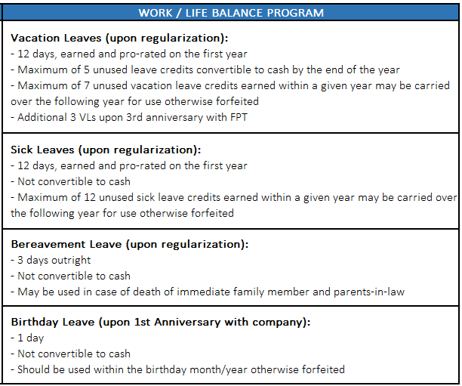
UPON REGULARIZATION

Slide 27
FILING OF LEAVES
SW – SUPPORT - Recommendation (to be included in enhancement):
VACATION / PLANNED LEAVE (DAYS) | NOTICE PERIOD (MINIMUM) | MGR RESPONSE TIME FROM RECEIPT OF LEAVE | FOR VL TRANSACTIONS ESCALATED TO 2ND LINE (NO MGR RESPONSE / NO AVAILABLE LEAVE CREDIT)
1 DAY | 2 WORKING DAYS | W/IN 1 WORKING DAY | +1 WORKING DAY AFTER ESCALATION
2 DAYS | 5 WORKING DAYS | W/IN 3 WORKING DAYS | +1 WORKING DAY AFTER ESCALATION
3 – 4 DAYS | 10 WORKING DAYS | W/IN 5 WORKING DAYS | +1 WORKING DAY AFTER ESCALATION
5 DAYS AND UP | 1 CALENDAR MONTH | W/IN 5 WORKING DAYS | +1 WORKING DAY AFTER ESCALATION
Mindset: Managers to reply
Employees to take ownership of their filed leaves and work closely with their Line Managers, MD as needed
Should be filed in TMS and fully approved to be considered official leave.
Guideline: Immediate Manager can respond with conditional approval if contingent to certain deliverables. Set expectations that it can either be approved or not depending on the status.
If no Immediate Manager's response within the above period, employee to escalate to 2nd level manager until last level. Lower levels to explain to MD.
For leaves without credits (unpaid leaves), Line Manager to escalate to MD for approval
Approved leaves may be recalled if due to urgent matters. Any cost incurred from the employees' side due to leave cancellation will be shouldered by FPT
The Employee must seek prior approval before start of the actual leave. An employee may not take vacation leave until his/her vacation leave application has been duly approved by his/her supervisor.
Absence should be filed in TMS and fully approved before going on leave. Otherwise considered insubordination AWOL.

Slide 28
FILING OF LEAVES
MGD SERVICES - Recommendation (to be included in enhancement):
VACATION / PLANNED LEAVE (DAYS) | NOTICE PERIOD | MGR RESPONSE TIME FROM RECEIPT OF LEAVE
1 DAY | 2 WORKING DAYS | W/IN 1 WORKING DAY
2 DAYS | 5 WORKING DAYS | W/IN 3 WORKING DAYS
1 WEEK/5DAYS | 1 CALENDAR MONTH | W/IN 5 WORKING DAYS
Mindset: Managers to reply
Immediate Manager can respond with conditional approval if contingent to certain deliverables. Set expectations that it can either be approved or not depending on the status.
If no Immediate Manager's response within the above period, escalate to 2nd level manager until last level. Lower levels to explain to MD.
Approved leaves may be recalled if due to urgent matters. Any cost incurred from the employees' side due to leave cancellation will be shouldered by FPT

Slide 29
LEAVE CONVERSION
Max 5 days by the end of the year or during separation/resignation except for:
    Special cases c/o MD for approval
    Special arrangements (pre-approved)
    RARE CASE: Special approvals wherein the manager cannot allow member to go on leave due to business need hence, manager can recommend for conversion to cash of #VLs for separating members or for those still active, increase #VL carry over the ff year (rare option) = c/o LM recommendation, no need for MD approval

Slide 30
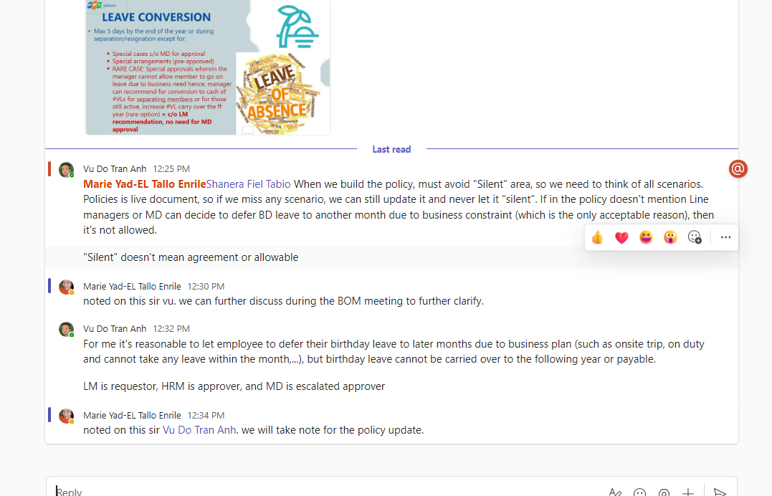

Slide 31

Health Benefit
Maxicare & Medical Reimbursement

Slide 32

100% covered by the company for employees
Can enroll up to 6 dependents
FPT to subsidize medical insurance premium for the first 4 dependents

Slide 33


UPON REGULARIZATION
REQUIREMENTS
Up to Php 5,000.00 / year (prorated)
80-20 % co-sharing
Doctor’s prescription
Medical Certificate
Official Receipt

Slide 34
Life & Accident Benefit

Slide 35


UPON HIRE
Life and Accident Insurance at 24x monthly base salary up to 2M (or double if death is due to accident)

Slide 36


