Slide 1
Machine Learning
Introduction (Seminar 01)
Valentin Malykh
MIPT, 2016

Slide 2
Plan
Course Introduction
Course program
Classwork and homework
Rating
Break
Python, R and other tools
Competitions

Slide 3
Valentin Malykh
valentin.malykh@phystech.edu
Education:
MIPT, CS
Work experience:
Yandex (search engine)
Sputnik (search engine)
Cognitive Technologies (computer vision)

Slide 4
General Resources
CourseWiki at Machine Learning
Resource for communication
email (general notification)
piazza (Q&A)
google drive (materials)

Slide 5
Semester Program
Neural nets (deep learning)
Compositions (Boosting)
Reinforcement learning
Semi-supervised learning
Times series forecasting (adaptive methods)
Collaborative filtering
Text mining

Slide 6
Semester roadmap
Classwork
theory (2 tests during the semester)
practical cases
Homework
labs (2)
contests (2)
theory tasks (optional)
competitions (optional)

Slide 7
Semester roadmap (continued)
Tools
Python (notebook)
R
Matlab / Octave
Weka, RapidMiner, Orange
VowpalWabbit, Spark MLLib
Competitions
Kaggle
Tunedit
Yandex Internet Mathematics
KDD Cup
TREC Tracks

Slide 8
Rating
Theory tests
Practical work
Competitions
Mark

Slide 9

Python
Since 1991
Designed by Guido van Rossum

Slide 10
Python?
Simple syntax
A lot of packages, built-in data structures
APIs for other languages
Different programming paradigms:
Structural
OOP
Functional
Dynamic typing (duck typing)
Garbage collector
Exception handling
Multi-threading (-processing)
High-level / Low-level programming
Scalability

Slide 11





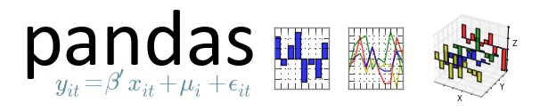



Python + packages
SciPy

Slide 12

Python + packages
NumPy is the fundamental package for scientific computing with Python.
a powerful N-dimensional array object
tools for integrating C/C++ and Fortran code
useful linear algebra, Fourier transform, and random number capabilities

Slide 13

Python + packages
SciPy library
provides many user-friendly and efficient numerical routines such as numerical integration and optimization.

Slide 14

Python + packages
Matplotlib is a python 2D plotting library which produces publication quality figures in a variety of hardcopy formats and interactive environments across platforms. It can be used in python scripts, shells, web application servers, and six graphical user interface toolkits.

Slide 15


Pandas
Pandas is an open source, BSD-licensed library providing high-performance, easy-to-use data structures and data analysis tools for the Python programming language.

Slide 16

Jyputer (Ipython) notebook
IPython provides a rich architecture for interactive computing with:
Powerful interactive shells (terminal and Qt-based).
A browser-based notebook with support for code, text, mathematical expressions, inline plots and other rich media.
Support for interactive data visualization and use of GUI toolkits.
Flexible, embeddable interpreters to load into your own projects.
Easy to use, high performance tools for parallel computing.

Slide 17

Python + packages
scikit-learn (Machine Learning in Python)
Simple and efficient tools for data mining and data analysis;
Classic algorithms, like kNN, SVM and so on.

Slide 18
Python Useful Links
Resources:
Python short introduction
Lectures on scientific computing with Python
Book:
Wes McKinney "Python for Data Analysis"
Examples:
Example from the seminar
http://scikit-learn.org/stable/auto_examples/index.html
http://scikit-learn.org/stable/tutorial/index.html
Enviroments:
Anaconda, Canopy, PyCharm
Notes:
что касается примеров\учебников
1) https://github.com/jrjohansson/scientific-python-lectures#online-read-only-versions
2) google
3) tutorials (http://docs.python.org/3/tutorial/index.html)
4) гугловские лекции:
https://developers.google.com/edu/python/?csw=1
1) anaconda: консоль для запуска скриптов, ipython netbook (для создания отчетов\примеров). Здесь уже много библиотек будет предустановлено
http://continuum.io/downloads
2) Pycharm - это уже более мощная средя для разработки (уже боевой, типа VS). http://www.jetbrains.com/pycharm/download/

Slide 19

R
R is a freely available language and environment for statistical computing and graphics which provides a wide variety of statistical and graphical techniques: linear and nonlinear modeling, statistical tests, time series analysis, classification, clustering, etc.
Since 1993
Ross Ihaka and Robert Gentleman

Slide 20
R features
A lot of built-in statistical and numerical routines
Good quality graphics with mathematical symbols
Easy extensible by external packages (R CRAN vs Python PIP, Perl CPAN)
4000+ packages available (01/01/2013)

Slide 21
R features
Command Line Interface
Several Graphical User Interfaces (GUIs):
R Commander
Rstudio
…

Slide 22
R Application Areas
Finance
Genetics
Machine Learning
Medical Image Analysis
Natural Language Processing
Differential Equations
…
Full list of application areas:
http://cran.r-project.org/web/views/

Slide 23
R Useful links
Books
R in action
The Art of R programming
Google’s R Style Guide
Resources:
http://www.rdatamining.com/examples
http://www.rdatamining.com/resources/onlinedocs

Slide 24
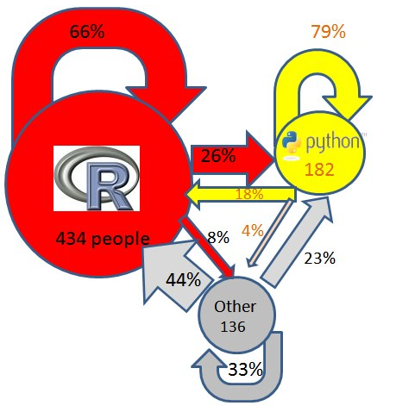
Why python?
http://www.kdnuggets.com/2013/12/poll-results-r-leading-python-gaining.html
http://www.kdnuggets.com/polls/2013/r-python-switch.html

Slide 25

Weka (Waikato Environment for Knowledge Analysis)
Data Mining Software in Java
Weka is a collection of machine learning algorithms for data mining tasks
The algorithms can either be applied directly to a dataset or called from your own Java code
It is also well-suited for developing new machine learning schemes
Some example datasets
are included in the Weka
distribution

Slide 26
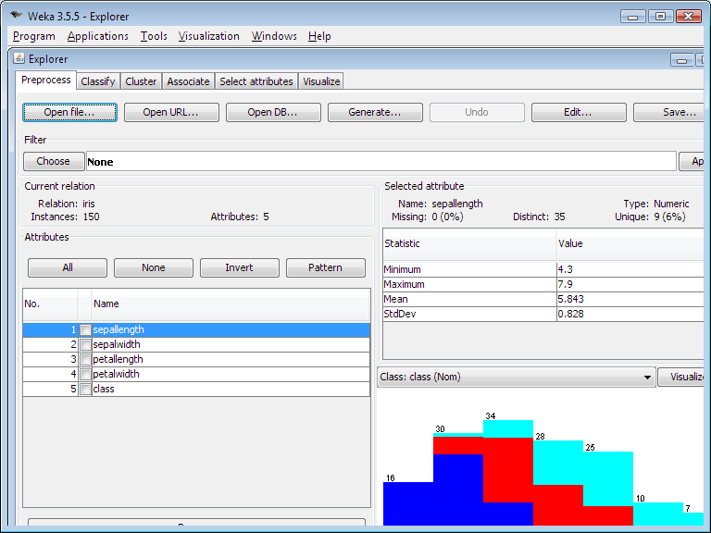
Weka

Slide 27

Orange
Open source data visualization and analysis for novice and experts
Data mining through visual programming or Python scripting
Components for machine learning. Add-ons for bioinformatics and text mining
Packed with features for data analytics
Visual Programming

Slide 28
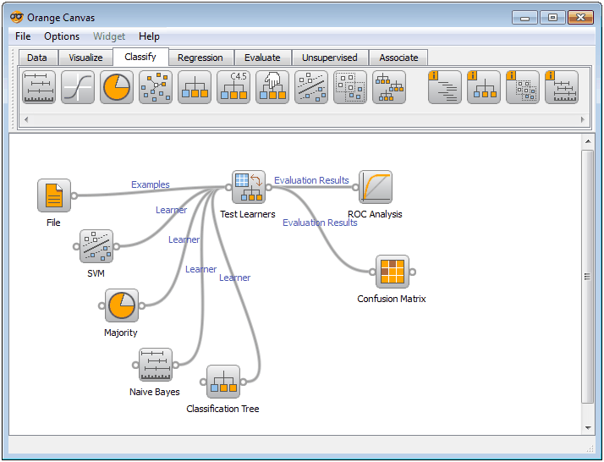
Orange
Visual Programming

Slide 29

Rapid Miner
RapidMiner, formerly known as YALE (Yet Another Learning Environment), was developed starting in 2001 by Ralf Klinkenberg
In 2007, YALE → RapidMiner (renamed)
Statistical analysis, data mining, predictive analytics

Slide 30
Rapid Miner
Provides an integrated environment for machine learning, data mining, text mining, predictive analytics and business analytics
It is used for business and industrial applications as well as for research, education, training, rapid prototyping, and application development
Supports all steps of the data mining process including results visualization, validation and optimization

Slide 31
ML in life
Data analysis (Rapidminer , etc.)
Prototype
(Python, etc.)
Soft
(C++, etc.)

Slide 32
Competitions
Kaggle
Yandex Internet Mathematics

Slide 33

Kaggle
Kaggle is the world's largest community of data scientists. They compete with each other to solve complex data science problems, and the top competitors are invited to work on the most interesting and sensitive business problems from some of the world’s biggest companies through Masters competitions.

Slide 34
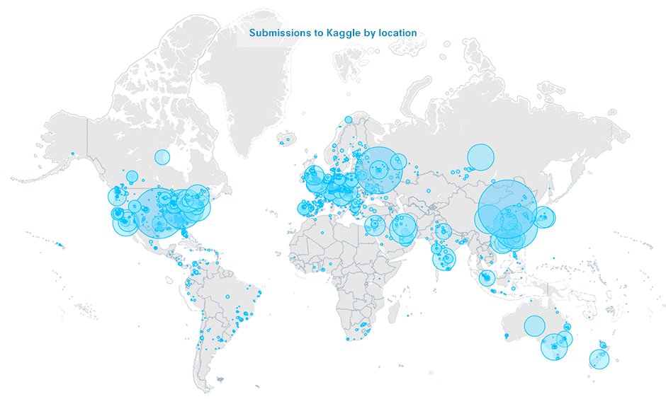
Kaggle

Slide 35
Kaggle
FAQ
Competitions
Featured: these are public competitions with significant prize money meant to solve commercial problems.
Recruiting: The goals of Prospect competitions include data exploration, analyses, and data visualizations.
Kaggle Prospect
Research: are public competitions where the competition goals are research/ scientific in nature or serve a public good.
Getting Started

Slide 36
Yandex Internet Mathematics
Internet Mathematics is a series of contests organized by Yandex.
Started in 2004
Contestants can participate as individuals, or as teams
Examples:
2009: Ranking
2010: Traffic Jam Prediction
2011: Image Similarity
2011: Document Classification (Relevance based on User Behavior)
2012: Switch Search Engine Detection
Notes:
Конкурс «Интернет-математика» стартовал в 2004 году как конкурс научных проектов. Со временем содержание конкурса изменилось. Сейчас «Интернет-математика» — это серия конкурсов, в рамках которых участники соревнуются в решении реальной задачи на основе реальных данных. Цель конкурса: стимулировать исследования в рамках информационного поиска и смежных областях. Темы прошедших конкурсов: машинное обучение ранжированию, предсказание загруженности дорог, визуальное сходство изображений и др.

Slide 37
Conclusion
It is interesting
It is difficult
We will do it! =)
* HW#0: Install Python and start to learn it

