Slide 1
Chapter – 3 Good Digital Hygiene: The Essentials

Slide 2
Intro
Technology is growing at a fast pace. Much faster than anyone could have predicted
100% security is not achievable
Notes:
Pg 23
You need to be prepared when something does go wrong

Slide 3
Malicious Software
Software that is designed to make a device work in an unintended way
Usually to cause damage, steal, corrupt or encrypt data, or control device
Notes:
Pg 24

Slide 4
Types of Malicious Software
Virus
Worm
Trojan Horse
Rootkit
Macro
Logic Bomb
Backdoor
other
Notes:
Pg 24
Computer virus- a program that replicates itself by putting copies of itself in other programs/files on the computer
Worm – like a virus – replicates itself, but does not have to be attached to an existing program. Typically uses the network to spread itself
Trojan Horse – a program that pretends to be a harmless program (like a screen saver download), but it has malicious code in it that does something other than it is intended to do
Rootkit – software designed to hide itself in your computer. Needs administrative access to be installed. Difficult to remove. Usually requires a re-install
Macro – a small program that is run inside of Word or Excel that uses programing language to manipulate the file. When it’s referred to as a virus. It means that the code has been altered to cause damage to the computer.
Logic Bomb – computer program that is designed to run at a specific time
Backdoor – a way to access a system that is not documented
Other – there are many other ways to maliciously damage a computer.

Slide 5
Protecting from Malicious Software
Keep your device up to date
Operating system updates
Antivirus software updated
Avoid “free” WiFi
Make sure that websites you visit are trustworthy
Download files from internet cautiously
Be careful about installing “free” software
Notes:
Pg 24

Slide 6
Protecting from Malicious Software - continued
Scan devices before plugging them into your computer
Don’t click on random pop-up messages
Be cautious of attachments you are not expecting
Ignore messages that your spam filter catches
Notes:
Pg 24

Slide 7
Protecting from Malicious Software - continued
Use security on your mobile devices
Back up your files regularly
Configure anti-virus software to check for malware when files are downloaded and quarantines the files that are malicious
If in doubt, don’t do it
Notes:
Pg 24

Slide 8
Software Firewall
A set of rules used to determine whether to allow or block traffic in or out of a computer
Notes:
Pg 25

Slide 9
Password Vault
Just like a vault at a bank. It’s a safe place to store valuable electronic documents
http://lifehacker.com/5529133/five-best-password-managers
Password store options
Locally only
Website
Sync with other devices
Notes:
Pg 26
Software you can use to store important documents, logins, passwords, credit card information and account numbers

Slide 10
BAD ideas – (not all ideas are listed)
No anti-virus
No firewall
Using employer email for personal use
Sharing confidential work information with others
Download “inappropriate” files
Make comments online that are considered offensive, defamatory or libelous
Planting malware or inappropriate material on someone else’s device
Notes:
Pg 27

Slide 11
Disposing of devices
Remove data when getting rid of an old computer or device
Shred old data – not just delete
Notes:
Pg 29
You can use a shredding software to more securely remove data from a device. It overwrites data with random 0s and 1s to make it less readable
(note: deleting files does not really delete them. It just makes the space available to be overwritten.

Slide 12
Backups
Copy data
Better backup
Copied to another device
Stored away from original data
Stored in a secure location
Backs up AUTOMATICALLY – without you doing anything
Notes:
Pg 29
If you lose data, it’s hard to bring some of it back.
Another discussion topic – have you ever lost data – problems that came from it

Slide 13
Cloud Backups
http://www.pcmag.com/article2/0,2817,2288745,00.asp
http://www.computerworld.com/article/2500640/data-center/5-online-backup-services-keep-your-data-safe.html
Notes:
Pg 30
Must access the internet to access your backed up data

Slide 14
Authentication
The process used to verify that you are who you say you are (to verify your identity)
Something you know (like a password)
Something you have (like an ID card or smartphone)
Something you are (like a fingerprint)
Notes:
Pg 30

Slide 15
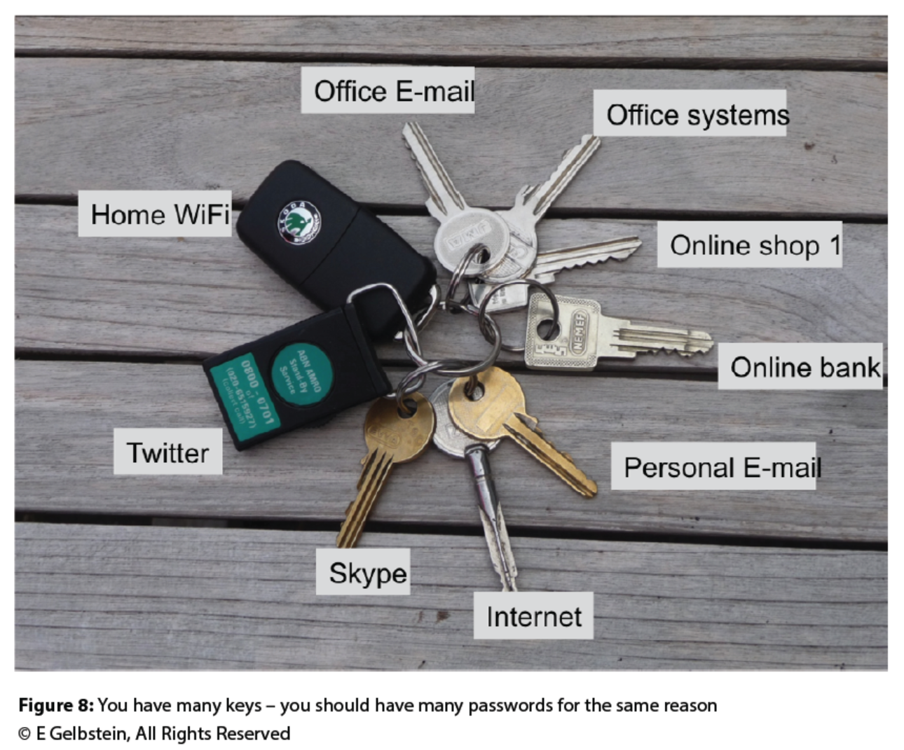
Passwords
Notes:
You don’t use the same key to open your door at work as you do at home. Why would you want to use the same passwords?

Slide 16
Password Problems
Using the same password for multiple devices/accounts
Using common passwords “password” “123456”
Writing down passwords
Notes:
Pg 31

Slide 17
Strengthen Passwords
Mixing in number/symbol replacements
$ for S
@ for a
3 for E
1st or 2nd letter in a phrase
1o2liap (from above sentence (using the 2nd letter replacement))
Notes:
Pg 32

Slide 18
Strengthen Passwords continued
Use a password generator (vault)
2 factor authentication (multifactor)
Password & a pin
Password and text
Notes:
Pg 32
Need to have good backups so you don’t lose your vault
Need to have the device with you

Slide 19
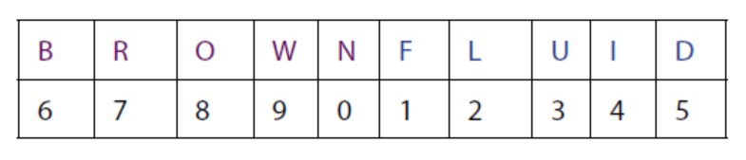
PIN – Personal Identification Number
Usually numeric – for credit cards/smartphones
Need to remember them
Strategy to remember pins
Notes:
Pg 33
Strategy to remember pins – come up with a 10 character phrase or word. Example above is brownfluid. Associate a number with each letter
Write down the letter association on your card or in your documentation
For 7276 write down RLRB or for a pin of 9243 write down WLIU

Slide 20
Categories of Software
Operating System
Browsers
Drivers
Utilities
Antivirus/Security
Applications/Apps
Notes:
Pg 33
OS – Android/iOS (Apple)/Windows/Linux
Browser – Firefox/Chrome/Internet Explorer/Opera
Drivers – support other devices like cameras/printers/mouse
Utilities – programs you install to make things easier for you or pre-installed on your computer
Antivirus/Security – to protect device from malicious software
Applications – word/Excel/powerpoint/games/programs

Slide 21
Categories of Software
Licensed – paid for
Shareware – they would like you to donate $ but you don’t have to
Freeware – no charge to download or use (may be funded by ads (like the textbook in this class)
Notes:
Pg 33

Slide 22
Issues with Software
Do not assume that software comes without errors
Some may snoop at data on your computer/device
Make sure that you only install quality software from a reputable vendor that provides support
Notes:
Pg 34

Slide 23
Downloads
Something that you copy from the internet to your device
Music
Video
Books
Photos
…
Notes:
Pg 35

Slide 24
Issues with Downloads
Be careful with downloads – you may be financially liable if you copy music/videos that are licensed or have a copyright on them
Don’t share files that you paid for with someone else
Notes:
Pg 35

Slide 25
More on Downloads
They are essential to the way that we do business now.
Make sure you trust the site you are downloading from
Notes:
Pg 36

Slide 26
Sharing Computers/Devices
Concerns
It might not work right afterwards
They may access your private data (email, accounting software…)
They may change your settings
Software may be installed
They may use your software to make it look like you did something or sent a message
Notes:
Pg 36

Slide 27
Sharing Computers/Devices
Install separate accounts to prevent the other user from installing software or using your software
Parental Controls
Notes:
Pg 37

Slide 28
Locking Computers/Devices
Set up a password or pin to use devices such as phones/computers
Keep others from posting material for/about your
Keep others from accessing your accounts/personal information
Turn off WiFi, Bluetooth, GPS when in public
Notes:
Pg 38
There are different laws for accessing a phone by the “Data” plan than over WiFi/Bluetooth. You have better protection over the “Data” plan
GPS can tag your photos and postings (facebook/twitter…) & let people know your location

Slide 29
Securing Transactions
Make sure you are doing business with a reputable company that you trust
When on credit card or bank sites make sure your on https (instead of http)
https gains trust by using an independent 3rd party (Certificate Authority)
Notes:
Pg 39
Your browser should be up to date or you may not know when certificates become untrustworthy

Slide 30
In Review…
Learn and understand different types of malicious software
Discover strategies that can be used to protect your devices from malicious software
Understanding Software Firewalls
Understanding Passwords and best practices
The importance of Backups
What is authentication and how does it work
Understanding Software, types of software, issues with software, and what are safe downloads
Best practices for shared devices
Online transactions and security

