Slide 1
Chapter – 4 Your Footprints in Cyberspace

Slide 2
Intro
It’s easy to forget that what we do in cyberspace is recorded
Computers are configured to watch traffic on the internet and make reports

Slide 3
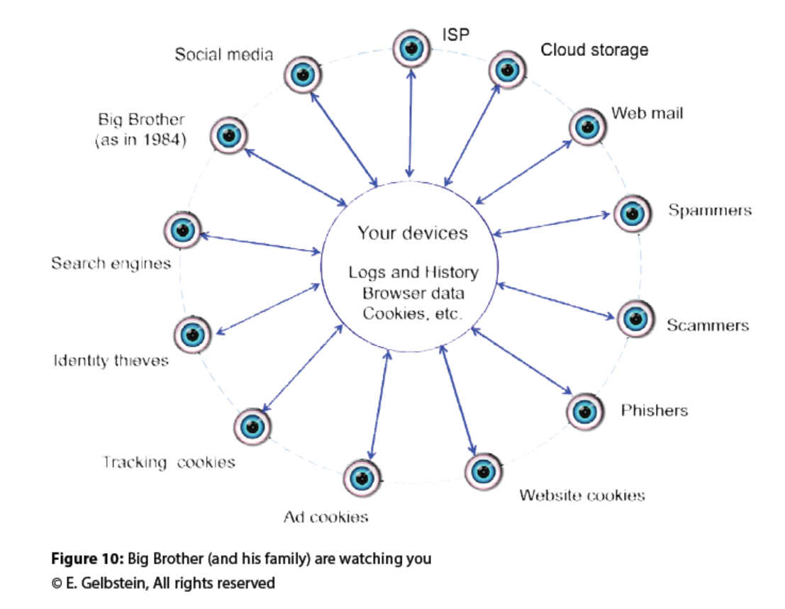
Who is watching your online activities
Notes:
Your device itself – logs, history, browser data, cookies
Social Media, ISP (Internet Service Providers), Cloud Storage (OneDrive, Dropbox), Web mail (google, yahoo, msn), Spammers, Scammers, Phishers, Website Cookies, Ad Cookies, Tracking Cookies, Identity Thieves, Search Engines

Slide 4
Privacy
Freedom of Speech
Limitations
International
Balance between
Privacy
Freedom of Speech
National Security
Anonymous
Notes:
Privacy is different across many cultures in the world.
There are limitations to privacy such as slander, libel, defamation of character, obscenity
Laws internationally are different than in the United States. - if you work at an international organization or conduct business internationally, you need to be familiar with the laws of the countries you operate in
Anonymous – it’s hard to remain anonymous in cyberspace – be aware of what you express online. It’s hard to remove some of your footprint once you put it in place.

Slide 5
Your Device
www.mybrowserinfo.com
Information your computer gives out when you browse online
Notes:
Go to the website on the slide & look at the detailed information. You can see your OS, resolution, language, city of ISP
Websites are looking at this information for marketing. This is why when you browse you see ads for Madison WI

Slide 6
Anonymizer Service
Connect to their website. They act as a switch & removes your IP address so it looks like you’re somewhere else, not Madison, WI
May make it look like you’re trying to hide something
Notes:
Government agencies may be interested in anonymizer service customers

Slide 7
Cookies
Small text file stored on your computer.
Placed on your device by the website you are visiting when browsing the internet
Convenient
Sometimes help with security – bank/credit card companies
Notes:
Convenient – remember information like name, address so you don’t need to type it again.
Banks/credit card companies use cookies to determine if you are connecting from the same computer you did last time you logged into their system. If you are not, they ask you the extra security questions.

Slide 8
Tracking Cookies
Placed by a 3rd party website.
Has information from pages you have visited.
If you look up a product on Amazon, you will often see it in advertisements when browsing the internet.

Slide 9
Cookies – Additional Information
http://www.tomsguide.com/us/-tracking-cookie-definition,news-17506.html

Slide 10
Issues with Cookies
Invasion of privacy is an issue with cookies.
Our textbook is written by someone in Europe. They have stronger laws that protect privacy more than the United States.

Slide 11
Tossing your Cookies
What cookies are on your computer?
How do you delete the cookies individually?
How do you delete all of the cookies?
Can you control the cookies – keep some – not keep others?
Notes:
Lab 3 – can be started as an in class activity. Research cookies on the internet for your OS.

Slide 12
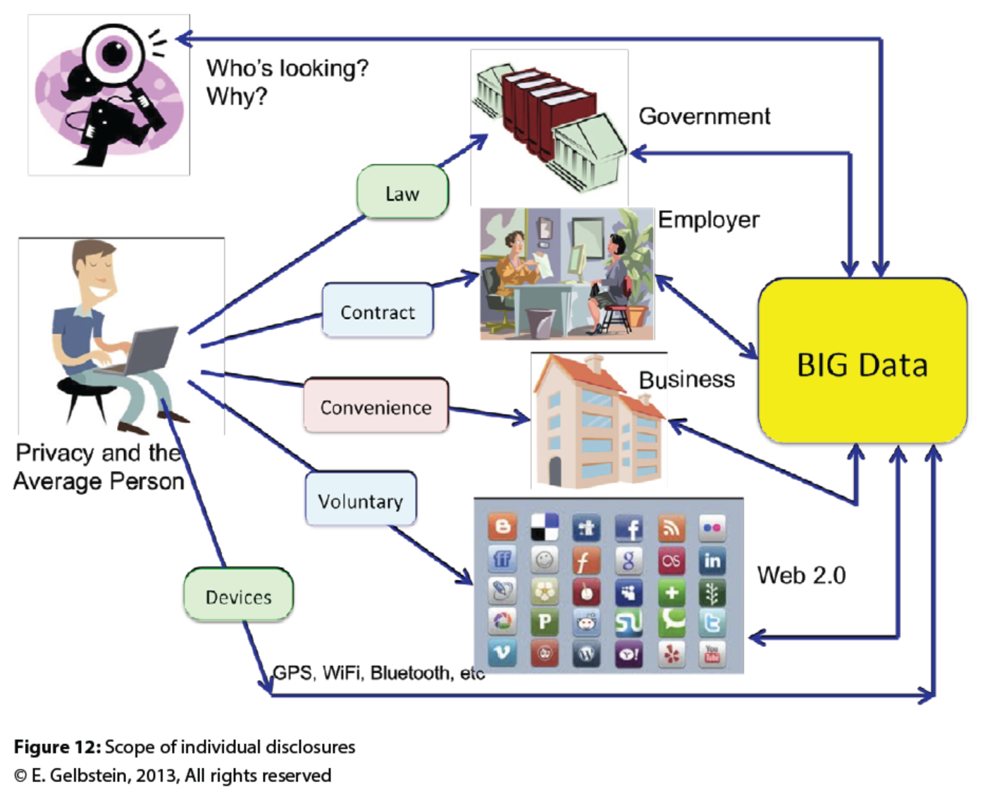
What are we sharing – disclosures
Notes:
Pg 46 in 1st edition of Good Digital Hygiene: A guide to staying secure in cyberspace

Slide 13
How are we sharing?
Law
Contract
Convenience
Voluntary
Devices
Notes:
Pg 46
Law – records that are required by law. Birth, marriage, divorce, court cases – CCAP – Circuit Court System Access https://wcca.wicourts.gov/index.xsl
Contract – records that are needed for employment, bank accounts, insurance
Convenience – rewards for shopping cards – they give us discounts, but businesses are using this information to track what we purchase so that they can use it for things like marketing
Voluntary – things we share personally in social media through outlets such as facebook, linkedin, twitter …
Devices – Bluetooth, wifi, gps – they measure traffic with Bluetooth readers. Gps data is stored on photos

Slide 14
Can we control what are we sharing?
No
Law
Contract
Yes – a little – is the reward worth the loss of privacy? You decide
Convenience
Voluntary
Devices
Notes:
Pg 47-48
Law – not really – this is a matter of public record
Contract – not really – this is part of the contract that we’re agreeing to
Convenience – you can choose to not sign up for this – there is NO UNDO
Voluntary – we need to be careful about what we post on social media and what we make publically available
Devices – the ability to track others with their mobile devices is a bit scary, but a reality. Do you turn off your gps, Bluetooth when you’re not using it?

Slide 15
Identity Theft
When someone pretends that they are you
Especially serious when it involves your finances
Notes:
Pg 50
Be careful with account numbers. Banks/credit card companies will not ask you for your account by email.
Security questions – many banks/credit card companies have security questions that are about you – Answers to these question could come from social media. Keep your social media private. Have friends that are truly people you know.
Stats about identity theft
https://www.ncjrs.gov/spotlight/identity_theft/facts.html

Slide 16
Social Media
Purpose – to connect people who have common interests
Assumptions
You can trust everyone
There are no guarantees that links are free from malware
It’s difficult to un-post something
Notes:
Pg 51
Know your friends in social media. Do you really know 500 people that well??

Slide 17
Controlling social media
Know your friends
Be selective. Especially if you are sharing private information
Remove people from your network that you don’t know
Have recent updates to your operating system, security software and internet browser
Monitor your privacy and security settings
Notes:
Pg 50
Know your friends in social media. Do you really know 500 people that well??

Slide 18
Controlling social media continued
Use strong passwords
Use different passwords for each social media site
Unfriend people – who you don’t really know or who post things that you don’t want to associate with
Don’t click on links (in email or websites or posts
Notes:
Pg 50
Longer passwords are better than shorter passwords
If someone is able to crack your password on one social media site, they can try the same password on other sites. If you use the same password for these sites, it’s easy for them to get in.

Slide 19
In Review…
Understanding who is watching you online and the limitations of privacy
How to find out information about your device
What are cookies and how do they affect my privacy
How to be secure in Cyberspace
Best practices when sharing information online

