Slide 1
Chapter – 5 Hygiene and the Cyber-Minefield

Slide 2
Intro
Be careful when browsing the internet
There are not a lot of laws that protect us
Notes:
Pg 52

Slide 3
Spam and Scams
Spam - Email that you don’t ask for
Scams – trick messages sent to take advantage of our human nature and willingness to help others
Notes:
Pg 52-53
Some scams take advantage of compromised email or information that can be found on social media like a grandkid’s name
Both fill up your inbox & waste your time

Slide 4
Spam Filter
Block out email messages that the system considers to be spam or junk
Don’t reply to spam
Don’t click “remove yourself”
Don’t give money
Notes:
Pg 54

Slide 5
Phishing
An attempt to get your personal/confidential information by pretending to be someone/something you trust
Looks like legitimate credit card company that you do business with
Try to get you to type in your personal login information
Notes:
Pg 54
Sounds like FISHING – like the sender of the message is fishing for information from you

Slide 6
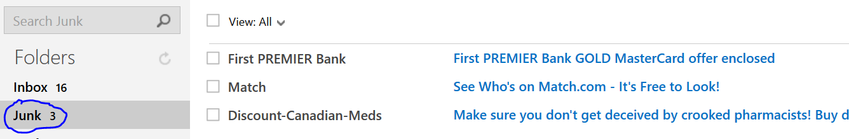
Phishing-spam filter or junk mailbox
Notes:
Pg 54
Look at the messages in my spam filter/junk box. They are just trying to get me to click on them

Slide 7
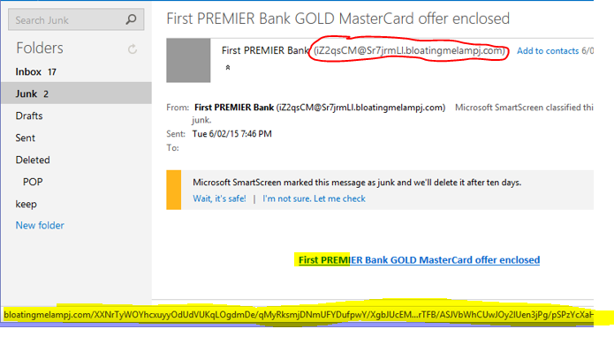
Phishing – actual message
Notes:
Pg 54
Look at the email address circled in red that it comes from – does this look legitimate
Look at the highlighted link “First Premier…”
The yellow highlight on the bottom of the page shows the website this will go to on the internet if I click on the link (you can see it when you hover over it) Does it look like a website name for a bank??

Slide 8
Spear-Phishing
This is a targeted phishing attack that has personal information in it.
The information is usually obtained through social media or corporate websites
REMEMBER – most legitimate businesses will not send messages that encourage you to go online for transactions
Notes:
Pg 54
Your title, name, role
Makes it seem more legitimate
If in doubt, call them (not at the phone number in their email, but on the one that is printed on your card or a statement

Slide 9
Attachments
File that is sent along with an email
Caution – opening some can cause code to run on your computer that can infect it
Potential dangerous file types
.exe, .com, .bat, .cmd, .lnk, .vbe, .vbs, .jar, .zip …
If you’re not expecting an attachment, contact the sender to see if it is legitimate
Notes:
Pg 56
Your antivirus software should be configured so that it scans attachments that you receive

Slide 10
Links
Look at the Phishing – actual message slide
When you hover over a link with the mouse, you can see on the bottom of the webpage where that link will take you. Always look at that before you click on it.
Notes:
Pg 57
Some say that you should never click on links. Is this realistic? The important thing is to pay attention. Look to see if the message is trustworthy. Hover over the links to see where they are going to take you. If in doubt, browse to the company’s website on your own to see if you can find it yourself.

Slide 11
Free WiFi
Not usually encrypted – so others connected to the same network could capture your data
Safer to use your “data” on mobile devices
Don’t check sensitive data on WiFi
Banks, credit cards, purchasing items …
Notes:
Pg 58
Data plans are protected by the same laws that phones are. If an app is looking at files on your device it is breaking laws that are in place for wiretapping. If an app is looking at files on your computer from WiFi (or WLAN) it isn’t protected by law yet

Slide 12
Protecting your home/personal WiFi
Works outside of most houses – (about 65 feet radius from access point)
Use encryption that comes with it – configuration is usually on a sticker on the device
Change the password if you are able to
MAC address access list
Change SSID from default (don’t use your name or address)
Make sure software/firmware is up to date
Use a firewall
Notes:
Pg 58
MAC addresses are not as easy to manage – especially if you have other people who come to your home and use your WiFi (teenagers…)
SSID – broadcasted by your router

Slide 13
Bluetooth
Meant for short range communication
Wireless keyboard/mouse
Headsets
Can be hacked
Turn off when not using
Make devices discoverable only when you need to
Notes:
Pg 59-60
Bluetooth hacking – bluejacking, bluesnarfing, bluebagging…

Slide 14
Logout when you leave
Logout when you are not on your device.
Keeps people from looking at your information if you leave your device unattended
Websites use tracking cookies to monitor what you browse and bring in ads into social media
Have you ever had a book that you looked up in amazon show up in facebook
Notes:
Pg 60-61
See chapter 4 to review information about cookies

Slide 15
In Review…
What is Spam, how does it affect me, how can I manage Spam?
What is Phishing?
How can I protect my data when using free WiFi, Personal WiFi, and Bluetooth?
Why it’s important to logout.

