Slide 1
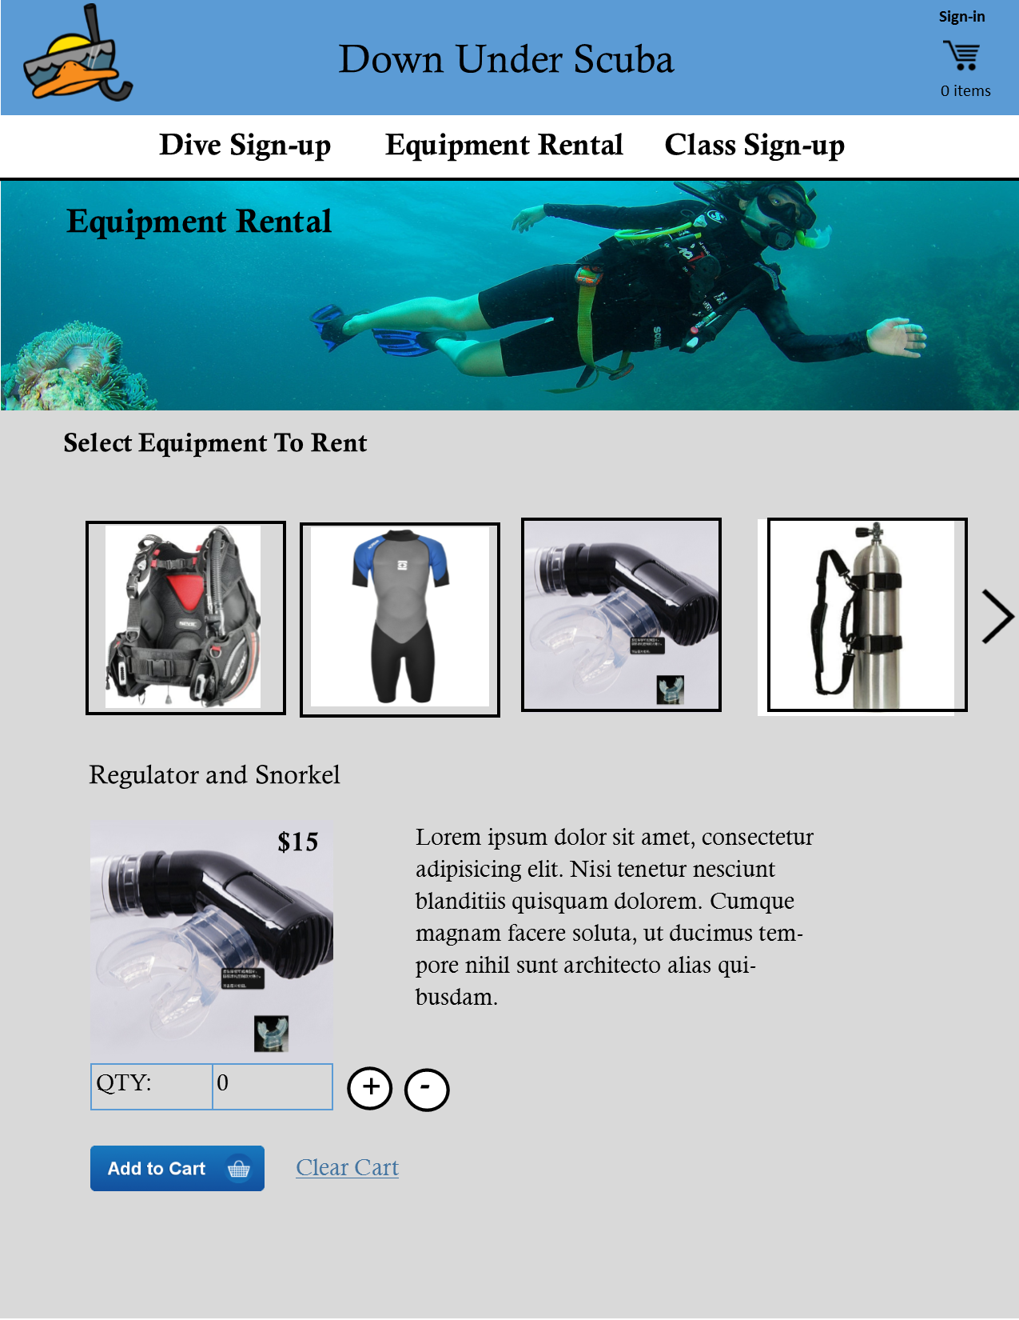
Notes:
Carousel of products with hover state shading that indicates the image can be clicked.
Packages are their own tiles (off screen)
Selected piece of equipment expands more info section
Add to cart is greyed out until quantity, start date, and days to rent
When Qty is increased, the product description text section is covered by a slideout form with start date, days of rental, and rental total for entire item

Slide 2
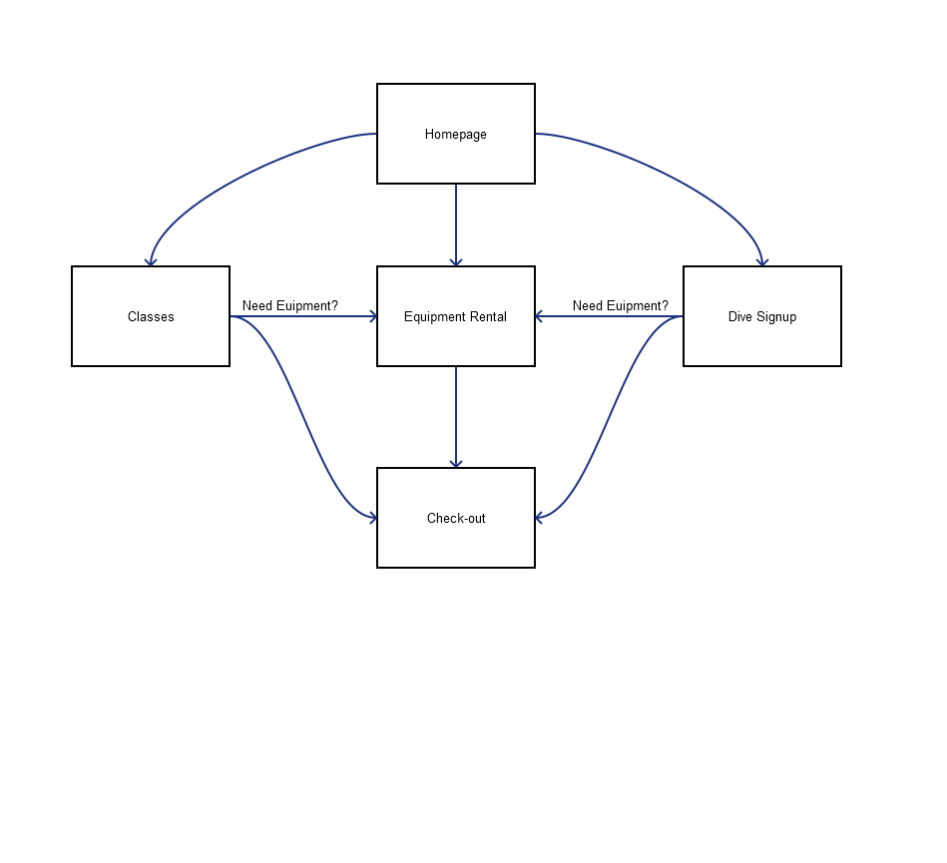

Slide 3
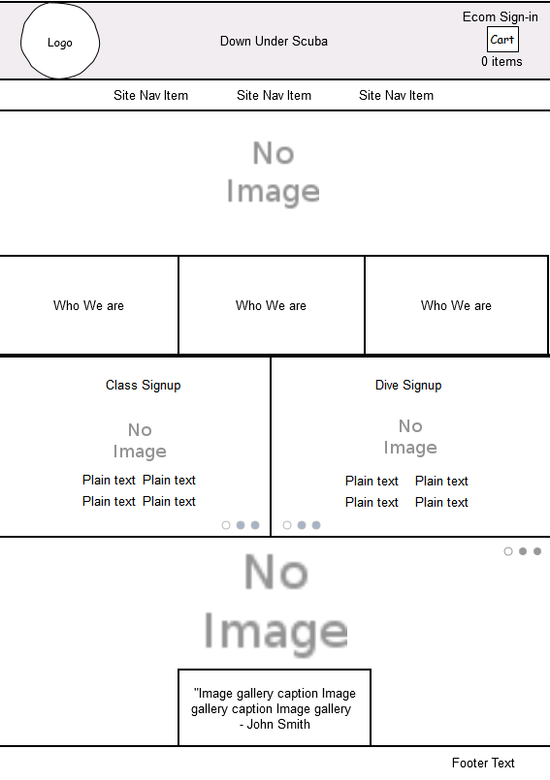

Slide 4
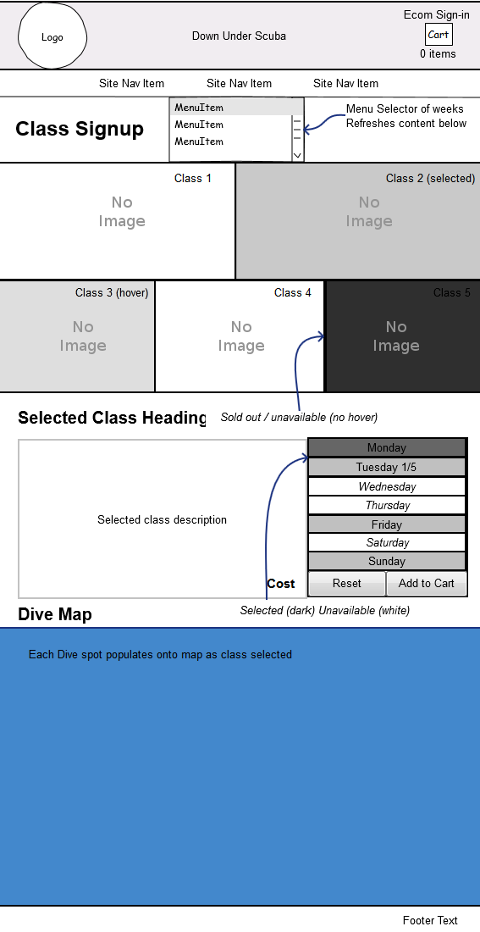

Slide 5
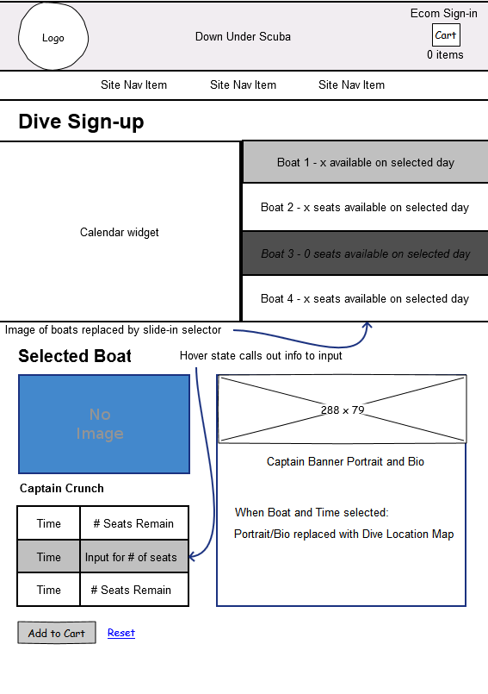

Slide 6
