Slide 1

FohBoh.ai
Certified Intelligence
Infrastructure
A deterministic trust layer for enterprise AI, agents, systems of record, and operational intelligence.
Seed: $500K @ $10M pre-money
Sentry launched as commercial wedge
Investor opening deck
01
FohBoh.ai | Confidential
© 2026 FohBoh.ai, Inc.
Notes:
Open with category, not product: FohBoh is building the trust layer under enterprise AI.
Sentry is proof of MGE in-market; the financing completes the infrastructure phase.

Slide 2
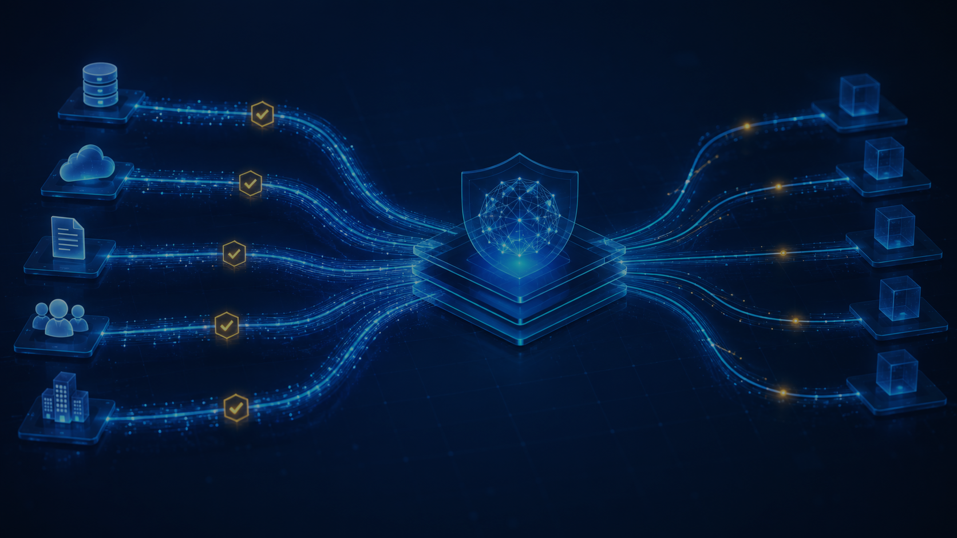
The thesis
Before AI can act safely, enterprises need certified business intelligence.
AI models are improving.
But the enterprise trust problem is not solved by better language generation.
FohBoh.ai certifies the facts, metrics, evidence, provenance, and rules that AI systems depend on before consequential decisions are made.
Not restaurant SaaS.
Not another dashboard.
Infrastructure for trusted AI.
02
FohBoh.ai | Confidential
© 2026 FohBoh.ai, Inc.
Notes:
The core thesis: better models do not certify business truth.
We govern the facts and metrics before AI, agents, or executives act on them.

Slide 3
Why now
The AI-agent adoption curve is steep. The governance layer is still immature.
17%
60%+
40%+
of organizations have deployed AI agents today
expect to deploy AI agents within two years
of agentic AI projects projected to be canceled by end of 2027
The opportunity is not another model. It is the missing enterprise infrastructure between unreliable business inputs and AI-driven decisions.
Sources: Gartner 2026 Hype Cycle for Agentic AI; Gartner June 25, 2025 agentic AI projects forecast.
03
FohBoh.ai | Confidential
© 2026 FohBoh.ai, Inc.
Notes:
Use Gartner as the timing hook: agent adoption is rising, but governance is the blocker.
The opportunity is the missing layer between messy enterprise data and AI decisions.

Slide 4
The problem
AI can reason over information. It cannot independently certify whether the information is true.
01
02
03
Data chaos
AI exposure
Enterprise risk
Different definitions, source systems, contracts, statements, time windows and owners.
A model can produce confident answers over incorrect, incomplete, or ungoverned inputs.
Without deterministic controls, agentic AI turns ambiguity into action.
The failure mode is not just hallucination. It is AI making consequential decisions from uncertified operational reality.
04
FohBoh.ai | Confidential
© 2026 FohBoh.ai, Inc.
Notes:
Make the problem concrete: enterprise data is fragmented, inconsistent, and often uncertified.
AI can amplify bad inputs into confident but wrong operational action.

Slide 5

Our answer: MGE
Metrics Governance Engine — deterministic certification infrastructure.
MGE sits between enterprise data and AI.
Defines the metric and its governing rules
Tests evidence, provenance and reconciliation
Produces certified intelligence objects
Creates auditability before AI action
From probabilistic outputs
to governed intelligence.
05
FohBoh.ai | Confidential
© 2026 FohBoh.ai, Inc.
Notes:
MGE is deterministic infrastructure, not another AI model.
It defines rules, tests evidence, certifies outputs, and creates auditability.

Slide 6
How the company scales
Sentry proves the engine. Cortex shows the AI experience. MGE becomes the infrastructure.
Sentry
Commercial wedge
Launched in restaurant operations to prove MGE functionality and create early revenue.
Cortex
Certified AI interface
AI answers and advice operate only on governed, certified intelligence.
Headless MGE
Infrastructure layer
APIs for systems of record, POS, BI, AI platforms and enterprise agents.
06
FohBoh.ai | Confidential
© 2026 FohBoh.ai, Inc.
Notes:
Explain the architecture simply: Sentry proves it, Cortex exposes it, MGE scales it.
Restaurants are the wedge; certified intelligence infrastructure is the company.

Slide 7
Where we are
Launched wedge. Focused charter program. Low-friction path to proof.
Now
Next 75 days
Sentry launched
25–50 charter customers
M01 + M02 modules use MGE to certify operational/financial intelligence and expose measurable discrepancies.
Charter pricing lowers sales resistance while generating customer proof, certification volume, revenue signal and reference accounts.
The objective is not to over-optimize early ARR. It is to prove the infrastructure in the field.
07
FohBoh.ai | Confidential
© 2026 FohBoh.ai, Inc.
Notes:
We are already in-market with Sentry and focused on charter customers.
The goal is proof: customers, certification volume, revenue signal, and reference accounts.

Slide 8
The financing ask
A small seed round to complete the infrastructure phase.
Production MGE
$500K
Scalable engine, certification pipeline, logs, API foundations.
at a $10M pre-money valuation
Sentry V2
Automation, stronger onboarding, faster certification cycles.
Cortex
Certified intelligence interface for customers and future enterprise use.
Milestone: many clients, measurable revenue growth and first reseller/strategic relationships.
Distribution
25–50 customers, early reseller / strategic partner conversations.
08
FohBoh.ai | Confidential
© 2026 FohBoh.ai, Inc.
Notes:
The $500K seed is a focused infrastructure round, not a vanity raise.
Capital converts the launched wedge into scalable MGE, Sentry V2, Cortex, and distribution.

Slide 9
Two paths forward
Financial seed capital, strategic acceleration — or both.
Path 1
Path 2
Angel capital
Strategic partner
Complete MGE, expand Sentry, launch Cortex, demonstrate repeatable customer economics, then raise a larger institutional round from strength.
Align with a company that already owns enterprise data, POS, BI, systems-of-record distribution, or AI infrastructure and needs a trust layer.
The right investor understands that infrastructure value appears before infrastructure monetization is obvious.
09
FohBoh.ai | Confidential
© 2026 FohBoh.ai, Inc.
Notes:
There are two viable paths: angel capital or strategic acceleration.
The right partner understands infrastructure value before monetization is fully obvious.

Slide 10
The first question is not ARR.
The first question is whether AI can be trusted to act on uncertified business intelligence.
FohBoh.ai built the deterministic layer for that answer.
Ask: 30 minutes to discuss the category, the architecture, and the financing path.
10
FohBoh.ai | Confidential
© 2026 FohBoh.ai, Inc.
Notes:
Close by reframing diligence: ARR matters, but category fit comes first.
Ask for 30 minutes to evaluate the trust-infrastructure thesis and financing path.

Slide 11
Source notes
Use selectively; keep this slide as appendix if presenting live.
Gartner, 2026 Hype Cycle for Agentic AI: 17% deployed AI agents today; more than 60% expect deployment within two years.
Gartner, June 25, 2025: over 40% of agentic AI projects projected to be canceled by end of 2027 due to cost, unclear value or inadequate risk controls.
Gartner, May 11, 2026: lack of semantics causes inaccurate AI agents and wasted spending; agents require input context throughout workflows.
Gartner, May 26, 2026: 40% of enterprises forecast to demote or decommission autonomous AI agents due to governance gaps after production incidents.
Deck positioning based on FohBoh.ai / MGE / Sentry / Cortex / Intelligence Under Management strategy materials.
11
FohBoh.ai | Confidential
© 2026 FohBoh.ai, Inc.
Notes:
Keep this as backup, not a main presentation slide.
Use only if someone asks for source support behind the AI-agent and governance claims.

Slide 12
FohBoh.ai
Contact
For financing, strategic-partner, and investor follow-up.
Michael L. Atkinson
CEO, Bailiwick Ventures
michael@bailiwickventures.com
(650) 206-8405
Certified Intelligence Infrastructure
© 2026 FohBoh.ai, Inc.

Slide 13
FohBoh.ai
See the Headless Pilot in Action
© 2026 FohBoh.ai, Inc.

