Slide 1
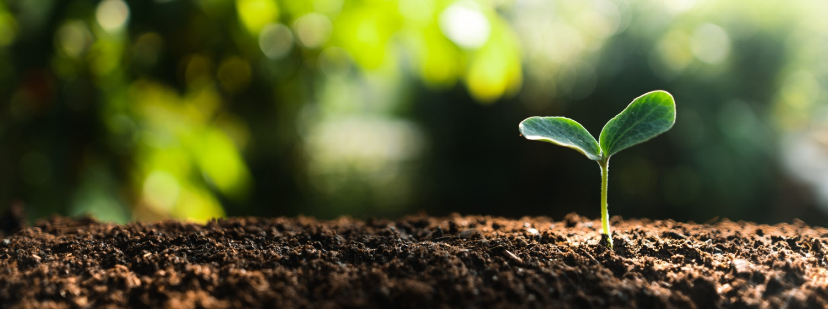
SOIL SCIENCE
AUTHOR
MUHAMMAD FOIJUL IKRAM CHOWDHURY
ROLL: 01-O35-05
UNIVERSITY OF BARISHAL

Slide 2
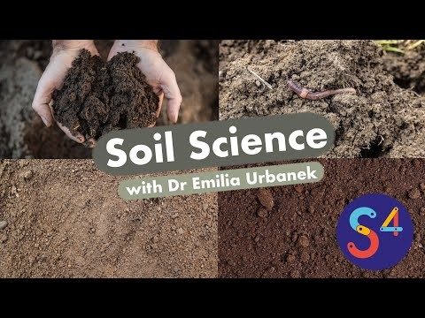
WHAT IS SOIL SCIENCE?
“The science dealing with soil as a natural resource on the surface of the earth, including Pedology (soil genesis, classification and mapping), physical, chemical, biological and fertility properties of soil and these properties in relation to their management for crop production.”
.”

Slide 3
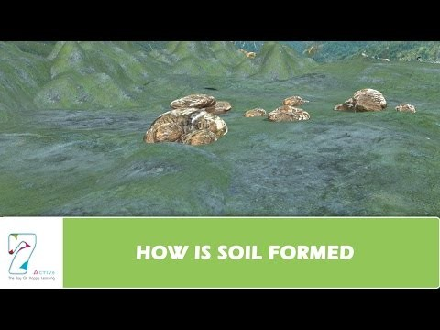
SOIL FORMATION PROCESS
Firstly, the parent rock is weathered and the broken up inorganic materials accumulate in situ, or the weathered particles are carried from some other place and deposited where the soil is to be formed.
In the second stage, vegetable or animal remains decay by heat and moisture and are further decomposed by the soil microorganisms to form the organic matter or humus in the soil.
Lastly, the inorganic particles and the organic matter then organic matter then get mixed up in three main ways: eluviation, leaching, Burrowing animals like worms, crickets and bush rats pulverize the earth or physically transport one part of the earth to another. This mixing up finally produces the soil.

Slide 4
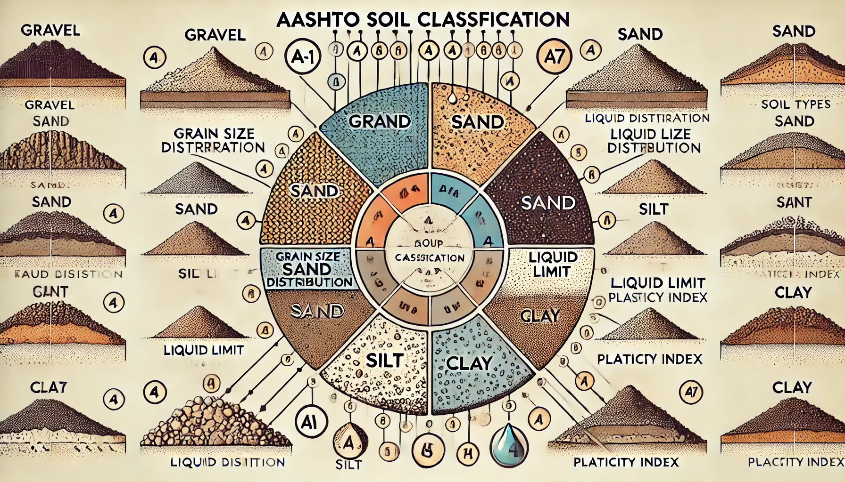
SOIL CLASSIFICATION SYSTEMS
Soil classification deals with the systematic categorization of soils based on distinguishing characteristics as well as criteria that dictate choices in use.

Slide 5
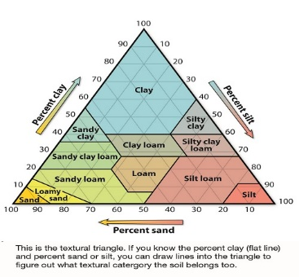
SOIL PHYSICAL PROPERTIES
Physical properties of soil include color, texture, structure, porosity, density, consistence, aggregate stability, and temperature. These properties affect processes such as infiltration, erosion, nutrient cycling, and biologic activity. These properties also affect suitability of soil for different uses, such as stormwater infiltration, subgrade for roads, and strength for building.

Slide 6
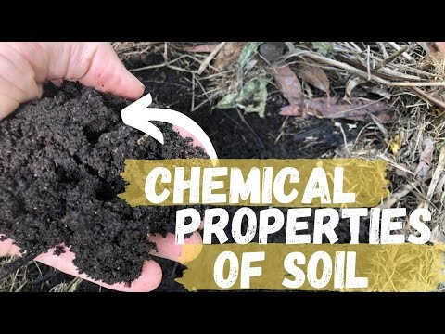
SOIL CHEMICAL PROPERTIES
Chemical properties of soils include the following aspects: inorganic matters of soil, organic matters in soil, colloidal properties of soil particles and soil reactions and buffering action in acidic soils and basic soils. The chemical side of a soil is extremely important of course and is about the correct balance of the available nutrients in the soil. This is largely determined by the organic-matter content and its humus percentage; this is the ‘store house’ of nutrients on any farm. The extent to which minerals have a dominant presence or not, affects the release of specific nutrients. Supplementing shortages is important, but the right balance is even more important. The soil only produces nutrients if you have the right balance. Chemical and physical properties impact biological properties. Optimal chemical and physical properties will lead to optimal biological properties and soil functions i.e. nutrient and water cycling.

Slide 7
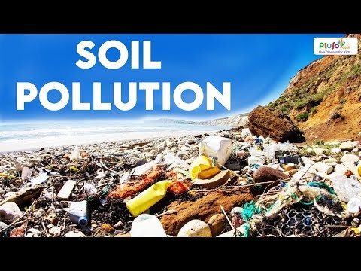

SOIL POLLUTION AND REMEDIATION
Soil pollution refers to the contamination of soil with anomalous concentrations of toxic substances. It is a serious environmental concern since it harbours many health hazards. For example, exposure to soil containing high concentrations of benzene increases the risk of contracting leukaemia.
Soil remediation is the process that uses to remove, degrade contaminants/pollutants to achieve soil for vegetation and a healthy ecosystem. It is a crucial process to understand based the soil nature, its organic matter, biological diversity.

Slide 8

APPLICATIONS OF SOIL SCIENCE IN AGRICULTURE
Soil sciences promote sustainable agriculture by advising on crop rotation, cover cropping, and reduced tillage, which improve soil health and reduce environmental impact.
Soil borne pathogens can harm crops. Soil scientists research and develop methods for disease management and prevention.

Slide 9
THANK YOU FOR WATCHING

