Slide 1
Sizzle引擎研究
By zhangpeng12@baidu.com

Slide 2
什么是sizzle
A pure-JavaScript CSS selector engine (power jQuery)
Standalone(no dependencies)
Competitive performance
Only 4kB with gzipped
Easy to use
Css3 support
Bla bla ……

Slide 3
为什么需要sizzle
Bugs
1. Id
IE<=8不区分大小写，混淆iuput的name和id
2. class
IE getAttribute ，混淆html的attribute和dom的property
非IE getElementsByClassName
3.Tag
getElementsByTagName(*)混淆注释节点
性能
考虑如下选择器：
div.container li:last-of-child a,div.container ul+a
var mySelector = function(){
bla bla…….
There gone be at least 100 lines here…….
bla bla…….
}

Slide 4
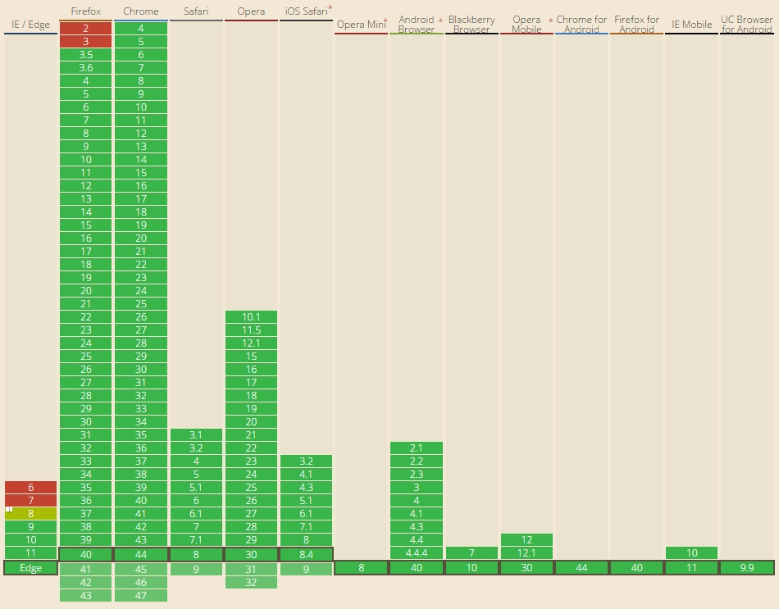
高版本浏览器(querySelector)

Slide 5
Sizzle概览
词法解析
过滤函数
种子集
结果集
编译函数匹配

Slide 6
词法解析
词法分析器又称扫描器，词法分析是指将我们编写的文本代码流解析为一个一个的记号，分析得到的记号以供后续语法分析使用
{matches: ["div"],type: "TAG",value: "div“ },
{matches: ["aaron"], type: "CLASS", value: ".aaron"},
{match:[“”], type: " ", value: " "},
{matches: ["input"], type: "TAG", value: "input"},
{matches: ["name"], type: "ATTR", value: "[name=ttt]"}
div.aaron input[name=ttt]

Slide 7
词法解析(模式)
分组(,) | /^[\x20\t\r\n\f]*,[\x20\t\r\n\f]*/
层级关系( >+~) | /^[\x20\t\r\n\f]*([>+~]|[\x20\t\r\n\f])[\x20\t\r\n\f]*/
单个元素处理 Id Tag Class Attribute …… | var characterEncoding = "(?:\\\\.|[\\w-]|[^\\x00-\\xa0])+" var ID = new RegExp("^#(" + characterEncoding + ")") var TAG = new RegExp( "^(" + characterEncoding.replace( "w", "w*" ) + ")" ) var Class = new RegExp( "^\\.(" + characterEncoding + ")" ) …….

Slide 8
词法解析(代码)
while (selector) {
//分组
if (match = rcomma.exec(selector)) {
selector = selector.slice(match[0].length)
groups.push((tokens = []));
}
//层级关系
if ((match = rcombinators.exec(selector))) {
matched = match.shift();
tokens.push({
value: matched,
type: match[0].replace(rtrim, " ")
});
selector = selector.slice(matched.length);
}
//选择器
for (type in matchExpr) {
if ((match = matchExpr[type].exec(selector))) {
matched = match.shift();
tokens.push({
value: matched,
type: type,
matches: match
});
selector = selector.slice(matched.length);
}
}
}
//分组
var rcomma = /^[\x20\t\r\n\f]*,[\x20\t\r\n\f]*/;
//层级
var rcombinators =
/^[\x20\t\r\n\f]*([>+~]|[\x20\t\r\n\f])[\x20\t\r\n\f]*/
//选择器
var TAG = /^((?:\\.|[\w*-]|[^\x00-\xa0])+)/;
var matchExpr = {
CLASS: /^\.((?:\\.|[\w-]|[^\x00-\xa0])+)/,
TAG: /^((?:\\.|[\w*-]|[^\x00-\xa0])+)/
}

Slide 9
过滤函数
//各种类型的token的过滤器，全部返回闭包函数
Expr.filter = {
ATTR : function (name, operator, check) {return function}
CHILD : function (type, what, argument, first, last) {return function}
CLASS : function (className) {return function}
ID : function (id) {return function}
PSEUDO : function (pseudo, argument) {return function}
TAG : function (nodeNameSelector) {return function}
}
//tag类型的过滤器，判断nodeName是否匹配，返回闭包函数
TAG: function(nodeNameSelector) {
return function(elem) {
return elem.nodeName && elem.nodeName.toLowerCase() === nodeNameSelector;
};
}

Slide 10
结果集
TAG过滤
div.aaron input[name=ttt]
div.aaron [name=ttt]
Input标签种子集合
{ matches: ["div"],type: "TAG",value: "div“ },
{matches: ["aaron"], type: "CLASS", value: ".aaron"},
{match:[“”], type: " ", value: " "},
{matches: ["input"], type: "TAG", value: "input"},
{matches: ["name"], type: "ATTR", value: "[name=ttt]"}
{ matches: ["div"],type: "TAG",value: "div“ },
{matches: ["aaron"], type: "CLASS", value: ".aaron"},
{match:[“”], type: " ", value: " "},
{matches: ["name"], type: "ATTR", value: "[name=ttt]"}
Token集简化

Slide 11
编译原理
过滤后的token集
{ matches: ["div"],type: "TAG",value: "div“ },
{matches: ["aaron"], type: "CLASS", value: ".aaron"},
{match:[“”], type: " ", value: " "},
{matches: ["name"], type: "ATTR", value: "[name=ttt]"}
过滤后的选择器
div.aaron [name=ttt]
超级匹配函数
function(){
层次很深的闭包…..
}
过滤函数
Expr.filter = {
ATTR : function (name, operator, check) {return function}
CHILD : function (type, what, argument, first, last) {return function}
CLASS : function (className) {return function}
ID : function (id) {return function}
PSEUDO : function (pseudo, argument) {return function}
TAG : function (nodeNameSelector) {return function}
}

Slide 12
编译过程
遇到关系token(+> ~)则依次出栈合并匿名函数，其他情况压入对应的token处理函数
选择器表达式
div [name=ttt]
( )[name=ttt]
[name=ttt]
超级匹配器
Function(elem){
//tag filter
}
Function(elem){
elem=elem[‘parentNode’];
return Function(elem){
tag filter
}
}
Function(elem){
//attribute filter
}
Function(elem){
while(matcher=matchrs.pop()){
if(!matcher(elem)){
return false;
}
}
return true;
}
Function(elem){
elem=elem[‘parentNode’];
return Function(elem){
//tag filter
}
}
Matchers集合

Slide 13
超级匹配器
for item in seed
if(superMatcher(item )){
resultSet.push(item);
}
return resultSet

Slide 14
Thanks & Regards

