Slide 1
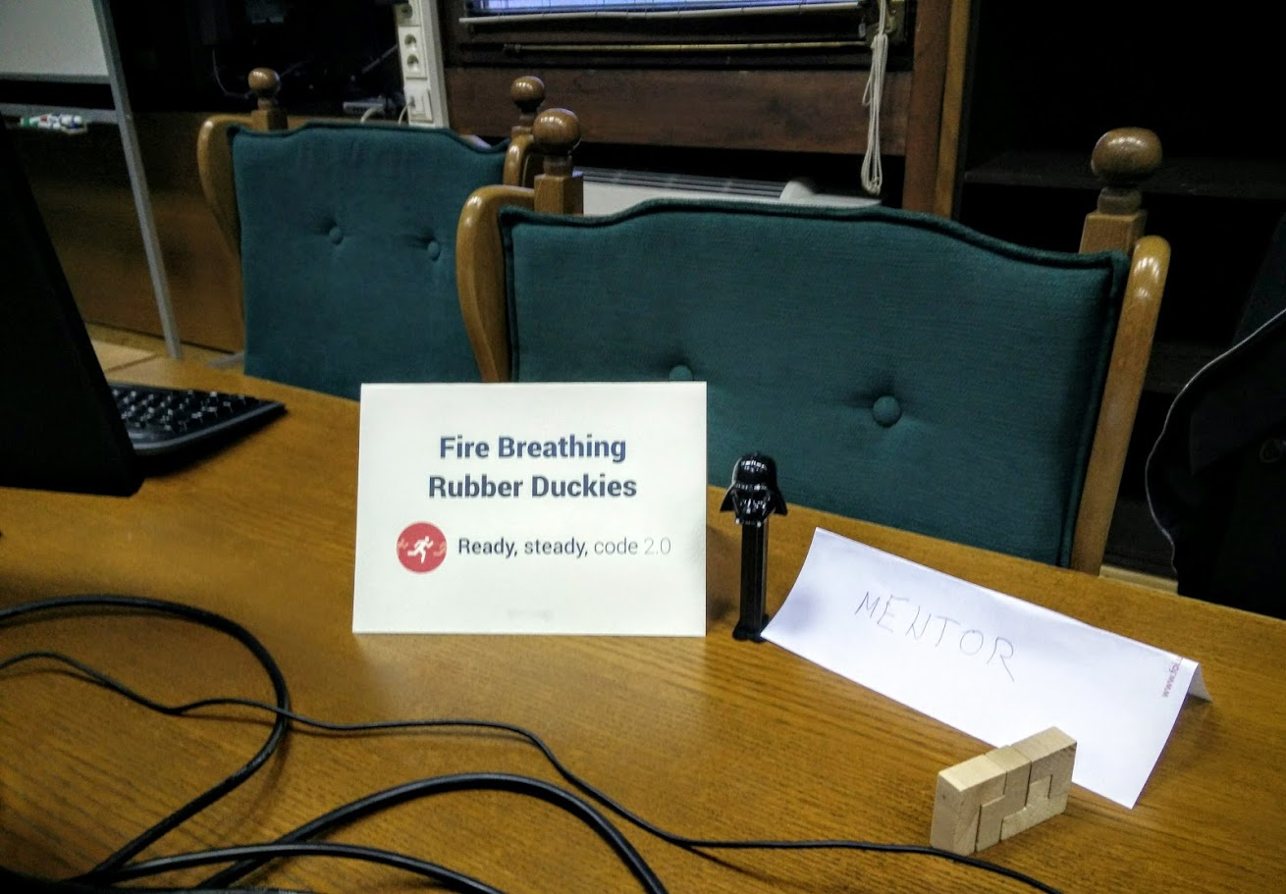

Slide 2
Come Shoot

Slide 3
Complex stuff
Android SDK
GCM
Android client
WebRTC
Google Login
Facebook Login
SASS
WebPack & Bubble
Web client
Angular JS
Leaflet API
Gulp
.NET Web API
GCM
Server
nodeJS
WebRTC
S3 Integration

