Slide 1
Code for Harambe
Filip Aleksić
Ante Barić
Sven Vukelić
Tomislav Vunak

Slide 2
Idea
Our idea was to make something cool
We had our eye on application performance
Did we do it?
…

Slide 3
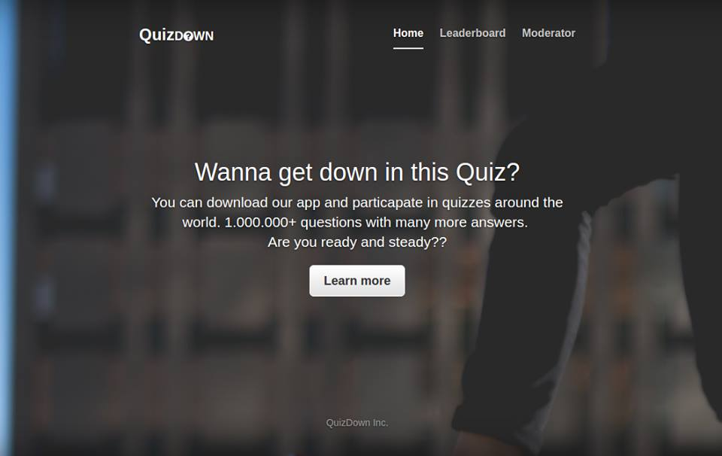

Slide 4
Used technologies
Backend: ASP.NET MVC Web Api 2, SQL Server
Frontend: Angular, Node JS, Typescript, Bootstrap
Mobile: Android, Firebase

Slide 5
Implemented functionalities
Social Login
Events management
Questions management
Answers management
Results view
Leaderboard
Question timer
Firebase – Notifications, Synchronization (Web-only)

Slide 6

Hands on?

