Slide 1
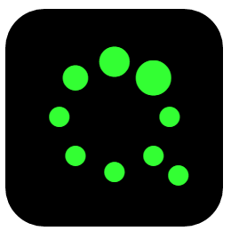
Quisar
Evil Geniuses For A Better Tomorrow

Slide 2
Main functionalities
Notifications from Android app
Smart Watch App
Live Video
Shop & Rewards

Slide 3
Powered By
NodeJS
Bootstrap
jQuery
Java
FireBase
PHP

Slide 4
Notable Mentions
Amazon Web Services
Domain.com
Pebble

