Slide 1
CEREBRO
knowledge = null, balls = full

Slide 2
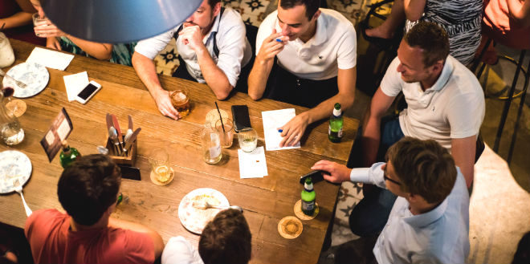
Application details
Free and public application
For use in pubs for organizing fun quizzes
Aimed users are pub guests

Slide 3





Technologies used
Bootstrap
JavaScript
AngularJS
NodeJS
Firebase

Slide 4
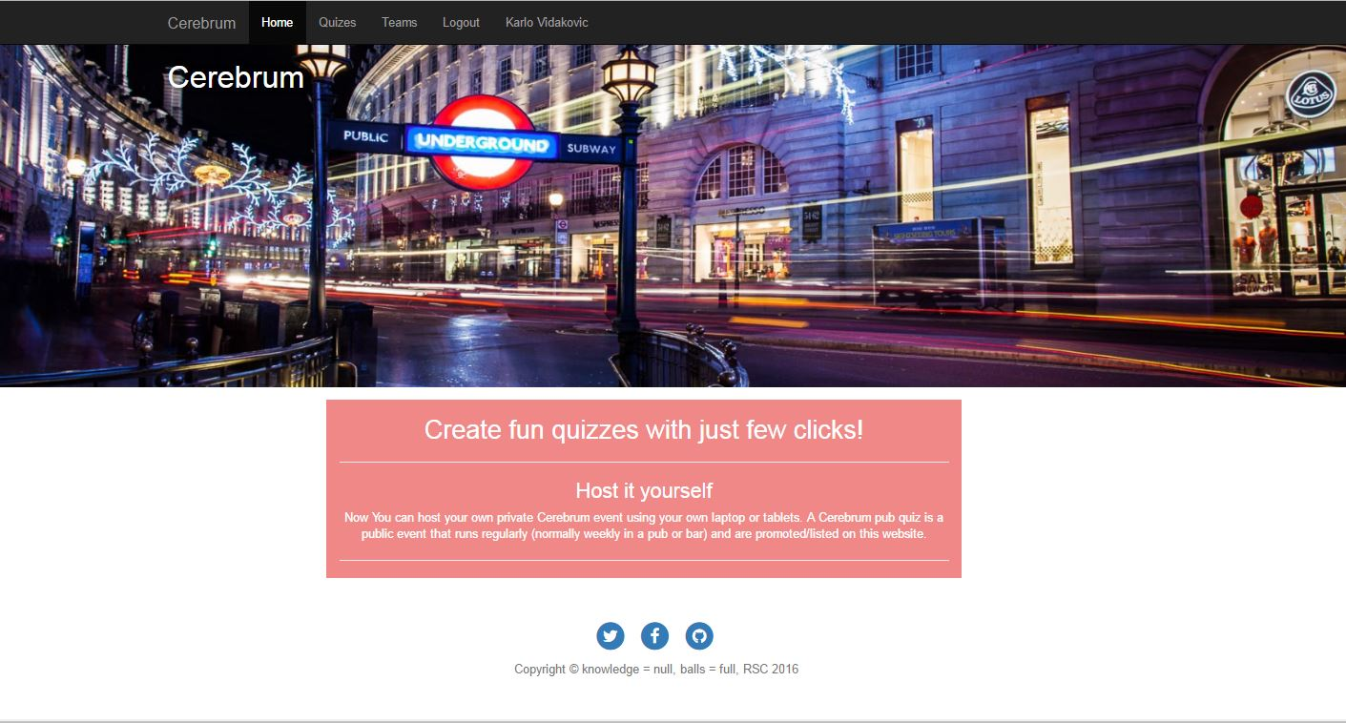
Application details
Web application for pub quizzes
Three way social login
Player profile & new quiz creation (event)

Slide 5
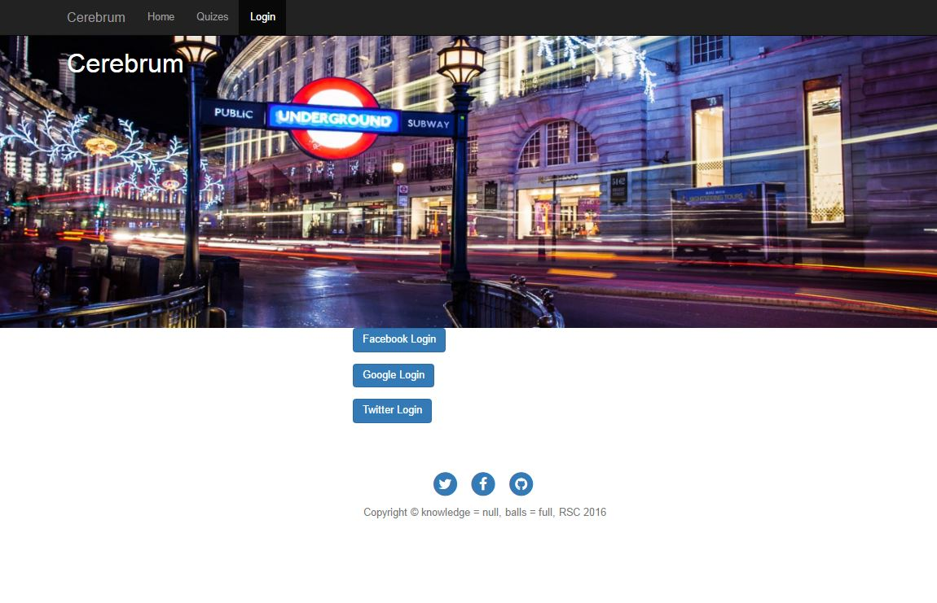
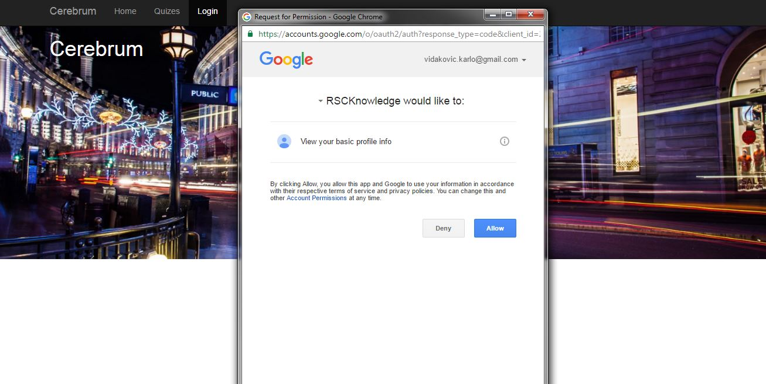

Slide 6
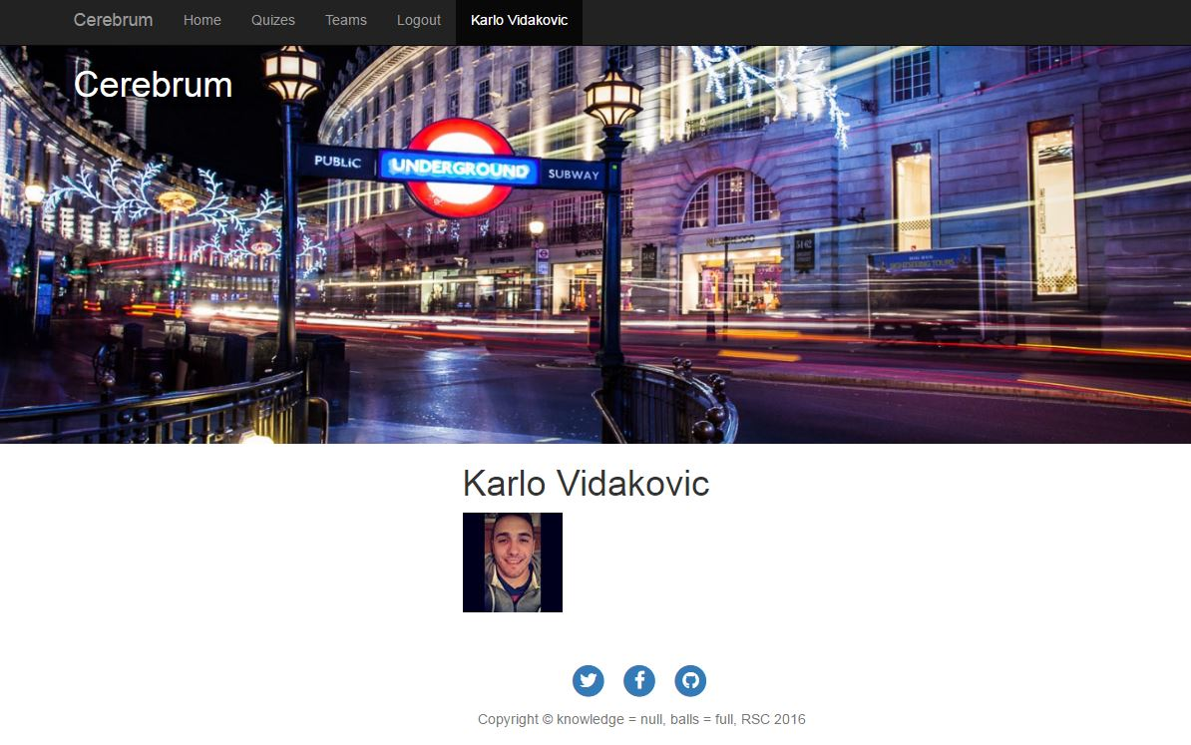
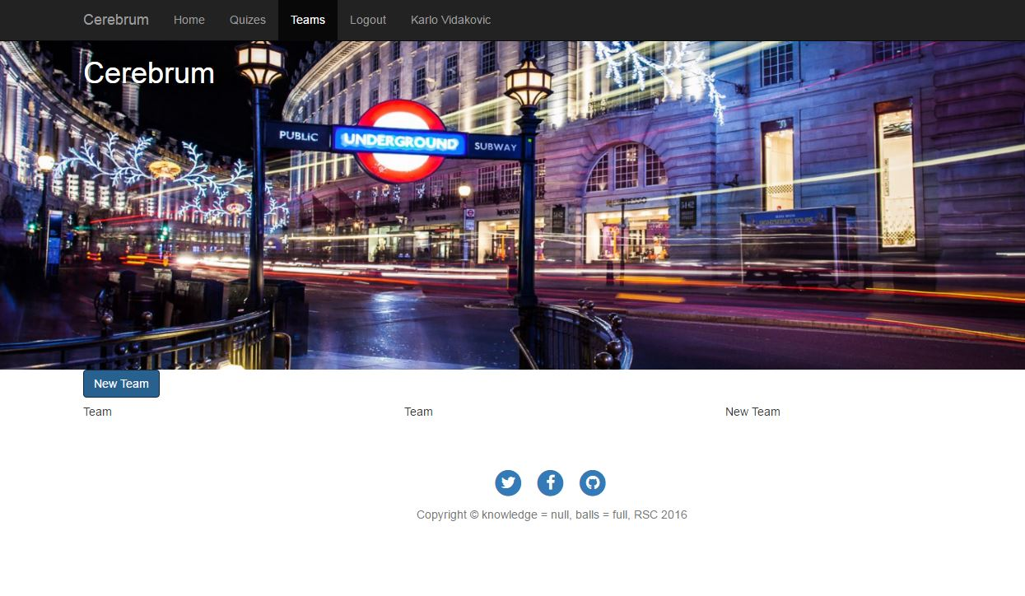

Slide 7
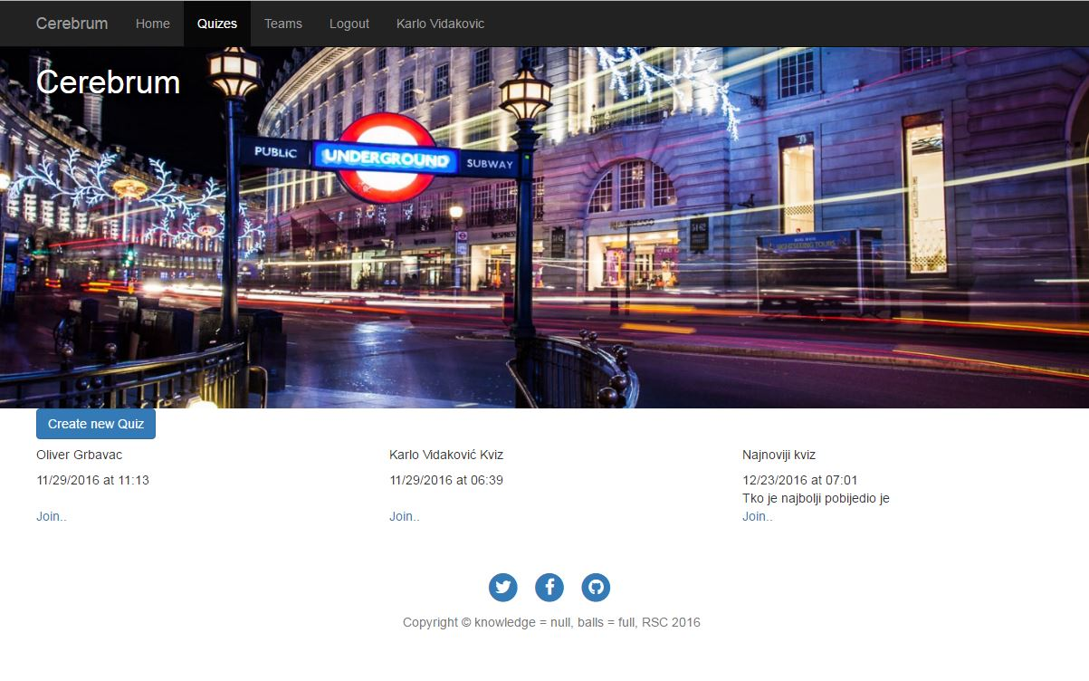
Quiz creation and list of quizzes

Slide 8
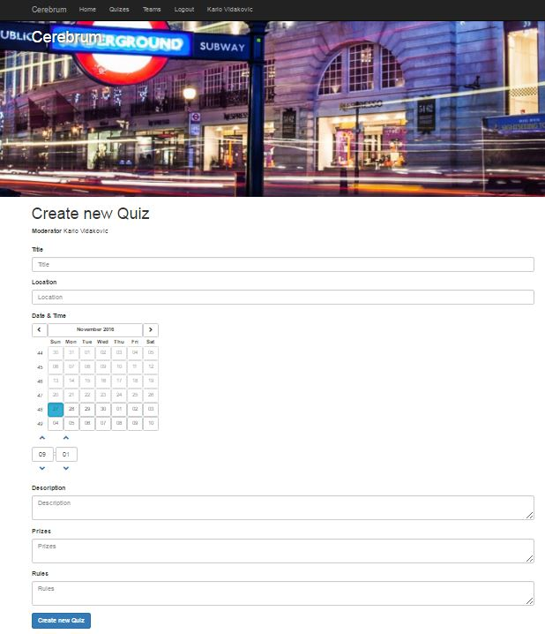

Slide 9


