Slide 1
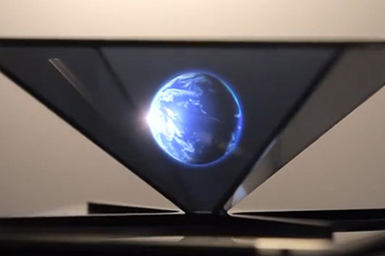
HOLOGRAM-DEVELOPING WITH A JAVA APP
BY
FANTASTIC FOUR

Slide 2

WHAT IS HOLOGRAPHY???
Holography is a photographic technique that records the light scattered from an object, and then presents it in a way that appears three-dimensional.

Slide 3
_{HOW HOLOGRAPHY WORKS??}

Slide 4
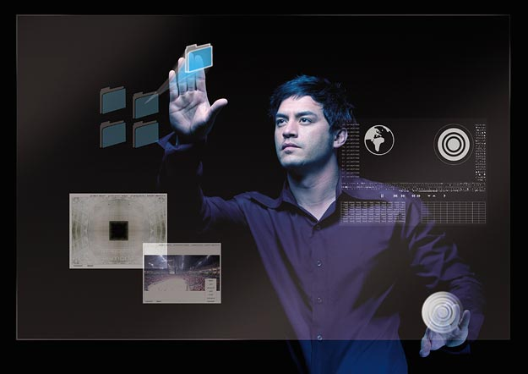
HOW ARE HOLOGRAMS RELATED TO COMPUTER???

Slide 5
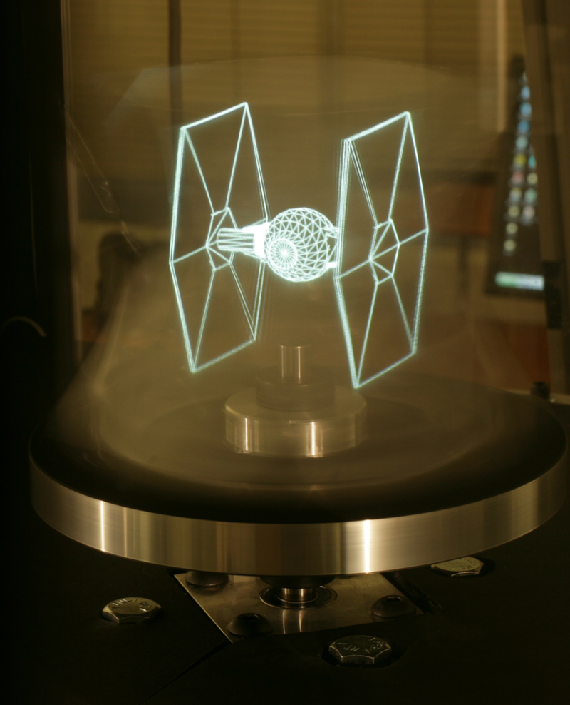
Computer Generated Holograms
Computer Generated Holography (CGH) is the method of digitally generating holographic interference patterns.
A holographic image can be generated e.g. by digitally computing a holographic interference pattern and
Printing it onto a mask or film for subsequent illumination by suitable coherent light source.
Alternatively, the holographic image can be brought to life by a holographic 3D display
(a display which operates on the basis of interference of coherent light), bypassing the
need of having to fabricate a "hardcopy" of the holographic interference pattern each time.

Slide 6
WHAT IS THE DIFFERENCE BETWEEN HOLOGRAPHY AND PHOTOGRAPHY???
Photography
---Records intensity distribution of light .
Does not record direction.
Two-dimensional image.

Holography = “whole + writing”
---Records intensity & direction of light.
Information in interference pattern.
Reconstruct image by passing original light
through hologram.
*Need laser so that light interferes.

Slide 7
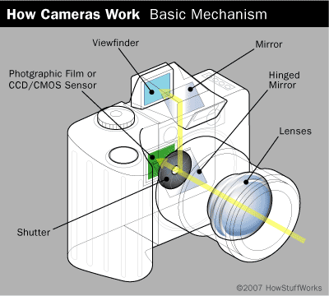
What happens when a photo is taken:
1) The shutter opens.
2) Light passes through a lens and hits the photographic emulsion on a piece of film.
3) Silver halide reacts with the light and records its amplitude as it reflects off of the scene.
4) The shutter closes.

Slide 8



WANT TO MAKE YOUR OWN HOLOGRAM???????
IS IT POSSIBLE?????
IS IT SIMPLE?????
CAN HOLOGRAM BE MADE BY JUST USING A PHONE????

Slide 9

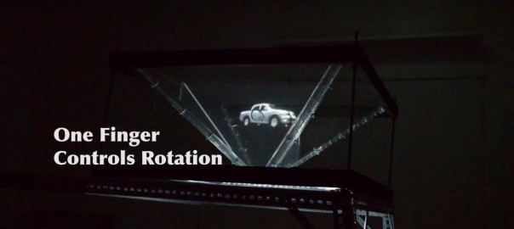
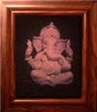
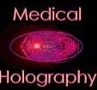
SECURITY
COMPUTER FIELD
HOLOGRAPHIC APPLICATIONS
MEDICAL USES
VIRTUAL DISPLAYS

Slide 10
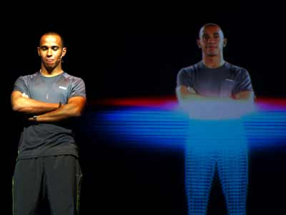
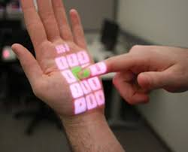
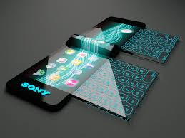
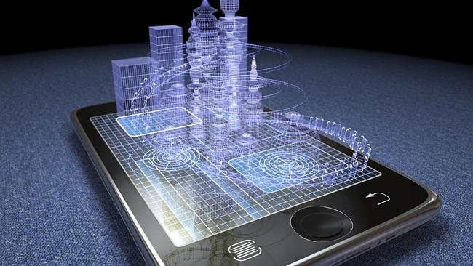
Formula 1 driver Lewis Hamilton of Great Britain stands next to a 3D hologram during the Reebok launch of their new Smooth Fit technology.
One day we will be able to hologram our phones on our hand. Also we could hologram our keypads. Isn’t this amazing??

Slide 11
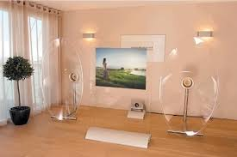
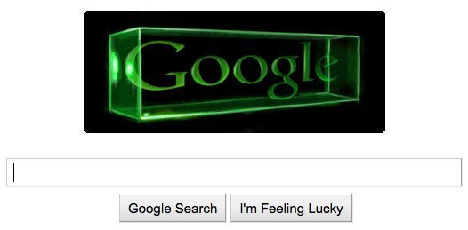
Holography in Entertainment

Slide 12
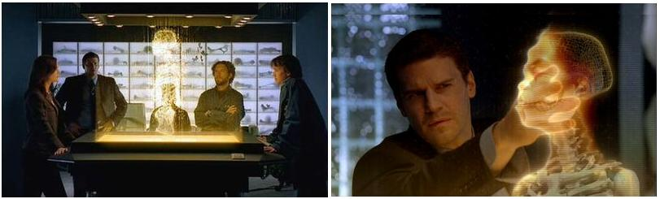
Holography in Medicine

Slide 13
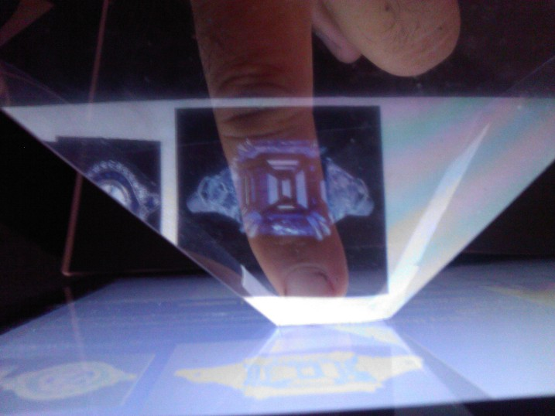
HOLOGRAPHY IN E-BUISNESS

Slide 14
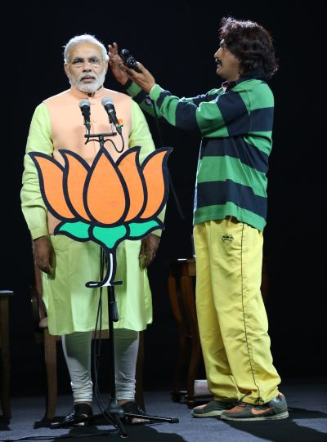
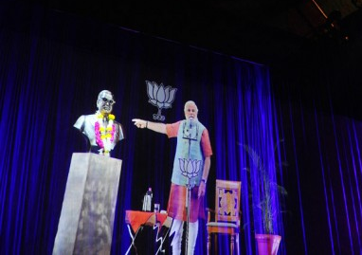
OUR RESPECTED PRIME MINISTER MR. NARENDRA MODI USED COMPUTER GENERATED HOLOGRAMS BEFORE THE ELECTIONS WHICH HELPED HIM TO CONNECT WITH COMMON PEOPLE EFFECTIVELY.

