Slide 1
MENTOR REVIEW READY
Mythos Aegis
AI Security + RAG Demo Platform
Final submission scope
Release status
FastAPI backend + Next.js admin dashboard
Supabase/Postgres with pgvector RAG
JWT, RBAC, SQL Airlock, Vision fallback
Main branch pushed and clean
GitHub Actions green
Ruff, Mypy, Pytest 970+ passing
Repository: https://github.com/fokrulanthro16-eng/mythos-aegis-v2
Mythos Aegis • Final Demo Package
01

Slide 2
Architecture Overview
Clear separation between API, admin console, database, retrieval, and providers
Next.js Admin Frontend
Request flow
Dashboard, live feed, RAG UI, Vision Analyze UI
User actions start in the admin console
JWT and RBAC validate access before sensitive operations
SQL Airlock blocks unsafe database queries
RAG pipeline retrieves relevant chunks and returns citations
Vision factory routes to fallback mode unless Gemini is configured
FastAPI Backend
/health, /status, auth, RBAC, SQL Airlock, RAG/vision endpoints
Supabase + pgvector
Postgres storage, vector embeddings, retrieval-ready knowledge base
Providers
Vision fallback mode by default; Gemini optional via API key
Mythos Aegis • Final Demo Package
02

Slide 3
Completed Capabilities
The release package focuses on verified, mentor-demo-ready functionality
Security Controls
RAG System
Demo + Ops
JWT authentication
RBAC permissions
SQL Airlock query blocking
Rate-limit and event feed evidence
PDF upload support
Supabase pgvector integration
Retrieval pipeline
RAG ask endpoint with citations
/health and /status endpoints
Admin dashboard
Vision fallback analyze
CI and test evidence
Mythos Aegis • Final Demo Package
03

Slide 4
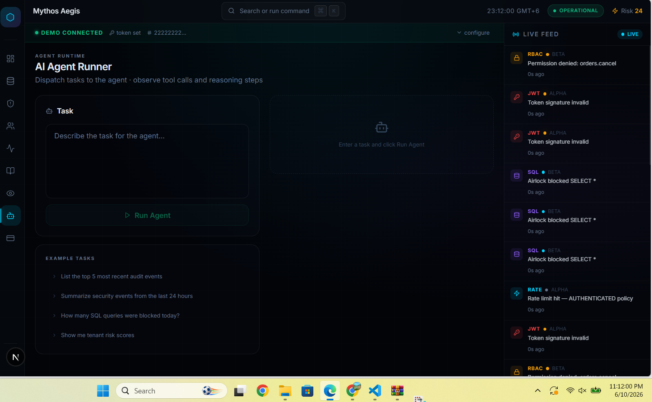
Admin Dashboard + Live Security Feed
Operational UI showing security events in real time
DEMO CONNECTED
JWT • RBAC • SQL
OPERATIONAL
Mythos Aegis • Final Demo Package
04

Slide 5
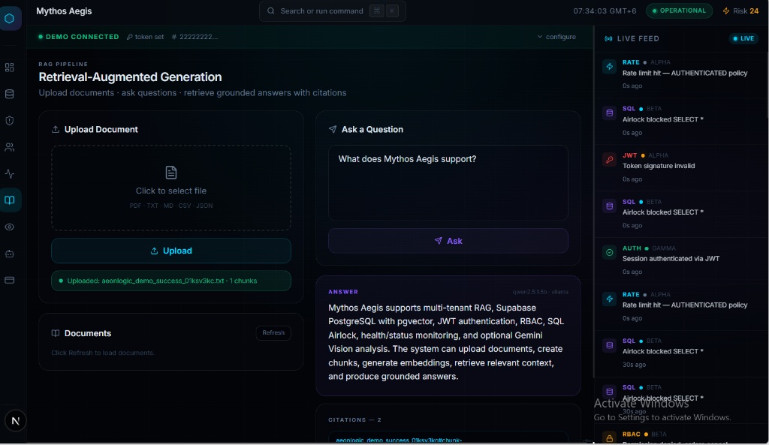
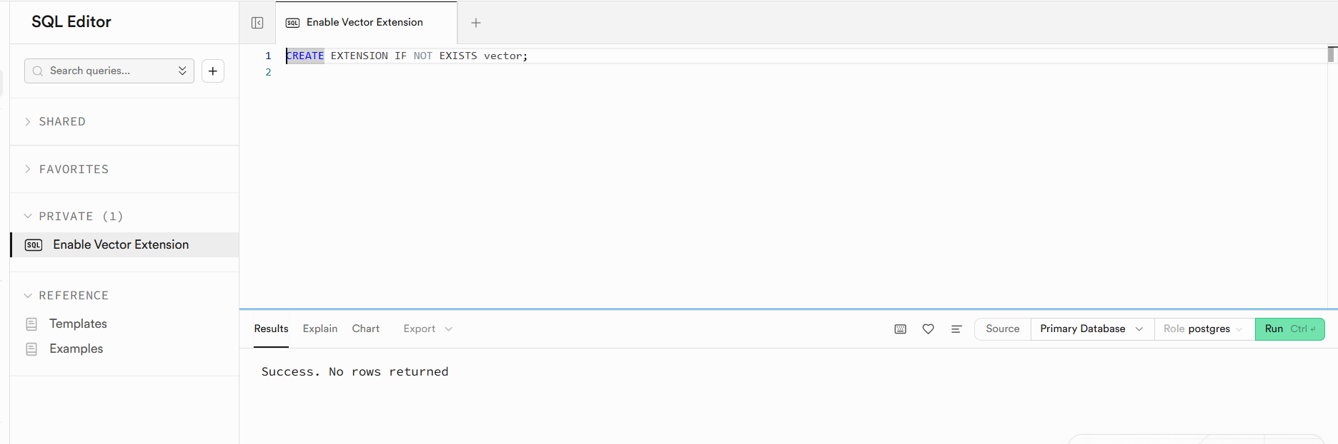
RAG Pipeline Evidence
Upload, retrieve, ask, and cite source chunks
RAG answer with citations
Supabase pgvector setup
Evidence confirms PDF/RAG workflow and pgvector-backed retrieval are documented for the demo.
Mythos Aegis • Final Demo Package
05

Slide 6
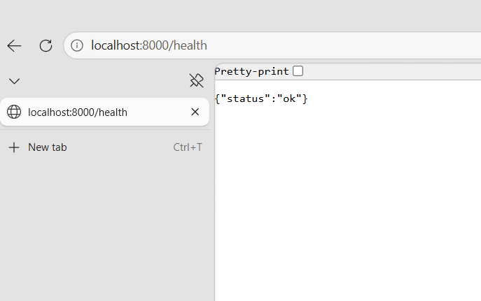
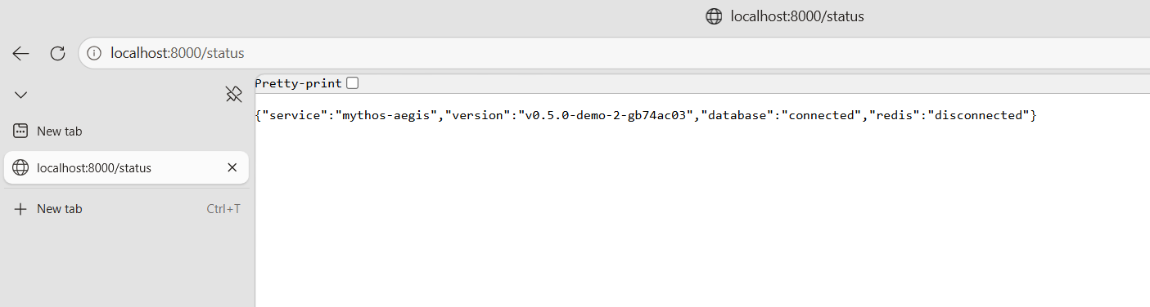
Operational Endpoints
Core service checks documented and screenshot-backed
/health
/status
Mythos Aegis • Final Demo Package
06

Slide 7
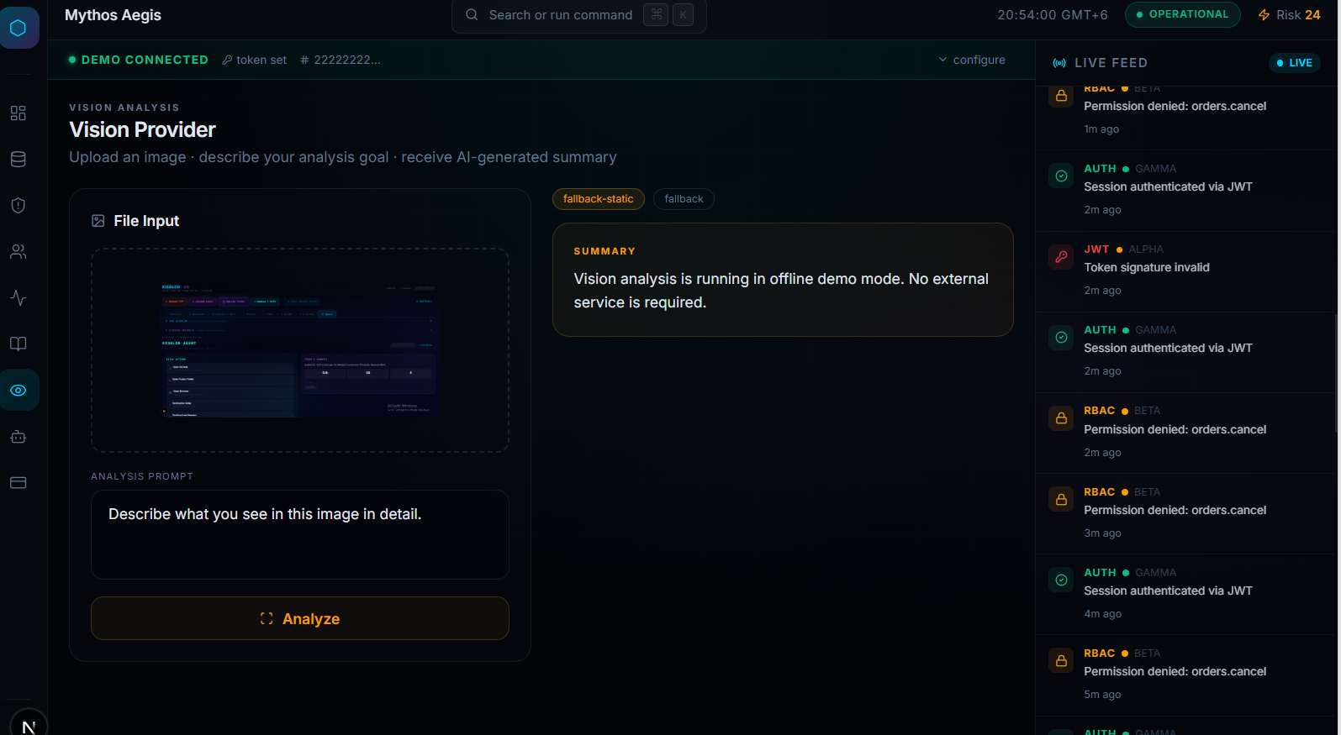
Vision Analyze Fallback Mode
Demo-safe vision provider without external API dependency
Vision Analyze result
Why fallback matters
No GEMINI_API_KEY required for offline demo
Avoids old Ollama 404 issue
VISION_PROVIDER=fallback is documented
Still shows the complete Vision Analyze flow
Mythos Aegis • Final Demo Package
07

Slide 8
Quality + Release Readiness
Final package is backed by CI, tests, screenshots, and documentation
970+
PASS
PASS
GREEN
Pytest passing
Ruff
Mypy
GitHub Actions
Release readiness review
Final recommendation: READY
No WARN items and no FAIL items
Working tree clean and main synced with origin/main
Mythos Aegis • Final Demo Package
08

Slide 9
Final Submission Package
Files included in the repository for mentor review and demo preparation
README.md
Architecture, setup, features, screenshots, test evidence
FINAL_SUBMISSION_REPORT.md
Completed scope and release readiness result
DEMO_SCRIPT.md
3-minute read-aloud demo video script
MENTOR_DEMO_CHECKLIST.md
Before/live/evidence/backup/final checklists
MENTOR_EMAIL.md
Concise submission email draft
Mythos Aegis • Final Demo Package
09

Slide 10
3-Minute Demo Flow
Recommended order for the recorded presentation
0:00–0:20
Intro
Mythos Aegis purpose and scope
0:20–0:50
Architecture
FastAPI, Next.js, Supabase pgvector, providers
0:50–1:25
Security
JWT, RBAC, SQL Airlock, live feed
1:25–2:10
RAG
Upload/retrieve/ask with citations
2:10–2:35
Vision
Fallback analyze result
2:35–3:00
Close
CI/test evidence and mentor-review readiness
Close line: “The project is release-ready and mentor-review ready.”
Mythos Aegis • Final Demo Package
10

