Slide 1
IS CYBERNEXT 2026 · CYBERSECURITY TRACK
ReverseShield
Reverse-Engineering Exposure Workbench
“See what your build reveals — before an attacker does.”
Local
Static-only
Evidence, not a verdict
Naser · Zayed · Nomai · Faisal
Four-person student team · working prototype, built and tested locally
DRAFT — owner review · not for submission
ReverseShield 0.5.0-team 01
Notes:
Open with the problem, not the product: a compiled program is a readable document. ReverseShield is a local, static workbench that shows what a build exposes and measures what a change actually removed. Everything in this deck comes from recorded evidence.

Slide 2
THE PROBLEM
A shipped binary is a readable document
▸ Symbols, debug information, build paths and plaintext messages often survive release.
▸ An attacker starts from the binary — no source code required.
▸ Ghidra-class decompilers recover structure, constants and readable logic.
▸ Teams rarely see their own build the way an attacker does.
WHAT A BUILD CAN LEAK
$ strings app
/home/dev/policy-engine/…
"tenant is not set"
"blocked by policy flag"
$ readelf -s app
35 symbol-table entries
.debug_info present
$ ghidra
policy_allows() reconstructed
Not a hypothetical: the original Level 5 sample showed exactly these artefacts.
DRAFT — owner review · not for submission
ReverseShield 0.5.0-team 02
Notes:
The Level 5 sample is self-authored and intentionally realistic. In its original build: 35 ELF symbol entries, debug information present, source paths and six policy messages in plaintext, and readable decompiled logic. This is the exposure the workbench measures.

Slide 3
WHY NOW
Existing tools answer different questions
Packers & obfuscators
Vulnerability scanners
Manual Ghidra work
Claim protection. Rarely show what an analyst can still recover.
Return CVE/CWE verdicts — not binary exposure evidence.
Powerful, but expert-only, ad hoc and hard to reproduce.
The gap: a safe, repeatable way to see binary exposure, change a copy, and verify what the change removed — without executing the target.
DRAFT — owner review · not for submission
ReverseShield 0.5.0-team 03
Notes:
This is the positioning. We do not claim to out-protect commercial packers or to replace a vulnerability scanner. The contribution is measurement: exposure evidence and a bounded before/after comparison, reproducible on a laptop.

Slide 4
THE IDEA
Analyze → transform a copy → reanalyze → compare
1
2
3
4
5
Select
Analyze
Transform
Reanalyze
Compare
→
→
→
→
ELF/PE, package,
app or sample
bounded static tools
+ optional Ghidra
a copy only —
original untouched
same tools,
same settings
qualified evidence,
not a score
▸ Local loopback server; no cloud upload and no target execution on the host.
▸ Every job keeps a private snapshot, live event log and report under runs/<job>.
▸ Claims stay bounded: observations and hashes, never a universal protection score.
DRAFT — owner review · not for submission
ReverseShield 0.5.0-team 04
Notes:
Walk the five steps once. Emphasise step 3: the original is never modified. The comparison is between measured reports, not marketing claims. This loop is the product.

Slide 5
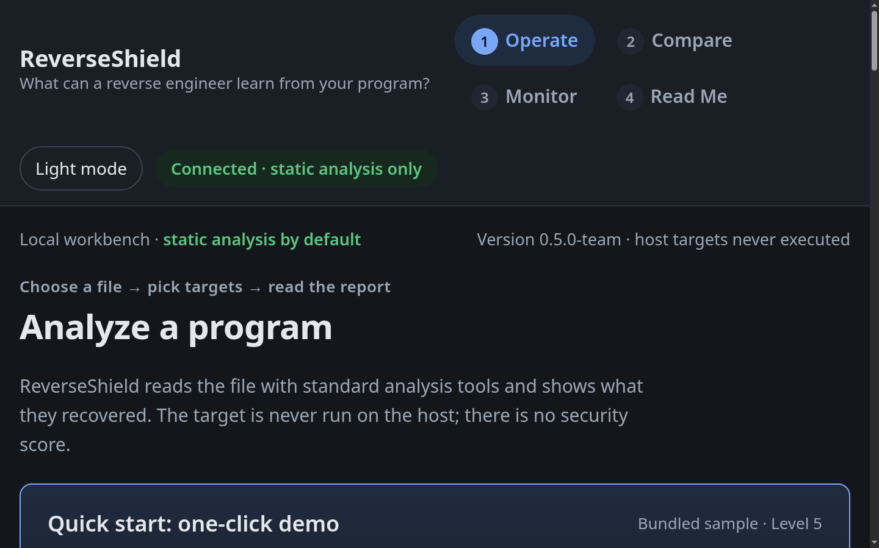
PRODUCT
Built as a local workbench, not a slide demo
▸ Analyzes Linux ELF and Windows PE files; discovers Flatpak apps, folders, RPM payloads and uploads.
▸ Runs readelf, objdump, strings, nm and optional project-local Ghidra headless.
▸ Six self-authored samples ship with the project for reproducible demonstrations.
▸ Reports: plain-language findings, metrics, functions, pseudocode, call graphs and raw output.
Real local UI, 11 Nov 2026 · static analysis only
DRAFT — owner review · not for submission
ReverseShield 0.5.0-team 05
Notes:
This is the actual interface, not a mockup. Point out the one-click demo, the six bundled samples and the explicit “static analysis by default” status. The UI is English and local.

Slide 6
EVIDENCE
What the report actually reveals
Signal | Why an analyst cares
Names & symbols | Function and variable names make logic easier to follow.
Debug information | Source paths, build flags and compiler details.
Strings & messages | URLs, internal messages, policy text, hardcoded values.
Imports & exports | Capabilities and the public interface of the build.
Functions & pseudocode | Recovered structure and readable C-like logic.
Call graph & CFG | How execution flows between routines.
Hardening properties | Observed NX, PIE, RELRO, canary, FORTIFY and PE flags.
Exposure evidence for a human decision — not a vulnerability verdict and not a security score.
DRAFT — owner review · not for submission
ReverseShield 0.5.0-team 06
Notes:
The report deliberately mixes static artefacts and hardening properties, but never merges them into a score. A name is not a vulnerability; a missing mitigation is not exploitability.

Slide 7
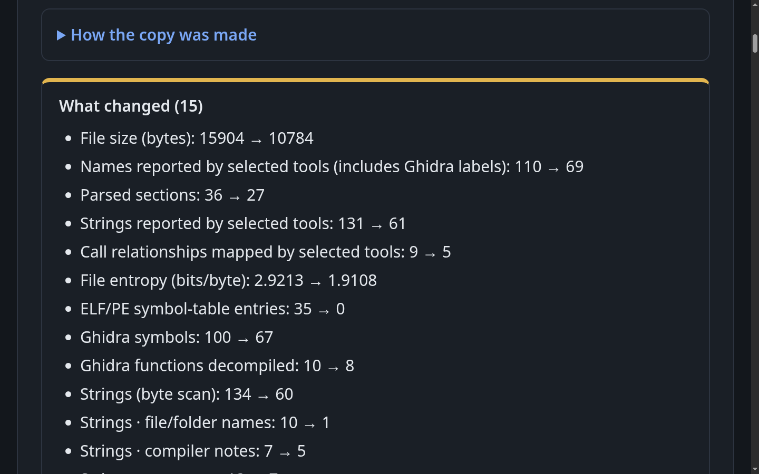
EVIDENCE
The comparison is the claim
▸ ELF symbol-table entries: 35 → 0
▸ Byte-scan strings: 134 → 60
▸ File size: 15,904 → 10,784 bytes
▸ Debug sections and symbol table: present → absent
Counts come from named tools. N/A means unmeasured, never zero. A smaller file is not automatically safer.
DRAFT — owner review · not for submission
ReverseShield 0.5.0-team 07
Notes:
This is a real symbol-removal comparison on Level 5, completed locally. The strongest line is 35 → 0 ELF symbols, not the total file size. We explicitly warn that removing names does not remove logic: Ghidra still recovers the policy function.

Slide 8
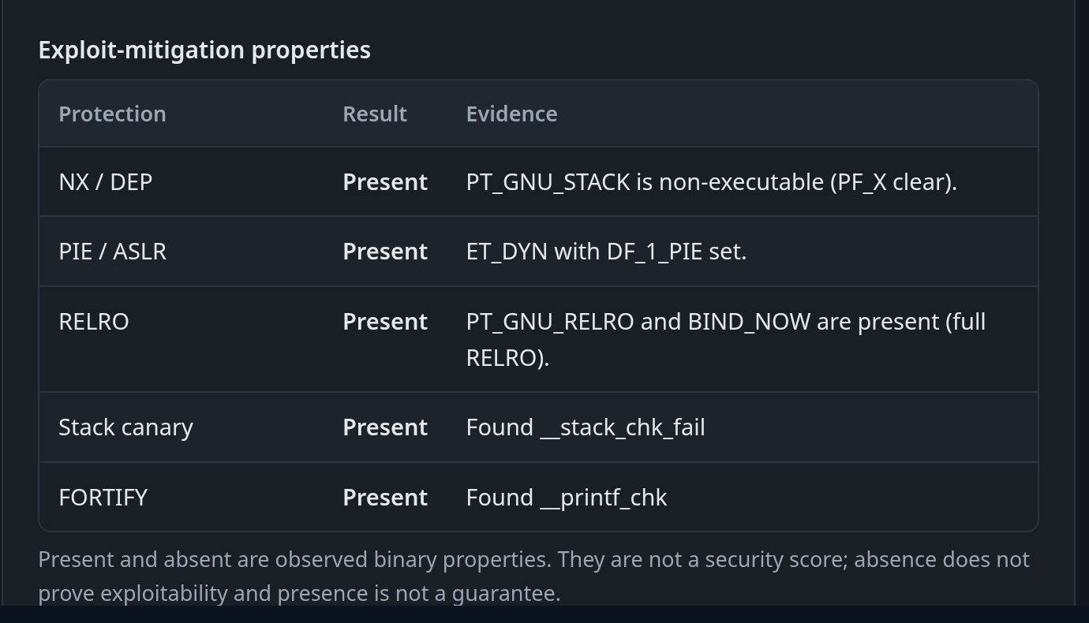
EVIDENCE
Static mitigation posture, with evidence
Property | Level 5 original | Level 5 hardened
NX / DEP | Present | Present
PIE / ASLR | Absent | Present
RELRO | Partial | Full
Stack canary | Absent | Present
FORTIFY | Absent | Present
Observed file properties. Presence is not a guarantee; absence is not exploitability.
DRAFT — owner review · not for submission
ReverseShield 0.5.0-team 08
Notes:
Two separately built ELF fixtures: the original Level 5 and a hardened build with PIE, full RELRO, stack protector and FORTIFY. The checker reads headers, dynamic tags and imports. This is static evidence, not a behaviour or exploitability test.

Slide 9
PROTECTION
A real source transformation — on our own samples only
C source
LLVM IR
xollvm passes
Protected ELF
self-authored
→
clang
→
flattening · BCF · subst. · strings
→
stripped, 0600
▸ Level 5: 15,904 → 109,296 bytes; all six policy messages removed from plaintext.
▸ ELF symbol table 35 → 0; Ghidra labels and generated code increase, so aggregate counts rise.
▸ Entropy 2.9213 → 6.4849 bits/byte; Ghidra still recovers the logic and takes longer.
▸ Obfuscation raises analysis cost — it is not proof of protection.
Scope: five original bundled sample sources. Arbitrary ELF/PE files remain analysis-only — a compiler pass cannot transform a binary without source.
DRAFT — owner review · not for submission
ReverseShield 0.5.0-team 09
Notes:
This is a genuine compiler-level transformation, not a demo flag. Be precise: it only works on our self-authored sample sources. The protected copy is stripped and never executed on the host. Larger size and more Ghidra labels are expected effects, not a regression.

Slide 10
VERIFICATION
Behaviour check with a narrow, stated scope
WHAT RUNS
RESULT
▸ Separate original and protected driver builds.
▸ Packed into a minimal initramfs with a host kernel.
▸ QEMU micro-VM: no disk, no network, serial output only.
▸ Transcripts and exit codes compared; five self-authored samples.
▸ Every transcript and driver hash recorded in evidence.
5 / 5
deterministic driver vectors matched
exit codes 0 / 0 · QEMU return code 0
scope: separate_deterministic_drivers
artifact behaviour verified: false
Critical scope: the guest ran separate driver builds, NOT the downloadable protected ELF. behavior_verified remains false for that artifact; matching vectors are not full equivalence.
DRAFT — owner review · not for submission
ReverseShield 0.5.0-team 10
Notes:
This slide is deliberately conservative. The QEMU check is a bounded regression test for deterministic vectors. It does not execute the downloadable protected ELF and does not prove general behavioural equivalence. Saying this clearly is part of the engineering.

Slide 11
ARCHITECTURE
Local architecture and trust boundary
Browser UI
Loopback API
Job engine
Evidence store
Operate · Compare · Monitor
→
token · origin checks · CSP
→
queue · cancel · events
→
runs/<job>/ report.json
Tool adapters
Transform copies
→
readelf · objdump · strings · nm · Ghidra
strip · constant blind · OLLVM · hygiene
↓
QEMU micro-VM
sample drivers only · no disk/network
Host targets are never executed. Only copies are transformed; QEMU is limited to separate deterministic sample drivers.
DRAFT — owner review · not for submission
ReverseShield 0.5.0-team 11
Notes:
One Python process serves the loopback UI and runs bounded jobs. Tool adapters read the snapshot as data. Transformations always write a new copy. The only execution path is the sample-driver QEMU guest, and it is not reachable for external targets.

Slide 12
SECURITY
Security posture and what backs it
Control / check | Evidence
Loopback + session token | Every API read/write rejected without the per-session token
Same-origin / CSP | Host, Origin, Referer and fetch-site checks; strict CSP
No host target execution | Static tools read bytes; copies only; QEMU sample drivers isolated
Operation/profile validation | Analysis jobs cannot dispatch a transformation (tested at HTTP level)
Test suite | 167 tests, 1 skipped — Ghidra-enabled, passed
SAST / secret scan | Bandit 0 high, 3 medium (tests only); detect-secrets: checksums/fixtures only
Sample privacy & package | DWARF paths removed; 101-entry ZIP extracted and re-tested
Boundaries: the token is CSRF protection, not multi-user IAM; static parsers are not a malware sandbox.
DRAFT — owner review · not for submission
ReverseShield 0.5.0-team 12
Notes:
Security of the workbench is separate from the security of the analysed binary. Give the concrete numbers: 167 tests, Bandit 0 high, token checks, operation/profile validation. Then state the boundaries before a judge asks.

Slide 13
POSITIONING
Where ReverseShield fits
 | Packer / protector | Vulnerability scanner | Manual Ghidra | ReverseShield
Primary output | Claimed protection | CVE/CWE verdict | Expert notes | Exposure evidence
Before / after | Rarely measured | Not applicable | Ad hoc | Bounded and repeatable
Target execution | Runtime loader | Often none | Possible | Never on the host
Works from binary | Yes | Yes | Yes | Yes (ELF/PE)
States limits | Marketing copy | CVE database scope | Analyst judgement | Built into the report
We do not claim to out-protect commercial tools. We make the comparison auditable and keep the limits visible.
DRAFT — owner review · not for submission
ReverseShield 0.5.0-team 13
Notes:
Keep this grounded. Commercial protectors and scanners are established products. The differentiation is transparent, reproducible comparison with explicit limits — not a claim of stronger obfuscation.

Slide 14
LIMITS
What we do not claim
NOT CLAIMED
KNOWN GAPS
▸ That a build is “secure” or “unhackable”.
▸ CVE/CWE detection, risk scores or exploitability.
▸ Full behavioural equivalence from five vectors.
▸ Protection of arbitrary third-party binaries.
▸ Native-Windows OLLVM or a hardened sandbox.
▸ Windows manual acceptance is still pending.
▸ QEMU tests separate drivers, not the downloadable ELF.
▸ Semgrep and ZAP were not re-run on this tree.
▸ Parser isolation and full dynamic analysis are future work.
▸ OLLVM is limited to the five original sample sources.
Every item above maps to an acceptance-matrix row or a documented test boundary — not a footnote added at the end.
DRAFT — owner review · not for submission
ReverseShield 0.5.0-team 14
Notes:
Read this slide aloud. Judges trust teams that state limits before being asked. Every item here maps to an acceptance-matrix row or a documented limitation.

Slide 15
ROADMAP
From prototype to a repeatable release gate
NOW · 0.5
NEXT
RESEARCH
Evidence-first prototype
Release readiness
Deeper evidence
▸ ELF/PE static analysis
▸ Six samples
▸ OLLVM + QEMU scope
▸ Local release candidate
▸ Windows manual acceptance
▸ Signed, reproducible ZIP
▸ CI on every change
▸ Pilot with two teams
▸ Isolated dynamic lab
▸ SBOM / CVE correlation
▸ More formats
▸ Larger benchmark set
The near-term goal is trust: reproducible builds, clean-platform evidence, and pilots that test whether the report changes release decisions.
DRAFT — owner review · not for submission
ReverseShield 0.5.0-team 15
Notes:
Do not promise a commercial platform. The next milestone is release readiness and pilot feedback. Dynamic analysis is a research track because it changes the safety boundary.

Slide 16
TEAM
Four people, one evidence chain
Naser
Zayed
Day 1 · Windows & PE
Day 2 · Analysis accuracy
Setup, PE acceptance, first-run reliability
Metrics, Ghidra integration, one-click demo
Nomai
Faisal
Day 3 · Security & API
Day 4 · Integration
Token checks, sanitizer, SAST/DAST evidence
Release packaging, docs, evidence, demo
Evidence, not verdicts.
We are looking for technical feedback, a pilot team, and a reason to make the next build safer.
DRAFT — owner review · not for submission
ReverseShield 0.5.0-team 16
Notes:
Close on the team and the ask. The project is a working local prototype with a documented evidence chain. We want feedback and a pilot, not a claim that the problem is finished.

