Slide 1

COMP1050
Object Oriented Programming (Java-2)
Lecture 1
Java fundamentals
Yetunde Folajimi, PhD.
(Professor Yetty)
Notes:
If this PowerPoint presentation contains mathematical equations, you may need to check that your computer has the following installed:
1) MathType Plugin
2) Math Player (free versions available)
3) NVDA Reader (free versions available)
Slides in this presentation contain hyperlinks. JAWS users should be able to get a list of links by using INSERT+F7

Slide 2

Who Am I?
Associate Professor, School of Computing & Data Science
BSc, MSc, PhD Computer Science
20+ years experience in the Academia
  University of Ibadan, Nigeria
  De Montfort University, UK
  University of British Columbia, Canada
  University of Pittsburgh, United States
  Northeastern University, United States

Slide 3
Who Am I? (2)
Teaching:
  Java, Python, Visual Basic, C#, Systems Admin/Linux, Data Mining, Artificial Intelligence, AI for Gaming, Internet Technology, Distributed Systems, Databases, Natural Language Programming, Technology Management, IT Policy and Strategies, etc.
Co-op supervision:
  Su-20, Fa-20, Sp-21, Su-21, Fa-21, Sp-22
Projects:
  GrACE, QuizMap, Knowledge Tree, Preservation, SCrisis Terminator, Fluid Mechanics Game, WatchOut! Quiz Recommender, Text summarization, eLearning porters, NLPs etc
Tech Summer camps
More at yfolajimi.com

Slide 4
Course learning outcomes
  Describe the differences between traditional programming and object-oriented programming
  Explain concepts related to object-oriented programming, including classes, objects, methods, inheritance, polymorphism, interfaces, overloading vs. overriding, and encapsulation
  Develop and analyze programs that make use of abstract data types (e.g., lists, sets, maps)
  Design and implement applications with a GUI interface

Slide 5
A Simple Java Program
Code Example 1
// This program prints Welcome to Java!
public class Welcome {
public static void main(String[] args) {
System.out.println("Welcome to Java!");
}
}
Code Example 1!
Notes:
Welcome: https://liveexample.pearsoncmg.com/html/Welcome.html

Slide 6
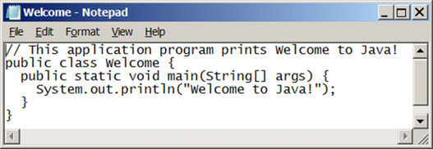
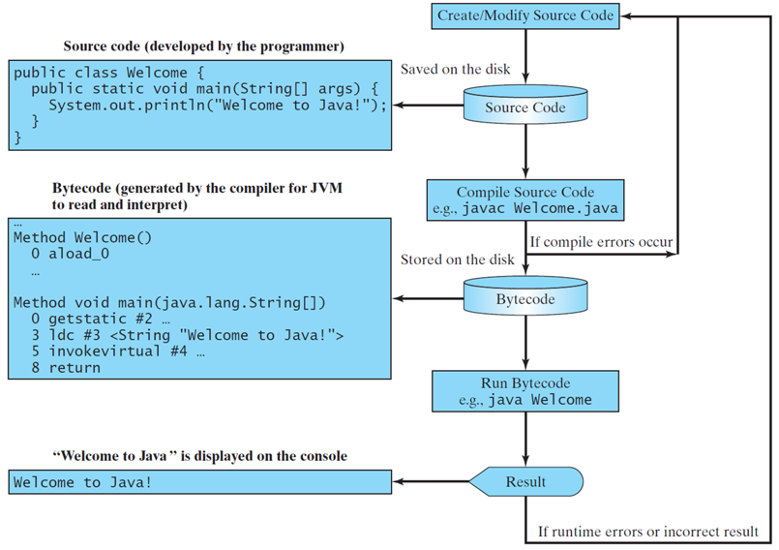
Creating, Compiling, and Running Programs
Notes:
Forward slash, forward slash. This application program prints Welcome to Java mark of exclamation.
Public class welcome left brace
public static void main left parenthesis String left bracket right bracket args right parenthesis left brace
System.out.println left parenthesis start quotation mark Welcome to Java mark of exclamation end double quotation mark right parenthesis semi colon
right brace
right brace"
The flow chart time sets with Create or Modify source code followed by Source Code, Compile Source Code, for example, java welcome dot java, Bytecode, Run Bytecode, for example, java welcome, and result. Source Code is connected to programming developed by the programmer, Bytecode is connected to a panel reads generated by the compiler for J V M to read and interpret, and the result is connected to a panel, reads welcome to java is displayed on the console.

Slide 7
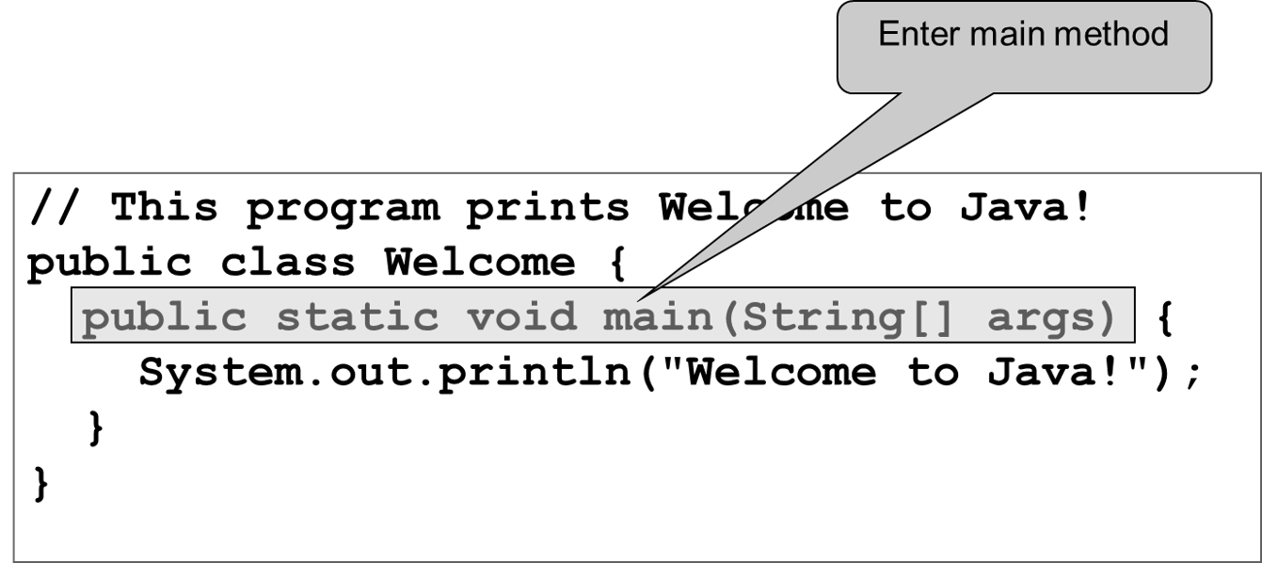
Trace a Program Execution (1 of 3)

Slide 8
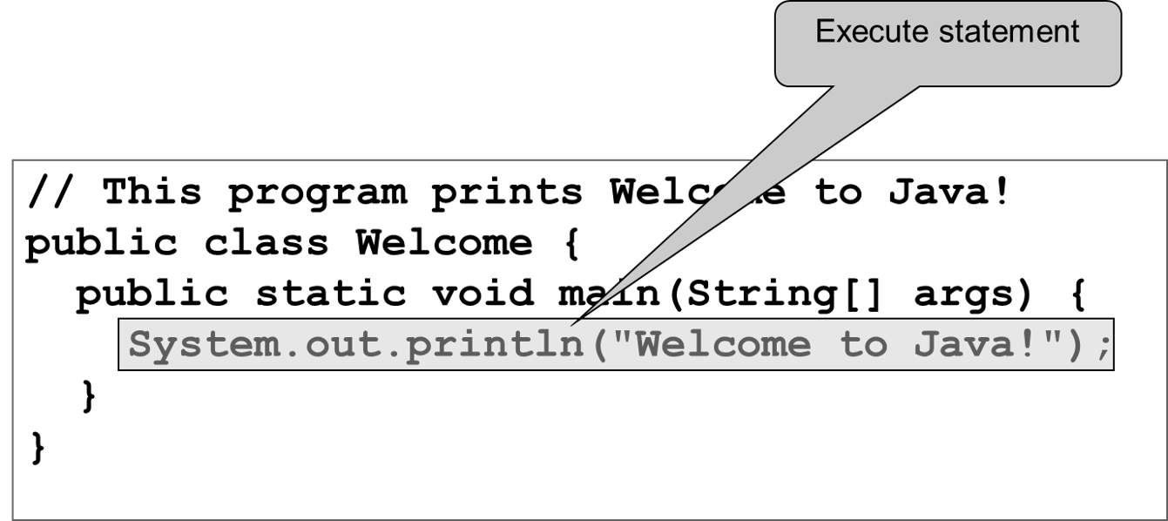
Trace a Program Execution (2 of 3)

Slide 9
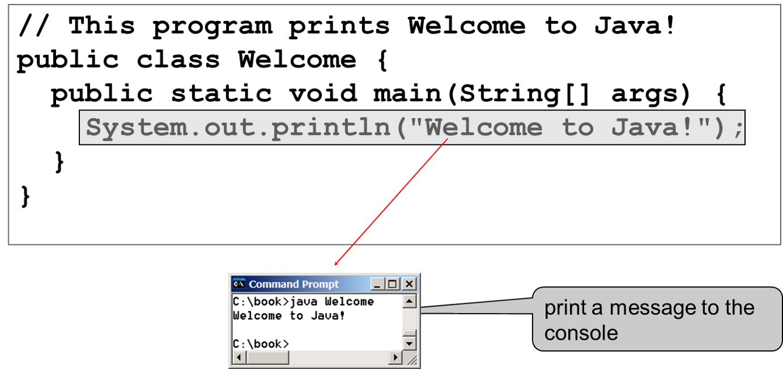
Trace a Program Execution (3 of 3)

Slide 10
Programming Style and Documentation
Appropriate Comments
Naming Conventions
Proper Indentation and Spacing Lines
Block Styles

Slide 11
Two More Simple Examples
Code Example 2
WelcomeWithThreeMessages
Code Example 3
ComputeExpression
Notes:
WelcomeWithThreeMessages: https://liveexample.pearsoncmg.com/html/WelcomeWithThreeMessages.html
ComputeExpression: https://liveexample.pearsoncmg.com/html/ComputeExpression.html
https://liveexample.pearsoncmg.com/LiveRun13e/faces/LiveExample.xhtml?programName=WelcomeWithThreeMessages&programHeight=431&username=slide&header=on

Slide 12
Anatomy of a Java Program
Class name
Main method
Statements
Statement terminator
Reserved words
Comments
Blocks

Slide 13
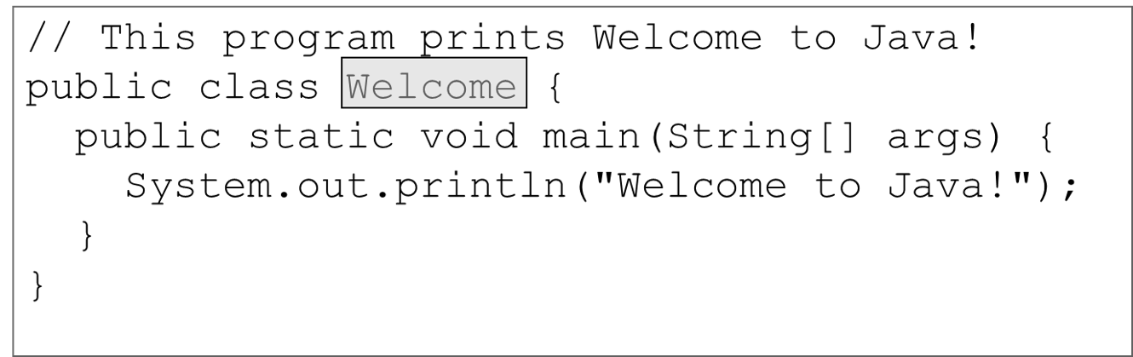
Class Name
Every Java program must have at least one class. Each class has a name. By convention, class names start with an uppercase letter. In this example, the class name is Welcome.
Notes:
Public class welcome left brace (Welcome in this row is highlighted)
public static void main left parenthesis String left bracket right bracket args right parenthesis left brace
System.out.println left parenthesis start quotation mark Welcome to Java mark of exclamation end double quotation mark right parenthesis semi colon
right brace
right brace"

Slide 14
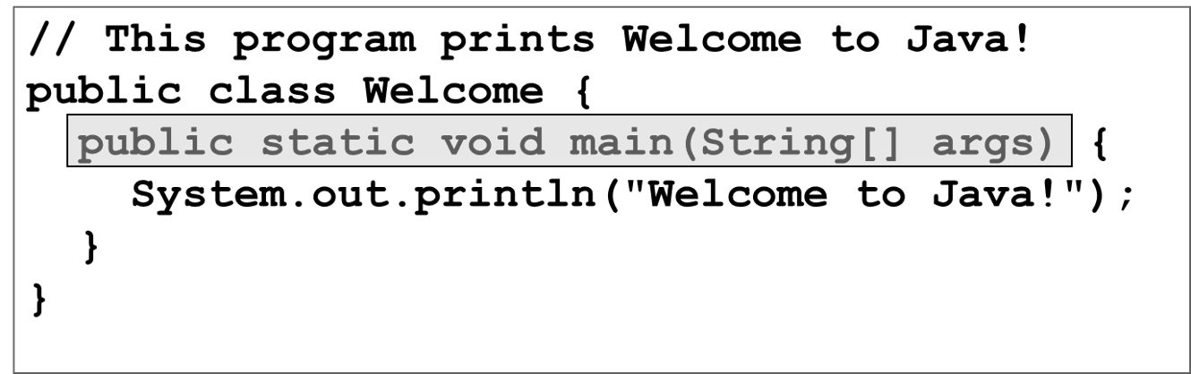
Main Method
Line 2 defines the main method. In order to run a class, the class must contain a method named main. The program is executed from the main method.
Notes:
Public class welcome left brace
public static void main left parenthesis String left bracket right bracket args right parenthesis left brace (Entire line except left brace is highlighted)
System.out.println left parenthesis start quotation mark Welcome to Java mark of exclamation end double quotation mark right parenthesis semi colon
right brace
right brace

Slide 15
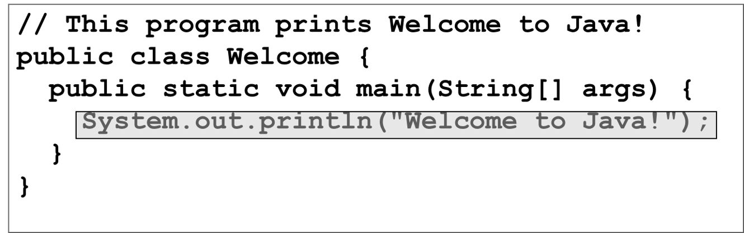
Statement
A statement represents an action or a sequence of actions. The statement System.out.println(“Welcome to Java!”) in the program in Listing 1.1 is a statement to display the greeting “Welcome to Java!”.
Notes:
Public class welcome left brace
public static void main left parenthesis String left bracket right bracket args right parenthesis left brace
System.out.println left parenthesis start quotation mark Welcome to Java mark of exclamation end double quotation mark right parenthesis semi colon (Entire line is highlighted)
right brace
right brace

Slide 16
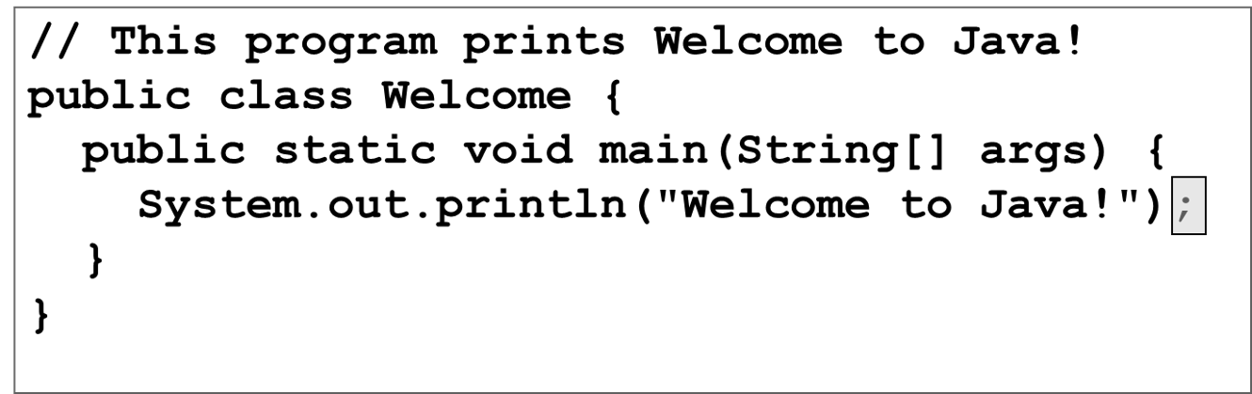
Statement Terminator
Every statement in Java ends with a semicolon (;).
Notes:
Public class welcome left brace
public static void main left parenthesis String left bracket right bracket args right parenthesis left brace
System.out.println left parenthesis start quotation mark Welcome to Java mark of exclamation end double quotation mark right parenthesis semi colon (Semi colon is highlighted)
right brace
right brace

Slide 17
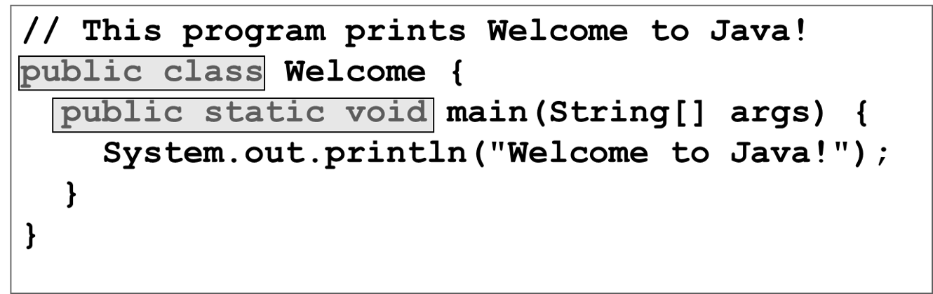
Keywords
Keywords are words that have a specific meaning to the compiler and cannot be used for other purposes in the program. For example, when the compiler sees the word class, it understands that the word after class is the name for the class.
Notes:
Public class welcome left brace (Public class is highlighted)
public static void main left parenthesis String left bracket right bracket args right parenthesis left brace (public static void is highlighted)
System.out.println left parenthesis start quotation mark Welcome to Java mark of exclamation end double quotation mark right parenthesis semi colon
right brace
right brace

Slide 18
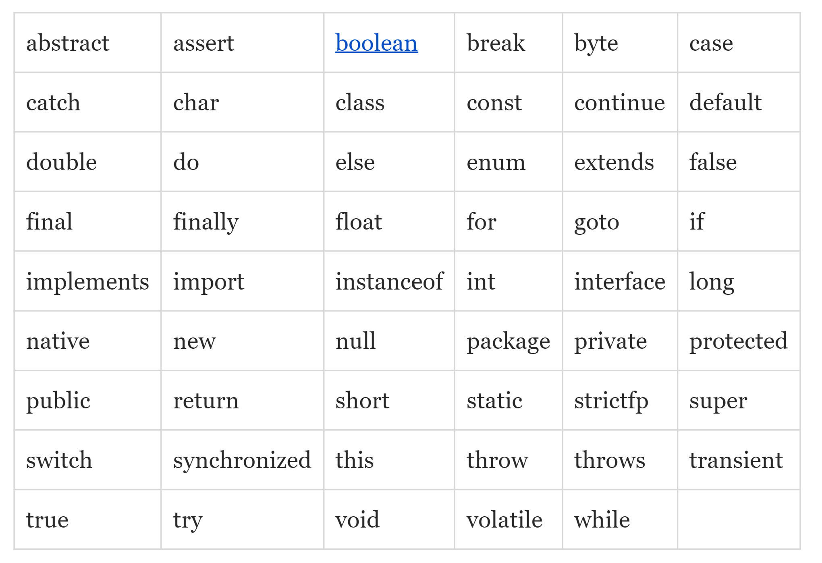
Java Reserved Words / Keywords
An identifier cannot be a reserved word.

Slide 19
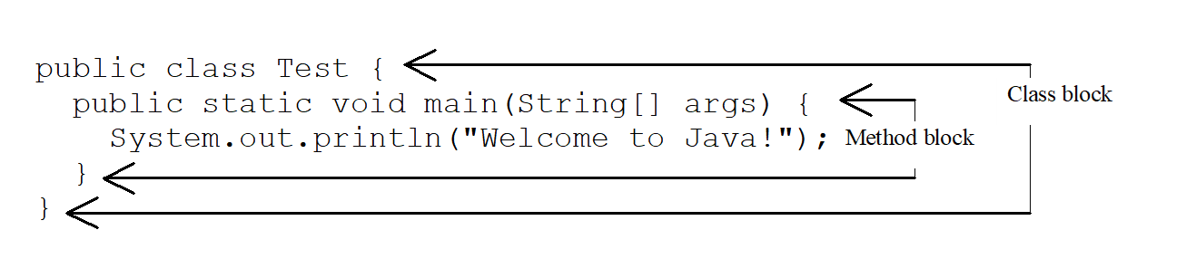
Blocks
A pair of braces in a program forms a block that groups components of a program.

Slide 20
Special Symbols
Character | Name | Description
{ } | Opening and closing braces | Denotes a block to enclose statements.
( ) | Opening and closing parentheses | Used with methods.
[ ] | Opening and closing brackets | Denotes an array.
/ / | Double slashes | Precedes a comment line.
“ ” | Opening and closing quotation marks | Enclosing a string (i.e., sequence of characters).
; | Semicolon | Marks the end of a statement.

Slide 21
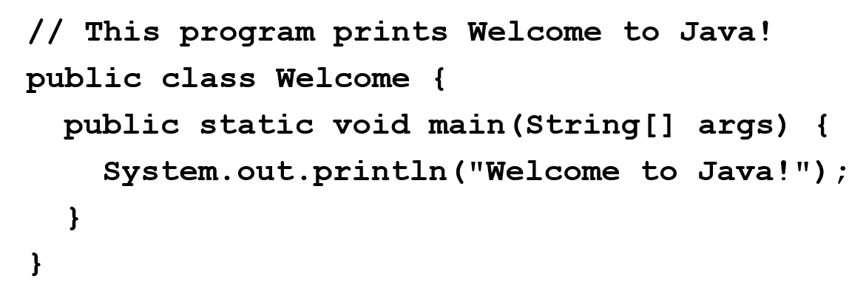
Braces { …
Notes:
Public class welcome left brace
public static void main left parenthesis String left bracket right bracket args right parenthesis left brace
System.out.println left parenthesis start quotation mark Welcome to Java mark of exclamation end double quotation mark right parenthesis semi colon
right brace
right brace
Left braces and right braces in entire code block are highlighted.

Slide 22
Parentheses ( … )
Notes:
Public class welcome left brace
public static void main left parenthesis String left bracket right bracket args right parenthesis left brace
System.out.println left parenthesis start quotation mark Welcome to Java mark of exclamation end double quotation mark right parenthesis semi colon
right brace
right brace
Left parentheses and right parentheses in entire code block are highlighted.

Slide 23
Statement Terminator ;
Notes:
Public class welcome left brace
public static void main left parenthesis String left bracket right bracket args right parenthesis left brace
System.out.println left parenthesis start quotation mark Welcome to Java mark of exclamation end double quotation mark right parenthesis semi colon (Semi colon is highlighted)
right brace
right brace

Slide 24
// Comments
Notes:
Public class welcome left brace (Forward slashes are highlighted)
public static void main left parenthesis String left bracket right bracket args right parenthesis left brace
System.out.println left parenthesis start quotation mark Welcome to Java mark of exclamation end double quotation mark right parenthesis semi colon
right brace
right brace

Slide 25
“ String ”
Notes:
Public class welcome left brace
public static void main left parenthesis String left bracket right bracket args right parenthesis left brace
System.out.println left parenthesis start quotation mark Welcome to Java mark of exclamation end double quotation mark right parenthesis semi colon (Quotation marks are highlighted)
right brace
right brace

Slide 26
Programming Errors
Syntax Errors
  Detected by the compiler
Runtime Errors
  Causes the program to abort
Logic Errors
  Produces incorrect result

Slide 27
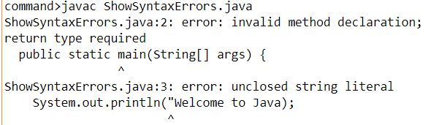
Syntax Errors
public class ShowSyntaxErrors {
public static main(String[] args) {
System.out.println("Welcome to Java);
}
}
ShowSyntaxErrors
Notes:
ShowSyntaxErrors: https://liveexample.pearsoncmg.com/html/ShowSyntaxErrors.html
https://liveexample.pearsoncmg.com/LiveRun13e/faces/LiveExample.xhtml?programName=ShowSyntaxErrors&programHeight=431&username=slide&header=on

Slide 28
Runtime Errors
public class ShowRuntimeErrors {
public static void main(String[] args) {
System.out.println(1 / 0);
}
}
ShowRuntimeErrors
Notes:
ShowRunTimeErros: https://liveexample.pearsoncmg.com/html/ShowRuntimeErrors.html
https://liveexample.pearsoncmg.com/LiveRun13e/faces/LiveExample.xhtml?programName=ShowRuntimeErrors&programHeight=431&username=slide&header=on

Slide 29
Logic Errors
public class ShowLogicErrors {
public static void main(String[] args) {
System.out.println("Celsius 35 is Fahrenheit degree ");
System.out.println((9 / 5) * 35 + 32);
}
}
ShowLogicErrors
Notes:
ShowLogicErrors: https://liveexample.pearsoncmg.com/html/ShowLogicErrors.html
https://liveexample.pearsoncmg.com/LiveRun13e/faces/LiveExample.xhtml?programName=ShowLogicErrors&programHeight=431&username=slide&header=on

Slide 30
Reading Input From the Console
Create a Scanner object
  Scanner input = new Scanner(System.in);
Use the method nextDouble() to obtain to a double value. For example,
  System.out.print("Enter a double value: ");
  Scanner input = new Scanner(System.in);
  double d = input.nextDouble();
ComputeAreaWithConsoleInput
ComputeAverage
Notes:
ComputeAreaWithConsoleInput: https://liveexample.pearsoncmg.com/html/ComputeAreaWithConsoleInput.html
ComputeAverage: https://liveexample.pearsoncmg.com/html/ComputeAverage.html
https://liveexample.pearsoncmg.com/LiveRun13e/faces/LiveExample.xhtml?programName=ComputeAreaWithConsoleInput&programHeight=431&username=slide&header=on
https://liveexample.pearsoncmg.com/LiveRun13e/faces/LiveExample.xhtml?programName=ComputeAverage&programHeight=431&username=slide&header=on

Slide 31
Identifiers
An identifier is a sequence of characters that consist of letters, digits, underscores (_), and dollar signs ($).
An identifier must start with a letter, an underscore (_), or a dollar sign ($). It cannot start with a digit.
An identifier cannot be a reserved word. (See next slide for a list of Java reserved words).
An identifier cannot be true, false, or null.
An identifier can be of any length.

Slide 32
Naming Conventions (1 of 2)
Choose meaningful and descriptive names.
Variables and method names: Use lowercase. For compound names, use lowercase for the first word, and capitalize the first letter of each subsequent word.
  Example computeArea.
Class names: Capitalize the first letter of each
  Example: ComputeArea.
Constants: Capitalize all letters in constants, and use underscores to connect words.
Example: PI and MAX_VALUE

Slide 33
Declaring Variables
int x; // Declare x to be an
// integer variable;
double radius; // Declare radius to
// be a double variable;
char a; // Declare a to be a
// character variable;

Slide 34
Assignment Statements
x = 1; // Assign 1 to x;
radius = 1.0; // Assign 1.0 to radius;
a = 'A'; // Assign 'A' to a;

Slide 35
Declaring and Initializing in One Step
int x = 1;
double d = 1.4;

Slide 36
Named Constants
final datatype CONSTANTNAME = VALUE;
final double PI = 3.14159;
final int SIZE = 3;

Slide 37
Numeric Operators
Name | Meaning | Example | Result
+ | Addition | 34 + 1 | 35
The symbol of minus | Subtraction | 34.0 minus 0.1 | 33.9
* | Multiplication | 300 times 30 | 9000
division slash | Division | 1.0 divided by 2.0. | 0.5
symbol of modulo remainder | Remainder | 20 modulo remainder 3 | 2

Slide 38
Operator Precedence
Evaluated
First
( ) parentheses
*, /, % multiplication, division, mod
+, - addition, subtraction
= assignment
For binary operators, if both operands are int values, then the result is an int value; else double
Evaluated
Last

Slide 39
Integer Division
+,
*, /, and %
yields an integer 2.
yields a double value 2.5
5 % 2 yields 1 (the remainder of the division)

Slide 40
Problem: Displaying Time
Write a program that obtains minutes and remaining seconds from seconds.
DisplayTime (animation)
DisplayTime (live code)
Notes:
DisplayTime: https://liveexample.pearsoncmg.com/html/DisplayTime.html
https://liveexample.pearsoncmg.com/codeanimation13ejava/DisplayTime.html?
https://liveexample.pearsoncmg.com/LiveRun13e/faces/LiveExample.xhtml?programName=DisplayTime&programHeight=431&username=slide&header=on

Slide 41
Exponent Operations
System.out.println(Math.pow(2, 3));
// Displays 8.0
System.out.println(Math.pow(4, 0.5));
// Displays 2.0
System.out.println(Math.pow(2.5, 2));
// Displays 6.25
System.out.println(Math.pow(2.5, -2));
// Displays 0.16

Slide 42
Arithmetic Expressions
is translated to
Notes:
Reads start fraction 3 + 4 x over 5 end fraction minus start fraction 10 left parenthesis y minus 5 right parenthesis left parenthesis a + b + c right parenthesis over x end fraction + 9 left parenthesis start fraction 4 over x end fraction + start fraction 9 + x over y end fraction right parenthesis.
start fraction 3 + 4 times x over 5 end fraction minus start fraction 10 times left parenthesis y minus 5 right parenthesis times left parenthesis a + b + c right parenthesis over x end fraction + 9 times left parenthesis start fraction 4 over x end fraction + start fraction 9 + x over y end fraction right parenthesis.

Slide 43
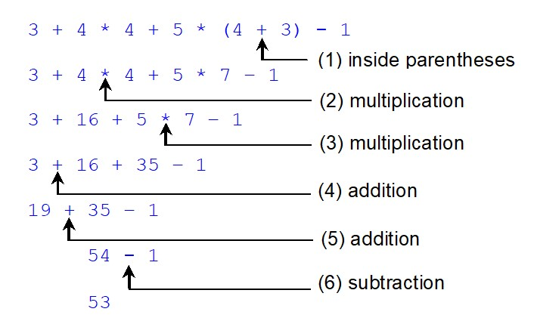
Evaluating an Expression
Notes:
3 + 4 times 4 + 5 times 7 minus 1 (multiplication sign between 4 and 4 is labeled, (2) multiplication.
3 + 16 + 5 times 7 minus 1 (multiplication sign between 5 and 7 is labeled, (3) multiplication.
3 + 16 + 35 minus 1 (+ sign between 3 and 16 is labeled, (4) addition.
19 + 35 minus 1 (+ sign between 19 and 35 is labeled, (5) addition.
54 minus 1 (minus sign between 54 and 1 is labeled, (6) subtraction.
53.

Slide 44
Problem: Converting Temperatures
Write a program that converts a Fahrenheit degree to Celsius using the formula:
Note: you have to write
FahrenheitToCelsius
Notes:
FahrenheitToCelsius: https://liveexample.pearsoncmg.com/html/FahrenheitToCelsius.html
https://liveexample.pearsoncmg.com/LiveRun13e/faces/FahrenheitToCelsius.xhtml?programName=DisplayTime&programHeight=431&username=slide&header=on

Slide 45
Augmented Assignment Operators
Operator | Name | Example | Equivalent
+ = | Addition assignment | i += 8 | i = i + 8
negative = | Subtraction assignment | i minus = 8 | I = I minus 8
*= | Multiplication assignment | i *= 8 | i = i * 8
forward slash = | Division assignment | I forward slash = 8 | I = I over 8
%= | Remainder assignment | i %= 8 | i = i % 8

Slide 46
Assignment Expressions and Assignment Statements
variable op= expression; // Where op is +,
++variable;
variable++;

Slide 47
Conversion Rules
When performing a binary operation involving two operands of different types, Java automatically converts the operand based on the following rules:
If one of the operands is double, the other is converted into double.
Otherwise, if one of the operands is float, the other is converted into float.
Otherwise, if one of the operands is long, the other is converted into long.
Otherwise, both operands are converted into int.

Slide 48
Quick Check: x=?
int x = 5/2;
double x = 5/2;
int x = 5.0/2;
double x = 5.0/2;
int x = 5/4*4;
int x = 5/(4*4);
double x = 5/4*4.0;
int x = 5.0/4*8;
double y = 5;
double x = 1+y*(y/2);
2
2.0
Error!
2.5
4
0
4.0
Error!
13.5

Slide 49
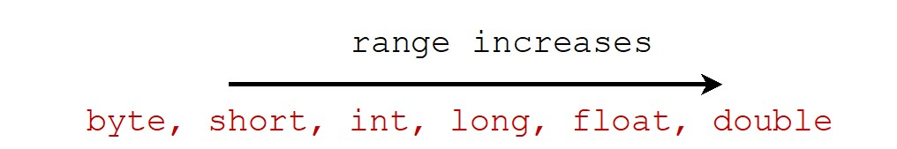
Type Casting
Implicit casting
double d = 3; (type widening)
Explicit casting
int i = (int)3.0; (type narrowing)
int i = (int)3.9; (Fraction part is truncated)
What is wrong?

Slide 50
Terminal Input
Java doesn't (easily) allow reading directly from System.in
Instead, you use a Scanner object that handles reading the input and ensures that the type of data you read matches what you want

Slide 51
Using a Scanner
Declare and initialize a Scanner object
  Scanner s = new Scanner(System.in);
  One per program!
  Requires import java.util.Scanner;
Call methods on the Scanner object to read different types of values from the terminal
  int var = s.nextInt();
  double var = s.nextDouble();
  String var = s.next();
  String var = s.nextLine(); // whole line
    Careful mixing with others due to whitespace handling

Slide 52
Terminal Output
You should get into the habit of using formatted printing by default
  System.out.printf("format", arg1, arg2, …);
  String s = String.format("format", arg1, arg2, …);
% in the format string followed by a converter, with optional flag(s) in between
  Aside from new line, expects corresponding argument (1st % -> 1st arg, 2nd -> 2nd, …)

Slide 53
Common Converters/Flags
Converter | Flag | Description
d |  | An integer
f |  | A float (includes double)
s |  | A String
b |  | A Boolean
n |  | New line
 | + | Includes the sign (positive or negative)
 | , | Includes grouping characters
 | .3 | Three places after the decimal.

Slide 54
Quick Check
What is the output to the terminal when the following code is run?
String a = String.format("W%sT", "I");
String b = String.format("%d2%d", "!".length(), a.length());
System.out.printf("%s %s%n%.2f!%n", a, b, 3.14159);

Slide 55
More Operators
x += a; // x = x + a
  Also: -= *= /=
x++; // x = x + 1
  Also: --

Slide 56
Math Class
Remember useful static methods available via the Math class
  Math.sqrt(double)
  Math.pow(double, double)
  Math.abs(double)
  Math.log(double)
  Math.log10(double)
  …

Slide 57
Boolean Expression
An expression that evaluates to a true or false
Comparison operators, returns true if…
  !a (a is false)
  a == b (a is equal to b)
  a != b (a is not equal to b)
  a < b (a is less than b)
  a <= b (a is less than or equal to b)
  a > b (a is greater than b)
  a >= b (a is greater than or equal to b)

Slide 58
Equality Gotcha
Remember, equality only works for constant values/primitive variables – not objects!
Object variables hold a reference (think memory address), so equality is asking if they are actually the same object
String a = "WIT";
String b = "wit".toUpperCase();
System.out.printf("%b%n", a==b);
System.out.printf("%b%n", b==a);
System.out.printf("%b%n", a==a);
System.out.printf("%b%n", b==b);
System.out.printf("%b%n", a.equals(b));
System.out.printf("%b%n", b.equals(a));

Slide 59
Complex Boolean Expressions
Logical AND
Logical OR
a | b | a && b
false | false | false
false | true | false
true | false | false
true | true | true
a | b | a || b
false | false | false
false | true | true
true | false | true
true | true | true

Slide 60
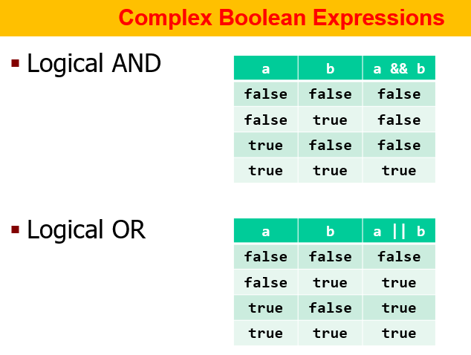
Checkup
a | b | c | ((a && !b) || (!a && b)) && !c
false | false | false
false | false | true
false | true | false
false | true | true
true | false | false
true | false | true
true | true | false
true | true | true
Notes:
false | false | false | false
false | false | true | false
false | true | false | true
false | true | true | false
true | false | false | true
true | false | true | false
true | true | false | false
true | true | true | false

Slide 61
Arrays
An array is a fixed-size list of variables of the same type, that represents a set of related values
Access many values via a single variable name
There is special syntax to create an array and to use its elements

Slide 62
Declaring an Array
Similar syntax to other variables, but type is now TYPE[]
  TYPE[] name;
Examples…
  int[] counts;
  double[] costs;
  boolean[] tf;
  String[] names;

Slide 63
Initializing an Array
Must set the size of the array at initialization, but options to set initial element values
First option: set all to 0/false/null via new (remember, arrays are objects!)…
  int[] counts = new int[5];
  double[] costs = new int[4];
  boolean[] tf = new boolean[2];
  String[] names = new String[3];

Slide 64
Initialize an Array with Size/Values
If at same time as declaration…
  int[] counts = {1, 2, 3, 4, 5};
  double[] costs = {1.1, 2.2, 3.3, 4.4};
  boolean[] tf = {false, true};
  String[] names = {"foo", "bar", "baz"};
If later…
  boolean[] tf;
  …
  tf = new boolean[] {false, true};

Slide 65
Array Size
Once initialized, the array has a fixed size available via a member variable: length
Example…
  int[] counts = new int[5];
  boolean[] tf = {false, true};
  System.out.printf("%d %d%n",
  counts.length, tf.length);

Slide 66
Accessing Array Elements
Every element within the array has an “index” (think address, relative to the beginning of the array): 0 – array.length-1
After initialization, access an individual element using any expression that resolves to an integer within brackets
  array[index expression] = value;
  var = array[index expression] * 2;
  System.out.printf("%d%n",
  array[index expression]);
Bad index raises ArrayIndexOutOfBoundsException
int[] a = {5, 4, 3, 2, 1};
System.out.printf("%d", a[a.length]);

Slide 67
Checkup
int[] a = {5, 4, 3, 2, 1};
int x = 2;
System.out.printf("%d %d %d %d %d", a[3], a[x], a[x/2],
a[x+x], a[x-2]);

Slide 68
Arrays in Memory
Arrays are stored in memory so that all the elements are sequential, in order:
int[] counts;
counts = new int[8];
counts[3] = 10;
address
value
variable
1000
0
counts[0]
1004
0
counts[1]
1008
0
counts[2]
1012
10
counts[3]
1016
0
counts[4]
1020
0
counts[5]
1024
0
counts[6]
1028
0
counts[7]
1032
1036
…

Slide 69
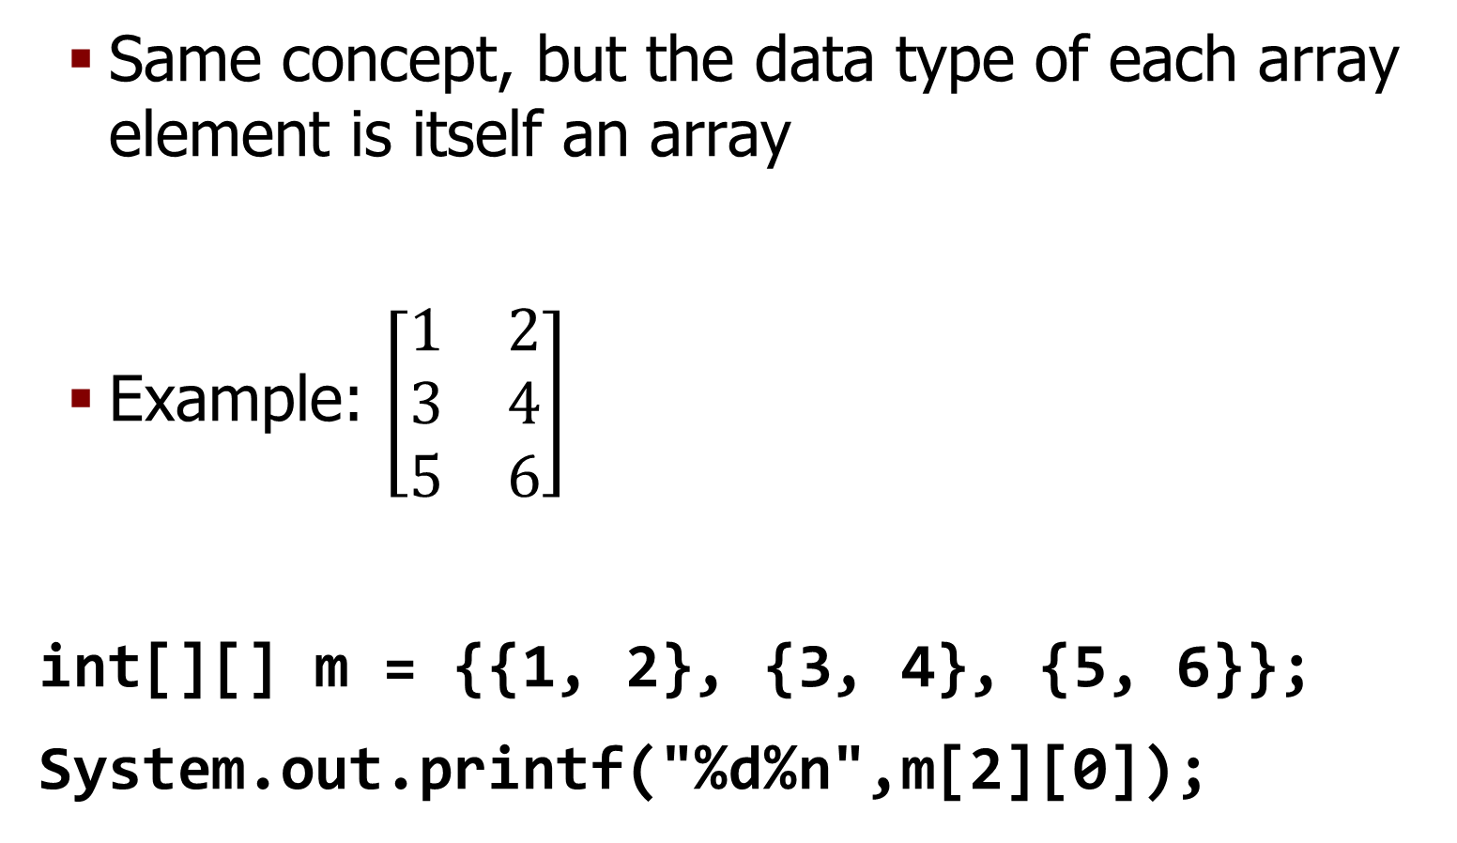
Arrays of … Arrays (Twist!)
Same concept, but the data type of each array element is itself an array
Example: $\left[\begin{matrix}1 & 2 \\ 3 & 4 \\ 5 & 6\end{matrix}\right]$
int[][] m = {{1, 2}, {3, 4}, {5, 6}};
System.out.printf("%d%n",m[2][0]);

Slide 70
Multidimensional Arrays
  int[][] m;
  m = new int[][] {{1, 2}, {3, 4}, {5, 6}};
  int[][] m = new int[3][];
  m[0] = new int[] {1, 2};
  m[1] = new int[] {3, 4};
  m[2] = new int[] {5, 6};
  int[][] m = new int[3][2];
  m[0][0] = 1;
  m[0][1] = 2;
  m[1][0] = 3;
  m[1][1] = 4;
  m[2][0] = 5;
  m[2][1] = 6;

Slide 71
COMP1000 Topics
Computation/Programming
Variables, I/O
Expressions
Arrays
Control Flow, Conditionals, Loops
Methods
Exceptions, File I/O
Misc

Slide 72
Sequential Execution
Control flow is the order in which program statements are executed
Remember: the program starts at main() and executes line-by-line till either System.exit() or end of main()
However, some commands cause the execution to “hop” somewhere else
  Conditionals, loops, exceptions

Slide 73
Conditional Statements
if (B_EXPR_A) {
  // a
} else if (B_EXPR_B) {
  // b
} else if (B_EXPR_C) {
  // c
} else {
  // d
}
// e
Starts with if
  Execute a only if B_EXPR_A==true
  Then e
Any number of else if
  Tested only if B_EXPR_A==false
  Sequentially tested:
    b if B_EXPR_B==true
    c if B_EXPR_B==false && B_EXPR_C==true
Optional else
  Only if prior B_EXPR_* all false
  Cannot have a condition

Slide 74
Why is this strange?
if (a == true) {
  …
}
if (a) {
…
}

Slide 75
Checkup
int x = 5;
if (x=5) {
System.out.printf("foo");
}

Slide 76
Assignment Operator
The assignment operator (=) returns the assigned value
int x = 5;
System.out.printf("%b%n", x==5); // true
System.out.printf("%b%n", x==7); // false
System.out.printf("%d%n", x=5); // 5
System.out.printf("%d%n", x=7); // 7

Slide 77
Checkup
boolean x = false;
if (x=false) {
System.out.printf("foo");
}
if (x==true) {
System.out.printf("bar");
}

Slide 78
?: Operator (Ternary)
Shortcut to an “if-else” expression
  (condition)?(result if true):(result if false)
int x=10, y;
if (x%2 == 0) {
y = 1;
} else {
y = 0;
}
System.out.printf("%d%n", y);
int x=10, y;
y = (x % 2 == 0)?1:0;
System.out.printf("%d%n", y);

Slide 79
while Loops
while loops are used to repeat a set of statements while some condition is true
int x = 1, y = 1;
while (x<100) {
  x *= 2;
  y++;
}
System.out.printf("%d %d", x, y);

Slide 80
do-while Loops
A while loop body might be executed zero times if the condition is never true
If you need to always execute the body at least once, use a do-while loop (remember the final ;)
int x;
Scanner s = new Scanner(System.in);
do {
System.out.printf("Enter 1 to loop: ");
x = s.nextInt();
} while (x == 1);
System.out.printf("Freedom!%n");

Slide 81
for Loops
Used as a shortcut for a commonly occurring pattern
  Initialization (once before loop)
  Condition (before each iteration)
  Update (at the end of each loop body)
int i=0;
while (i<10) {
System.out.printf("%d%n", i);
i++;
}
for (int i=0; i<10; i++) {
System.out.printf("%d%n", i);
}

Slide 82
for-each Loop
Shortcut to iterate over all elements of some “iterable collection” (more later!)
Common in many languages, added as of JDK5
int[] phone = {8, 6, 7, 5, 3, 0, 9};
for (int x : phone) {
System.out.printf("%d", x);
}
System.out.printf(" Jenny%n");

Slide 83
Truth Table Example
boolean[] tf = {false, true};
for (boolean a : tf) {
for (boolean b : tf) {
for (boolean c : tf) {
System.out.printf(
"%-5s | %-5s | %-5s | %-5s%n",
a, b, c,
((a && !b) || (!a && b)) && !c);
}
}
}

Slide 84
Breaking a Loop
The break statement allows you to terminate a loop early
  Immediately ends the inner-most loop in which it is found (like return for loops)
When used well, typically improves efficiency by reducing the number of unnecessary iterations (e.g. when something is found early in an array)

Slide 85
Example (try with/without break)
final int[] haystack = {0, 1, 2, 3, 4, 5, 6, 7, 8, 9};
final int needle = 2;
boolean found = false;
int i = 0;
for (i=0; i<haystack.length; i++) {
if (haystack[i]==needle) {
found = true;
break;
}
}
System.out.printf("found: %b, loop iterations: %d%n", found, i);

Slide 86
COMP1000 Topics
Computation/Programming
Variables, I/O
Expressions
Arrays
Control Flow, Conditionals, Loops
Methods
Exceptions, File I/O
Misc

Slide 87
Methods
Programs can be logically broken down into a set of tasks
Individual tasks can be separated out from the main program into methods
A method is simply a mini-program that completes a specific task
Great for avoiding mistakes from writing the same code in multiple places in the program

Slide 88
Method Pieces
public static int smallerOf(int a, int b) {
return (a<=b)?a:b;
}
Every method has…
  A name
    Multiple can have the same (“overloading”) as long as something about parameter list is changed (type, number)
  A return type (or void)
  A parameter list (any number of [type name],)
  Visibility (public, private, protected)
    None = package protected (more later)
  Membership (static vs. member)
    Owned by the class (static) or each object

Slide 89
Invocation (“Calling”)
Static:
  ClassName.methodName([arg1, arg2, …])
  methodName() if in same class (laziness!)
Member:
  objName.methodName([arg1, arg2, …])
Execution stops, hops to method, goes back to line when hit end of method or first use of return (there might be multiple)
  Even void methods can use return;

Slide 90
Example
public class Bar {
public static int smallerOf(int a, int b) {
return (a<=b)?a:b;
}
public static void main(String[] args) {
int a=1, b=2;
System.out.printf("%d %d %d%n", a, a, Bar.smallerOf(a, a)); System.out.printf("%d %d %d%n", b, b, smallerOf(b, b)); System.out.printf("%d %d %d%n", a, b, smallerOf(a, b)); System.out.printf("%d %d %d%n", b, a, smallerOf(b, a));
}
}

Slide 91
Parameter Handling
When invoking a method, argument values are copied to parameters
Straightforward for primitive variables
  Means variables unchanged in invoking context
Since object variables’ value is a reference (think memory address), “copying” means that method can in fact change the variable permanently
  Includes arrays (which are actually objects)

Slide 92
Checkup (1)
public static void change(int a) {
a--;
}
public static void main(String[] args) {
int x = 10;
System.out.printf("before: %d", x);
change(x);
System.out.printf(", after: %d%n", x);
}

Slide 93
Checkup (2)
public static void change(int[] a) {
a[0]--;
}
public static void main(String[] args) {
int[] x = {10};
System.out.printf("before: %d", x[0]);
change(x);
System.out.printf(", after: %d%n", x[0]);
}

Slide 94
Class Constants
Every variable has a “scope”
  Where it can be accessed
Defined by where it is declared
  From that point to the } of the closest { before
To have a value accessible in multiple methods within the class, use a variable with class-level scope (declared outside any method)
  In most cases it is a dangerous practice to have a variable with class-level scope that is mutable

Slide 95
Example
public static final double DOLLARS_PER_EURO = 1.05;
public static double dollarsToEuros(double dollars) {
} return dollars / DOLLARS_PER_EURO;
public static double eurosToDollars(double euros) {
return euros * DOLLARS_PER_EURO;
}
public static void main(String[] args) {
System.out.printf("1 dollar is %.2f euros%n", dollarsToEuros(1));
System.out.printf("1 euro is %.2f dollars%n", eurosToDollars(1));
}

Slide 96
A Note on main
The main method is just like any other
The parameter is an array of strings, which are any command-line arguments supplied to the program when it is run by the JVM
  Click the “Run” menu -> “Run Configurations”
  Find your application on the left list under “Java Application”
  Click the “Arguments” tab on the right
  Type some values, separated by spaces, into the “Program arguments” box

Slide 97
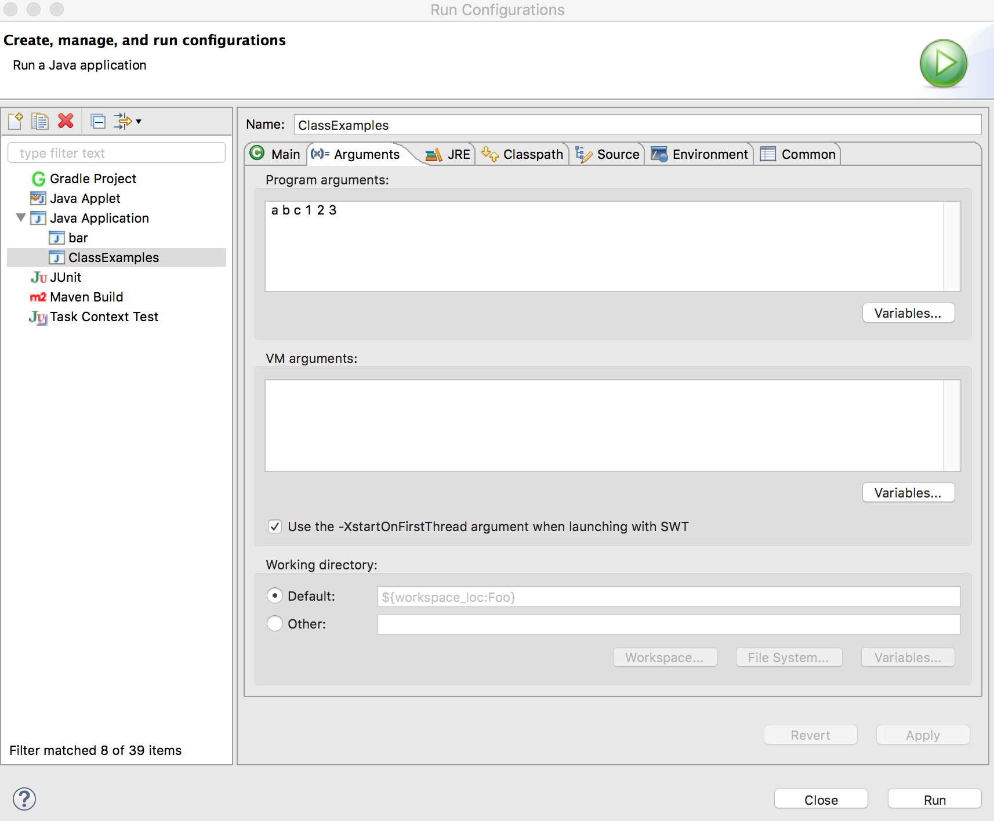
Example
public class ClassExamples {
public static void main(String[] args) {
System.out.printf("%d:", args.length);
for (String arg : args) {
System.out.printf(" %s", arg);
}
}
}

Slide 98
Checkup
Write a method that searches a supplied array (of integers) for a supplied integer value. If found, return the index of the value; else, -1 (why?).

Slide 99
Answer
public static int searchArray(int[] haystack, int needle) {
for (int i=0; i<haystack.length; i++) {
if (haystack[i] == needle) {
return i;
}
}
return -1;
}

Slide 100
Exceptions
Programmatic mechanism to handle errors that occur during execution of the program (runtime)
Verbs…
  Throw: when an error occurs, code throws a new instance of an Exception class
  Catch: code that knows how to handle a particular type catches an exception to handle it

Slide 101
Exception Mechanics
When an exception is thrown, execution sequentially pops out of each scope until either code catches it, or the program ends
Programmers use try-catch blocks to handle potential runtime errors within a section of code

Slide 102
try-catch
try {
STATEMENTS THAT MIGHT THROW EXCEPTIONS
} catch (EXCEPTION_TYPE1 EXCEPTION_VARIABLE1) {
STATEMENTS THAT HANDLE EXCEPTION_TYPE1
} catch (EXCEPTION_TYPE2 EXCEPTION_VARIABLE2) {
STATEMENTS THAT HANDLE EXCEPTION_TYPE2
}
…

Slide 103
Example
Scanner input = new Scanner(System.in);
int inputValue = 0;
try {
System.out.printf("Enter an integer: ");
inputValue = input.nextInt();
} catch (InputMismatchException ex) {
System.out.printf("Error! Integer required!%n");
System.exit(0);
}
System.out.printf("%d^2=%d%n",
inputValue, inputValue*inputValue);

Slide 104
Passing the Buck
If a method programmer opts not to catch exception(s), these should be listed in the method signature via the throws keyword
public static int readInt(Scanner s) throws InputMismatchException {
System.out.print("Enter an integer: ");
return s.nextInt();
}

Slide 105
Example
public static void doSomethingBad() throws IOException {
throw new IOException("Oops");
}
public static void main(String[] args) {
try {
doSomethingBad();
System.out.printf("Yay :)%n");
} catch (IOException e) {
System.out.printf("%s :(%n", e.getMessage());
}
}

Slide 106
I/O
I/O stands for Input/Output
So far, we've used a Scanner object based on System.in for all terminal input (usually user's keyboard) and System.out for all terminal output
System.in and System.out are predefined I/O objects that are available automatically in every Java program

Slide 107
Files
Files are useful to store large data sets for a program and/or to save the need to type in all the input data values individually
Accessed via File objects
  File f = new File("path");
  Paths default to current directory, unless absolute (prefixed with c:/ or /) are given
For basic cases, we use Scanner objects for file input and PrintWriter objects for output

Slide 108
Issues with Files
When opening files, Java forces you to handle the situation of a file not being found via FileNotFoundException
When you are done, you should close the file – make sure this happens no matter what!
To handle both these issues, we use the try-with-resource block in this class

Slide 109
Example File Input
try (Scanner fin = new Scanner(new File("test.txt"))) {
while (fin.hasNextLine()) {
String nextLine = fin.nextLine();
System.out.printf(nextLine+"%n");
}
} catch (FileNotFoundException ex) {
System.out.printf("File not found!%n");
System.exit(0);
}

Slide 110
Example File Output
try (PrintWriter fout = new PrintWriter(new File("numbers.txt"))) {
for (int i=1; i<=100; i++) {
fout.printf("%d%n", i);
}
} catch (FileNotFoundException ex) {
System.out.printf("File not found!%n");
System.exit(0);
}

Slide 111
Example File Input/Output
try (
Scanner fin = new Scanner(new File("numbers.txt"));
PrintWriter fout = new PrintWriter(new File("odds0.txt"));
) {
while (fin.hasNextInt()) {
int next = fin.nextInt();
if (next % 2 == 1) {
fout.printf("%d%n", next);
}
}
} catch (FileNotFoundException ex) {
System.out.printf("File not found!%n");
System.exit(0);
} catch (IOException ex) {
System.out.printf("IO error occurred!%n");
System.exit(0);
}
Notes:
try (
Scanner fin = new Scanner(new File("numbers.txt"));
PrintWriter fout = new PrintWriter(new File("odds.txt"));
) {
while (fin.hasNextInt()) {
int next = fin.nextInt();
if (next % 2 == 1) {
fout.printf("%d%n", next);
}
}
} catch (FileNotFoundException ex) {
System.out.printf("File not found!%n");
System.exit(0);
}

Slide 112
Take Home Points
If all of this made sense, you are ready for COMP1050
  Note: most OOP content was ignored – that’s this class!
If you had troubles, the complete set of COMP1000 slides are on Blackboard, including exercises for you to try
  Also feel free to talk with me!

