Slide 1

Welcome to COMP1050!
Professor Folajimi
Notes:
WIT COMP1050 Computer Science II Course Material by Wentworth Institute of Technology (http://www.wit.edu/computer-science) is licensed under a Creative Commons Attribution-NonCommercial 4.0 International License (http://creativecommons.org/licenses/by-nc/4.0/).

Slide 2


Slide 3
Introduction to JavaFX
JavaFX is a powerful, rich-client application platform for Java.
It replaces the older Swing and AWT libraries.
It is widely used for developing desktop applications and internet-based rich-client applications
Notes:
Key Features:
Modern UI controls and features.
Graphics and animation support.
Media support for video and audio playback.
CSS for styling.
Hardware-accelerated graphics.

Slide 4
Key Features
Rich UI Controls:
  Supports modern UI controls such as sliders, charts, and tables.
CSS Styling:
  Allows developers to style UI elements using CSS, similar to web development.
FXML:
  Provides an XML-based language for defining the UI, making the separation of design and logic easier.
Media Support:
  Built-in capabilities for handling images, videos, and audio.
WebView:
  Embeds web content into JavaFX applications using WebEngine.
Scene Graph:
  JavaFX uses a scene graph to represent the graphical layout, offering hierarchical and flexible UI designs.
Hardware Acceleration:
  Makes use of GPU acceleration to improve performance.
Multiplatform Support:
  Runs on Windows, macOS, and Linux.

Slide 5
Setting Up JavaFX in Eclipse
Download JavaFX SDK from the OpenJFX website: https://gluonhq.com/products/javafx/
Extract the SDK to a location on your computer (e.g., C:/javafx-sdk).

Slide 6
Configure the JavaFX SDK
Add JavaFX SDK to the Module Path
  Right-click your project in the Project Explorer.
  Select Properties.
  Navigate to Java Build Path.
  Click on the Modulepath tab.
  Click Add External JARs.
  Browse to the extracted JavaFX SDK folder:
    Open the lib folder.
    Select all the .jar files.
  Click Apply and Close.

Slide 7
Update JavaFX VM Arguments
Go to Run > Run Configurations.
Select your application in the Java Application category.
Go to the Arguments tab.
Under VM Arguments, add the following (replace <path_to_sdk> with the actual path to your JavaFX SDK lib folder):
Example:
--module-path <path_to_sdk> --add-modules javafx.controls,javafx.fxml
--module-path C:/javafx-sdk/lib --add-modules javafx.controls,javafx.fxml

Slide 8
Setting Up JavaFX with E(fx)clipse
Set up a New JavaFX Project:
Create a New Java Project:
  Open Eclipse.
  Go to File → New → Java Project.
  Select JavaFX Project (if the option isn't available, ensure e(fx)clipse is installed).
  Follow the wizard to create a new JavaFX project.

Slide 9
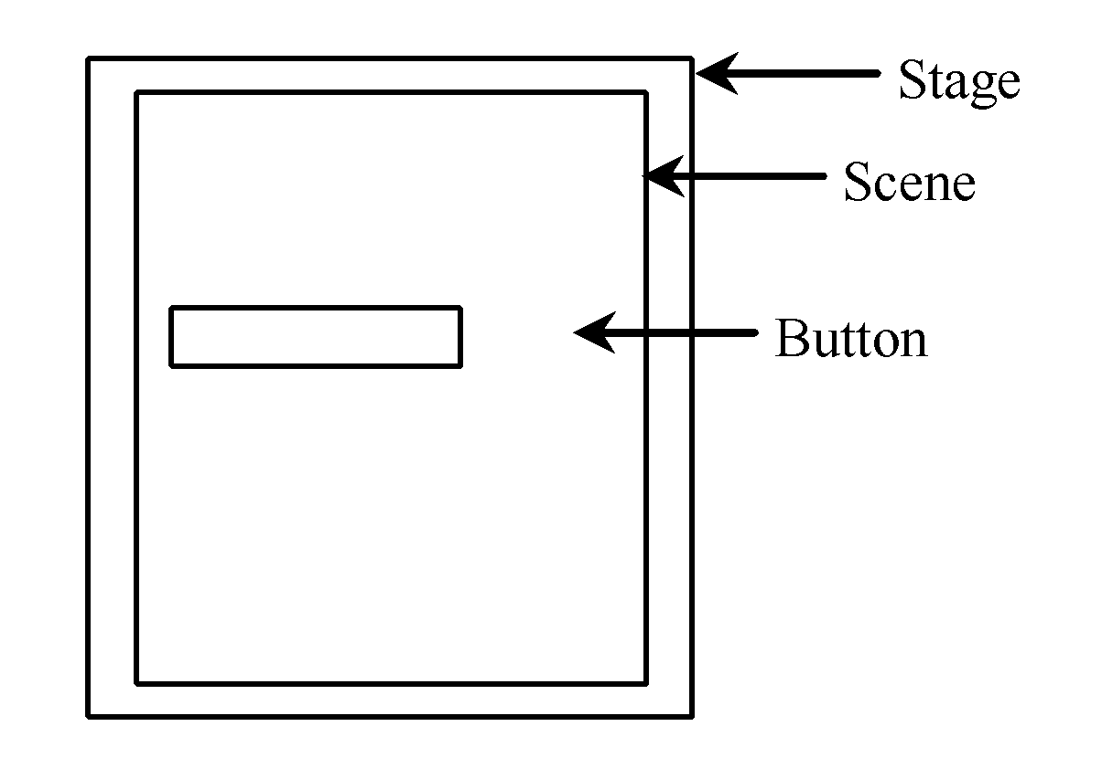
Basic Structure of JavaFX Application
Extend Application
  Import Application
launch(args) in main
Override start(Stage)
  Import Stage
Populate
  Stage (Window): primary=default, can have multiple
  Scene: hierarchical graph of nodes
  Nodes: UI elements like buttons, text fields, etc.
Notes:
As you can see, the main() method calls the static launch() method with the command line parameters. The launch() method is a static method located in the Application class. This method launches the JavaFX runtime and your JavaFX application.
The launch() method will detect from which class it is called, so you don't have to tell it explicitly what class to launch.
That is really all it takes to create a JavaFX application. It is quite simple, isn't it? Now you are ready to start playing around with JavaFX !
The main() method is ignored in correctly deployed JavaFX application. * main() serves only as fallback in case the application can not be * launched through deployment artifacts, e.g., in IDEs with limited FX * support. NetBeans ignores main().
So essentially, it shouldn't even be called as it is JavaFX, however if it is called then it will just pass the command line arguments (args) to the javafx.application.Application.launch which will open the JavaFX as expected.

Slide 10
My First JavaFX Application
Create a new project in Eclipse
  Name: MyJavaFX
Create a new class
  MyJavaFX
    Extend the “Application” class
  Include a main method
public class MyJavaFX extends Application {
public static void main(String[] args) {
}
}

Slide 11
My First JavaFX Application
Create a new project in Eclipse
  Name: MyJavaFX
Create a new class
  MyJavaFX
    Extend the “Application” class
  Include a main method
public class MyJavaFX extends Application {
public static void main(String[] args) {
}
}

Slide 12
My First JavaFX Application
import javafx.application.*;
import javafx.stage.*;
public class MyJavaFX extends Application {
@Override
public void start (Stage s) {
s.setWidth(800);
s.setHeight(600);
s.show();
}
public static void main(String[] args ) {
launch(args);
}
}

Slide 13
My First JavaFX Application (2)
Code Structure Example:
public class HelloWorld extends Application {
public void start(Stage primaryStage) {
Scene scene = new Scene(new StackPane(new Button("Click Me!")), 400, 300);
primaryStage.setScene(scene);
primaryStage.show();
}
}

Slide 14
My First JavaFX Application (3)
import javafx.application.Application;
import javafx.scene.Scene;
import javafx.scene.control.Button;
import javafx.scene.layout.StackPane;
import javafx.stage.Stage;
public class MyJavaFX extends Application {
public static void main(String[] args) {
launch(args);
}
@Override
public void start(Stage primaryStage) {
primaryStage.setTitle("Hello World!");
final Button btn = new Button();
btn.setText("Click Me!");
final StackPane root = new StackPane();
root.getChildren().add(btn);
primaryStage.setScene(new Scene(root, 300, 250));
primaryStage.show();
}
}

Slide 15
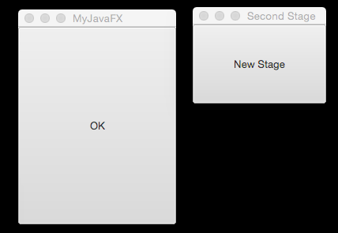
Multiple Windows
public void start(Stage primaryStage) {
Scene scene = new Scene(new Button("OK"), 200, 250);
primaryStage.setTitle("MyJavaFX");
primaryStage.setScene(scene);
primaryStage.show();
Stage stage = new Stage();
stage.setTitle("Second Stage");
stage.setScene(new Scene(new Button("New Stage"), 100, 100));
stage.show();
}

Slide 16
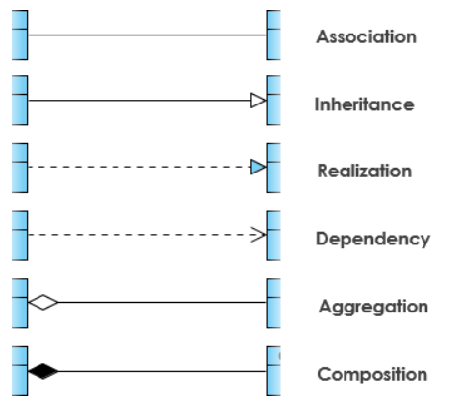
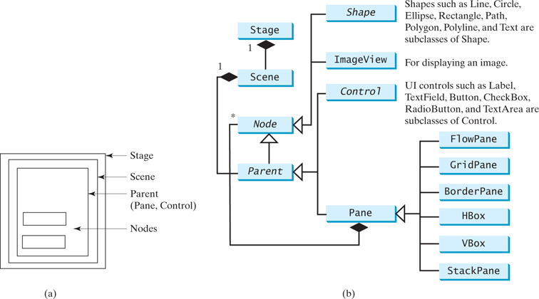
UML Relationships
JavaFx Package hierarchy:
https://docs.oracle.com/javase/8/javafx/api/overview-tree.html
JavaFX All Classes:
https://docs.oracle.com/javase/8/javafx/api/allclasses-noframe.html
Notes:
There are 6 Panels in javaFX such as: BorderPane, StackPane, GridPane, FlowPane,TilePane and AnchorPane.
StackPane
Stack pane allows you to place many nodes one on top of an other.
StackPane root = new StackPane(); Button btn1 = new Button(" 1 "); Button btn2 = new Button("22222222"); root.getChildren().addAll(btn2, btn1); root.setStyle("-fx-background-color: #87CEFA;");
GridPane
GridPane allows you to create a flexible grid of rows and columns and position each node in exact place.
GridPane grid = new GridPane(); grid.setPadding(new Insets(10, 10, 10, 10)); grid.setMinSize(300, 300); grid.setVgap(5); grid.setHgap(5); Text username = new Text("Username:"); grid.add(username, 0, 0); TextField text = new TextField(); text.setPrefColumnCount(10); grid.add(text, 1, 0); Text password = new Text("Password:"); grid.add(password, 0, 1); TextField text2 = new TextField(); text2.setPrefColumnCount(10); grid.add(text2, 1, 1); grid.setStyle("-fx-background-color: #D8BFD8;");
FlowPane
Flow Pane lays all nodes one after an other in the order they were added.
FlowPane flow = new FlowPane(); flow.setPadding(new Insets(10, 10, 10, 10)); flow.setStyle("-fx-background-color: DAE6F3;"); flow.setHgap(5); flow.getChildren().addAll(left, center);
TilePane
TilePane is similar to the flow pane. All nodes are placed in a grid in the same order they were added.
TilePane tile = new TilePane(); tile.setPadding(new Insets(10, 10, 10, 10)); tile.setPrefColumns(2); tile.setStyle("-fx-background-color: #CD5C5C;"); HBox hbox2 = new HBox(8); // spacing = 8 hbox2.getChildren().addAll(top, left, center); tile.getChildren().add(hbox2);
AnchorPane
AnchorPane allows you to position nodes in the top, bottom, left side, right side, or center of the pane.
AnchorPane anchorpane = new AnchorPane(); Button buttonSave = new Button("Save"); Button buttonCancel = new Button("Cancel"); anchorpane.setStyle("-fx-background-color: #A9A9A9;"); HBox hb = new HBox(); hb.getChildren().addAll(buttonSave, buttonCancel); anchorpane.getChildren().addAll(hb); anchorpane.setMinSize(300, 100); AnchorPane.setRightAnchor(hb, 10.0);
BorderPane
BorderPane splits the scene in five regions such as: top, bottom, left, right, and center. Where you can adjust added nodes. BorderPane also allows you to add different panes in each region as shown in my example. However you cannot use the same pane more than once.
BorderPane pane = new BorderPane(); pane.setLeft(anchorpane); pane.setCenter(root); pane.setRight(grid); pane.setTop(flow); pane.setBottom(tile); Scene scene = new Scene(pane, 300, 250);
A generalization is a taxonomic relationship between a more general classifier and a more specific classifier. Each instance of the specific classifier is also an indirect instance of the general classifier. Thus, the specific classifier inherits the features of the more general classifier.
Association
Associations are relationships between classes in a UML Class Diagram. They are represented by a solid line between classes. Associations are typically named using a verb or verb phrase which reflects the real world problem domain.
Aggregation
A special type of association.
It represents a "part of" relationship.
Class2 is part of Class1.
Many instances (denoted by the *) of Class2 can be associated with Class1.
Objects of Class1 and Class2 have separate lifetimes.
The figure below shows an example of aggregation. The relationship is displayed as a solid line with a unfilled diamond at the association end, which is connected to the class that represents the aggregate.
Composition
A special type of aggregation where parts are destroyed when the whole is destroyed.
Objects of Class2 live and die with Class1.
Class2 cannot stand by itself.
The figure below shows an example of composition. The relationship is displayed as a solid line with a filled diamond at the association end, which is connected to the class that represents the whole or composite.
Dependency
An object of one class might use an object of another class in the code of a method. If the object is not stored in any field, then this is modeled as a dependency relationship.
A special type of association.
Exists between two classes if changes to the definition of one may cause changes to the other (but not the other way around).
Class1 depends on Class2
The figure below shows an example of dependency. The relationship is displayed as a dashed line with an open arrow.
Realization
Realization is a relationship between the blueprint class and the object containing its respective implementation level details. This object is said to realize the blueprint class. In other words, you can understand this as the relationship between the interface and the implementing class.
For example, the Owner interface might specify methods for acquiring property and disposing of property. The Person and Corporation classes need to implement these methods, possibly in very different ways.

Slide 17
JavaFX Pane Examples
// GridPane
GridPane gridPane = new GridPane();
gridPane.add(new Label("Grid 0,0"), 0, 0);
gridPane.add(new Button("Grid 1,1"), 1, 1);
// FlowPane
FlowPane flowPane = new FlowPane(10, 10, new Button("Flow 1"), new Button("Flow 2"));
// Combine all panes
VBox mainLayout = new VBox(20, borderPane, hBox, vBox, stackPane, gridPane, flowPane);
// Set scene and show stage
Scene scene = new Scene(mainLayout, 600, 600);
primaryStage.setTitle("Short Pane Example");
primaryStage.setScene(scene);
primaryStage.show();
// BorderPane
BorderPane borderPane = new BorderPane();
borderPane.setTop(new Label("BorderPane - Top"));
borderPane.setCenter(new Button("Center"));
// HBox
HBox hBox = new HBox(10, new Button("HBox 1"), new Button("HBox 2"));
// VBox
VBox vBox = new VBox(10, new Label("VBox 1"), new Label("VBox 2"));
// StackPane
StackPane stackPane = new StackPane(new Label("StackPane Layer"));

Slide 18
Layout Panes
JavaFX provides many types of panes for organizing nodes in a container
Pane Type | Description | Best Use Case
Pane | Base class for all Pane layouts, allows free positioning. | Custom layouts or absolute positioning.
BorderPane | Divides layout into five regions: Top, Bottom, Left, Right, Center. | Dashboards, menus with content sections.
HBox | Arranges children horizontally in a single row. | Toolbars, navigation bars, horizontal layouts.
VBox | Arranges children vertically in a single column. | Menus, form fields, or stacked layouts.
StackPane | Overlays nodes in a stack, with the last on top. | Layered elements, overlays, or centered items.
GridPane | Divides layout into rows and columns. | Forms, tables, or grids.
FlowPane | Arranges nodes in a flow-like manner with wrapping. | Dynamic layouts with varying node sizes.
AnchorPane | Positions children relative to edges. | Precise positioning (e.g., forms or dialogs).
TilePane | Arranges children in equally sized tiles. | Icon grids, tool palettes, or tiled layouts.
Region | Resizable container with customizable backgrounds. | Base for custom layout containers or effects.
ScrollPane | Provides scrollable view for large content. | Lists, images, or dynamic, large content.
Group | Groups nodes without layout management. | Combining shapes or simple visual grouping.
Usage: https://docs.oracle.com/javase/8/javafx/api/javafx/scene/layout/Pane.html

Slide 19
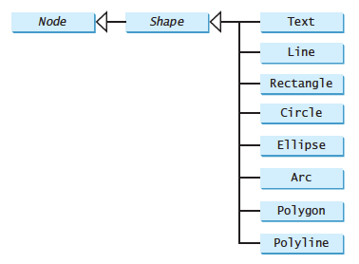
Shapes

Slide 20
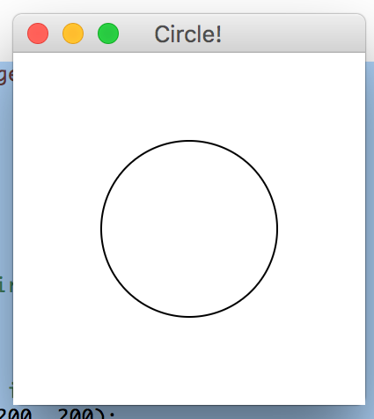
Another Example
public void start(Stage primaryStage) {
final Circle c = new Circle();
c.setCenterX(100);
c.setCenterY(100);
c.setRadius(50);
c.setStroke(Color.BLACK);
c.setFill(Color.WHITE);
Pane pane = new Pane();
pane.getChildren().add(c);
Scene scene = new Scene(
pane, 200, 200);
primaryStage.setTitle("Circle!");
primaryStage.setScene(scene);
primaryStage.show();
}

Slide 21
A big missing piece: interaction
To have a GUI interact with a user, we have elements respond to user actions, or event-driven programming
Notes:
--module-path "\path\to\javafx-sdk-12.0.1\lib" --add-modules javafx.controls,javafx.fxml
--module-path "C:\Program Files\Java\jdk-15.0.1\lib" --add-modules javafx.controls,javafx.fxml

Slide 22
Big Picture
When GUI elements want to implement event-driven programming, they will offer ways to "handle" an event via a class that implements an interface
Typical sequence:
  Create GUI
  "Register" a class to handle event(s), sometimes referred to as a "listener"
  Implement handling code in the listener

Slide 23
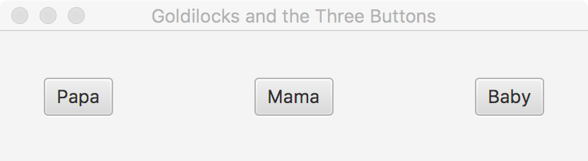
A Simple Example (1)
Make a new JavaFX project
Create a GUI with three buttons
final HBox pane = new HBox(100);
pane.setAlignment(Pos.CENTER);
final Button btnP = new Button("Papa");
final Button btnM = new Button("Mama");
final Button btnB = new Button("Baby");
pane.getChildren().addAll(btnP, btnM, btnB);
primaryStage.setTitle("Goldilocks and the Three Buttons");
primaryStage.setScene(new Scene(pane));
primaryStage.show();

Slide 24
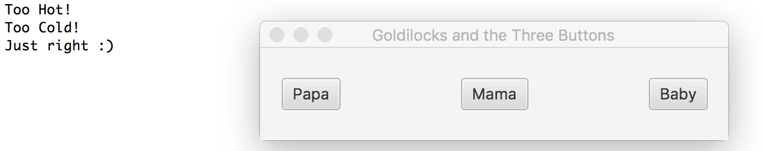
A Simple Example (2)
Handle event: Any class that implements the appropriate interface can be used, including anonymous inner classes and Lambda’s
private static class JustRight implements
EventHandler<ActionEvent> {
@Override
public void handle(ActionEvent event) {
System.out.printf("Just right :)%n");
}
}
btnP.setOnAction(new EventHandler<ActionEvent>() {
@Override
public void handle(ActionEvent event) {
System.out.printf("Too Hot!%n");
}
});
btnM.setOnAction(e->{ System.out.printf("Too Cold!%n");
});
btnB.setOnAction(new JustRight());
Notes:
--module-path "\path\to\javafx-sdk-12.0.1\lib" --add-modules javafx.controls,javafx.fxml
--module-path "C:\Program Files\Java\jdk-15.0.1\lib" --add-modules javafx.controls,javafx.fxml

Slide 25
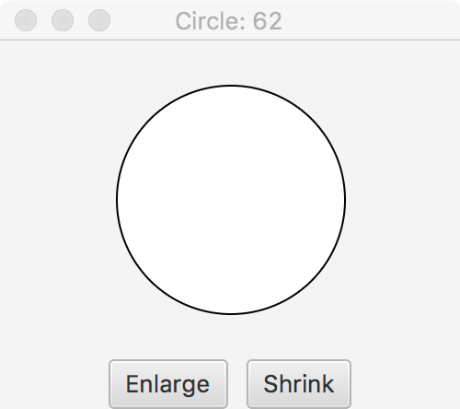
Exercise
Create a JavaFX application that allows you to grow/shrink a circle via buttons

Slide 26
Solution
Circle c = new Circle(50);
c.setStroke(Color.BLACK);
c.setFill(Color.WHITE);
Button grow = new Button("Grow");
grow.setOnAction(new EventHandler<ActionEvent>() {
@Override
public void handle(ActionEvent event) {
c.setRadius(c.getRadius()+3);
}
});
Button shrink = new Button("Shrink");
shrink.setOnAction(new EventHandler<ActionEvent>() {
@Override
public void handle(ActionEvent event) {
c.setRadius(c.getRadius()-3);
}
});
HBox hb = new HBox();
hb.getChildren().add(grow);
hb.getChildren().add(shrink);
hb.setSpacing(10);
hb.setPadding(new Insets(10));
hb.setAlignment(Pos.CENTER);
VBox vb = new VBox();
vb.getChildren().add(c);
vb.getChildren().add(hb);
vb.setAlignment(Pos.CENTER);
primaryStage.setTitle("Circle");
primaryStage.setScene(new Scene(vb, 200, 200));
primaryStage.show();

Slide 27
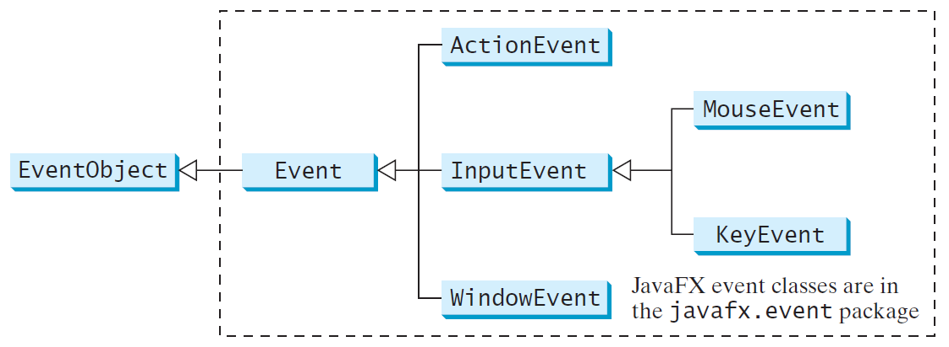
JavaFX Events

Slide 28
Event Information
An event object contains whatever properties are related to the event
You can identify the source object of the event using the getSource() instance method in the EventObject class
The subclasses of EventObject deal with special types of events, such as button actions, window events, component events, mouse movements, and keystrokes

Slide 29
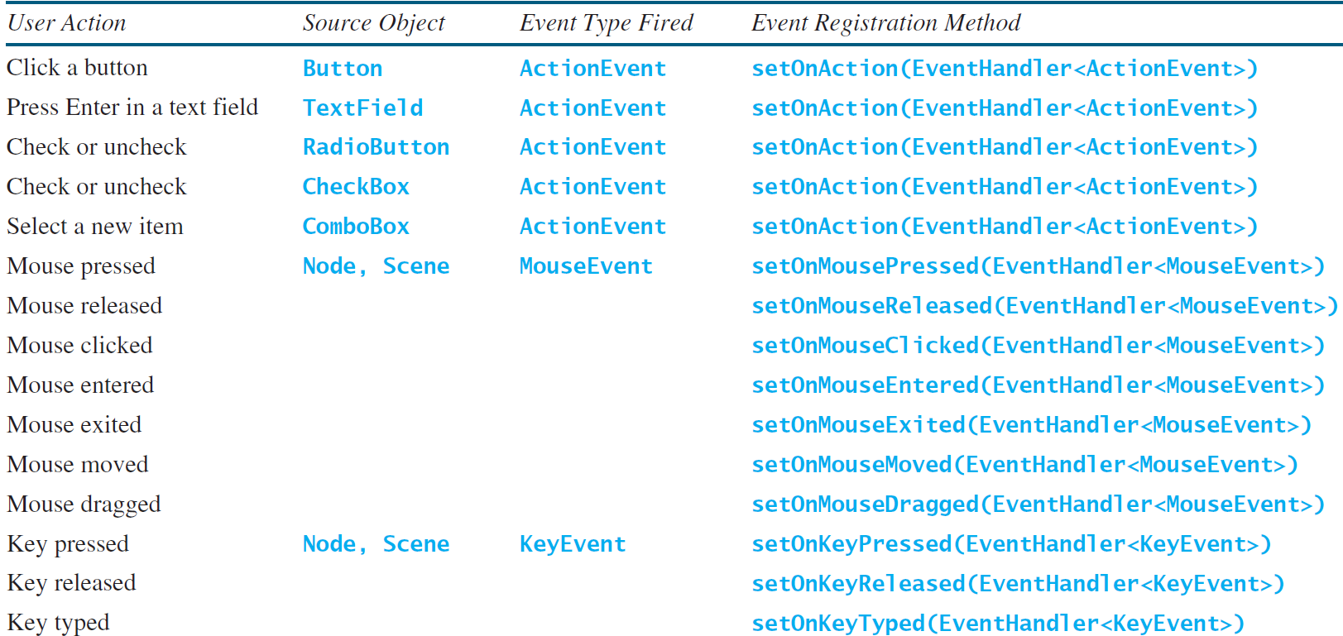
Example User Actions & Handlers

Slide 30
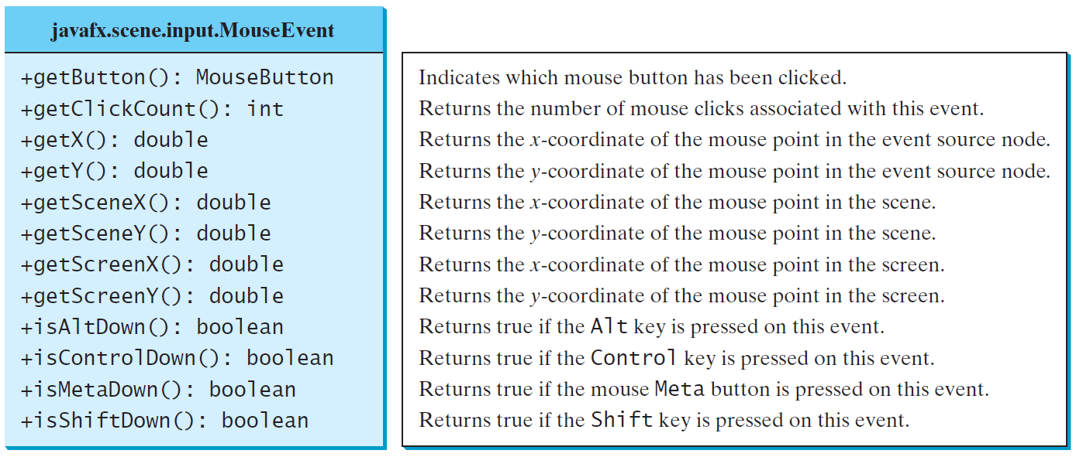
MouseEvent

Slide 31
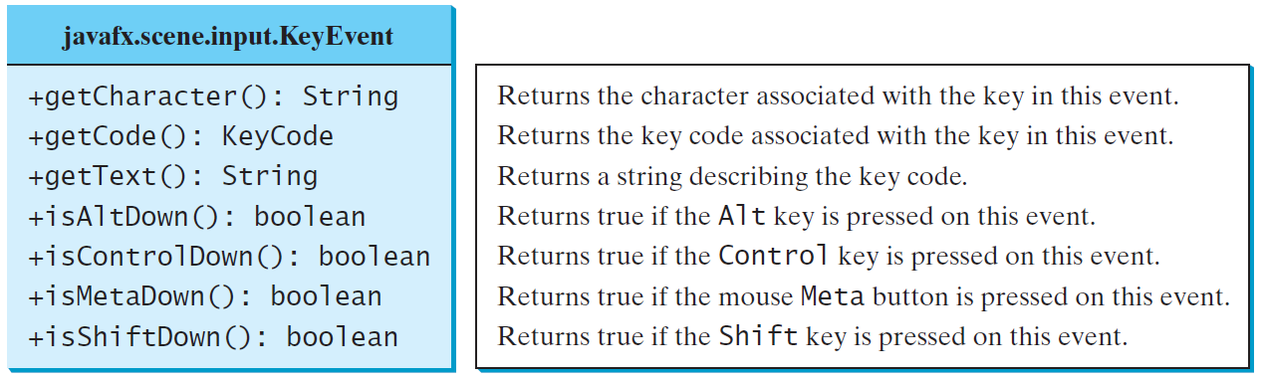
KeyEvent

Slide 32
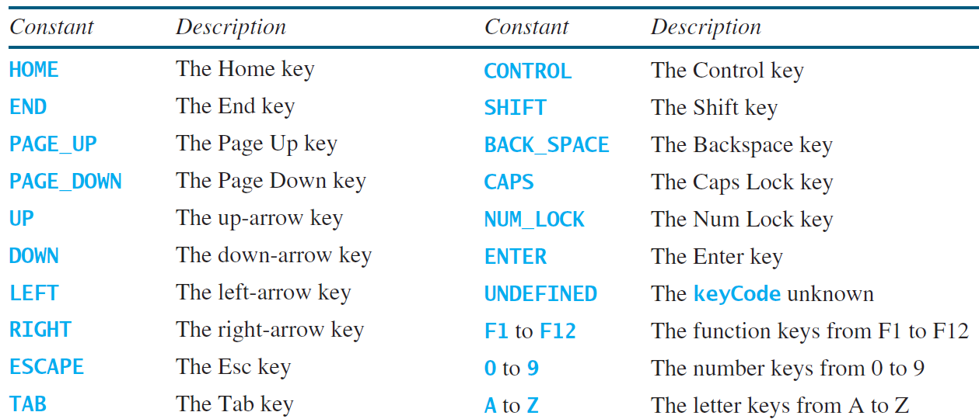
KeyCode Constants

Slide 33
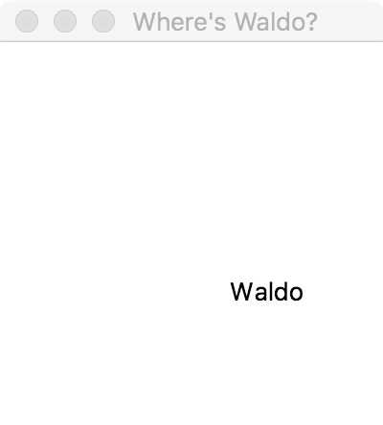
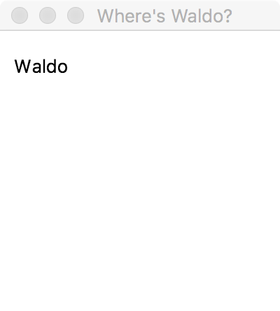
Exercise
Write a JavaFX program that allows the user to control the position of the text "Waldo" via Left/Down/Up/Right arrow keys

Slide 34
Solution
Pane p = new Pane();
Text waldo = new Text("Waldo");
waldo.setX(100);
waldo.setY(100);
waldo.setOnKeyPressed(new EventHandler<KeyEvent>() {
@Override
public void handle(KeyEvent event) {
if (event.getCode() == KeyCode.UP) {
waldo.setY(waldo.getY()-2);
} else if (event.getCode() == KeyCode.DOWN) {
waldo.setY(waldo.getY()+2);
} else if (event.getCode() == KeyCode.LEFT) {
waldo.setX(waldo.getX()-2);
} else if (event.getCode() == KeyCode.RIGHT) {
waldo.setX(waldo.getX()+2);
}
}
});
p.getChildren().add(waldo);
primaryStage.setTitle("Where's Waldo?");
primaryStage.setScene(new Scene(p, 200, 200));
primaryStage.show();
waldo.requestFocus();

Slide 35
More JavaFX Examples

