Slide 1

Welcome to COMP1050!
Professor Folajimi
Notes:
WIT COMP1050 Computer Science II Course Material by Wentworth Institute of Technology (http://www.wit.edu/computer-science) is licensed under a Creative Commons Attribution-NonCommercial 4.0 International License (http://creativecommons.org/licenses/by-nc/4.0/).

Slide 2

Event-Driven Programming
Notes:
Object-oriented programming (OOP) is a computer programming model that organizes software design around data, or objects, rather than functions and logic. An object can be defined as a data field that has unique attributes and behavior.
OOP focuses on the objects that developers want to manipulate rather than the logic required to manipulate them. This approach to programming is well-suited for programs that are large, complex and actively updated or maintained.
The organization of an object-oriented program also makes the method beneficial to collaborative development, where projects are divided into groups.
Additional benefits of OOP include code reusability, scalability and efficiency. Even when using microservices, developers should continue to apply the principles of OOP.
The first step in OOP is to collect all of the objects a programmer wants to manipulate and identify how they relate to each other -- an exercise often known as data modeling.
Examples of an object can range from physical entities, such as a human being who is described by properties like name and address, down to small computer programs, such as widgets.
Once an object is known, it is labeled with a class of objects that defines the kind of data it contains and any logic sequences that can manipulate it. Each distinct logic sequence is known as a method. Objects can communicate with well-defined interfaces called messages.

Slide 3
Recall: JavaFX Basics
So far we’ve learned about some of the basic GUI classes (e.g. shapes, buttons) and how to arrange them in window(s)
Notes:
--module-path "\path\to\javafx-sdk-12.0.1\lib" --add-modules javafx.controls,javafx.fxml
--module-path "C:\Program Files\Java\jdk-15.0.1\lib" --add-modules javafx.controls,javafx.fxml

Slide 4
A big missing piece: interaction
To have a GUI interact with a user, we have elements respond to user actions, or event-driven programming
Notes:
--module-path "\path\to\javafx-sdk-12.0.1\lib" --add-modules javafx.controls,javafx.fxml
--module-path "C:\Program Files\Java\jdk-15.0.1\lib" --add-modules javafx.controls,javafx.fxml

Slide 5
Big Picture
When GUI elements want to implement event-driven programming, they will offer ways to "handle" an event via a class that implements an interface
Typical sequence:
  Create GUI
  "Register" a class to handle event(s), sometimes referred to as a "listener"
  Implement handling code in the listener

Slide 6
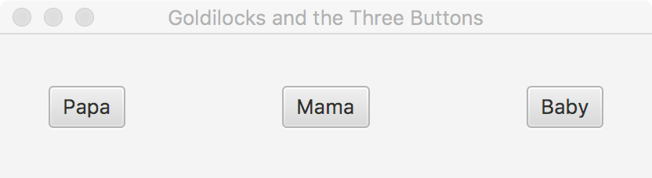
A Simple Example (1)
Make a new JavaFX project
Create a GUI with three buttons
final HBox pane = new HBox(100);
pane.setAlignment(Pos.CENTER);
final Button btnP = new Button("Papa");
final Button btnM = new Button("Mama");
final Button btnB = new Button("Baby");
pane.getChildren().addAll(btnP, btnM, btnB);
primaryStage.setTitle("Goldilocks and the Three Buttons");
primaryStage.setScene(new Scene(pane));
primaryStage.show();

Slide 7
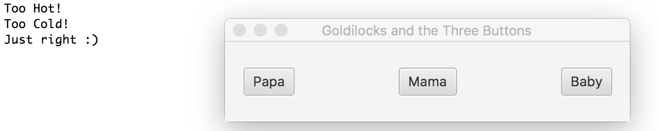
A Simple Example (2)
Handle event: Any class that implements the appropriate interface can be used, including anonymous inner classes and Lambda’s
private static class JustRight implements
EventHandler<ActionEvent> {
@Override
public void handle(ActionEvent event) {
System.out.printf("Just right :)%n");
}
}
btnP.setOnAction(new EventHandler<ActionEvent>() {
@Override
public void handle(ActionEvent event) {
System.out.printf("Too Hot!%n");
}
});
btnM.setOnAction(e->{ System.out.printf("Too Cold!%n");
});
btnB.setOnAction(new JustRight());
Notes:
--module-path "\path\to\javafx-sdk-12.0.1\lib" --add-modules javafx.controls,javafx.fxml
--module-path "C:\Program Files\Java\jdk-15.0.1\lib" --add-modules javafx.controls,javafx.fxml

Slide 8
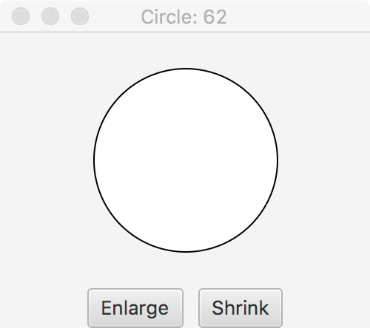
Exercise
Create a JavaFX application that allows you to grow/shrink a circle via buttons

Slide 9
Solution
Circle c = new Circle(50);
c.setStroke(Color.BLACK);
c.setFill(Color.WHITE);
Button grow = new Button("Grow");
grow.setOnAction(new EventHandler<ActionEvent>() {
@Override
public void handle(ActionEvent event) {
c.setRadius(c.getRadius()+3);
}
});
Button shrink = new Button("Shrink");
shrink.setOnAction(new EventHandler<ActionEvent>() {
@Override
public void handle(ActionEvent event) {
c.setRadius(c.getRadius()-3);
}
});
HBox hb = new HBox();
hb.getChildren().add(grow);
hb.getChildren().add(shrink);
hb.setSpacing(10);
hb.setPadding(new Insets(10));
hb.setAlignment(Pos.CENTER);
VBox vb = new VBox();
vb.getChildren().add(c);
vb.getChildren().add(hb);
vb.setAlignment(Pos.CENTER);
primaryStage.setTitle("Circle");
primaryStage.setScene(new Scene(vb, 200, 200));
primaryStage.show();

Slide 10
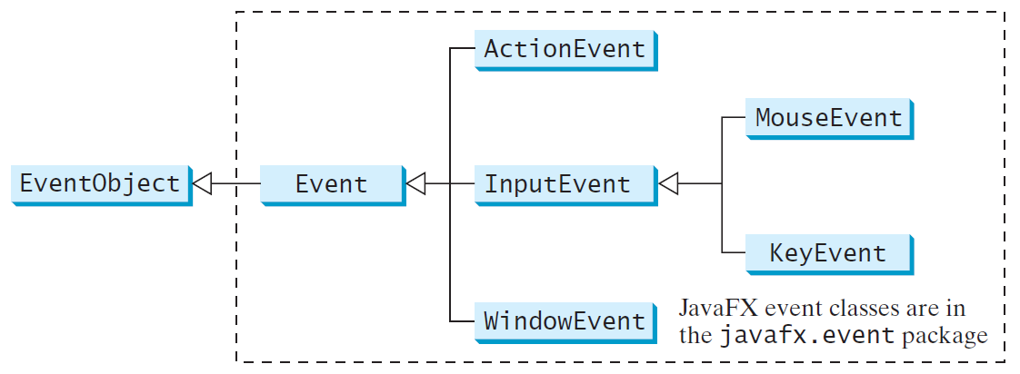
JavaFX Events

Slide 11
Event Information
An event object contains whatever properties are related to the event
You can identify the source object of the event using the getSource() instance method in the EventObject class
The subclasses of EventObject deal with special types of events, such as button actions, window events, component events, mouse movements, and keystrokes

Slide 12
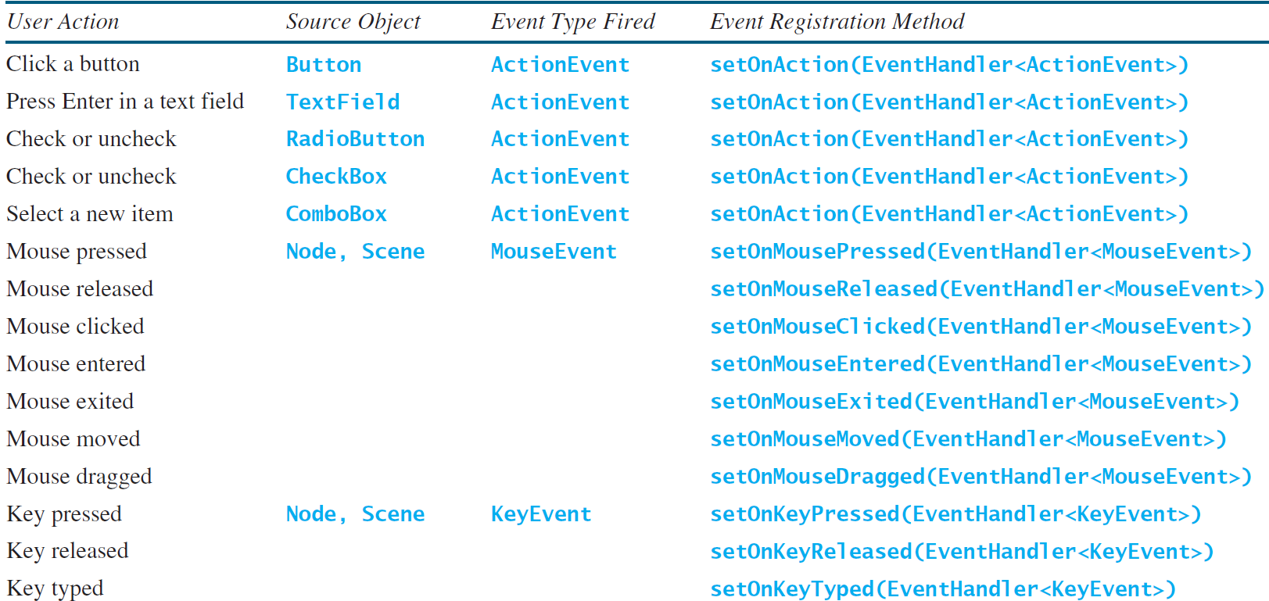
Example User Actions & Handlers

Slide 13
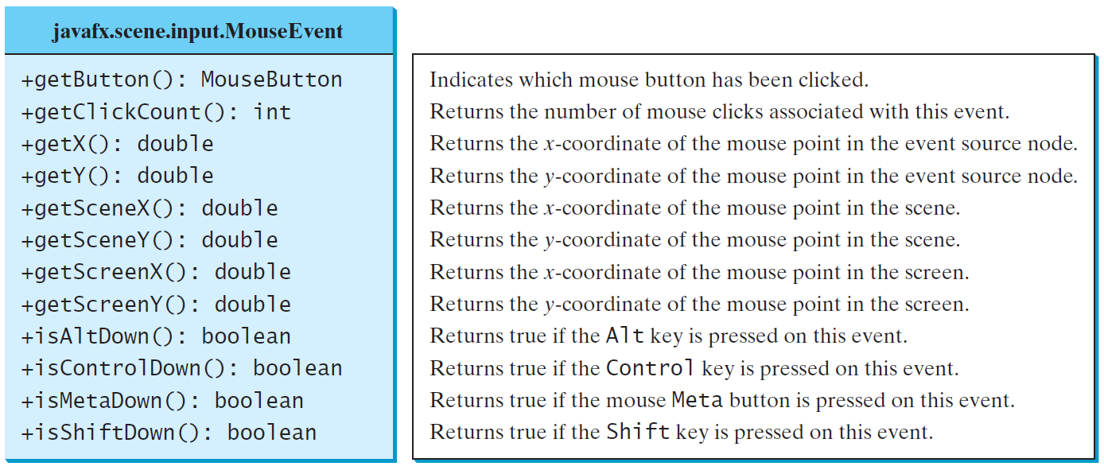
MouseEvent

Slide 14
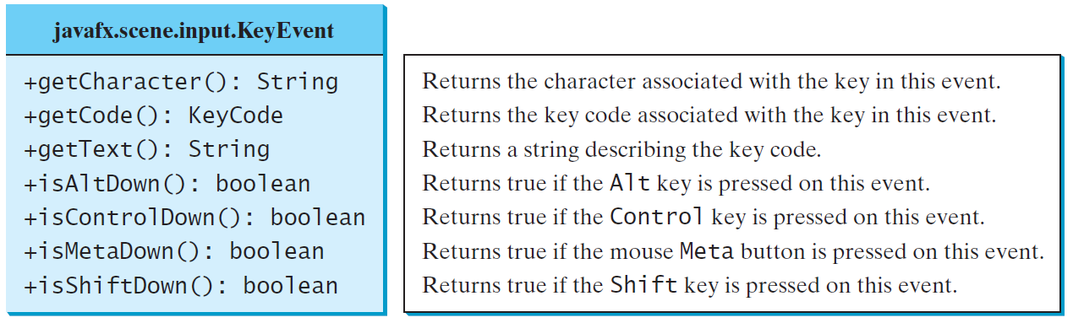
KeyEvent

Slide 15
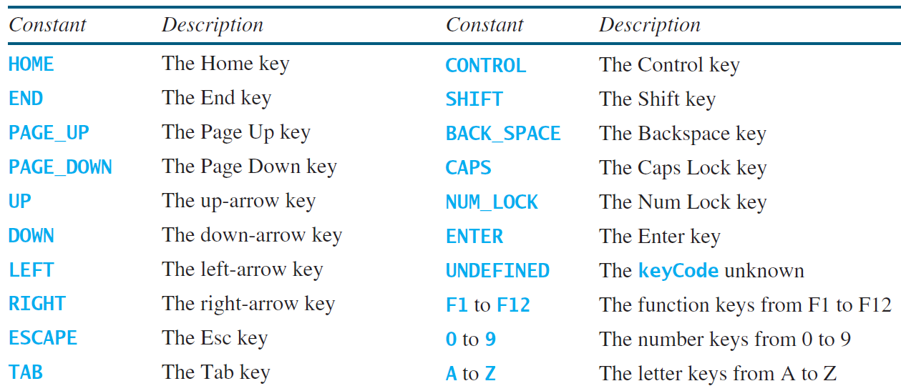
KeyCode Constants

Slide 16
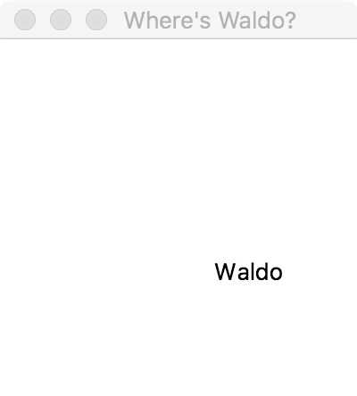
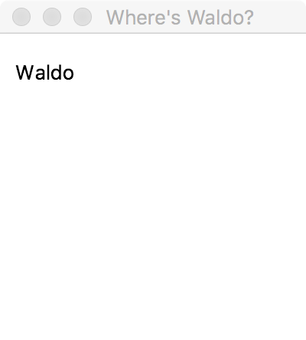
Exercise
Write a JavaFX program that allows the user to control the position of the text "Waldo" via Left/Down/Up/Right arrow keys

Slide 17
Solution
Pane p = new Pane();
Text waldo = new Text("Waldo");
waldo.setX(100);
waldo.setY(100);
waldo.setOnKeyPressed(new EventHandler<KeyEvent>() {
@Override
public void handle(KeyEvent event) {
if (event.getCode() == KeyCode.UP) {
waldo.setY(waldo.getY()-2);
} else if (event.getCode() == KeyCode.DOWN) {
waldo.setY(waldo.getY()+2);
} else if (event.getCode() == KeyCode.LEFT) {
waldo.setX(waldo.getX()-2);
} else if (event.getCode() == KeyCode.RIGHT) {
waldo.setX(waldo.getX()+2);
}
}
});
p.getChildren().add(waldo);
primaryStage.setTitle("Where's Waldo?");
primaryStage.setScene(new Scene(p, 200, 200));
primaryStage.show();
waldo.requestFocus();

Slide 18
JavaFX Animations
JavaFX provides the Animation class with the core functionality for all animations
Look to PathTransition for movement along a path
Look to FadeTransition for opacity change over a given time
The Timeline class supports general animation across specified time intervals

Slide 19
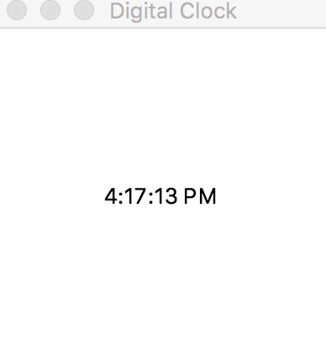
Example
BorderPane pane = new BorderPane();
Text text = new Text(50, 50, "");
pane.setCenter(text);
Scene scene = new Scene(pane, 200, 200);
primaryStage.setTitle("Digital Clock");
primaryStage.setScene(scene);
primaryStage.show();
EventHandler<ActionEvent> eH = new EventHandler<ActionEvent>() {
@Override
public void handle(ActionEvent event) {
final LocalDateTime dt = LocalDateTime.now();
text.setText(String.format("%d:%02d:%02d %sM",
dt.getHour()%12, dt.getMinute(),
dt.getSecond(), dt.getHour()>=12?"P":"A"));
}
};
Timeline a = new Timeline(new KeyFrame(Duration.millis(1000), eH));
a.setCycleCount(Timeline.INDEFINITE);
a.play();

Slide 20
SceneBuilder
A Visual Layout Tool for JavaFX Applications
Quickly design JavaFX GUI via drag-and-drop components that write an FXML file
FXML file can be combined with a Java project
http://gluonhq.com/products/scene-builder/

Slide 21
http://10.220.96.93:8501/

Slide 22
Take Home Points
Event-driven programming is a way of delegating responsibility for handling an event to a class
JavaFX makes heavy use of this model via the EventHandler interface
You now have the basics to create interactive GUIs via code and/or SceneBuilder

