Slide 1

Welcome to COMP1050!
Professor Folajimi
Notes:
WIT COMP1050 Computer Science II Course Material by Wentworth Institute of Technology (http://www.wit.edu/computer-science) is licensed under a Creative Commons Attribution-NonCommercial 4.0 International License (http://creativecommons.org/licenses/by-nc/4.0/).

Slide 2

Java Collection Framework
Notes:
Object-oriented programming (OOP) is a computer programming model that organizes software design around data, or objects, rather than functions and logic. An object can be defined as a data field that has unique attributes and behavior.
OOP focuses on the objects that developers want to manipulate rather than the logic required to manipulate them. This approach to programming is well-suited for programs that are large, complex and actively updated or maintained.
The organization of an object-oriented program also makes the method beneficial to collaborative development, where projects are divided into groups.
Additional benefits of OOP include code reusability, scalability and efficiency. Even when using microservices, developers should continue to apply the principles of OOP.
The first step in OOP is to collect all of the objects a programmer wants to manipulate and identify how they relate to each other -- an exercise often known as data modeling.
Examples of an object can range from physical entities, such as a human being who is described by properties like name and address, down to small computer programs, such as widgets.
Once an object is known, it is labeled with a class of objects that defines the kind of data it contains and any logic sequences that can manipulate it. Each distinct logic sequence is known as a method. Objects can communicate with well-defined interfaces called messages.

Slide 3
What is a Data Structure?
A data structure is a collection of data organized in some fashion
The structure not only stores data but also supports operations for accessing/manipulating the data
Java provides several data structures that can be used to organize/manipulate data efficiently in the Java Collections Framework

Slide 4
Java Collections Framework (JCF)
The Java Collections Framework (JCF) is a unified architecture for storing and manipulating groups of objects in Java.
Key Features:
  Reduces programming effort by providing reusable data structures and algorithms.
  Provides type safety and eliminates the need for manually implementing collections.
  Includes Interfaces, Classes, and Algorithms.
JCF supports two types of containers:
  Storing a collection of elements (collection)
  Storing key/value pairs (map)
Notes:
Key Features:
Reduces programming effort by providing reusable data structures and algorithms.
Provides type safety and eliminates the need for manually implementing collections.
Includes Interfaces, Classes, and Algorithms.

Slide 5
Example
final Collection<String> c = new ArrayList<>();
c.add("New York");
c.add("Atlanta");
c.add("Dallas");
c.add("Madison");
final Iterator<String> i = c.iterator();
while(i.hasNext()) {
System.out.printf("%s ", i.next().toUpperCase());
}
System.out.printf("- done!%n");
Notes:
List<String> names = new ArrayList<>();
names.add("Alice");
names.add("Bob");

Slide 6
The foreach Loop
Any type that implements Iterable can be iterated over via the foreach loop:
for (String s : c) {
System.out.printf("%s ", s.toUpperCase());
}

Slide 7
Hierarchy of JCF
Core Interfaces:
  Collection: The root interface for most collections.
  List: Ordered collection (e.g., ArrayList, LinkedList).
  Set: Unordered collection with unique elements (e.g., HashSet, TreeSet).
  Queue: Ordered collection for processing (e.g., PriorityQueue).
  Map: Key-value pairs (e.g., HashMap, TreeMap).

Slide 8
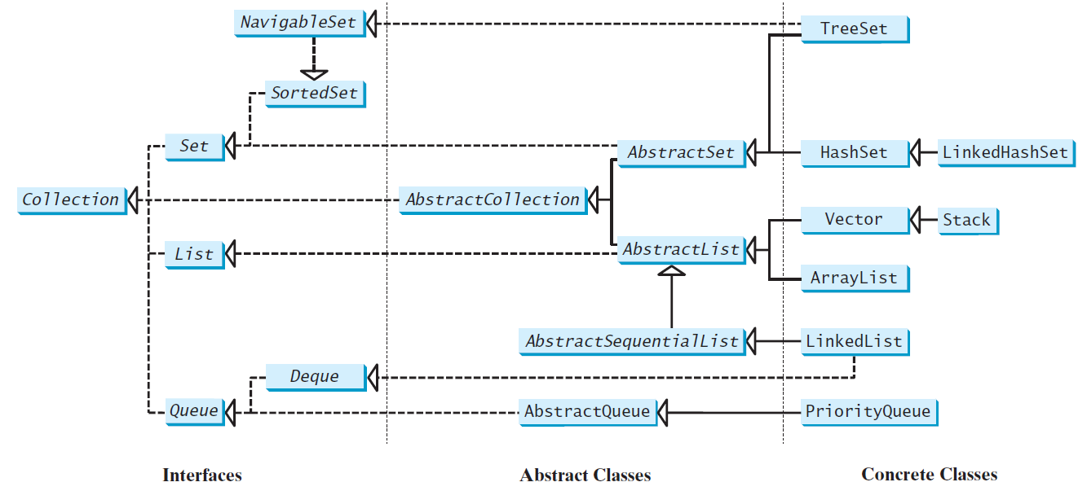
JCF Hierarchy (1)
Why this distinction?

Slide 9
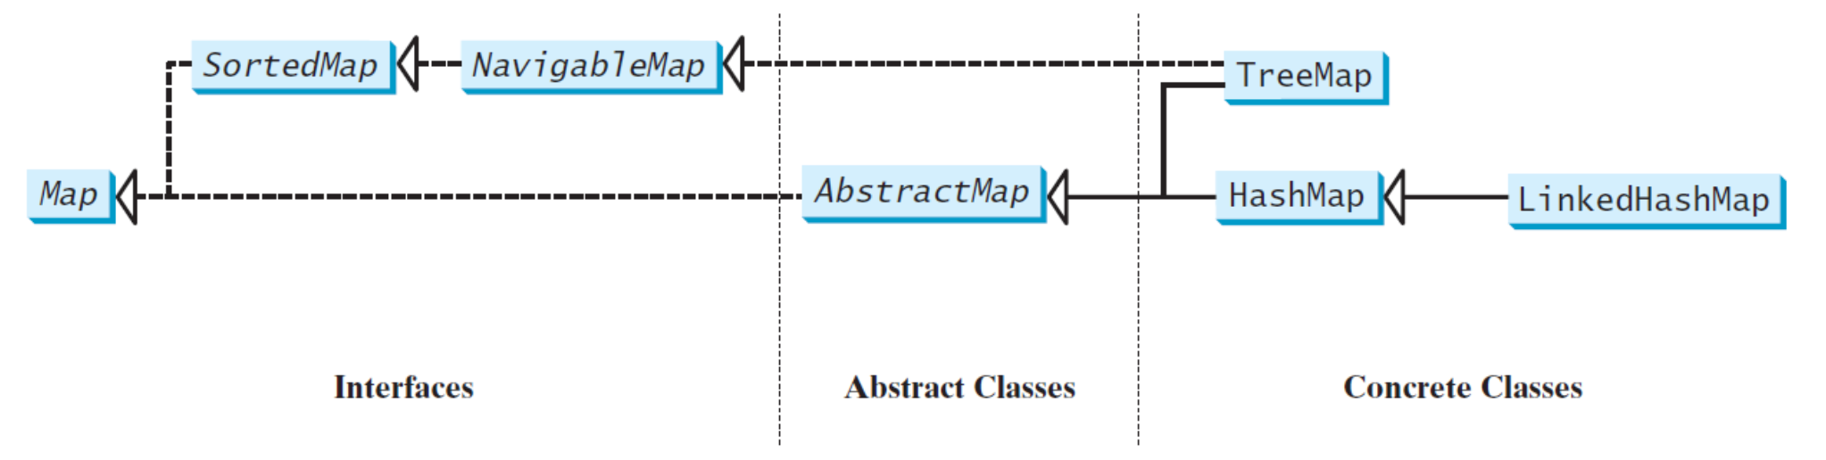
JCF Hierarchy (2)

Slide 10
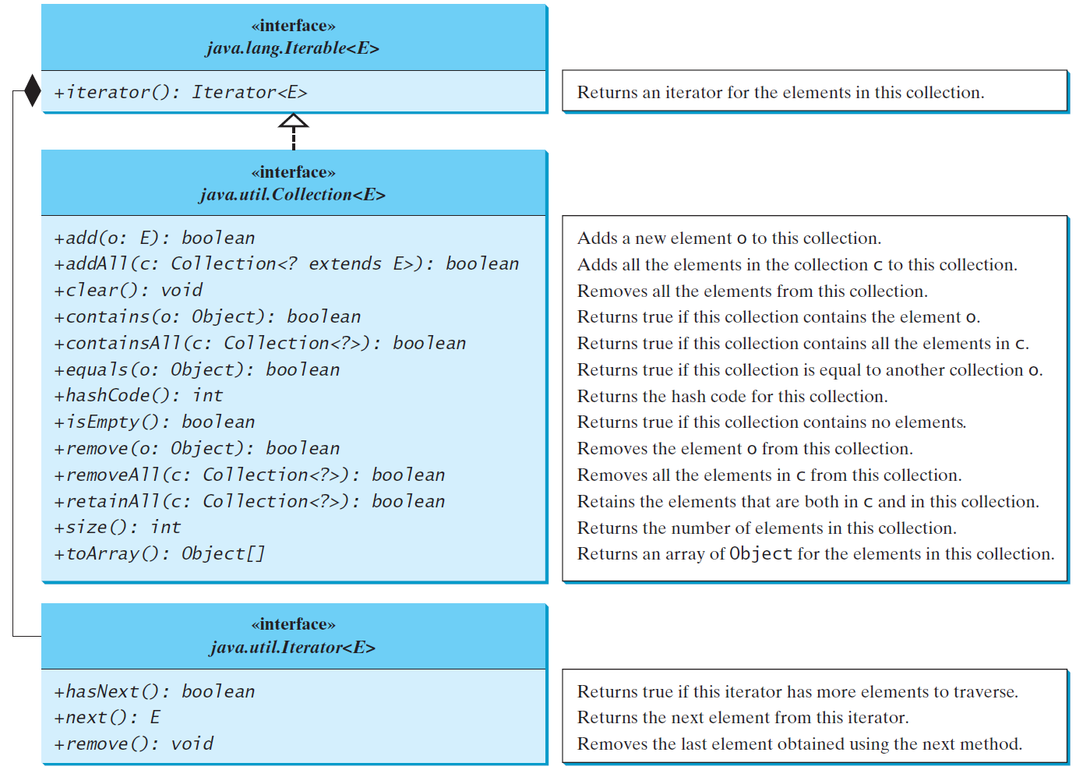
The Collection Interface

Slide 11
Key Classes and Use Cases
List:
  Maintains insertion order.
  Example: ArrayList, LinkedList.
  Use Case: Storing ordered data.
List<String> names = new ArrayList<>();
names.add("Alice");
names.add("Bob");
Notes:
List:
Maintains insertion order.
Example: ArrayList, LinkedList.
Use Case: Storing ordered data.

Slide 12
Key Classes and Use Cases
Set:
  No duplicate elements.
  Example: HashSet, TreeSet.Use
  Case: Storing unique IDs.
Set<Integer> ids = new HashSet<>();
ids.add(1);
ids.add(2);
Notes:
List:
Maintains insertion order.
Example: ArrayList, LinkedList.
Use Case: Storing ordered data.

Slide 13
Key Classes and Use Cases
Map:
  Stores key-value pairs.
  Example: HashMap, TreeMap.
  Use Case: Storing a phone directory..
Map<String, String> phoneBook = new HashMap<>();
phoneBook.put("Alice", "123-456");
phoneBook.put("Bob", "987-654");

Slide 14
Benefits of JCF
Standardized API: Consistent and reusable interfaces.
Type Safety: Generics reduce runtime errors.
Performance: Efficient data structures for different use cases.
Algorithms: Built-in methods like sorting and searching.
Example: Sorting a list:
List<Integer> numbers = Arrays.asList(5, 2, 8);
Collections.sort(numbers);
System.out.println(numbers); // Output: [2, 5, 8]

Slide 15
Practical Example
import java.util.*;
public class CollectionExample {
public static void main(String[] args) {
List<String> list = new ArrayList<>();
list.add("Apple");
list.add("Banana");
list.add("Cherry");
Set<Integer> set = new HashSet<>();
set.add(10);
set.add(20);
Map<String, Integer> map = new HashMap<>();
map.put("Alice", 25);
map.put("Bob", 30);
System.out.println("List: " + list);
System.out.println("Set: " + set);
System.out.println("Map: " + map);
}
}
Map<String, Integer> map = new HashMap<>();
map.put("Alice", 25);
map.put("Bob", 30);
System.out.println("List: " + list);
System.out.println("Set: " + set);
System.out.println("Map: " + map);
}
}

Slide 16
Exercise
Use ArrayList to store the following items and assign it to the variable myCollection of type Collection
  Pineapple, Banana, Orange, Apple, Watermelon
Use an Iterator to traverse all items in myCollection and print out items that contain “an”

Slide 17
Solution
final Collection<String> myCollection = new ArrayList<>();
myCollection.add("Pineapple");
myCollection.add("Banana");
myCollection.add("Orange");
myCollection.add("Apple");
myCollection.add("Watermelon");
final Iterator<String> myIterator = myCollection.iterator();
while(myIterator.hasNext()) {
final String str = myIterator.next();
if (str.toLowerCase().contains("an")) {
System.out.printf("%s%n", str);
}
}

Slide 18
All the Useful!
Name | What is it good for*? | Implementations
List | A sequence; access via index, search | ArrayList, Vector, LinkedList
 | + push, pop, peek (i.e. LIFO) | Stack
Set | Distinct objects (i.e. no duplicates) | Linked/HashSet, TreeSet
Queue | Hold elements in line (i.e. FIFO) | LinkedList
 | + custom ordering | PriorityQueue
Map | Associate two objects | HashMap
 | + ordered iteration | LinkedHashMap, TreeMap
*War Absolutely nothing! Huh, Yeah
Notes:
HashMap: fastest, no key ordering
LinkedHashMap: very fast, insertion order
TreeMap: fast, order via Comparable/Comparator
List A sequence; access via index, search ArrayList, Vector, LinkedList
+ push, pop, peek (i.e. LIFO) Stack
Set Distinct objects (i.e. no duplicates) Linked/HashSet, TreeSet
Queue Hold elements in line (i.e. FIFO) LinkedList
+ custom ordering PriorityQueue
Map Associate two objects HashMap
+ ordered iteration LinkedHashMap, TreeMap

Slide 19
Lists
The List interface extends the Collection interface
A list stores elements in a sequential order, and allows the user to specify where the element is store
  The user can access the elements by index
Notes:
HashMap: fastest, no key ordering
LinkedHashMap: very fast, insertion order
TreeMap: fast, order via Comparable/Comparator
List A sequence; access via index, search ArrayList, Vector, LinkedList
+ push, pop, peek (i.e. LIFO) Stack
Set Distinct objects (i.e. no duplicates) Linked/HashSet, TreeSet
Queue Hold elements in line (i.e. FIFO) LinkedList
+ custom ordering PriorityQueue
Map Associate two objects HashMap
+ ordered iteration LinkedHashMap, TreeMap

Slide 20
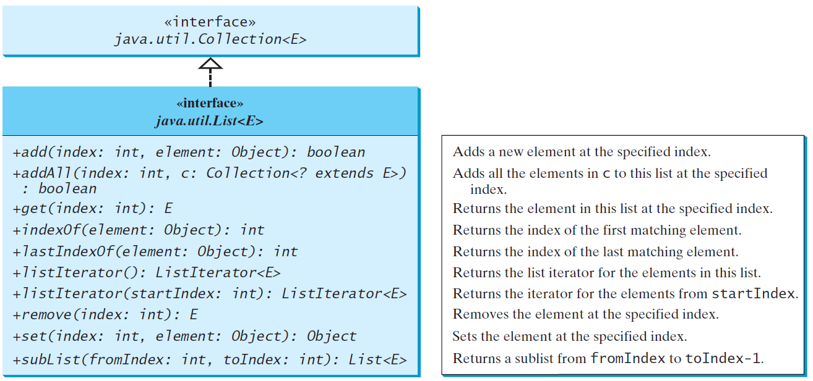
The List Interface
Notes:
HashMap: fastest, no key ordering
LinkedHashMap: very fast, insertion order
TreeMap: fast, order via Comparable/Comparator
List A sequence; access via index, search ArrayList, Vector, LinkedList
+ push, pop, peek (i.e. LIFO) Stack
Set Distinct objects (i.e. no duplicates) Linked/HashSet, TreeSet
Queue Hold elements in line (i.e. FIFO) LinkedList
+ custom ordering PriorityQueue
Map Associate two objects HashMap
+ ordered iteration LinkedHashMap, TreeMap

Slide 21
Sets
The Set interface simply states that an instance contains no duplicates
No two elements e1 and e2 can be in the set such that e1.equals(e2) is true
Key implementation question: do you need an ordering when iterating elements?
  If so, what kind?
Notes:
HashMap: fastest, no key ordering
LinkedHashMap: very fast, insertion order
TreeMap: fast, order via Comparable/Comparator
List A sequence; access via index, search ArrayList, Vector, LinkedList
+ push, pop, peek (i.e. LIFO) Stack
Set Distinct objects (i.e. no duplicates) Linked/HashSet, TreeSet
Queue Hold elements in line (i.e. FIFO) LinkedList
+ custom ordering PriorityQueue
Map Associate two objects HashMap
+ ordered iteration LinkedHashMap, TreeMap

Slide 22
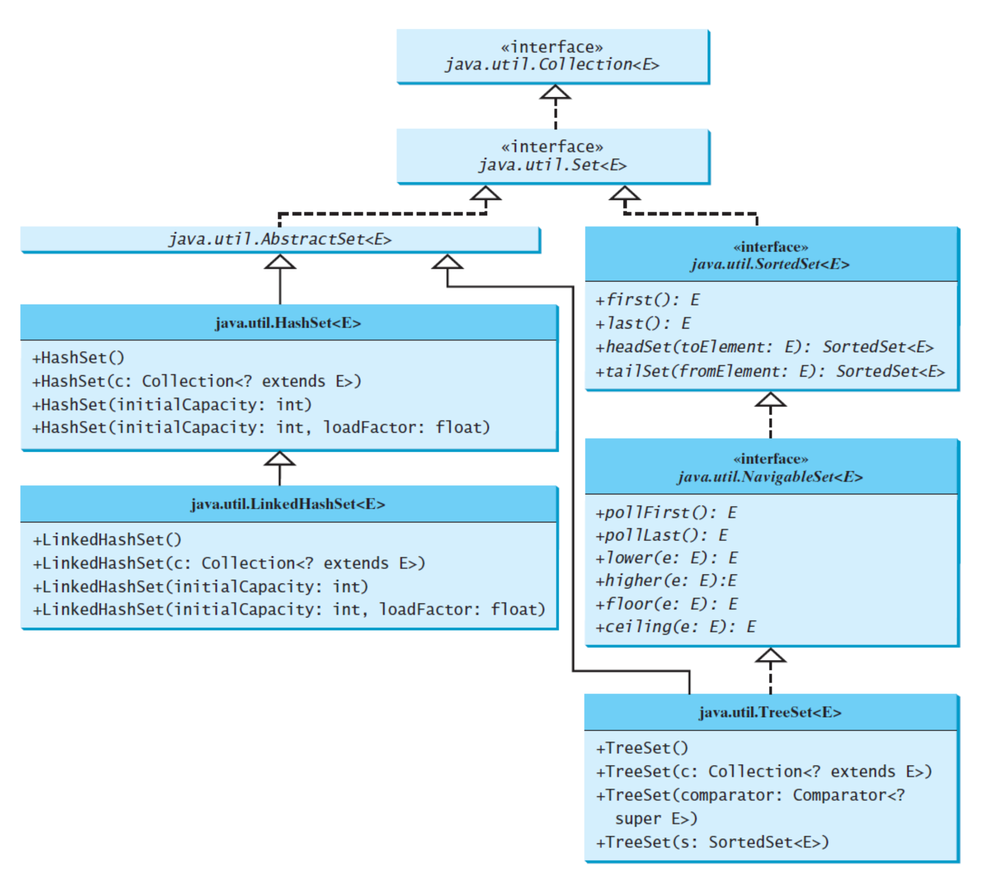
Set Hierarchy
Notes:
HashMap: fastest, no key ordering
LinkedHashMap: very fast, insertion order
TreeMap: fast, order via Comparable/Comparator
List A sequence; access via index, search ArrayList, Vector, LinkedList
+ push, pop, peek (i.e. LIFO) Stack
Set Distinct objects (i.e. no duplicates) Linked/HashSet, TreeSet
Queue Hold elements in line (i.e. FIFO) LinkedList
+ custom ordering PriorityQueue
Map Associate two objects HashMap
+ ordered iteration LinkedHashMap, TreeMap

Slide 23
Queues
The Queue interface represents a first-in/first-out (FIFO) data structure
  Elements are appended to the end of the queue and are removed from the beginning
The PriorityQueue interface represents a queue in which elements are assigned priorities
  When accessing elements, the element with the highest priority is removed first
Come in handy for storing items to process (e.g. work queues)
Notes:
HashMap: fastest, no key ordering
LinkedHashMap: very fast, insertion order
TreeMap: fast, order via Comparable/Comparator
List A sequence; access via index, search ArrayList, Vector, LinkedList
+ push, pop, peek (i.e. LIFO) Stack
Set Distinct objects (i.e. no duplicates) Linked/HashSet, TreeSet
Queue Hold elements in line (i.e. FIFO) LinkedList
+ custom ordering PriorityQueue
Map Associate two objects HashMap
+ ordered iteration LinkedHashMap, TreeMap

Slide 24
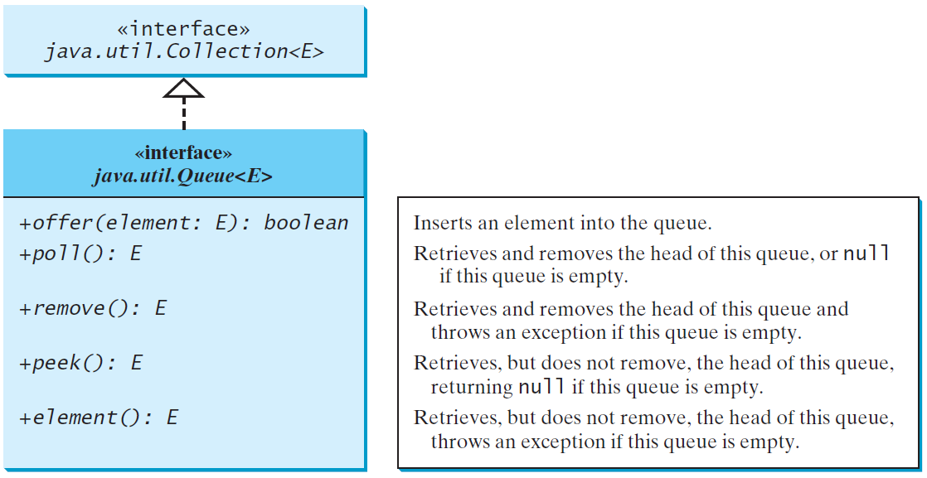
Queue Interface
Notes:
HashMap: fastest, no key ordering
LinkedHashMap: very fast, insertion order
TreeMap: fast, order via Comparable/Comparator
List A sequence; access via index, search ArrayList, Vector, LinkedList
+ push, pop, peek (i.e. LIFO) Stack
Set Distinct objects (i.e. no duplicates) Linked/HashSet, TreeSet
Queue Hold elements in line (i.e. FIFO) LinkedList
+ custom ordering PriorityQueue
Map Associate two objects HashMap
+ ordered iteration LinkedHashMap, TreeMap

Slide 25
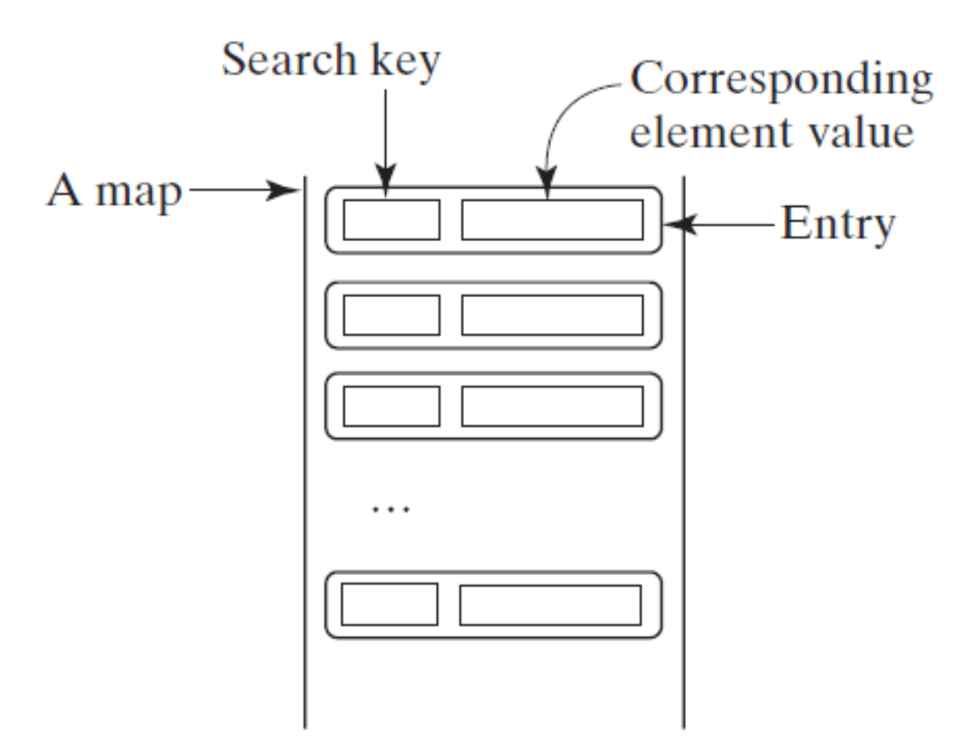
What are Maps?
Think of a map as an array… but where the index can be anything!
Technically a map is a set of Entry elements, each with a “key” and a “value”
Each key must be unique – this can be used to get/set the corresponding value
Notes:
HashMap: fastest, no key ordering
LinkedHashMap: very fast, insertion order
TreeMap: fast, order via Comparable/Comparator
List A sequence; access via index, search ArrayList, Vector, LinkedList
+ push, pop, peek (i.e. LIFO) Stack
Set Distinct objects (i.e. no duplicates) Linked/HashSet, TreeSet
Queue Hold elements in line (i.e. FIFO) LinkedList
+ custom ordering PriorityQueue
Map Associate two objects HashMap
+ ordered iteration LinkedHashMap, TreeMap

Slide 26
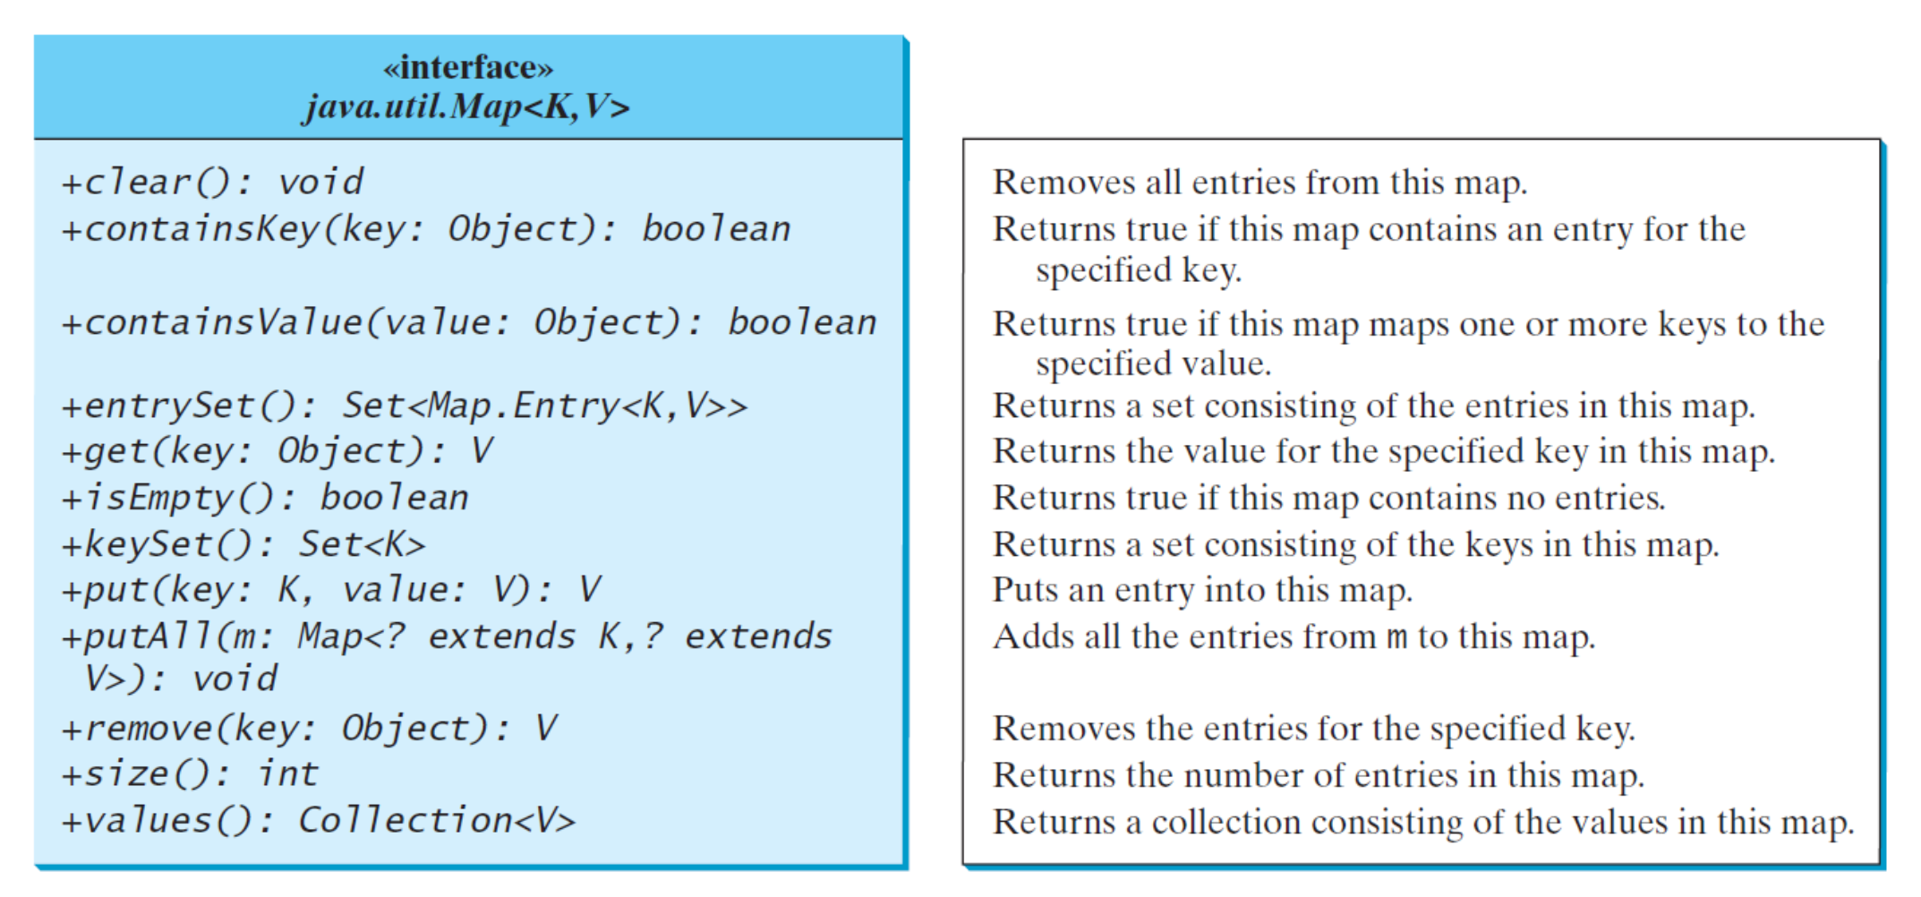
The Map Interface
Notes:
HashMap: fastest, no key ordering
LinkedHashMap: very fast, insertion order
TreeMap: fast, order via Comparable/Comparator
List A sequence; access via index, search ArrayList, Vector, LinkedList
+ push, pop, peek (i.e. LIFO) Stack
Set Distinct objects (i.e. no duplicates) Linked/HashSet, TreeSet
Queue Hold elements in line (i.e. FIFO) LinkedList
+ custom ordering PriorityQueue
Map Associate two objects HashMap
+ ordered iteration LinkedHashMap, TreeMap

Slide 27
Example (1)
public static <K, V> void inMap(Map<K,V> m, K key) {
System.out.printf("%s: %s%n", key,
m.containsKey(key)?m.get(key):"not in map");
}
public static void main(String[] args) {
Map<String, Integer> m = new HashMap<>();
m.put("Mount Everest", 29029);
m.put("K2", 28251);
m.put("Kangchenjunga", 28169);
m.put("Lhotse", 27940);
m.put("Makalu", 27838);
inMap(m, "K2");
inMap(m, "Manaslu");
System.out.printf("%nContents:%n");
for (Entry<String, Integer> e : m.entrySet()) {
System.out.printf(" %s=%d%n",
e.getKey(), e.getValue());
}
}
K2: 28251
Manaslu: not in map
Contents:
K2=28251
Mount Everest=29029
Kangchenjunga=28169
Lhotse=27940
Makalu=27838
Notes:
HashMap: fastest, no key ordering
LinkedHashMap: very fast, insertion order
TreeMap: fast, order via Comparable/Comparator
List A sequence; access via index, search ArrayList, Vector, LinkedList
+ push, pop, peek (i.e. LIFO) Stack
Set Distinct objects (i.e. no duplicates) Linked/HashSet, TreeSet
Queue Hold elements in line (i.e. FIFO) LinkedList
+ custom ordering PriorityQueue
Map Associate two objects HashMap
+ ordered iteration LinkedHashMap, TreeMap

Slide 28
Example (2)
public static <K, V> void inMap(Map<K,V> m, K key) {
System.out.printf("%s: %s%n", key,
m.containsKey(key)?m.get(key):"not in map");
}
public static void main(String[] args) {
Map<String, Integer> m = new LinkedHashMap<>();
m.put("Mount Everest", 29029);
m.put("K2", 28251);
m.put("Kangchenjunga", 28169);
m.put("Lhotse", 27940);
m.put("Makalu", 27838);
inMap(m, "K2");
inMap(m, "Manaslu");
System.out.printf("%nContents:%n");
for (Entry<String, Integer> e : m.entrySet()) {
System.out.printf(" %s=%d%n",
e.getKey(), e.getValue());
}
}
K2: 28251
Manaslu: not in map
Contents:
Mount Everest=29029
K2=28251
Kangchenjunga=28169
Lhotse=27940
Makalu=27838
Notes:
HashMap: fastest, no key ordering
LinkedHashMap: very fast, insertion order
TreeMap: fast, order via Comparable/Comparator
List A sequence; access via index, search ArrayList, Vector, LinkedList
+ push, pop, peek (i.e. LIFO) Stack
Set Distinct objects (i.e. no duplicates) Linked/HashSet, TreeSet
Queue Hold elements in line (i.e. FIFO) LinkedList
+ custom ordering PriorityQueue
Map Associate two objects HashMap
+ ordered iteration LinkedHashMap, TreeMap

Slide 29
Example (3)
public static <K, V> void inMap(Map<K,V> m, K key) {
System.out.printf("%s: %s%n", key,
m.containsKey(key)?m.get(key):"not in map");
}
public static void main(String[] args) {
Map<String, Integer> m = new TreeMap<>();
m.put("Mount Everest", 29029);
m.put("K2", 28251);
m.put("Kangchenjunga", 28169);
m.put("Lhotse", 27940);
m.put("Makalu", 27838);
inMap(m, "K2");
inMap(m, "Manaslu");
System.out.printf("%nContents:%n");
for (Entry<String, Integer> e : m.entrySet()) {
System.out.printf(" %s=%d%n",
e.getKey(), e.getValue());
}
}
K2: 28251
Manaslu: not in map
Contents:
K2=28251
Kangchenjunga=28169
Lhotse=27940
Makalu=27838
Mount Everest=29029
Notes:
HashMap: fastest, no key ordering
LinkedHashMap: very fast, insertion order
TreeMap: fast, order via Comparable/Comparator
List A sequence; access via index, search ArrayList, Vector, LinkedList
+ push, pop, peek (i.e. LIFO) Stack
Set Distinct objects (i.e. no duplicates) Linked/HashSet, TreeSet
Queue Hold elements in line (i.e. FIFO) LinkedList
+ custom ordering PriorityQueue
Map Associate two objects HashMap
+ ordered iteration LinkedHashMap, TreeMap

Slide 30
Example (4)
K2: 28251
Manaslu: not in map
Contents:
Mount Everest=29029
Makalu=27838
Lhotse=27940
Kangchenjunga=28169
K2=28251
public static <K, V> void inMap(Map<K,V> m, K key) {
System.out.printf("%s: %s%n", key,
m.containsKey(key)?m.get(key):"not in map");
}
public static void main(String[] args) {
Map<String, Integer> m = new TreeMap<>(
(k1,k2)->-k1.compareTo(k2));
m.put("Mount Everest", 29029);
m.put("K2", 28251);
m.put("Kangchenjunga", 28169);
m.put("Lhotse", 27940);
m.put("Makalu", 27838);
inMap(m, "K2");
inMap(m, "Manaslu");
System.out.printf("%nContents:%n");
for (Entry<String, Integer> e : m.entrySet()) {
System.out.printf(" %s=%d%n",
e.getKey(), e.getValue());
}
}
Notes:
HashMap: fastest, no key ordering
LinkedHashMap: very fast, insertion order
TreeMap: fast, order via Comparable/Comparator
List A sequence; access via index, search ArrayList, Vector, LinkedList
+ push, pop, peek (i.e. LIFO) Stack
Set Distinct objects (i.e. no duplicates) Linked/HashSet, TreeSet
Queue Hold elements in line (i.e. FIFO) LinkedList
+ custom ordering PriorityQueue
Map Associate two objects HashMap
+ ordered iteration LinkedHashMap, TreeMap

Slide 31
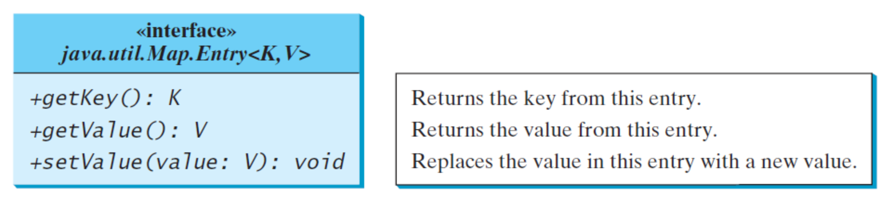
The Entry Interface
Notes:
Entry interface enables you to work with a map entry.
The entrySet( ) method declared by the Map interface returns a Set containing the map entries.
Each of these set elements is a Map
HashMap: fastest, no key ordering
LinkedHashMap: very fast, insertion order
TreeMap: fast, order via Comparable/Comparator
List A sequence; access via index, search ArrayList, Vector, LinkedList
+ push, pop, peek (i.e. LIFO) Stack
Set Distinct objects (i.e. no duplicates) Linked/HashSet, TreeSet
Queue Hold elements in line (i.e. FIFO) LinkedList
+ custom ordering PriorityQueue
Map Associate two objects HashMap
+ ordered iteration LinkedHashMap, TreeMap

Slide 32
Key Ordering
As with sets, the primary difference in concrete implementations comes down to key ordering
HashMap: fastest, no key ordering
LinkedHashMap: very fast, insertion order
TreeMap: fast, order via Comparable/Comparator
Notes:
HashMap: fastest, no key ordering
LinkedHashMap: very fast, insertion order
TreeMap: fast, order via Comparable/Comparator
List A sequence; access via index, search ArrayList, Vector, LinkedList
+ push, pop, peek (i.e. LIFO) Stack
Set Distinct objects (i.e. no duplicates) Linked/HashSet, TreeSet
Queue Hold elements in line (i.e. FIFO) LinkedList
+ custom ordering PriorityQueue
Map Associate two objects HashMap
+ ordered iteration LinkedHashMap, TreeMap

Slide 33
Exercise
Use a LinkedHashMap to create a menu with the following items, care of Bertie Bott
  Booger: $1
  Rotten Egg: $1.50
  Vomit: $1
  Cherry: $2
Write a method that updates the map to increase the price of all items by $0.50

Slide 34
Solution
public static void p(Map<?,? extends Number> m) {
for (Entry<?, ? extends Number> e : m.entrySet()) {
System.out.printf("%s=%.2f%n", e.getKey(), e.getValue().doubleValue());
}
System.out.printf("%n");
}
public static <K> void inc(Map<K, ? super Double> m, double amt) {
for (K k : m.keySet()) {
m.replace(k, (double) m.get(k) + amt);
}
}
public static void main(String[] args) {
Map<String, Double> m = new LinkedHashMap<>();
m.put("Booger", 1.);
m.put("Rotten Egg", 1.5);
m.put("Vomit", 1.);
m.put("Cherry", 2.);
p(m);
inc(m, 0.5);
p(m);
}
Booger=1.00
Rotten Egg=1.50
Vomit=1.00
Cherry=2.00
Booger=1.50
Rotten Egg=2.00
Vomit=1.50
Cherry=2.50
Notes:
List A sequence; access via index, search ArrayList, Vector, LinkedList
+ push, pop, peek (i.e. LIFO) Stack
Set Distinct objects (i.e. no duplicates) Linked/HashSet, TreeSet
Queue Hold elements in line (i.e. FIFO) LinkedList
+ custom ordering PriorityQueue
Map Associate two objects HashMap
+ ordered iteration LinkedHashMap, TreeMap

Slide 35
Take Home Points
A data structure is a collection of data organized to support efficient operations that access/modify the data
The Java Collections Framework provides a set of data structures for you to use in your programs
  Collections contain elements
  Maps contain key-value pairs
Iterators are a common pattern by which to access elements of data structures, independent of how they are implemented
  Make foreach loops work!

Slide 36
Take Home Points (2)
Name | What is it good for*? | Implementations
List | A sequence; access via index, search | ArrayList, Vector, LinkedList
 | + push, pop, peek (i.e. LIFO) | Stack
Set | Distinct objects (i.e. no duplicates) | Linked/HashSet, TreeSet
Queue | Hold elements in line (i.e. FIFO) | LinkedList
 | + custom ordering | PriorityQueue
Map | Associate two objects | HashMap
 | + ordered iteration | LinkedHashMap, TreeMap
The JCF has many useful data structures
Choosing the correct interface and concrete implementation requires you to understand your data, the important operations, and efficiency tradeoffs

