Slide 1

…Overview of Platforms …Web Web Application Frameworks
Web Application Framework (WAF) can also simply be referred to as Web Framework (WF).
A WAF is a software designed to facilitate the development of web applications by automating common activities that are typically part of web development.
WAFs have been developed for different languages
Most of the WAFs use MVC (Model-View-Controller) Architecture

Slide 2
…Learning Outcomes
Database Access
Session Management. Typically HTTP session
URL route definition and access control
Template Engine or Template Processor. It facilitates the dynamic generation of HTML pages from templates and data

Slide 3
…Learning Outcomes
S/N | WAF Name + Project URL | Primary Language | Typical Template Engine | Popular Web App built with Framework
1 | Flask + http://flask.pocoo.org/ | Python | Jinja2 | -Pinterest -Twilio
2 | Django + https://www.djangoproject.com/ | Python | -Django Template Language (DTL) -Jinja2 | -Instagram -Disqus -Pinterest -Washington Post -Eventbrite -Etc.
3 | Zend + https://framework.zend.com/ | PHP | -Zend view -PHP | -Magento eCommerce solution
4 | Symfony + https://symfony.com/ | PHP | -Twig -PHP | -Drupal Content Management System, Etc.
5 | Laravel + https://laravel.com/ | PHP | -PHP | -Mastercard -etc.

Slide 4
…Learning Outcomes
S/N | WAF Name + Project URL | Primary Language | Typical Template Engine | Popular Web App built with Framework
1 | Flask + http://flask.pocoo.org/ | Python | Jinja2 | -Pinterest -Twilio
2* | Django + https://www.djangoproject.com/ | Python | -Django Template Language (DTL) -Jinja2 | -Instagram -Disqus -Pinterest -Washington Post -Eventbrite -Etc.
3 | Zend + https://framework.zend.com/ | PHP | -Zend view -PHP | -Magento eCommerce solution
4 | Symfony + https://symfony.com/ | PHP | -Twig -PHP | -Drupal Content Management System, Etc.
5 | Laravel + https://laravel.com/ | PHP | -PHP | -Mastercard -etc.

Slide 5
…Overview of Platforms …Web …Content Management Systems (CMS)
Software designed to create and manage digital content.
Web-based Content Management Systems (CMS) enable quick creation of dynamic web pages.
Can ship with application modules out-of-the-box
Software coding not required for use out-of-the-box.
Less flexible for software coding than WAF.

Slide 6
…Overview of Platforms …Web …Content Management Systems (CMS)
S/N | CMS Name + Project URL | Primary Language | Popular Web App built with CMS
1.* | Odoo + https://www.odoo.com/ | Python | SIMS
2.* | ERPNext + https://erpnext.org/ | Python | erpnext.com SaaS
2.* | Wordpress + https://wordpress.org/ | PHP | PAU Website
3. | Liferay + https://www.liferay.com/ | Java | UNAV.es
4. | DotNetNuke + http://www.dnnsoftware.com/ | C# ASP | See http://www.dnnsoftware.com/community/participate/community-showcase
5. | -NodeJS CMSs + See https://www.slant.co/topics/1847/~node-js-based-cms for examples -Strapi – headless CMS (strapi.io) | JavaScript (NodeJS)

Slide 7
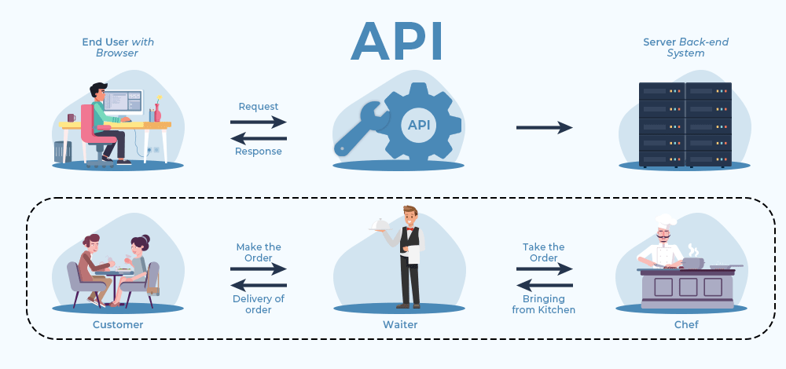
…Overview of Platforms …Web …Application Programming Interface (API)
An Application Programming Interface (API) is a set of rules that allows different software applications to communicate with each other.

Slide 8
…Overview of Platforms …Web …Application Programming Interface (API)
It allows two systems to communicate with each other (share data and access resources).
One application acts as a client and the other acts as a server. A client asks for some resource, say for example a photo, and the server sends that photo to the client.

Slide 9
…Overview of Platforms …Web … Types of API
1. Web APIs – Used for web applications (e.g., REST, GraphQL, SOAP).
2. Library APIs – Provided by software libraries to extend functionality.
3. Operating System APIs – Allow applications to interact with the OS.
4. Hardware APIs – Control hardware devices (e.g., camera, fingerprint scanner).

Slide 10
…Overview of Platforms …Web …HTTP Methods in REST APIs
GET – Fetches data (e.g., getting a list of items)
POST – Creates new data (e.g., adding a new items)
PUT – Replaces existing data (e.g., updating items information)
PATCH – Updates part of the data (e.g., changing a items email)
DELETE – Removes data (e.g., deleting a items)

Slide 11
…Overview of Platforms …Web …HTTP Methods in REST APIs
200 OK – The request was successful
201 Created – A new resource was created
204 No Content – The request worked, but there’s nothing to return
400 Bad Request – Something is wrong with the request
401 Unauthorized – You need permission to access it
403 Forbidden – You don’t have access
404 Not Found – The resource doesn’t exist
500 Internal Server Error – Something went wrong on the server

Slide 12
…Overview of Platforms …Web FastAPI
FastAPI is a modern, fast (high-performance), web framework for building APIs with Python based on standard Python type hints.
The key features are:
Fast: Very high performance, on par with NodeJS and Go (thanks to Starlette and Pydantic).
Fast to code: Increase the speed to develop features by about 200% to 300%.
Fewer bugs: Reduce about 40% of human (developer) induced errors.

Slide 13
…Overview of Platforms …Web FastAPI
Robust: Get production-ready code. With automatic interactive documentation.
Standards-based: Based on (and fully compatible with) the open standards for APIs: OpenAPI and JSON Schema.

Slide 14
…Overview of Platforms …Web FastAPI Installation
Before installing FastAPI, we need to create and activate a Python virtual environment.
Virtual environments isolate the packages you install for each project.
First, create a directory for this project
Run:
mkdir awesome-project
cd awesome-project

Slide 15
…Overview of Platforms …Web FastAPI Installation
To create a virtual environment, you can use “venv” module that comes with Python.
Run:
python –m venv .venv
What the command means:
python: use the program called “python”
-m: call a module as a script, we’ll tell it which module next
venv: use the module called “venv” that normally comes installed with Python

Slide 16
…Overview of Platforms …Web FastAPI Installation
.venv: create the virtual environment in the new directory “.venv”.
The command in the previous page creates a new virtual environment in a directory called “.venv”.
You could create the virtual environment in a different directory, but there’s convention of calling it “.venv”.

Slide 17
…Overview of Platforms …Web FastAPI Installation
Next, we need to activate the virtual environment.
Do this every time you start a new terminal session to work on the project.
For Linux and macOS users:
source .venv/bin/activate
For Windows PowerShell users:
.venv\Scripts\Activate.ps1

Slide 18
…Overview of Platforms …Web FastAPI Installation
For Windows Bash users:
source .venv/Scripts/activate
Next, let’s check that the environment is active.
This is optional, but it's a good way to check that everything is working as expected and you are using the virtual environment you intended.

Slide 19
…Overview of Platforms …Web FastAPI Installation
For Linux, macOS, and Windows Bash users, run:
which python
For Windows PowerShell users, run:
Get-Command python
If it shows the python binary at .venv\Scripts\python, inside of your project (in this case awesome-project), then it worked. 🎉

Slide 20
…Overview of Platforms …Web FastAPI Installation
Next, we need to upgrade “pip”.
Make sure the virtual environment is active and then run:
python -m pip install --upgrade pip
Now we can install FastAPI.
pip install “fastapi[standard]”
Make sure you put "fastapi[standard]“ in quotes to ensure it works in all terminals.

Slide 21
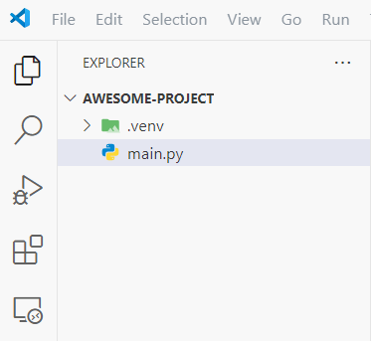
…Overview of Platforms …Web Creating FastAPI app
Create a file on the same level as “.venv”, name it “main.py”

Slide 22
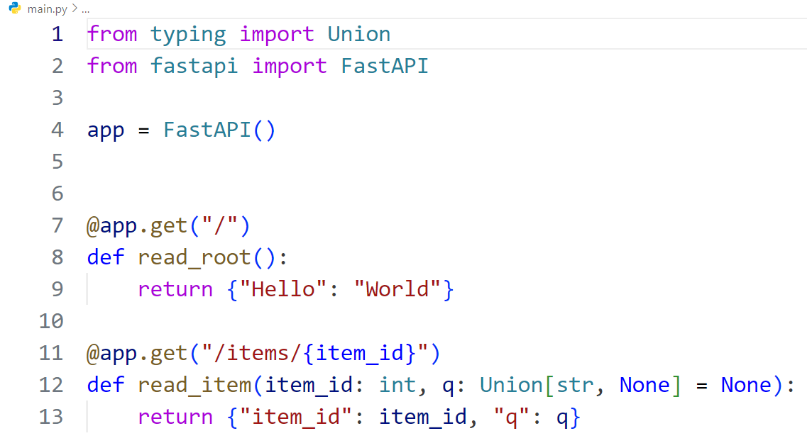
…Overview of Platforms …Web Creating FastAPI app
Type these in “main.py”:
Run the server:
fastapi dev main.py

Slide 23
…Overview of Platforms …Web Creating FastAPI app
Open your browser at http://127.0.0.1:8000
You will the the JSON response:
{“Hello”: “World”}
You have already created an API that:
Receives HTTP requests in the paths / and /items/{item_id}.
Both paths take GET operations (also known as HTTP methods).
The path /items/{item_id} has a path parameter item_id that should be an int.
The path /items/{item_id} has an optional str query parameter q.

Slide 24
…Overview of Platforms …Web Creating FastAPI app
Now go to http://127.0.0.1:8000/docs
You will see the automatic interactive API documentation (provided by Swagger UI).
You can also go to http://127.0.0.1:8000/redoc
You will see the alternative automatic documentation (provided by ReDoc)

Slide 25
…Overview of Platforms …Web Creating FastAPI app
Now modify the file main.py to receive a body from a PUT request.
Declare the body using standard Python types, thanks to Pydantic.

Slide 26
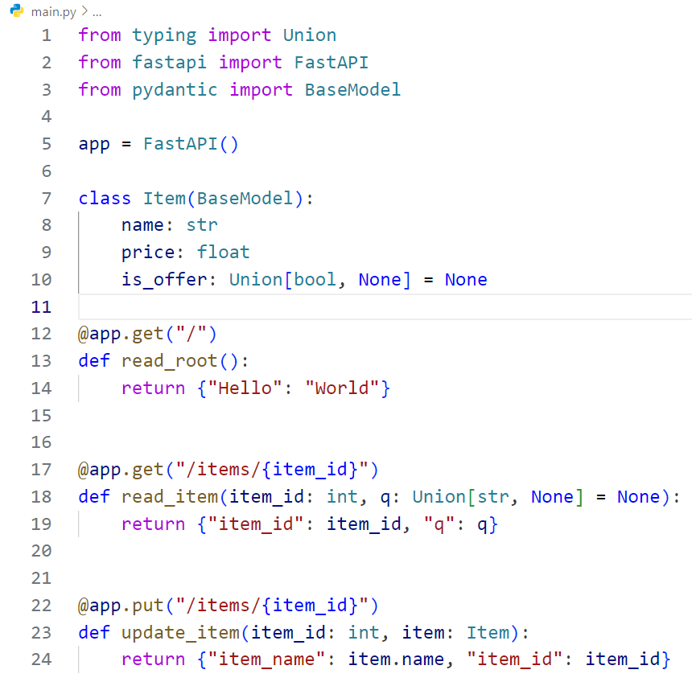
…Overview of Platforms …Web Creating FastAPI app
The fastapi dev server should reload automatically.

Slide 27
Let's explore a backend implementation for a Todo app using FastAPI, following the MVC architecture.
We'll define models to manage data persistence in a PostgreSQL database, implement controllers to handle CRUD operations, and integrate a Jinja2-powered frontend to render dynamic content.

Slide 28
We will start by creating a working directory for our project:
mkdir todo_app
cd todo_app
Then create a Python virtual environment in your working directory:
python -m venv .venv
Activate the virtual environment:
.venv\Scripts\Activate.ps1

Slide 29
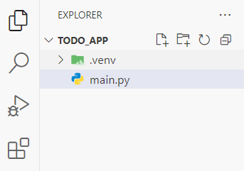
Install FastAPI in the created virtual environment:
python -m pip install “fastapi[standard]”
Create a main.py file in your project directory

Slide 30
We need to persist the data from our Todo app, so let’s setup a database (PostgreSQL).
We’ll have our PostgreSQL database and pgAdmin both running in separate Docker container.
The pgAdmin is a graphical interface that allows you to interact with PostgreSQL databases.
Create a file called docker-compose.yml on the same level as main.py.

Slide 31
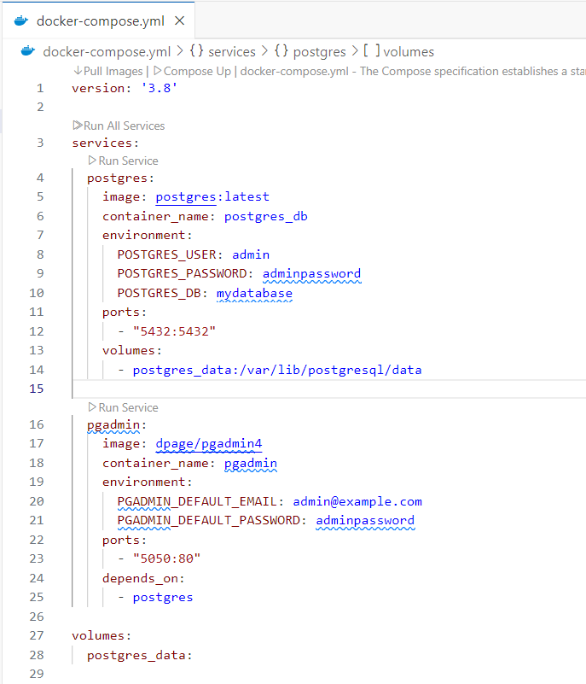

Slide 32
Since we are making use of an SQL database we need a python package called SQLModel.
SQLModel is built on top of SQLAlchemy and Pydantic.
As SQLModel is based on SQLAlchemy, you can easily use any database supported by SQLAlchemy (which makes them also supported by SQLModel), like:
PostgreSQL
MySQL
SQLite
Oracle (e.t.c.)

Slide 33
First make sure your virtual environment is activated, then install sqlmodel:
pip install sqlmodel
We also need to install psycopg2, a database adapter for Python:
pip install psycopg2
We will create the simplest version of the app with a single SQLModel first.
Then we’ll add endpoints after.

Slide 34
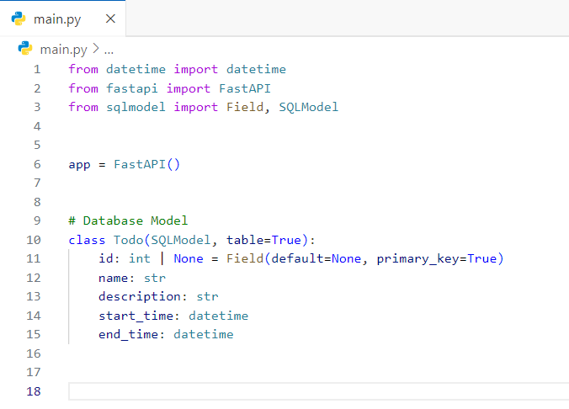

Slide 35
The Todo class is very similar to a Pydantic model.
There are a few differences:
table=True tells SQLModel that this is a table model, it should represent a table in the SQL database, it's not just a data model (as would be any other regular Pydantic class).
Field(primary_key=True) tells SQLModel that the id is the primary key in the SQL database.

Slide 36
By having the type id as int | None, SQLModel will know that this column should be an INTEGER in the SQL database and that it should be NULLABLE
Field(index=True) tells SQLModel that it should create a SQL index for this column, that would allow faster lookups in the database when reading data filtered by this column.
SQLModel will know that something declared as str will be a SQL column of type TEXT (or VARCHAR, depending on the database).

Slide 37
Next, we need to create an SQLModel engine.
It is what holds the connections to the database.
You would have one single engine object for all your code to connect to the same database.

Slide 38
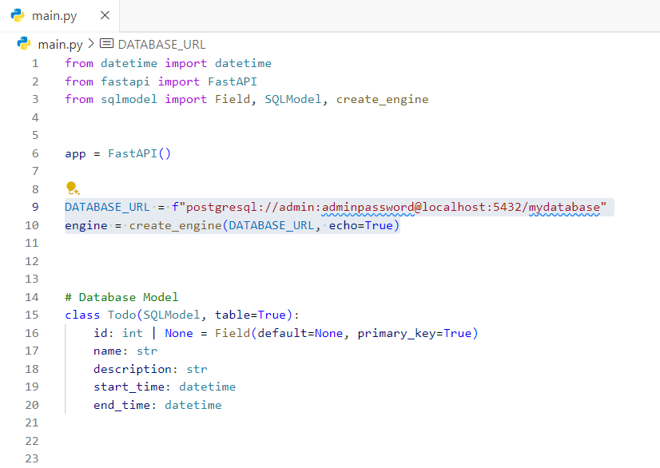
Of course you should change the credentials

Slide 39
Next, we need to add a function that uses SQLModel.metadata.create_all(engine) to create the tables for all the table models.
# Code above omitted 👆
def create_tables():
SQLModel.metadata.create_all(engine)
# Code below omitted 👇

Slide 40
Next, we need to create a Session dependency.
A Session is what stores the objects in memory and keeps track of any changes needed in the data, then it uses the engine to communicate with the database.
We will create a FastAPI dependency with yield that will provide a new Session for each request. This is what ensures that we use a single session per request.
Then we create an Annotated dependency SessionDep to simplify the rest of the code that will use this dependency.

Slide 41
# Code above omitted 👆
def get_session():
with Session(engine) as session:
yield session
SessionDep = Annotated[Session, Depends(get_session)]
# Code below omitted 👇

Slide 42
We will create the database tables when the application starts.
# Code above omitted 👆
@asynccontextmanager
async def lifespan(app: FastAPI):
# Initialize the database connection here
create_tables()
yield
# Close the database connection here
engine.dispose()
# Code below omitted 👇

Slide 43
We created the tables before the application starts and dispose the database connection when after the application has finished.
For production you would probably use a migration script that runs before you start your app.

Slide 44
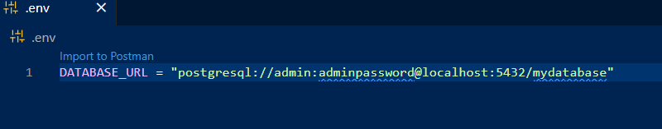
Let’s perform CRUD operations on the Todo model, but before we do that, let’s move our DATABASE_URL to a .env file to protect our database credentials.
Create a .env file on the same level as your main.py file.
Move the DATABASE_URL to the .env file

Slide 45
We need a module called python-dotenv to manage environment variables.
Install it using:
pip install python-dotenv
Then add these to main.py after the imports:
from dotenv import load_dotenv
import os
load_dotenv()
# =======================
# DATABASE CONFIGURATION
# =======================
DATABASE_URL = os.getenv('DATABASE_URL')
engine = create_engine(DATABASE_URL, echo=True)

Slide 46
We also need to create a validation schema.
This schema would be used to:
Validate incoming JSON data when creating new todos
Provide automatic API documentation
Enable type checking at runtime

Slide 47
Add this after the Todo class in main.py:
class TodoCreate(BaseModel):
name: str
description: str
start_time: datetime
end_time: datetime
Add this to your imports in main.py:
from pydantic import BaseModel

Slide 48
Since we're building a fullstack Todo app, we need a user interface.
To achieve this, we’ll integrate template rendering.
Templates in FastAPI allow us to dynamically generate HTML by combining static layouts with real-time data.
FastAPI supports templating through third-party libraries like Jinja2, one of the most popular and powerful templating engines in Python.

Slide 49
Install Jinja2:
pip install jinja2
Create a directory name ‘templates’ in your project (on the same level as main.py)
Your HTML files will live in the templates directory.
Next, we use Jinja2Templates class from fastapi.templating to configure the templates directory:

Slide 50
# Code above omitted 👆
from fastapi.templating import Jinja2Templates
templates = Jinja2Templates(directory="templates")
# Code below omitted 👆

Slide 51
Let’s create a base template that contains the shared structure of our interface. It will use placeholders (blocks) for dynamic content that child templates can override.
Create base.html in templates directory.

Slide 52
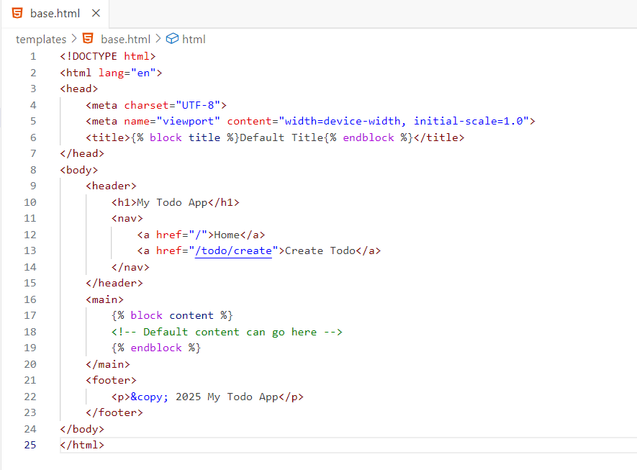

Slide 53
{% block title %} and {% block content %} are placeholders for child templates to override.
The header and footer are shared across all pages.
Next, we create a child template that inherits from the base template and overrides specific blocks to provide page-specific content.
Create a index.html in the templates directory

Slide 54
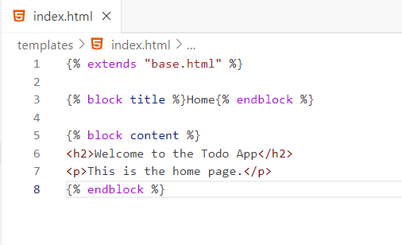
{% extends "base.html" %} specifies that this template inherits from base.html.
The title and content blocks are overridden with page-specific content

Slide 55
Next, we’ll use the Jinja2Templates class to render the templates in your route handlers.
Update the base route in main.py to:
@app.get("/", response_class=HTMLResponse)
async def home(request: Request):
return templates.TemplateResponse("home.html", {"request": request})

Slide 56
We can now go ahead with creating endpoints for CRUD operations:
For Create:
@app.post('/todo/create’, response_model=Todo)
def create_todo(
todo_data: TodoCreate, session: SessionDep):
todo = Todo(**todo_data.model_dump())
session.add(todo)
session.commit()
session.refresh(todo)
return todo

Slide 57
The code on the previous page defines a FastAPI route handler function, create_todo, which is responsible for creating a new "to-do" item in the database. Here's a breakdown of its functionality:
Route Definition: The @app.post('/todo/create', response_model=Todo) decorator registers this function as a POST endpoint at the /todo/create URL. The response_model=Todo parameter specifies that the response returned by this endpoint will conform to the Todo model. This ensures that the API response is validated and serialized according to the Todo schema.

Slide 58
Function Parameters:
todo_data: TodoCreate: This parameter expects a request body that matches the TodoCreate schema. FastAPI automatically validates the incoming JSON payload against this schema, ensuring that required fields like name, description, start_time, and end_time are provided and correctly formatted.
session: SessionDep: This parameter is a dependency injection for a database session. It allows the function to interact with the database, such as adding or querying records.

Slide 59
Inside the function, a new Todo instance is created using the TodoCreate data. The todo_data.model_dump() method (from Pydantic) converts the TodoCreate object into a dictionary, which is then unpacked (**) to populate the fields of the Todo model. This step bridges the gap between the input data (TodoCreate) and the database model (Todo).

Slide 60
session.add(todo): Adds the new Todo instance to the database session, marking it for insertion.
session.commit(): Commits the transaction, saving the new record to the database.
session.refresh(todo): Refreshes the todo instance with the latest data from the database, including any auto-generated fields like the id.
Returning the Todo: Finally, the function returns the newly created Todo instance. FastAPI automatically serializes this object into JSON, adhering to the Todo schema defined in the response_model.

