Slide 1
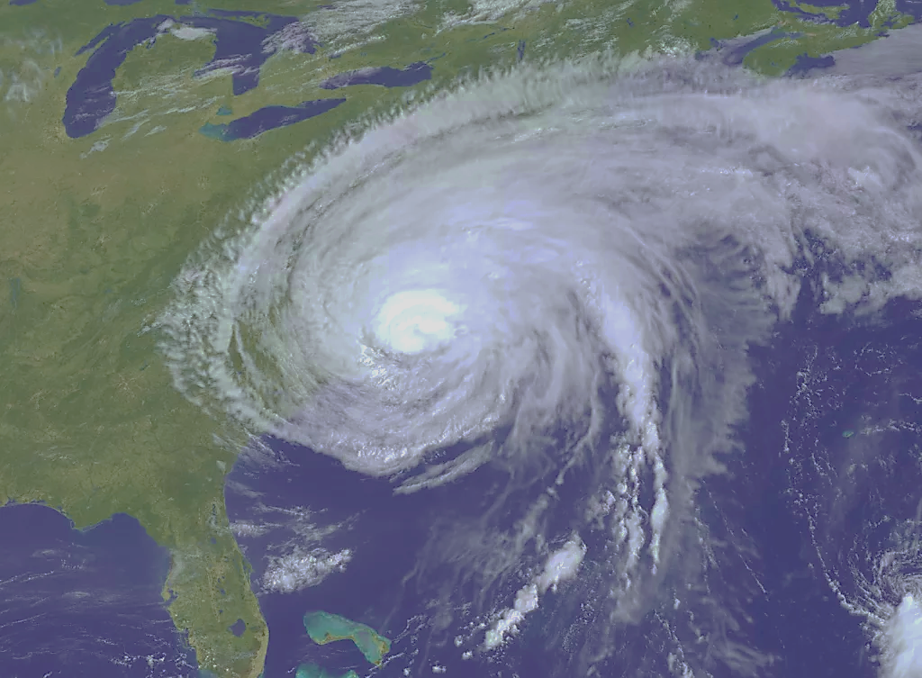
Tropical Cyclones in the Atlantic Basin: 1950-2015
Team Phoenix:
Lindsey Shavers
Mark Folashade
Khoi Tran
Stephanie Verbout
CS5010
18 November 2020

Slide 2
Data set: National Hurricane Center (NHC) database, HURricane DATabase (HURDAT) https://www.kaggle.com/noaa/hurricane-database
Original data set:
Years 1851-2015
ID, Name, Date, Time, Status, Event, Lat/Lon, Max Wind (kts), Min Pressure (mb)
Names aren’t unique, must use ID
Status = stage of storm development and decay
-Only interested in status Hurricane (wind speeds >64 knots)
Event = special identifications for storm
-Only interested in ‘Landfall’ event
Minimum Pressure = the lower the pressure in hurricanes, the more intense the storm strength and winds

Slide 3
Experimental Design Overview
Obtained data from kaggle hurricane database
Cleaned data to correct variable formatting and to create new variables
Created new, aggregated dataset with new variables per storm
Saved the cleaned and aggregated datasets into separate csv files
Read in our new datasets from csv files
Ran several queries on the data
Produced visualizations based on our experimental queries

Slide 4
Data cleaning
Focus on years 1950-2015
- started naming convention and better record keeping
Strip white space from variables
Remove “N, S, E, W” from lat/lon coordinates
Clean up time notation for 24-hr clock (ex. ‘0’ needed to be ‘0000’)
Process date and time in order to use datetime method for analysis
Remove missing data “-999” and replace with “NaN” for aggregate analysis

Slide 5
Data Pre-Processing
After data cleaning, created aggregate data frame with many new columns
Included calculating distances from the storm track data from lat/lons
Included a “Category” column, computed from the Saffir-Simpson Hurricane Wind Scale
-Category 1: max wind 64 <= x < 82
-Category 2: max wind 82 <= x < 95
-Category 3: max wind 95 <= x < 112
-Category 4: max wind 112 <= x < 136
-Category 5: max wind >= 136
Computed storm life-cycle duration from datetime column
Identified storms that made any landfall (‘Event’ = landfall)

Slide 6
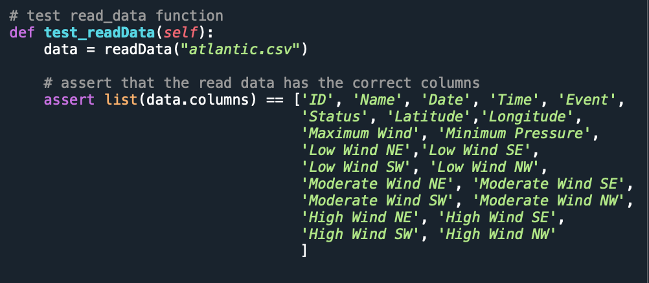
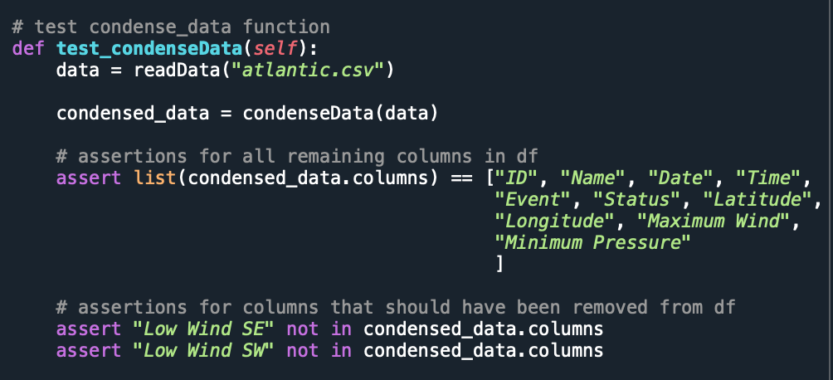
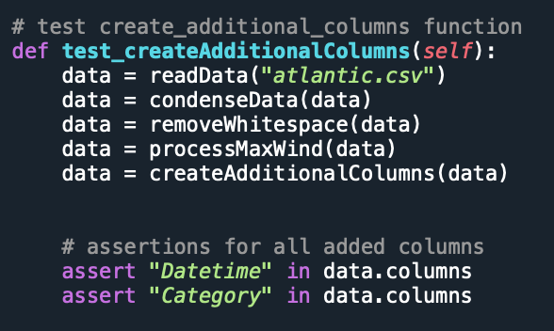
Unit Tests
CleanData_test.py
test_readData()
verified original column headers
test_condenseData()
verified removed unused column headers
test_createAdditionalColumns()
verified added additional column headers

Slide 7
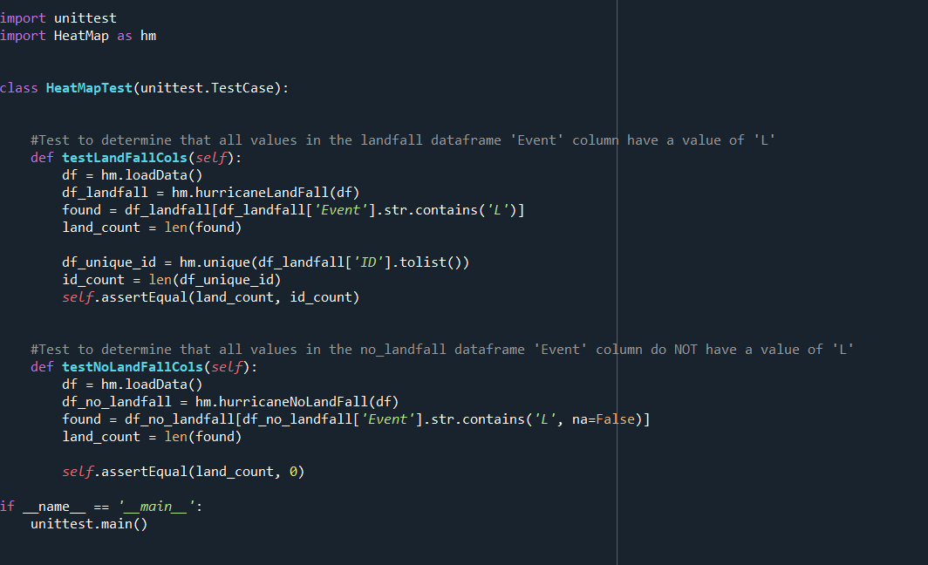
Unit Tests Cont.
HeatMap_test.py
testLandFallCols()
Test to determine that all values in the landfall dataframe 'Event' column have a value of 'L'
testNoLandFallCols()
Test to determine that all values in the no_landfall dataframe 'Event' column do NOT have a value of 'L'

Slide 8
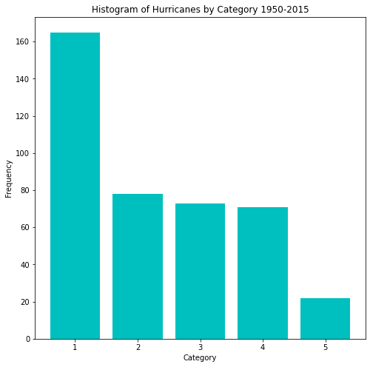

Slide 9
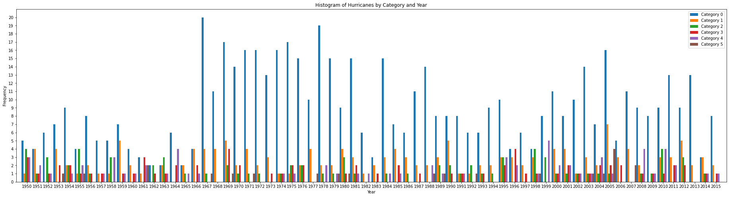

Slide 10
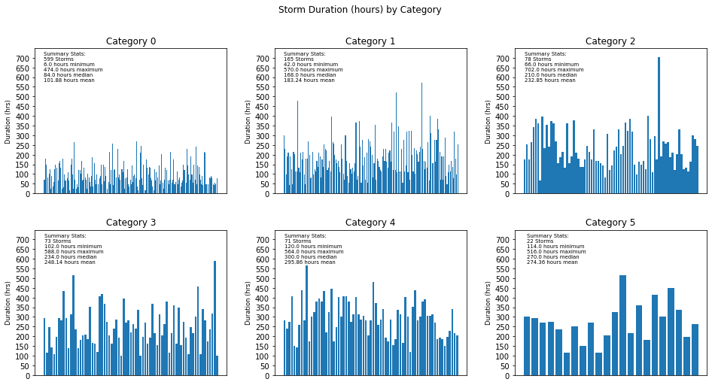

Slide 11
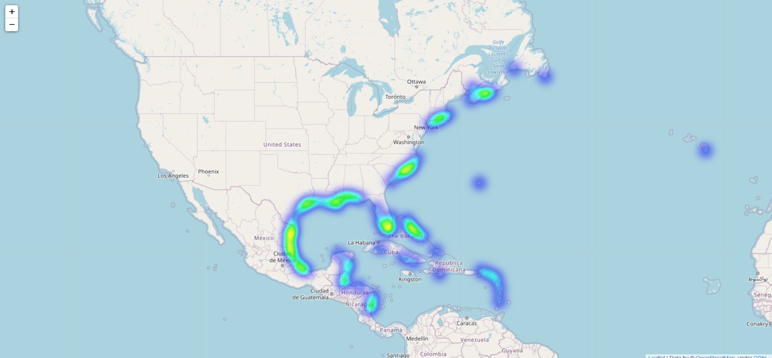
Landfall Heat Map

Slide 12
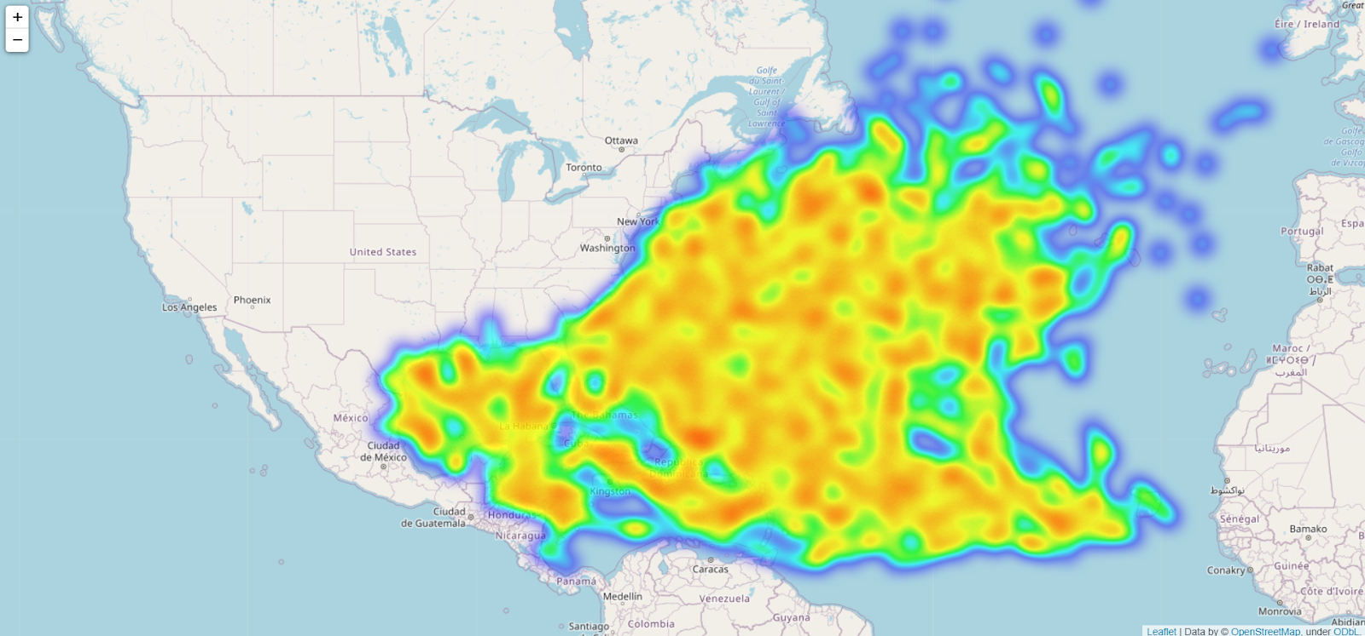
No Landfall Heat Map

Slide 13
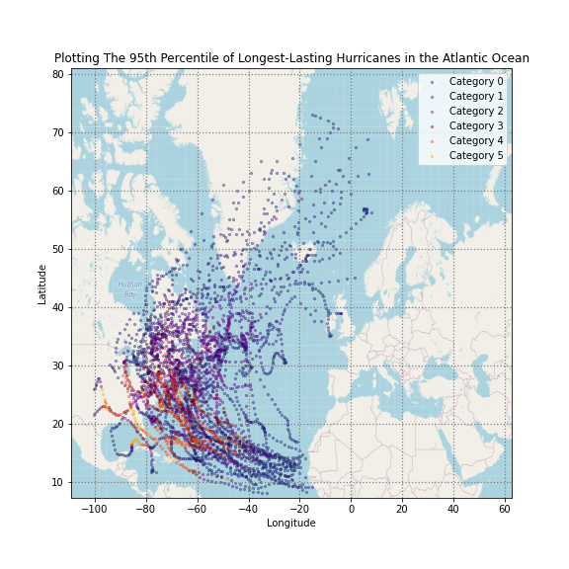
This plot shows the top 95th percentile of duration for hurricanes, as defined by the delta in between the first recorded date and time of the storm, and the last recorded date and time.
Each point on the map represents the longitude and latitude for each recorded observation for a storm, and the color of each point represents the Category (strength) of the storm at that point, as denoted by the legend.

Slide 14
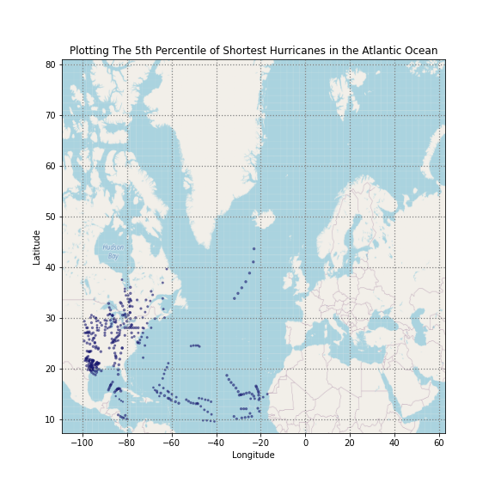
This plot shows the bottom 5th percentile of duration for hurricanes, as defined by the delta in between the first recorded date and time of the storm, and the last recorded date and time.
Each point on the map represents the longitude and latitude for each recorded observation for a storm. The colors of the points do not vary, as these short hurricanes were all Category 0.

Slide 15
Storm ID/Year Name Min Pressure(mb)
AL252005 WILMA 882.0
AL081988 GILBERT 888.0
AL182005 RITA 895.0
AL041980 ALLEN 899.0
AL091969 CAMILLE 900.0
AL122005 KATRINA 902.0
AL042007 DEAN 905.0
AL131998 MITCH 905.0
AL092004 IVAN 910.0
AL101955 JANET 914.0
Minimum Pressure (millibars)
Atlantic Basin 1950-2015
(top 10 hurricanes)

Slide 16
Storm ID/Year Name Max Wind(kts)
AL041980 ALLEN 165.0
AL252005 WILMA 160.0
AL081988 GILBERT 160.0
AL182005 RITA 155.0
AL131998 MITCH 155.0
AL091969 CAMILLE 150.0
AL062007 FELIX 150.0
AL091979 DAVID 150.0
AL122005 KATRINA 150.0
AL051977 ANITA 150.0
Maximum Wind Speeds (knots)
Atlantic Basin 1950-2005
(top ten hurricanes)

Slide 17
Citations:
Landsea, C. W., 2007: Counting Atlantic tropical cyclones back in time. Eos, Trans. Amer. Geophys. Union, 88 (18), 197–203.
——, and Coauthors, 2004: The Atlantic hurricane database reanalysis project: Documentation for the 1851–1910 alterations and additions to the HURDAT database. Hurricanes and Typhoons: Past, Present and Future, R. J. Murname and K.-B. Liu, Eds., Columbia University Press,177–221.

