Slide 1
A Sudoku web app in vanilla JavaScript
Without front-end frameworks,
CSS libraries, jQuery,
nor a back-end

Slide 2
Quick Sudoku introduction
Why all the constraints?
What does the app look like?
How does it work?
Next steps

Slide 3
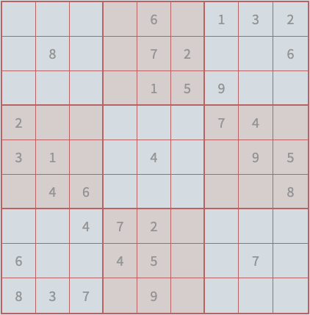
1. Quick Sudoku introduction

Slide 4
2. Why all the constraints?
To focus on learning goals:
Get better at the basic building blocks of web development - HTML, CSS and JavaScript
Think about UX and learn about browsers (e.g. DOM, devtools) - focus on features that don’t need a back-end.

Slide 5
Implications
Puzzles have to be generated by the browser.
No back-end-reliant features.
A front-end framework might help avoid ‘spaghetti code’.
Free hosting (on github.io) for front-end-only apps.

Slide 6
3. What does the app look like?
https://folde01.github.io/sudoku/
Responsive
Mobile first

Slide 7
4. How does it work?
index.html runs app.js. The JavaScript modules in app.js do the following things:
Generate a puzzle, i.e. the set of initial ‘clues’ that help you complete the puzzle.
Draw the board on the screen and populate it with the clues.
Run the game – and back to (1) if you finish the puzzle or click ‘New game’.

Slide 8
High level method calls
Inside app.js we do this:
const board = new Board()
const game = new Game(board)
game.play()
Inside game.play() we do this:
const puzzle = new Puzzle()
const cellDB = puzzle.getCellDB()
this.populateBoard(cellDB)
board.play(game)
Source code: https://github.com/folde01/sudoku

Slide 9
5. Next steps
Guarantee a single solution
Add front-end features, e.g. save game (using local storage), pencil marks, difficulty levels
Improve accessibility and cross-browser support
Rewrite in React
Back-end features
Refactor code, improve documentation

Slide 10
Thank you!

