Slide 1
DATA PREPARATION FINAL PROJECT
Final project
Team 1
Trinh Mai Anh - 11219260 (Leader)
Nguyen Phuong Linh - 11219275
Nguyen Thuy Linh - 11219276

Slide 2
Table of content
I. Exploratory Data Analysis
A. Overview, Check the data
B. EDA
II. Feature Engineering
A. Feature Creation
B. Handling data
III. Tuning Hyperparameters
A. GridSearchCV
B. Optuna
IV. Blending Method

Slide 3
I. Exploratory Data Analysis (EDA)

Slide 4

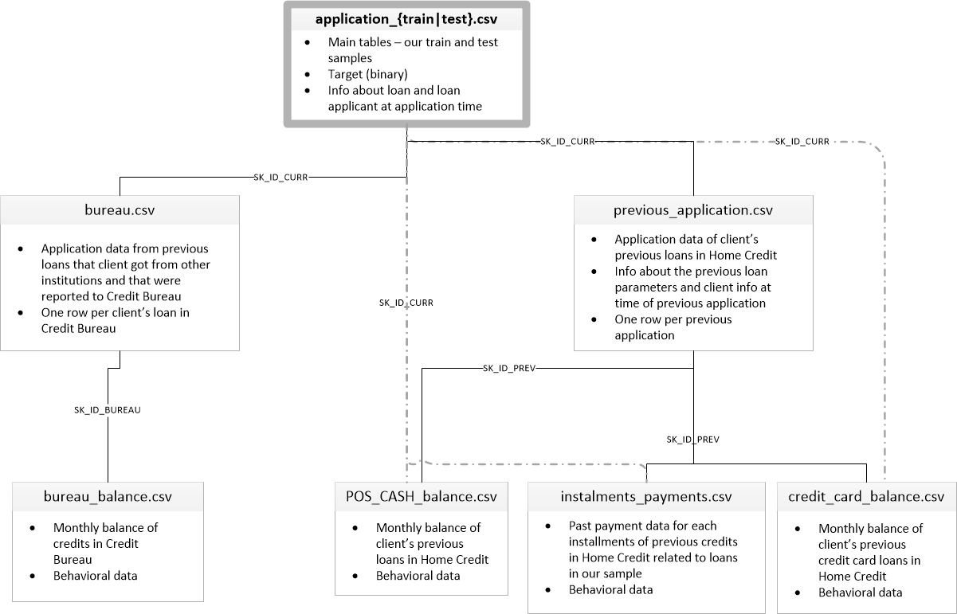
Overview
Get the first sight to the dataset, we use the following methods: df.info(), df.dtypes(), df.shape, …
EDA

Slide 5
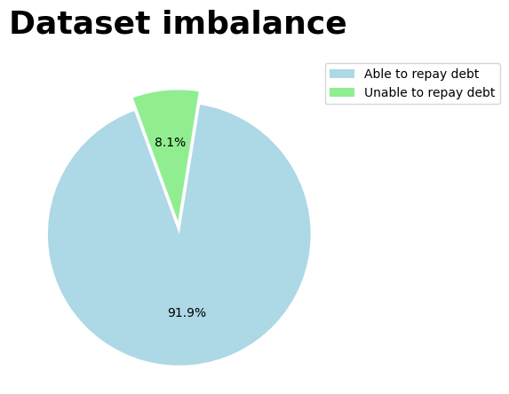
Imbalance
EDA

Slide 6
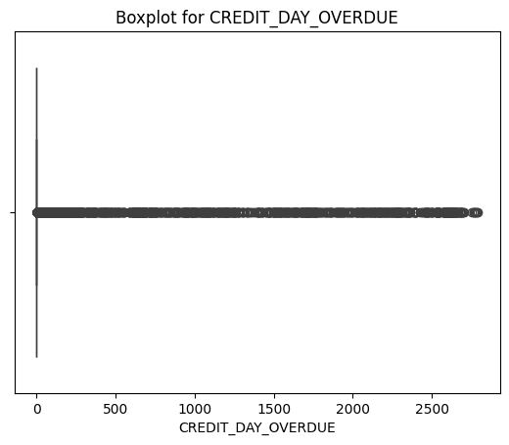
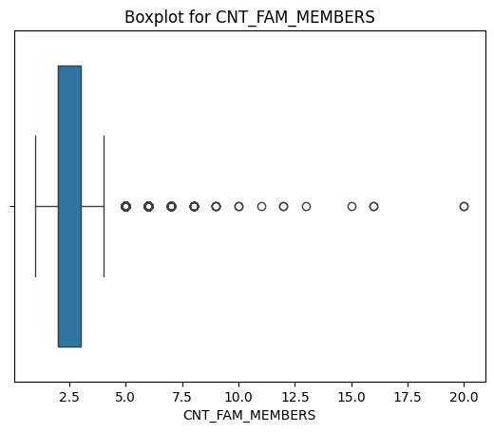
Outlier
EDA

Slide 7
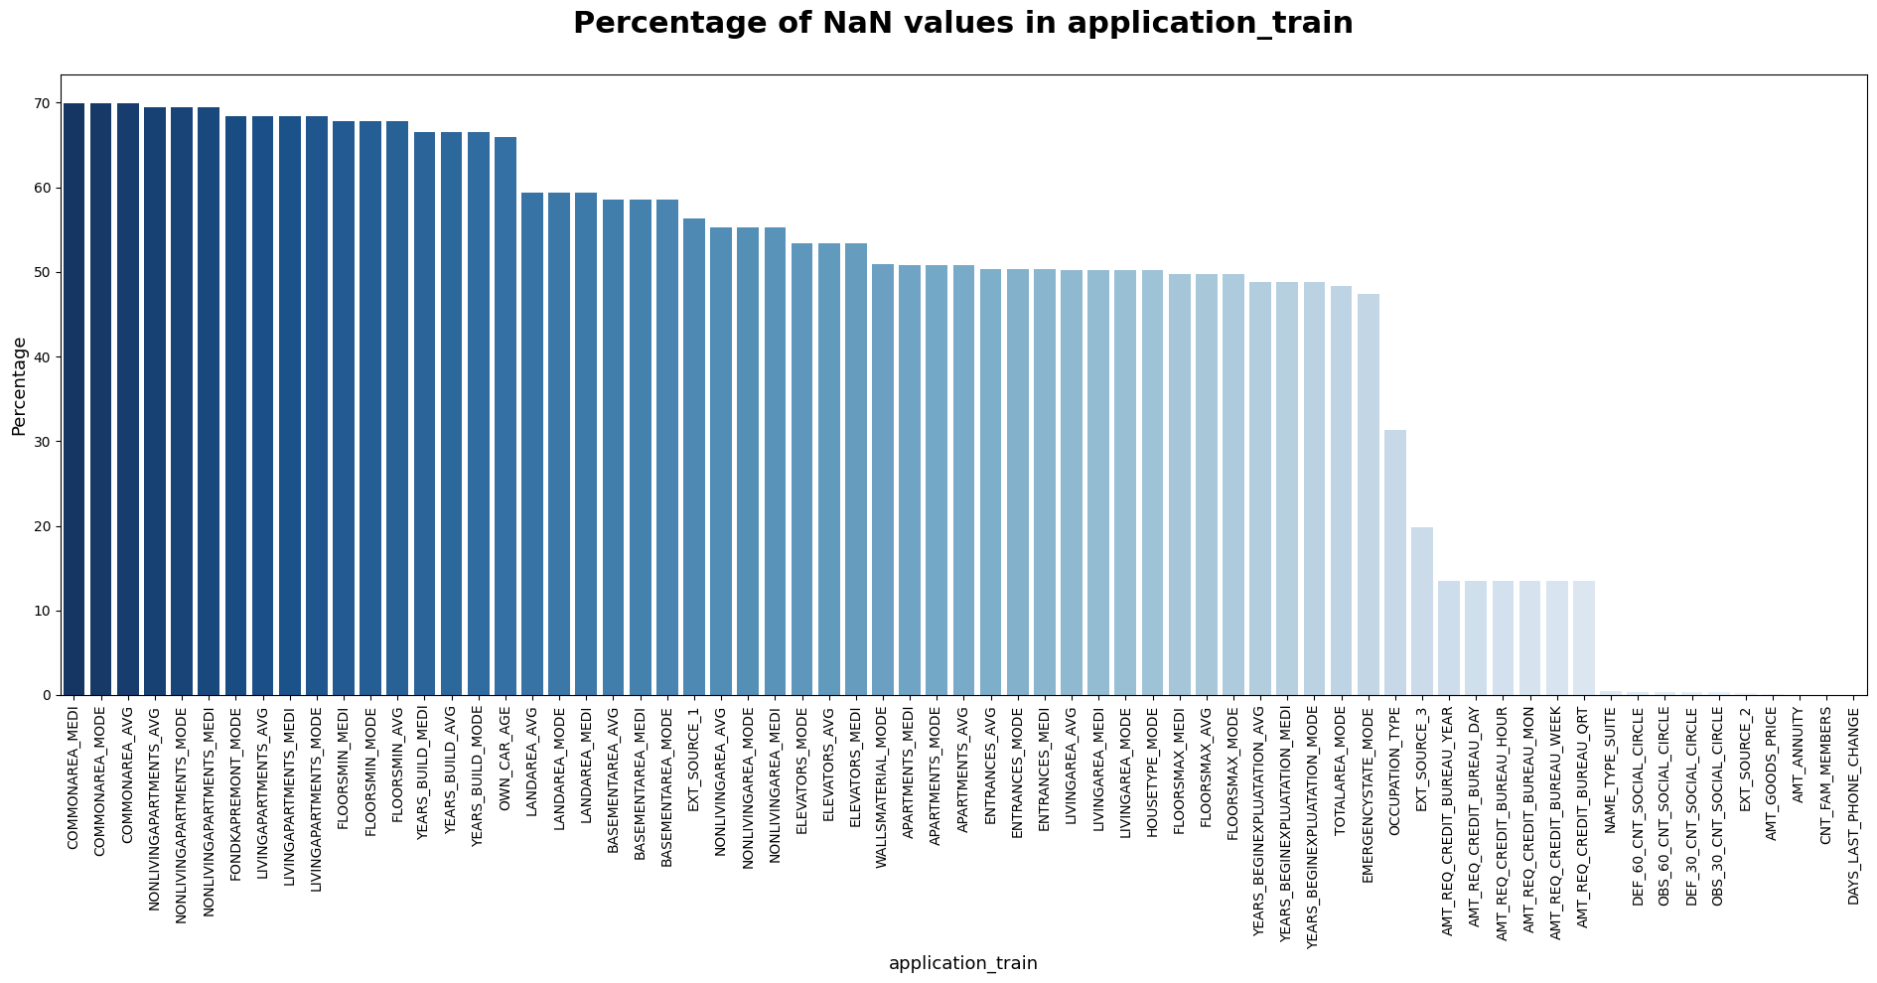
Missing value
EDA

Slide 8
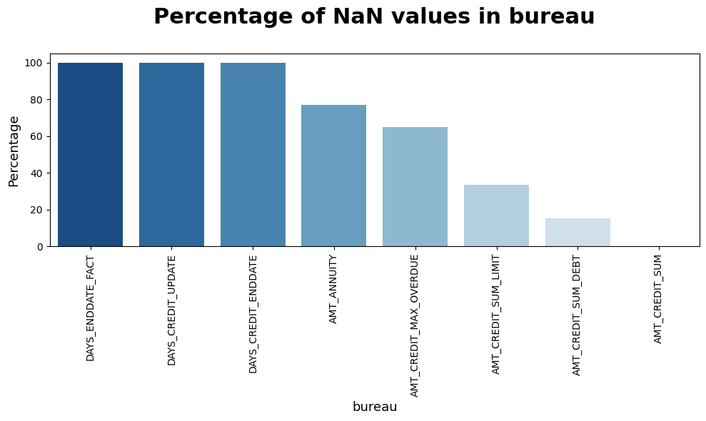
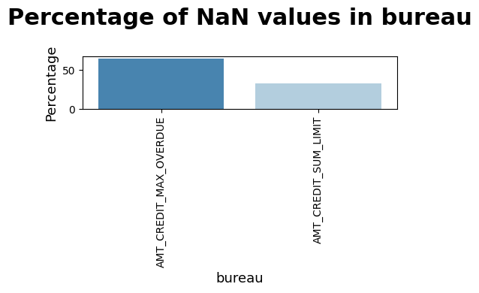
Missing value
EDA

Slide 9
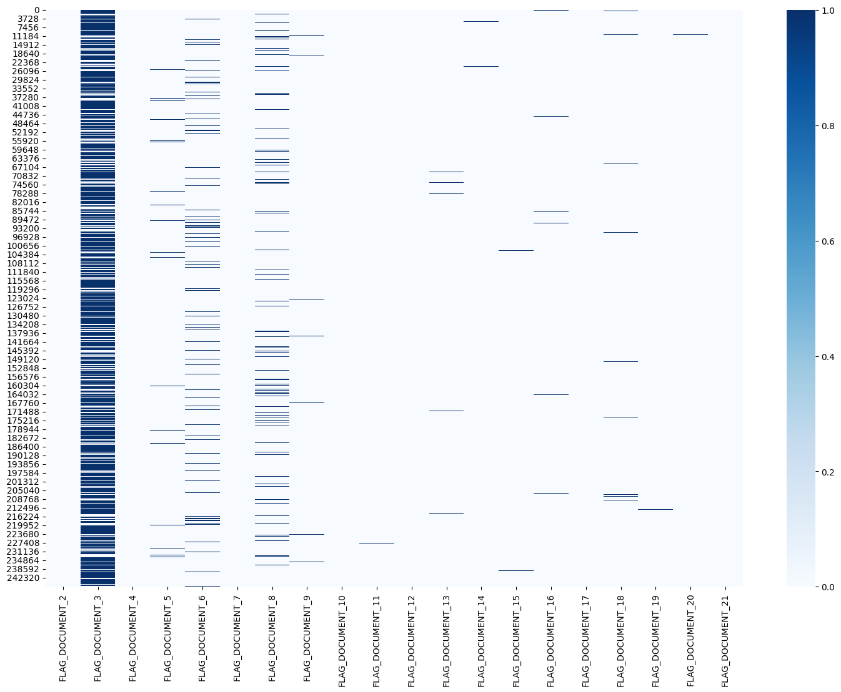
EDA
EDA

Slide 10
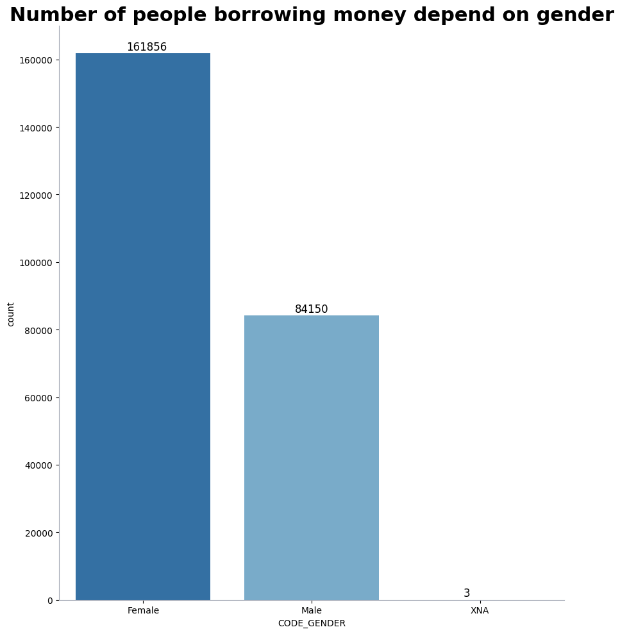
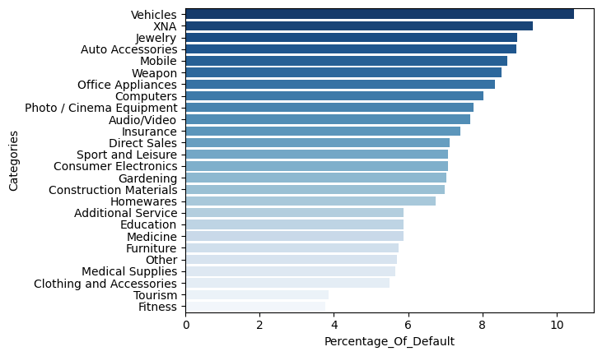
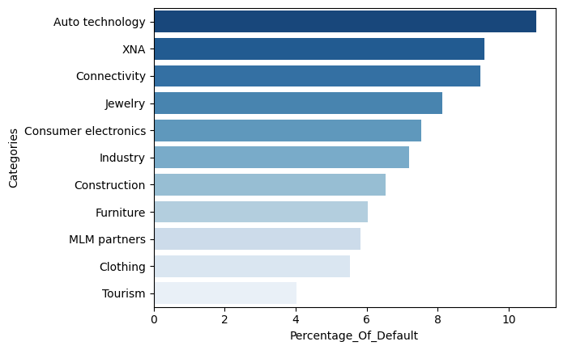
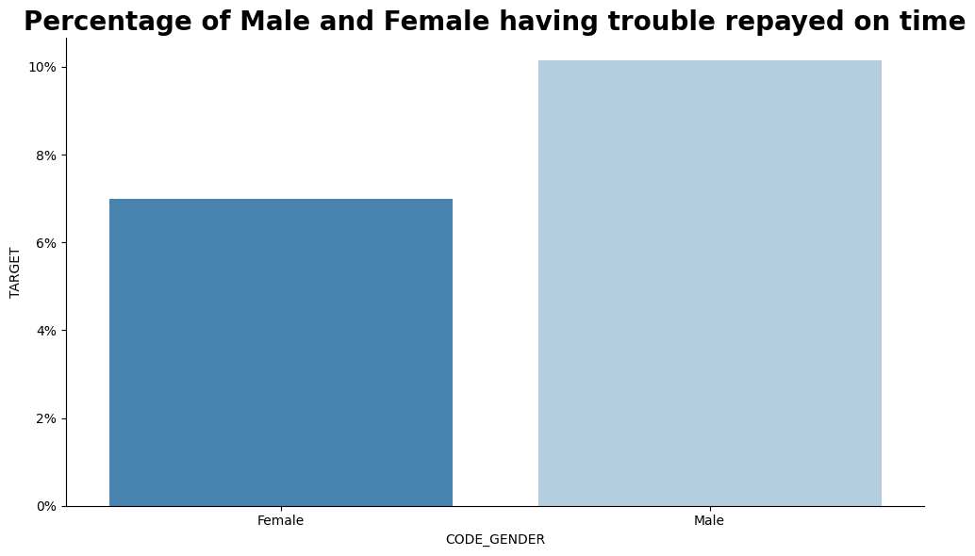
EDA - insight
EDA

Slide 11
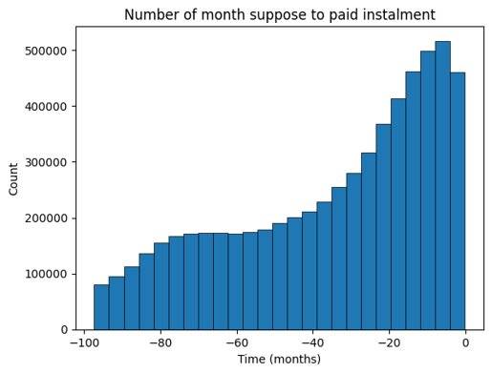
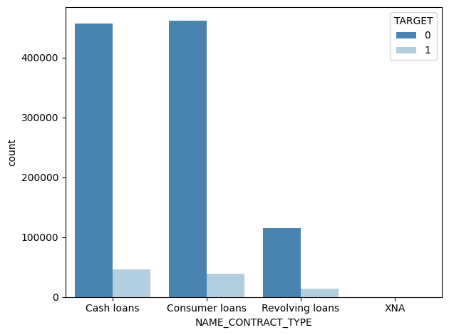
EDA - insight
EDA

Slide 12
II. Feature Engineering

Slide 13

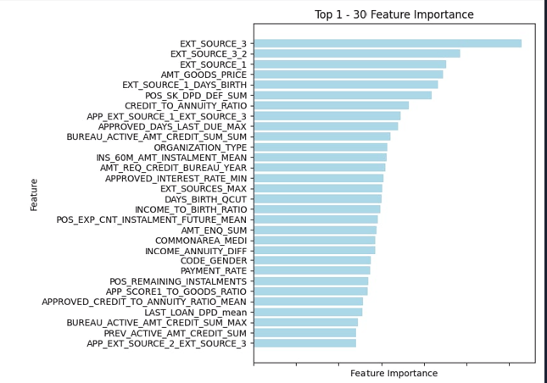
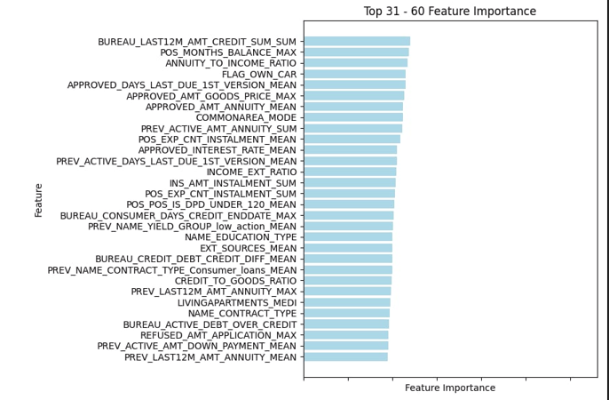
Feature Creation
Feature Engineering

Slide 14
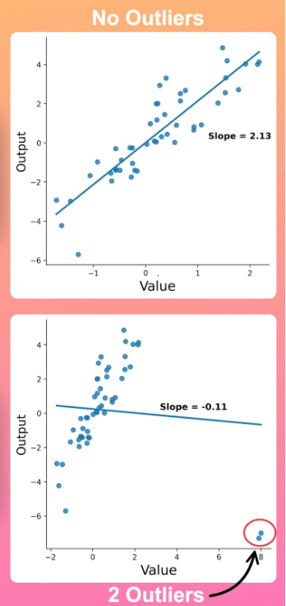
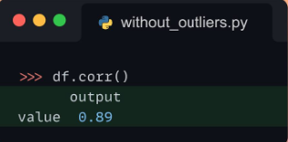

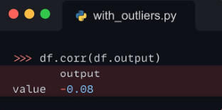
Outlier affects Correlation
Mercury is the closest planet to the Sun
Feature Engineering
Handling data
Outlier

Slide 15

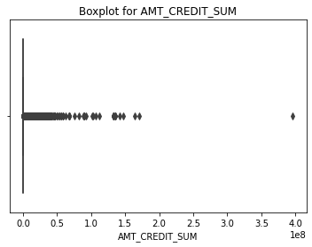
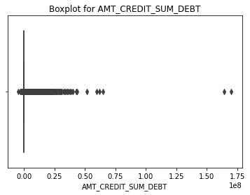
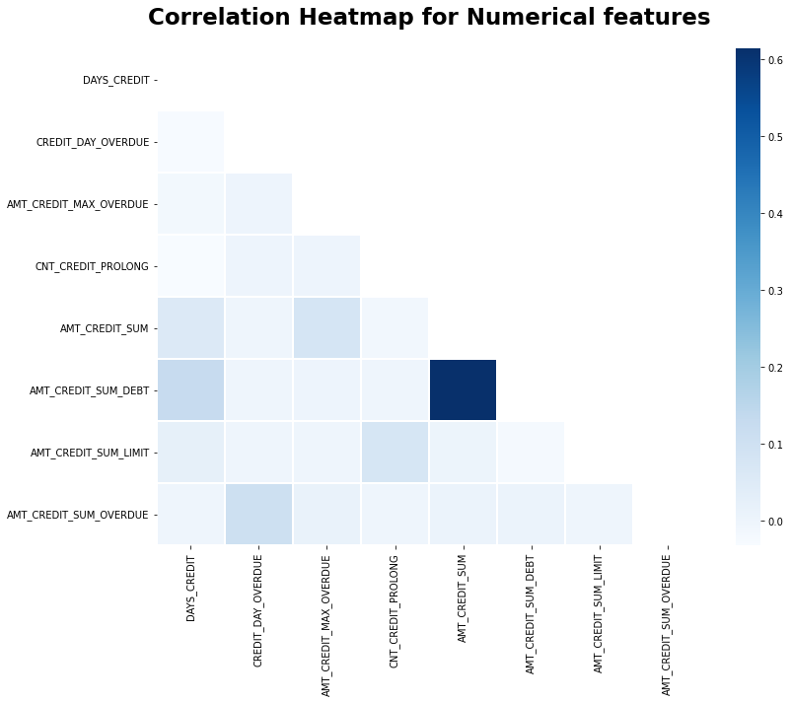
Bureau Example
Feature Engineering
Handling data
Outlier

Slide 16
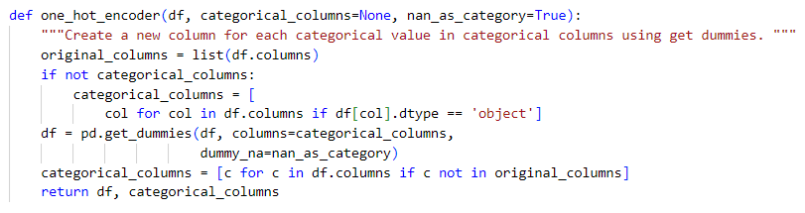
One Hot Encoder
Feature Engineering
Handling data
Encoder

Slide 17
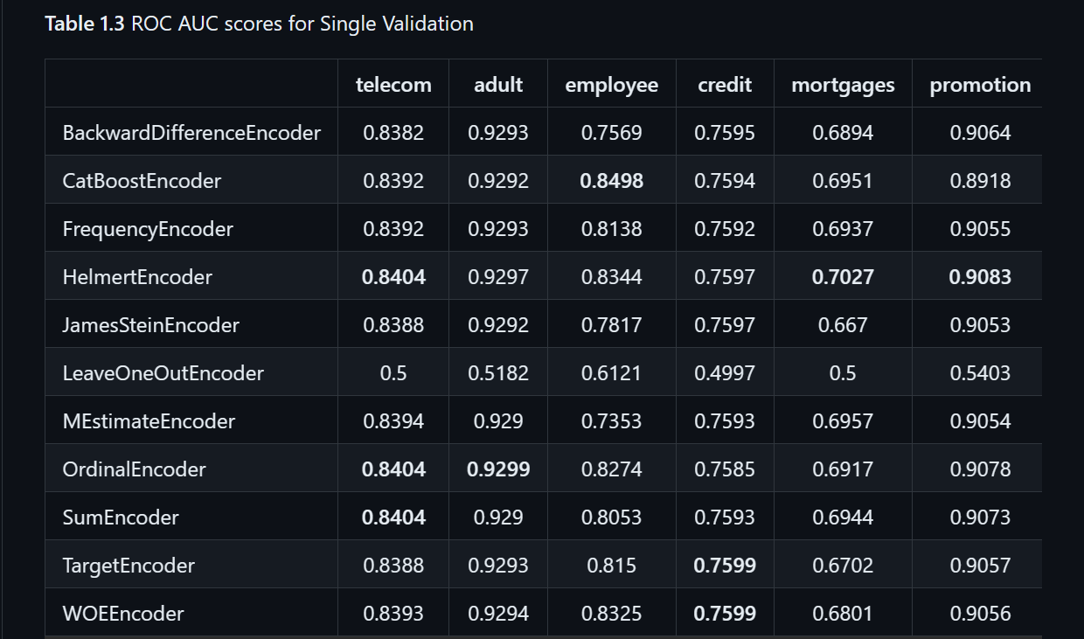

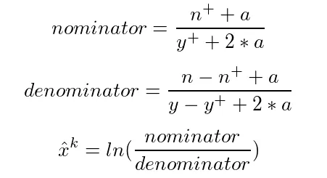
WOE Encoder
b. FORMULAR
a. RESEARCH
c. REGULARIZATION
Feature Engineering
Handling data
Encoder

Slide 18

Imputer
Simple Imputer (strategy = ‘median’)
Scaler
Standard Scaler
Feature Engineering
Handling data
Encoder

Slide 19

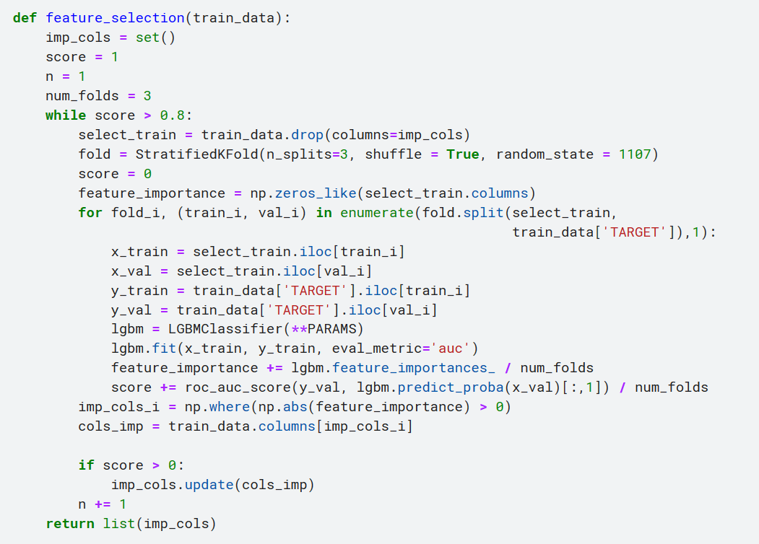

Feature Selection
Feature Engineering
Feature Selection

Slide 20
III. Tuning Hyperparameters

Slide 21

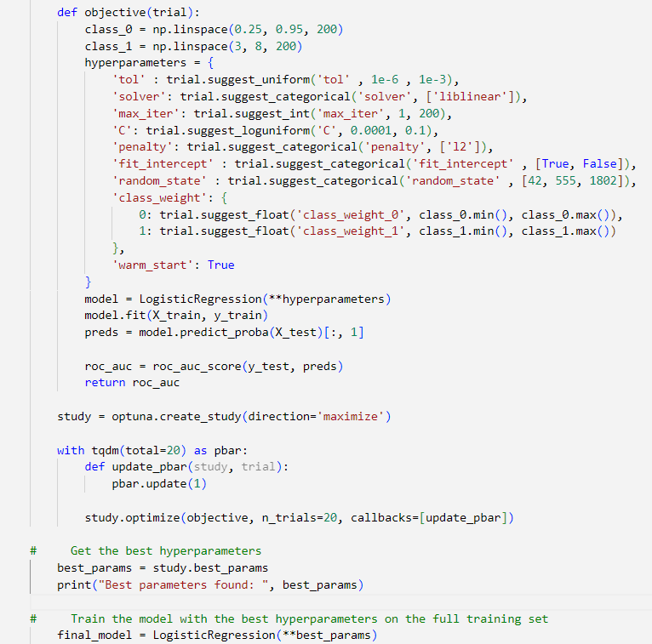
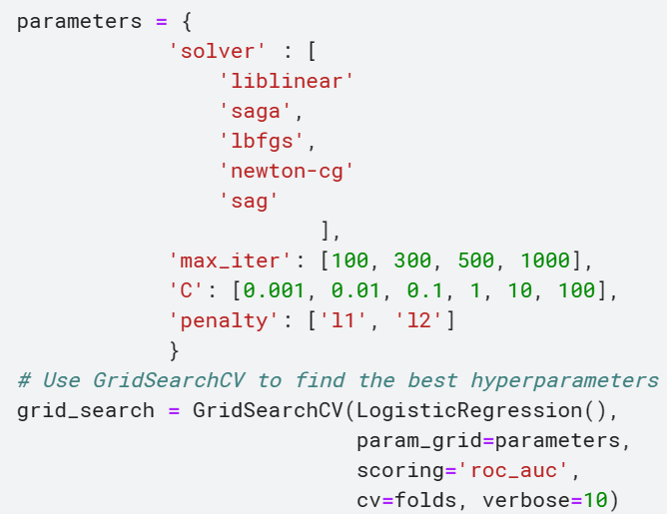
GridSearchCV
Optuna
Tunning hyperparameter

Slide 22
IV. Blending Method

Slide 23
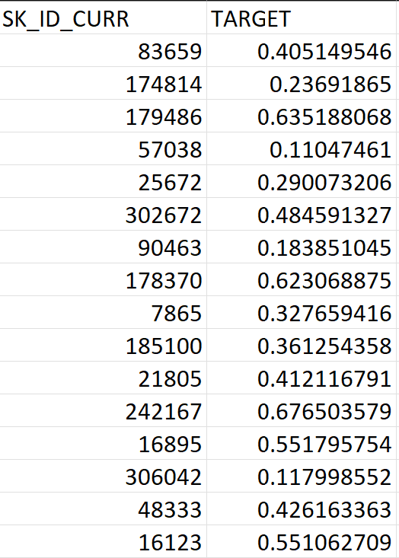
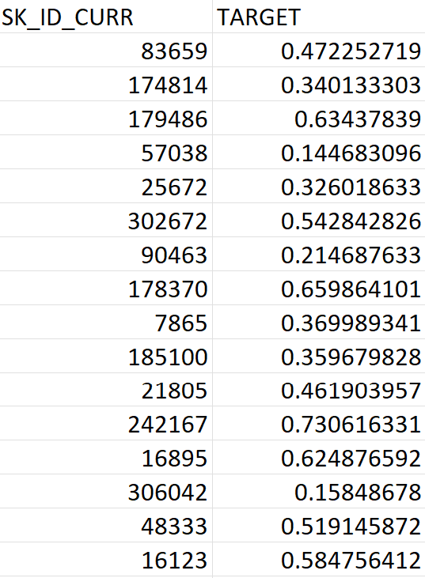



Result 1
Result 2
New Target
Blending method

Slide 24
THANK YOU !

