Slide 1
Campaign Performance
Intelligence Engine
AI-Powered Multi-Tenant Marketing Analytics Platform
13
5–10
3-Tier
34
ML Score Dimensions
AI Insights per Campaign
Model Fallback Chain
API Endpoints
Resulticks Solution Inc. · Architecture & ML Workflow · 2026

Slide 2
What We Built
Three integrated capabilities in one platform
🧠
Automated ML Scoring
🤖
LLM Insight Generation
⚡
REST API + Storage
Campaigns are scored across 13 dimensions using XGBoost + LightGBM models trained on live Resulticks data. A 3-tier fallback (BU → Tenant → Industry) ensures every campaign gets a score, even with sparse data.
A structured ~1,000-token context block (ML scores + raw metrics) is sent to Ollama qwen2.5:14b. The model returns 5–10 structured InsightObjects with observations, root causes, recommendations and business impact.
FastAPI async backend on port 8000 with 34 endpoints across 7 folders. Insights are persisted to PostgreSQL for fast retrieval. A full Postman collection is included for immediate team testing.
42-feature vector from campaign + audience + channel data
10 insight types: Performance, Audience, Channel, Journey…
POST generate-ollama, generate-from-campaign, predict, score
9 regression targets → 13 normalised score dimensions
Each insight: confidence 50–99, category, recommendation
GET /insights/{campaign_id} returns cached insight set
Scores displayed as percentages with benchmark delta (±pp)
Resulticks proxy format decoded automatically
34-request Postman collection, 7 folders, ready to import
Resulticks Solution Inc. · Campaign Intelligence Engine
2 / 13

Slide 3
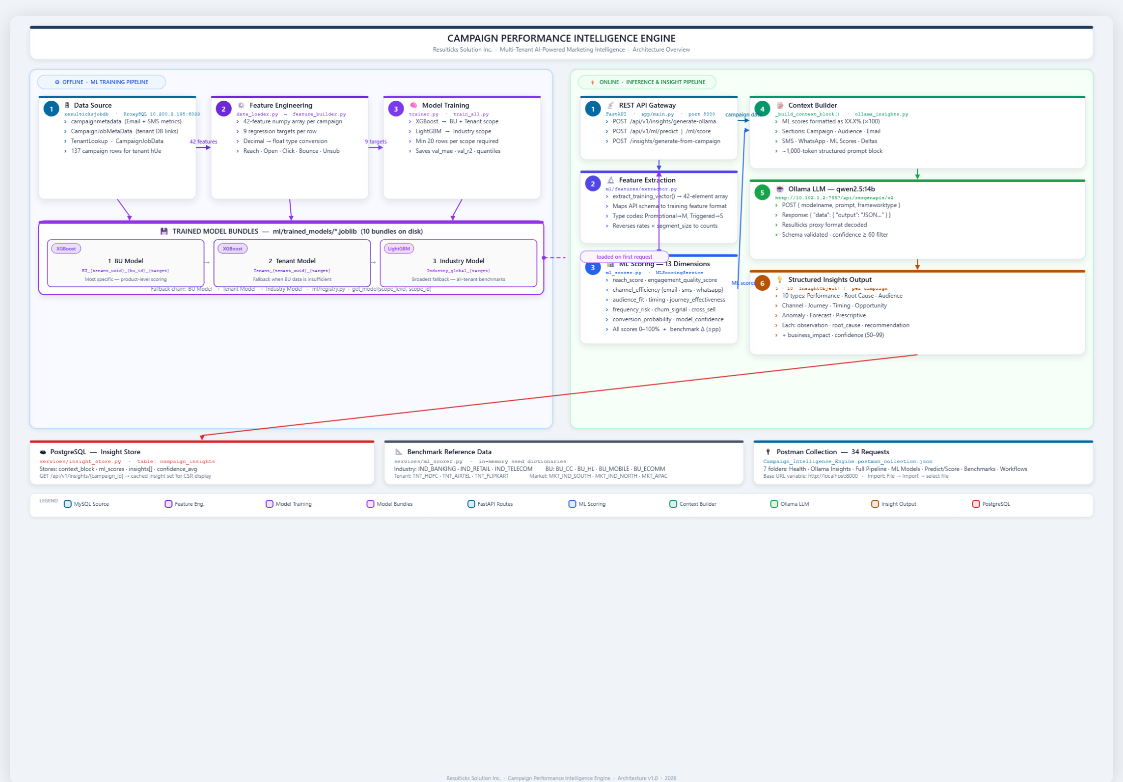
System Architecture
Offline ML training pipeline (left) + Online inference pipeline (right)
Resulticks Solution Inc. · Campaign Intelligence Engine
3 / 13

Slide 4
ML Training Pipeline
Offline batch process · trainer.py / train_all.py · Min 20 rows per scope
1
① Data Ingestion
2
② Feature Engineering
3
③ Model Training
data_loader.py
feature_builder.py · row_to_features()
trainer.py · XGBoost + LightGBM
› Pull campaignmetadata from MySQL via ProxySQL (10.200.2.195:6033)
› Build 42-feature numpy array per campaign row
› XGBoost → BU scope and Tenant scope models
› Filter by scope: BU / Tenant / Industry vertical
› 7 categories: Reach, Email, SMS/WA, Metadata, Historical, Audience, Deltas
› LightGBM → Industry-wide models (broadest coverage)
› Enforce minimum 20 rows per scope — skip if insufficient
› Type-code encoding: Promotional→M, Triggered→S, Lifecycle→L
› Persist: estimator + val_mae + val_r2 + quantiles → *.joblib
› Convert Decimal → float (PyMySQL type mismatch fix)
› Extract 9 regression target values per row
› 10 bundle files in ml/trained_models/ · 3 scope levels × targets
Resulticks Solution Inc. · Campaign Intelligence Engine
4 / 13

Slide 5
3-Tier Model Bundle Strategy
ml/registry.py · get_model(scope_level, scope_id) · 10 .joblib bundles on disk
①
BU Model
②
Tenant Model
③
Industry Model
XGBoost
XGBoost
LightGBM
BU_{tenant_uuid}_{bu_id}_{target}
Tenant_{tenant_uuid}_{target}
Industry_global_{target}
Most granular — trained on campaigns for a specific Business Unit within a tenant. Highest accuracy when data volume allows.
Mid-level fallback — combines all BUs under a tenant. Used when any single BU has insufficient training data.
Broadest fallback — trained across all tenants in the same industry vertical. Always available, ensures zero cold-start failures.
Requires ≥ 20 rows for the BU
Broader corpus than BU model
IND_BANKING · IND_RETAIL · IND_TELECOM
First choice in the fallback chain
Covers cross-BU campaign patterns
Lowest specificity, highest coverage
Separate model per regression target
Activated when BU bundle missing
LightGBM chosen for speed at industry scale
Captures product-level audience behaviour
One model per tenant per target
Used when both BU + Tenant bundles missing
Fallback chain: BU Model → Tenant Model → Industry Model · 9 regression targets per bundle · bundle = estimator + quantiles + metadata
Resulticks Solution Inc. · Campaign Intelligence Engine
5 / 13

Slide 6
Online Inference Pipeline
FastAPI async · port 8000 · Request → Score → Insights in one POST call
①
②
③
④
⑤
API Gateway
Feature Extraction
ML Scoring
Context Builder
Ollama LLM
app/main.py
extractor.py
ml_scorer.py
ollama_insights.py
qwen2.5:14b
› POST /api/v1/insights/ generate-ollama
› 42-dim numpy array
› 3-tier model load
› Scores as XX.X%
› POST to proxy endpoint
› Pydantic input validation
› Rates × size → counts
› 13 score dimensions
› All channels + metrics
› Decode data.output
› tenant_id · bu_id · metrics
› Type-code encoding
› Benchmark delta ±pp
› ~1,000-token block
› 5–10 InsightObjects
Output: InsightObject[] → persisted to PostgreSQL (campaign_insights table) · GET /api/v1/insights/{campaign_id} retrieves cached set for CSR display
Resulticks Solution Inc. · Campaign Intelligence Engine
6 / 13

Slide 7
ML Scoring — 13 Dimensions
MLScoringService · services/ml_scorer.py · All scores 0–100% + benchmark delta
1
reach_score
2
3
4
0–100%
engagement_quality
0–100%
channel_efficiency_email
0–100%
channel_efficiency_sms
0–100%
Audience reach effectiveness
Overall email engagement quality
Email ROI vs BU benchmark
SMS delivery + click performance
5
channel_efficiency_wa
6
7
8
0–100%
audience_fit_score
0–100%
timing_score
0–100%
journey_effectiveness
0–100%
WhatsApp read + reply engagement
Segment relevance for campaign type
Send-hour + day-of-week optimality
Multi-touch path completion rate
9
frequency_risk_score
10
11
12
0–100%
churn_signal_score
0–100%
cross_sell_opportunity
0–100%
conversion_probability
0–100%
Over-messaging / fatigue risk
Predicted churn based on engagement
Likelihood to respond to cross-sell
End-to-end conversion (XGBoost)
13
model_confidence
0–100%
ML prediction confidence level
Resulticks Solution Inc. · Campaign Intelligence Engine
7 / 13

Slide 8
API Endpoints & Postman Collection
34 requests · 7 folders · base_url = http://localhost:8000
🟢 Health & Status
🤖 Ollama Insights (4 variants)
🔗 Full Pipeline
🧠 ML Models
› GET /health — server + DB liveness
› POST /api/v1/insights/generate-ollama
› POST /api/v1/insights/generate — full ML+LLM flow
› POST /api/v1/ml/train — trigger training
› GET /api/v1/ml/models — list loaded models
› Minimal · Full · SMS+WA lifecycle · High-risk churn
› POST /insights/generate-from-campaign — DB-driven
› GET /api/v1/ml/models — registry list
📊 Predict & Score
📐 Benchmarks
⚡ Workflow Tests
› POST /api/v1/ml/predict — raw regression
› GET /api/v1/benchmarks/{scope}/{scope_id}
› End-to-end scenario chains
› POST /api/v1/ml/score — 13-dim scoring
› Scopes: industry · market · tenant · bu
› Cold-start · Warm-start · Anomaly detection
Import: File → Import → Campaign_Intelligence_Engine.postman_collection.json · Set collection variable base_url = http://localhost:8000
Resulticks Solution Inc. · Campaign Intelligence Engine
10 / 13

Slide 9
Thank You
Questions & Discussion
🔬 Deep-dive on any architecture layer
📊 Model accuracy benchmarks & retraining cadence
🤖 LLM prompt tuning & insight quality validation
⚡ Deployment, scaling, and monitoring strategy
Campaign Performance Intelligence Engine · Resulticks Solution Inc. · 2026

