Slide 1

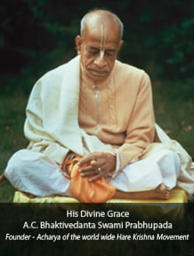

Hare Krishna, welcome please sign up to chant and hear the holy name, Haribol!
Continue with Google

Slide 2
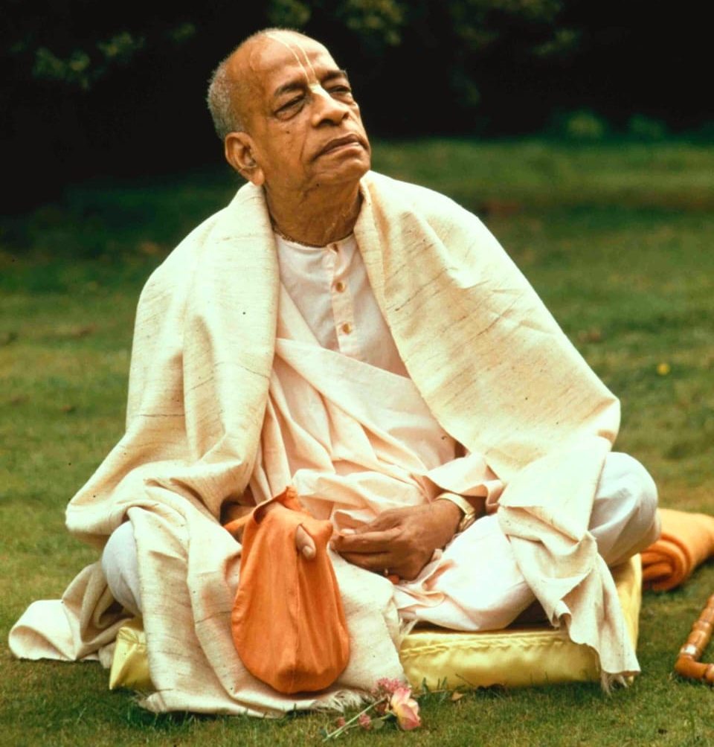
His Divine Grace
A.C.Bhaktivedanta Swami Prabhupada
Founder - Acharya of the world wide Hare Krishna Movement
Hare Krishna, welcome please sign up to chant and hear the holy name, Haribol!
Continue with Google

Slide 3
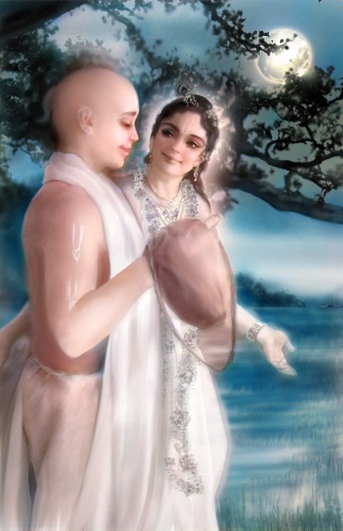
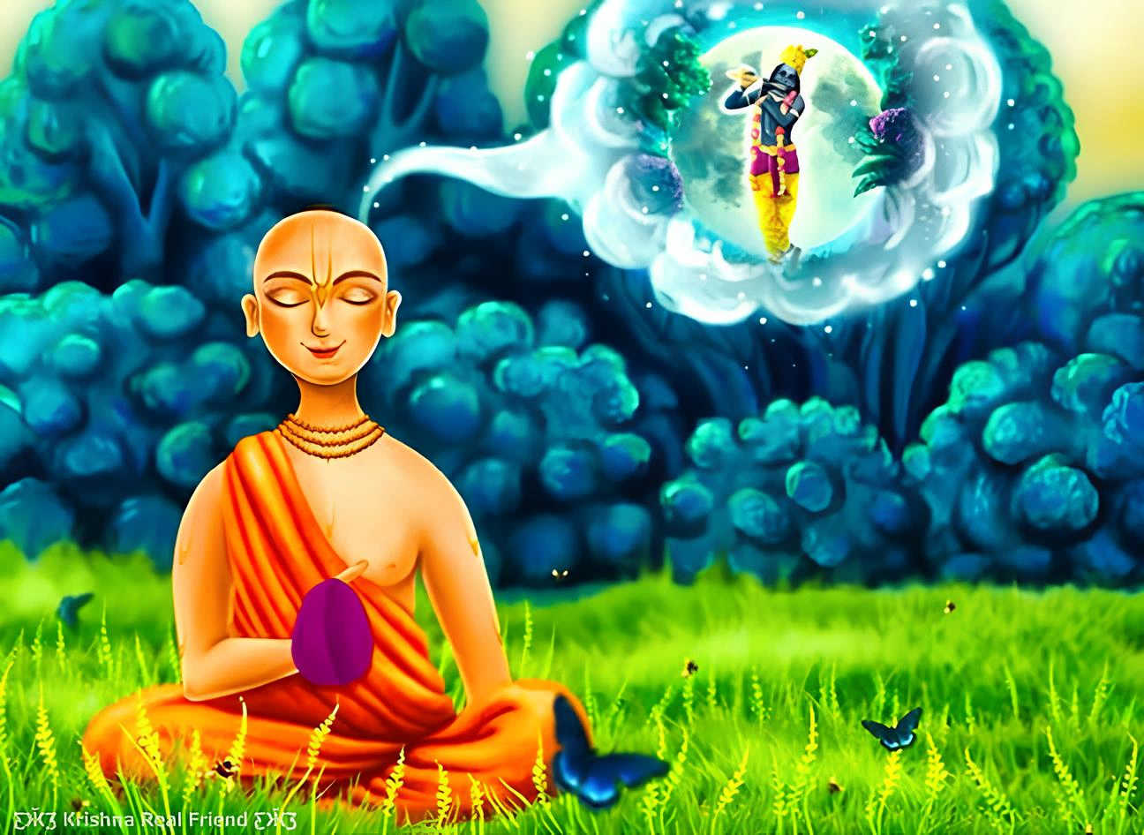
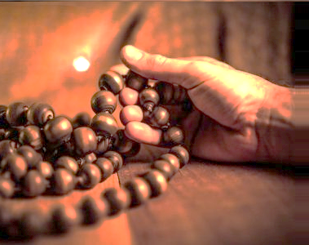
Mindful Japa
Heartful Japa
Soulful Japa

