Slide 1


Slide 2
Interfaccia
HTML
JavaScript
CSS

Slide 3
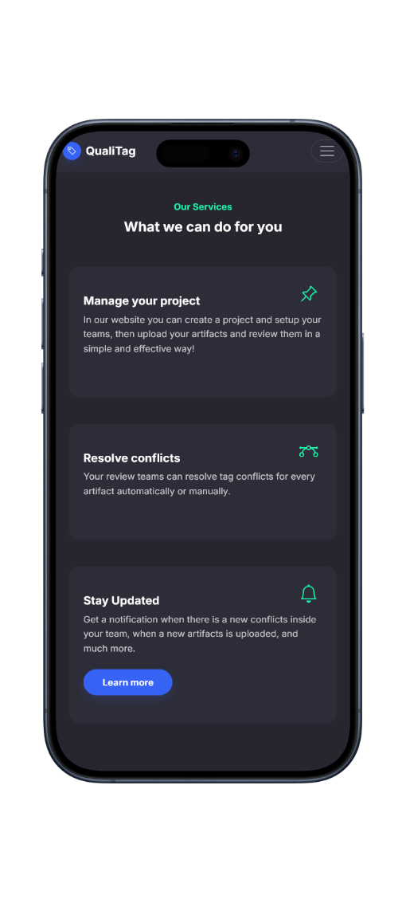
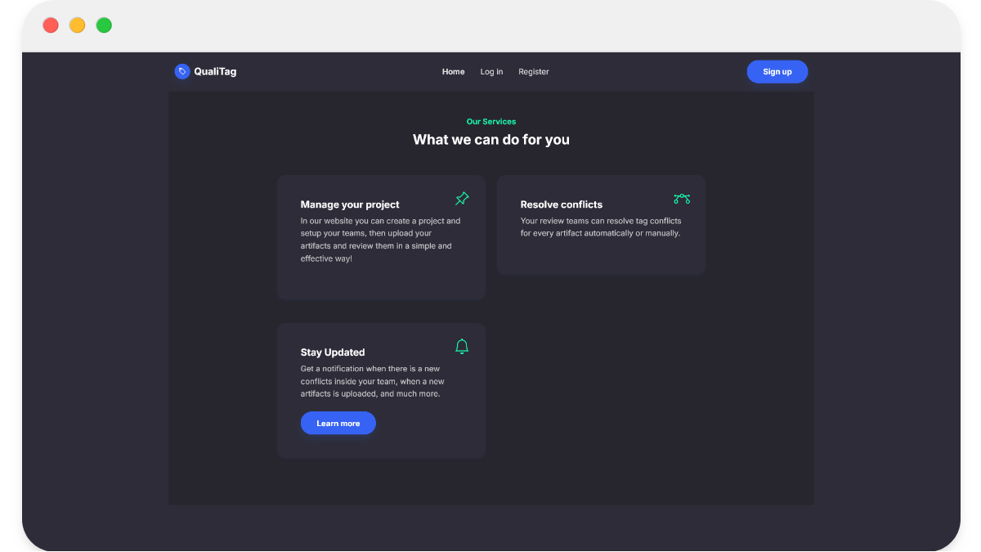
Homepage

Slide 4
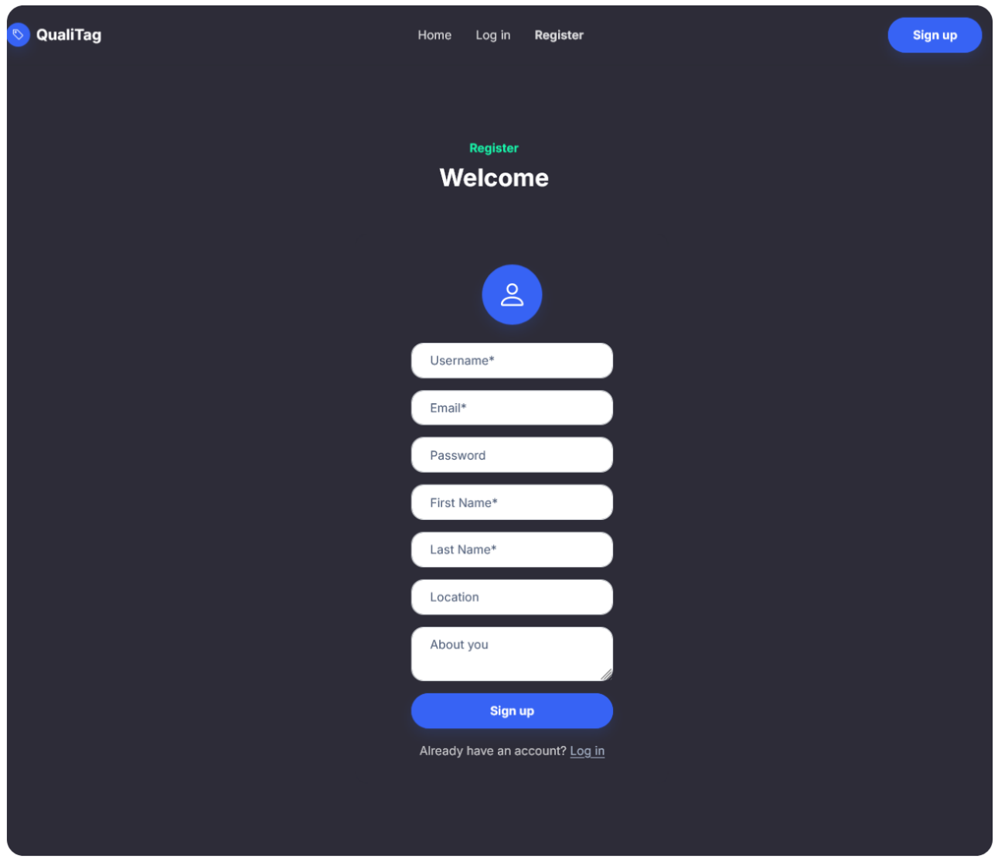
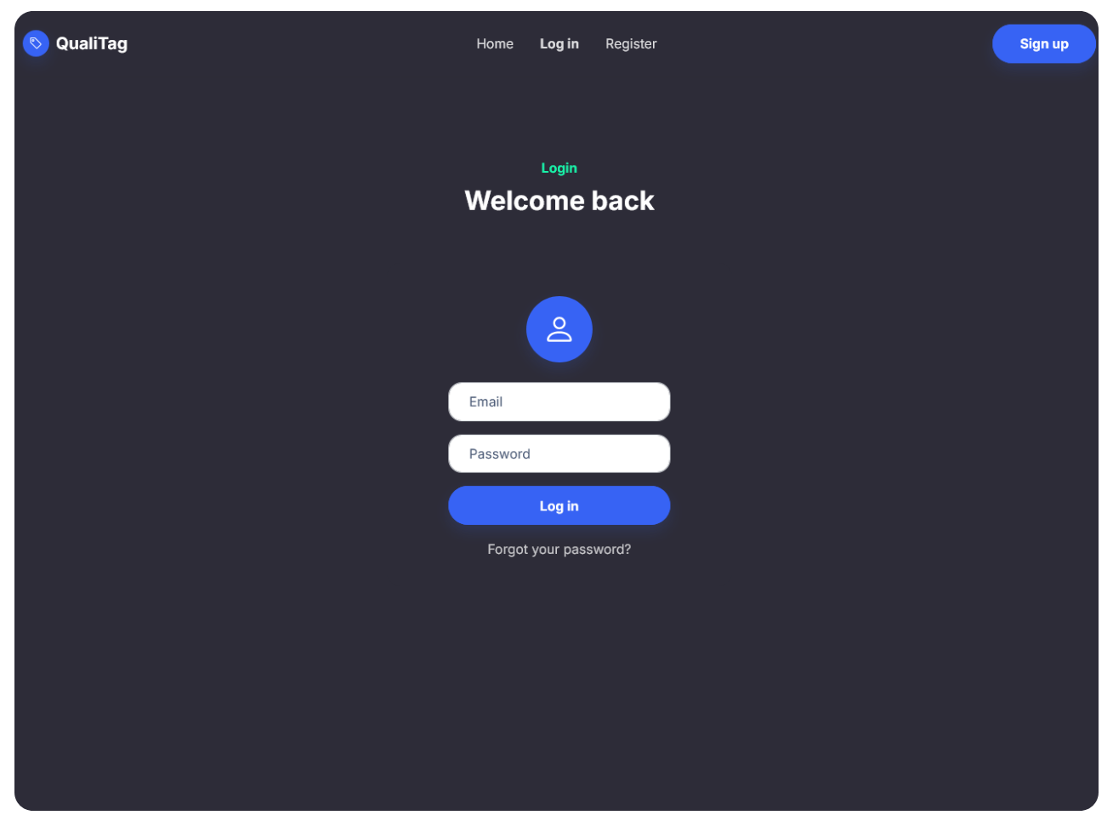
Registrazione e login

Slide 5
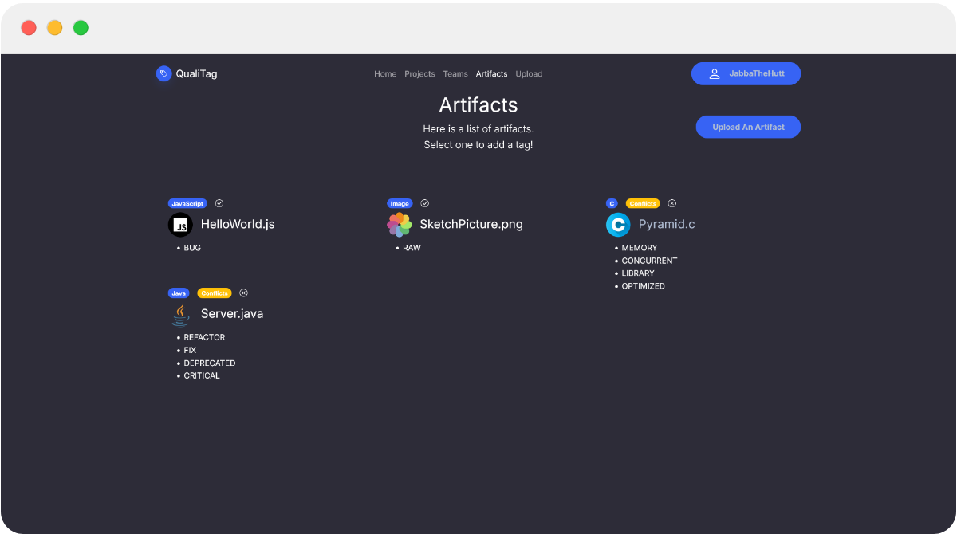
Artifacts

Slide 6
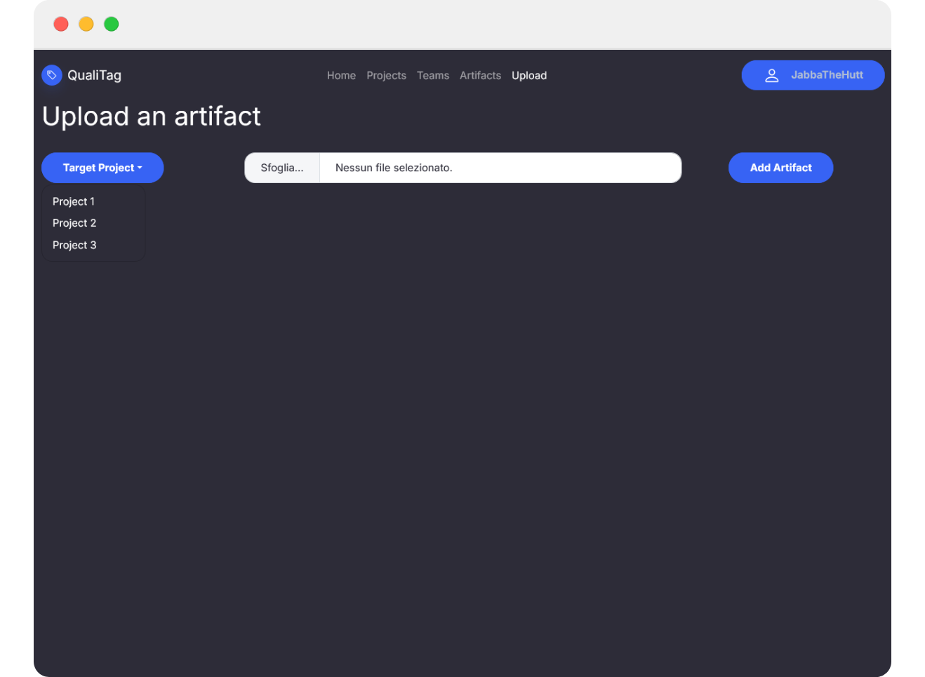
Upload an artifact
Select a project
Upload an artifact from your device

Slide 7
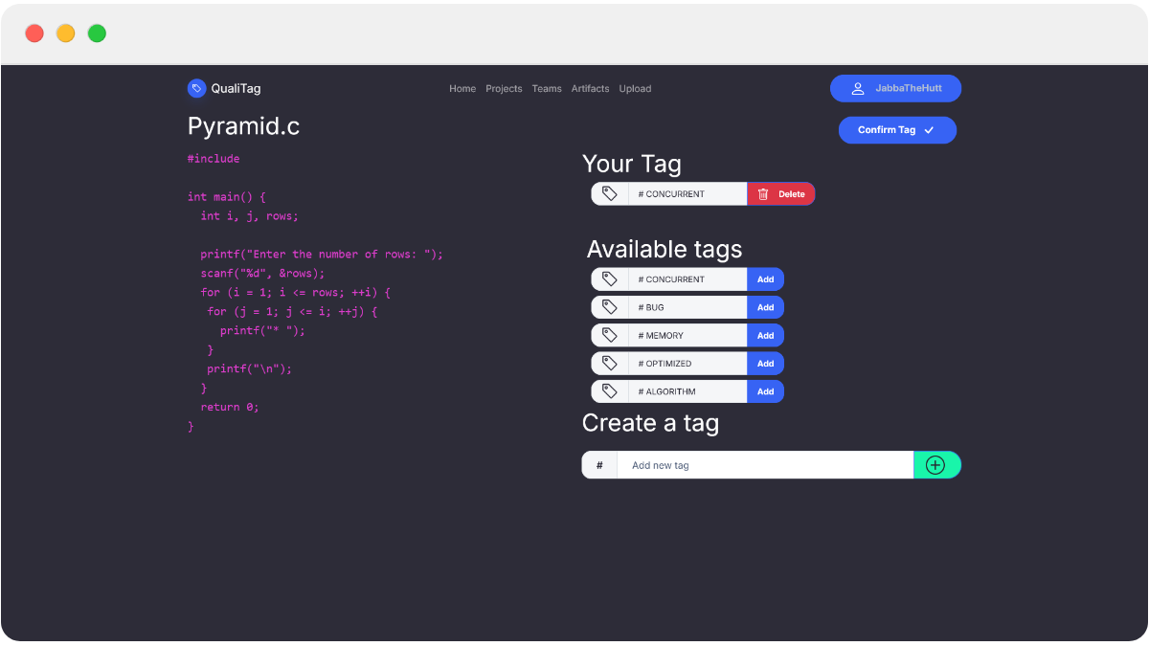
Artifact focus

Slide 8
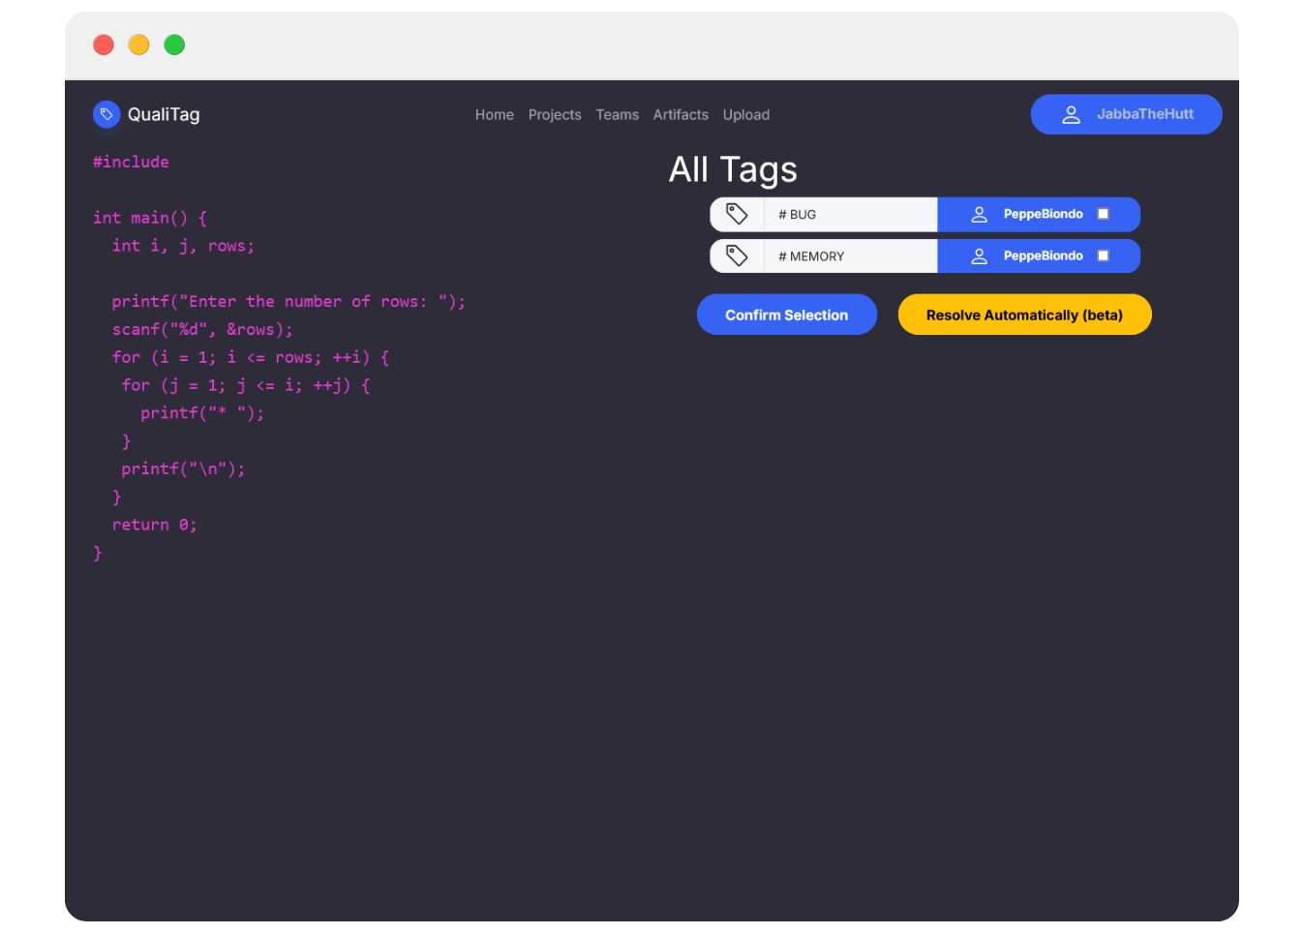
Resolve conflicts
Resolve automatically using WordNet.
Resolve manually selecting the right tag.

Slide 9
Servizi
Java
SpringBoot
...

Slide 10
Authorization
...

Slide 11
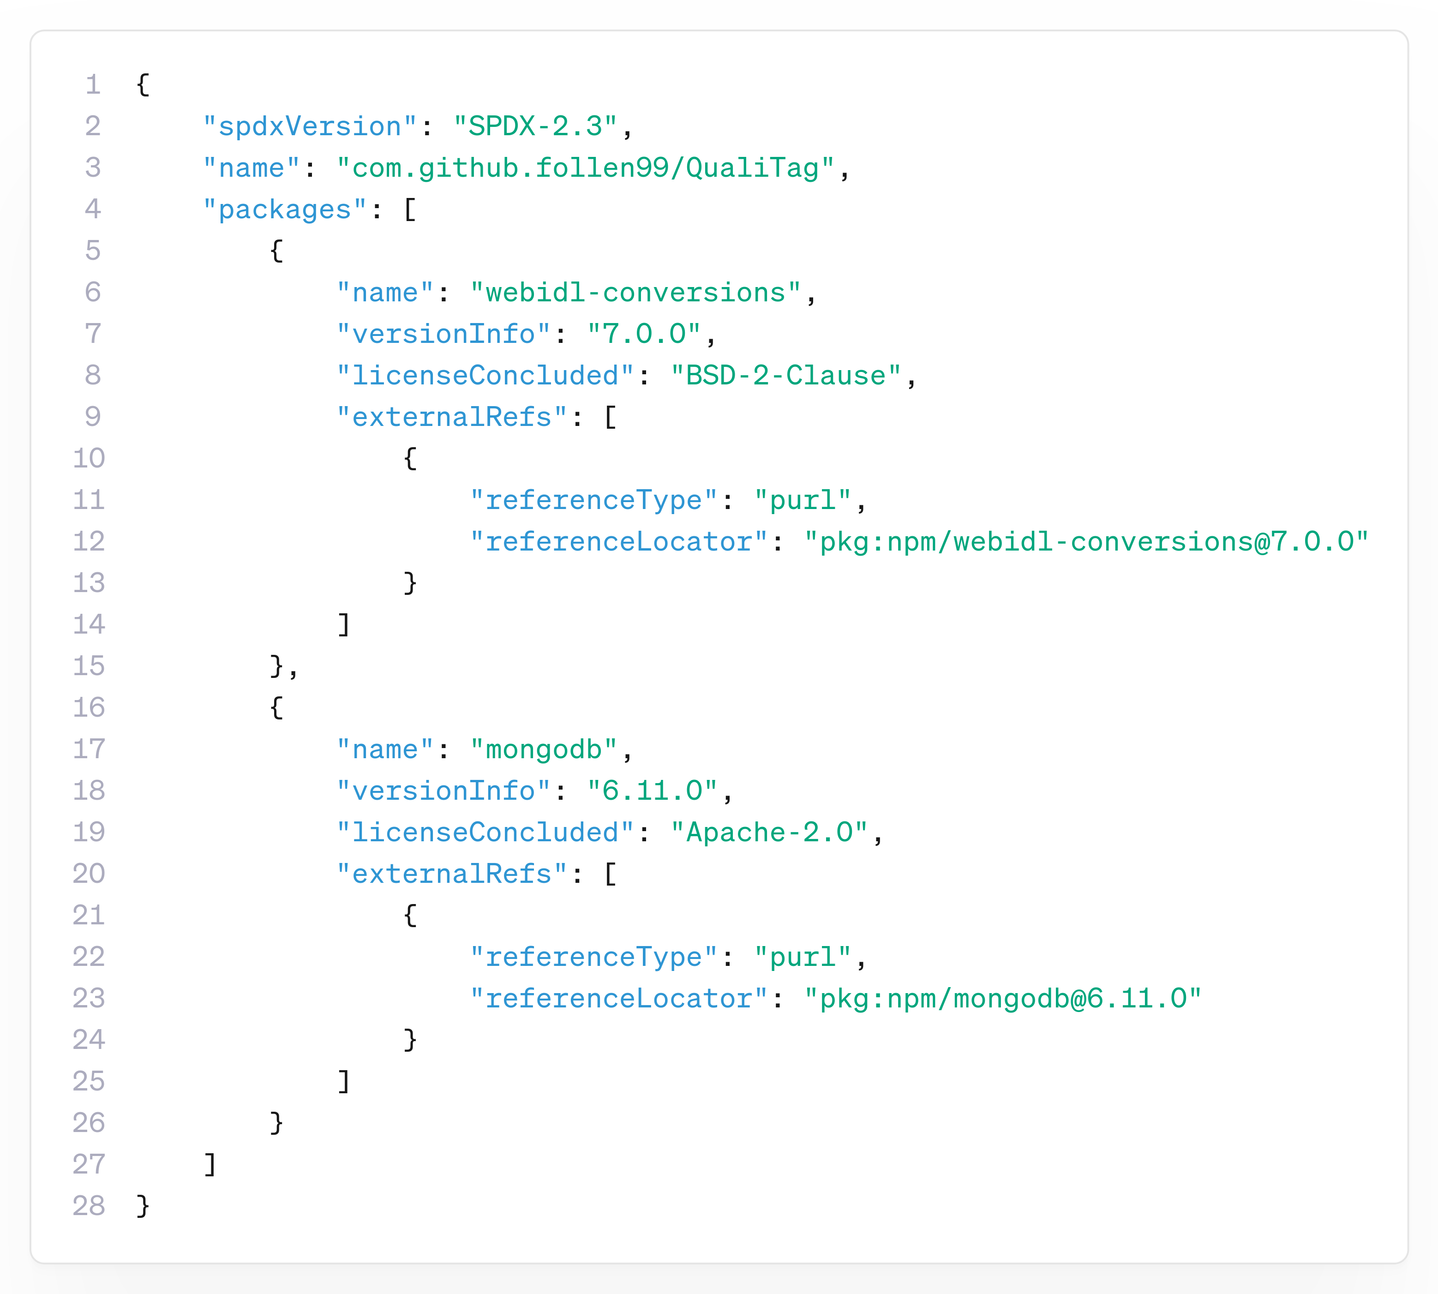
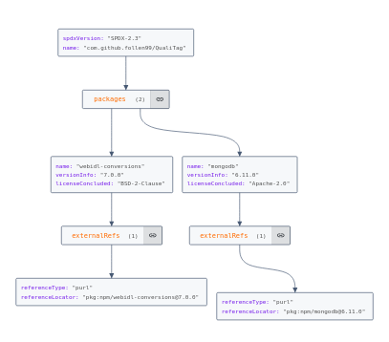
Dependency Graph - SBOM
Licenza scelta: GPL3

Slide 12
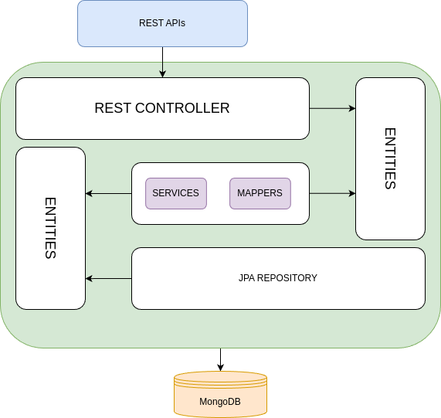
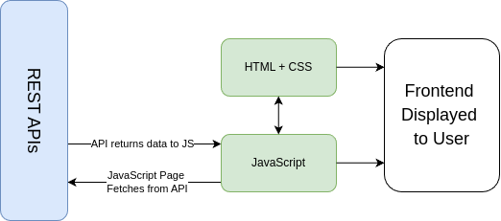
APIs Structure

