Slide 1


Slide 2
Interfaccia
HTML
JavaScript
CSS

Slide 3
Servizi
Java
SpringBoot
...

Slide 4
Authorization
...

Slide 5
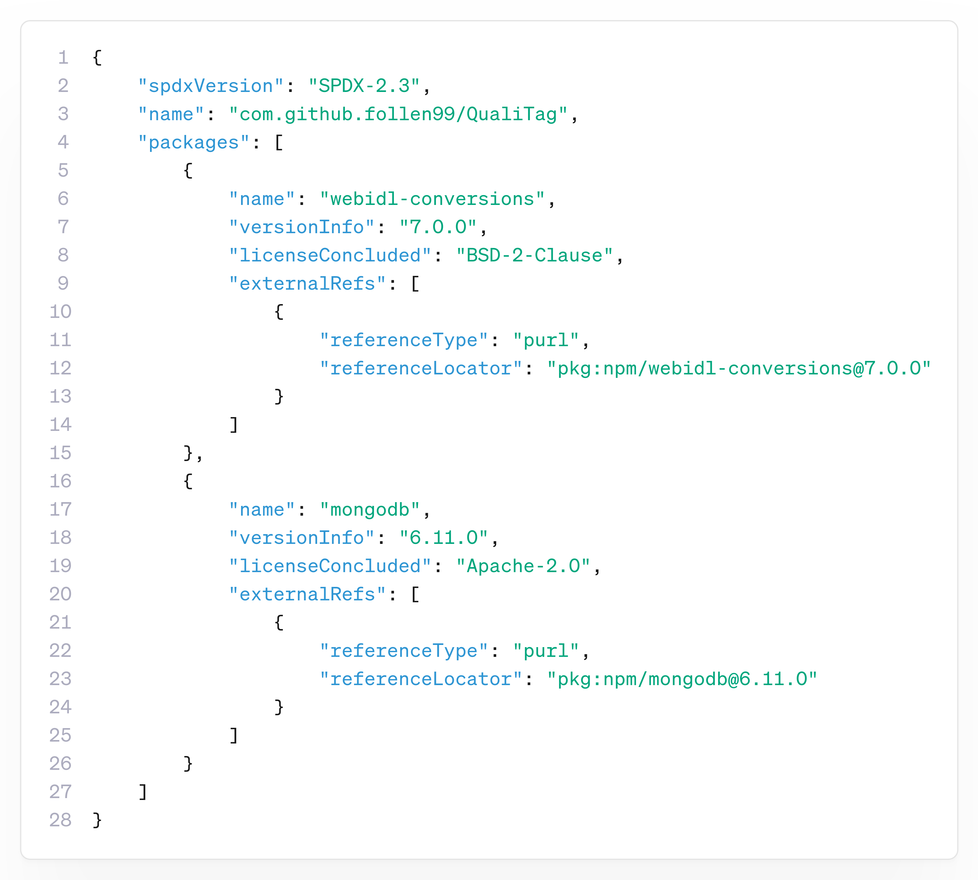
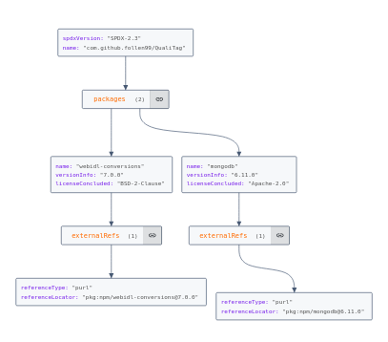
Dependency Graph - SBOM
Licenza scelta: GPL3

Slide 6
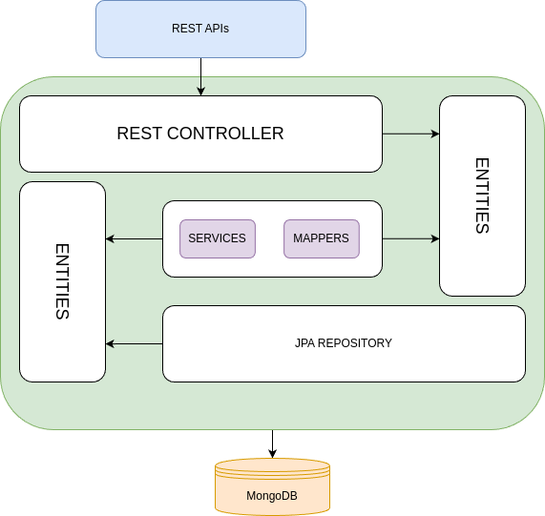
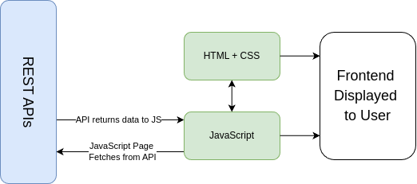
APIs Structure

