Slide 1


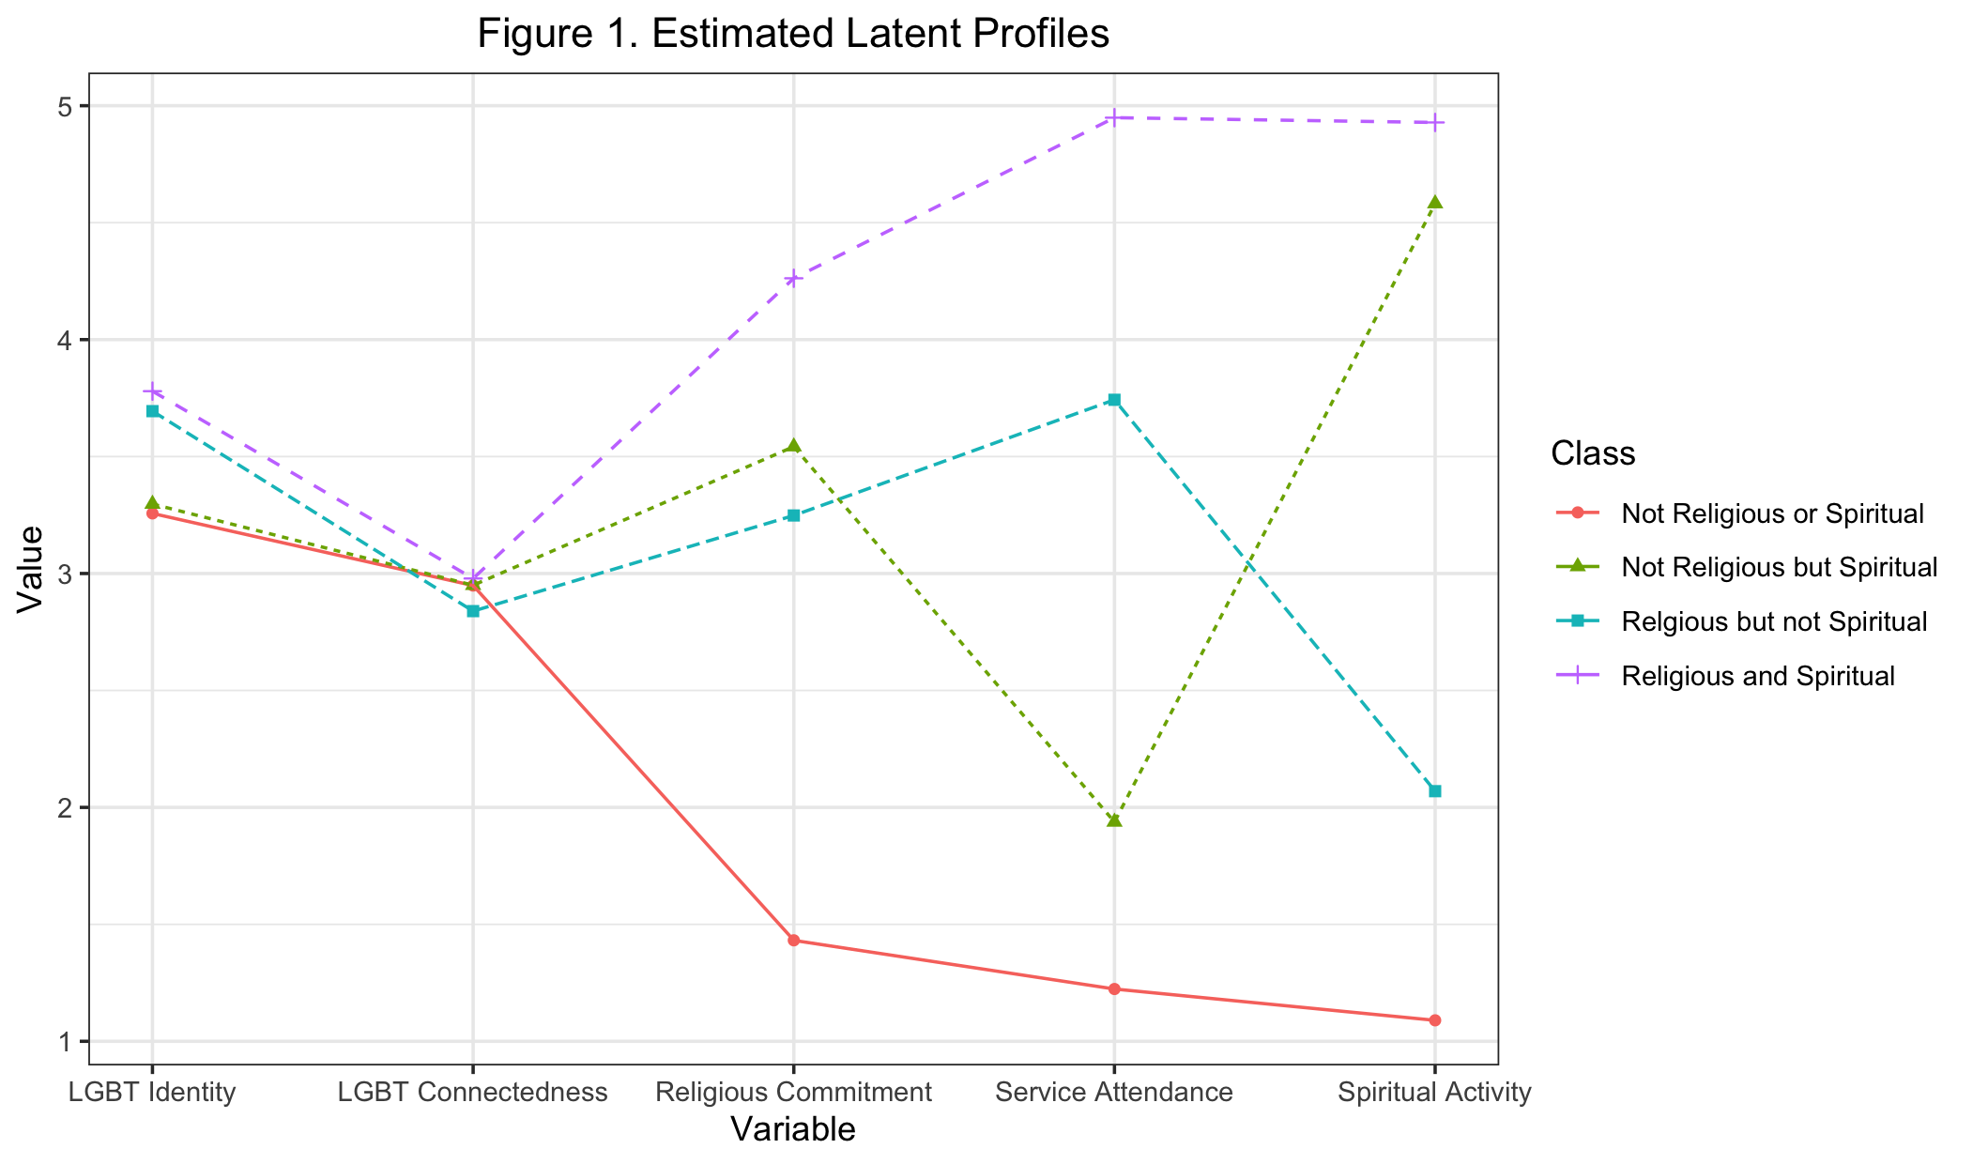
In our study, we found four patterns of engagement with religion and spirituality. In fact, non-religious or spiritual SGM-POC reported the lowest levels of internalized stigma and religious/spiritual identity conflict. However, religious and spiritual SGM-POC reported lower depression than spiritual SGM-POC and non-religious or spiritual SGM-POC. Black SGMs were more likely to be either religious or spiritual than non-religious or spiritual.
Authors
Seungju Kim, University of Illinois
G. Tyler Lefevor, Utah State University
How Do Sexual and Gender Minorities of Color
Engage with Religion and Spirituality?
METHODS
The present study utilized a sample of 403 sexual and gender minorities of color (SGM-POC) to perform latent profile analysis using the {tidySEM} package in R programming (R Core Team, 2024), and subsequently perform analyses with auxiliary variables.
RESULTS
We identified four patterns of engagement in a sample of SGM-POC: (1) Not Religious or Spiritual, (2) Not Religious but Spiritual, (3) Religious but not Spiritual, and (4) Religious and Spiritual.
We observed several significant demographic predictors of class membership and health and religious outcomes between classes.
For in-depth results see link.
Read more results, code, data, and preprint at doi.org/MISSING
Notes:
Notes:
In Powerpoint, click View > Guides
Keep text within gutter guides.
Author list: Don’t split names onto two lines (e.g., “Jimmy [break] Smith”). If that happens, use a new line, unless you need the space. Bold the first names of anybody who’s presenting in person.
Intro/methods/result: Do not drop below font size 28, but if you have extra space, jack up the font size until the space is full.
Do not use color in the sidebars except in graphs/figures. It’ll pull attention from the center and slow interpretation for passersby.

