Slide 1
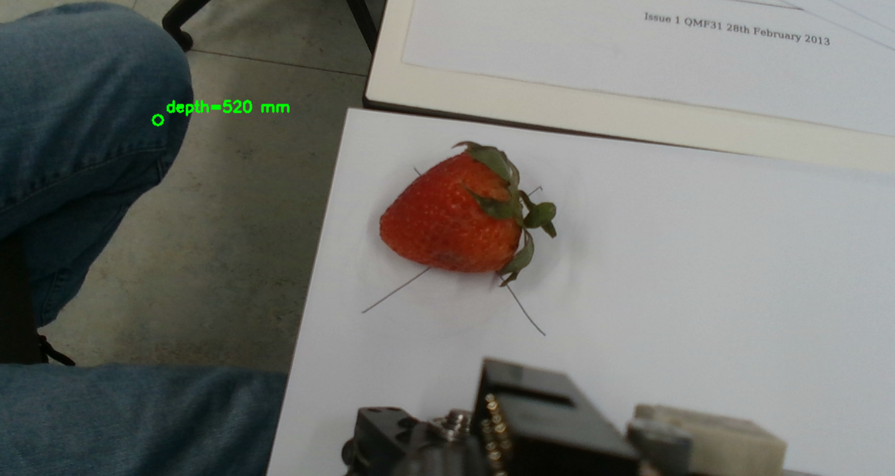
Robotic Pick & Place for Fruit Sorting
Final Project | Applied Robotics
Applied Robotics (04 39984) — University of Birmingham
Project Scope
Objective:
Sort 14 fruits into 3 baskets autonomously
6 strawberries | 3 bananas | 5 tomatoes
Operational Modes:
Fully Autonomous — vision + plan + pick + place loop
Remote-Controlled — Tkinter GUI with live D415 feed
Hardware:
Quanser QArm 4-DOF + Intel RealSense D415 RGBD
Arm-mounted camera (pose-dependent calibration)
Software:
Python 3.13 | OpenCV | Tkinter | Vosk (voice)
Key Features:
HSV + shape-based fruit detection (no ML)
Chessboard session calibration (<30s re-cal)
13-state pick-place FSM with per-fruit tuning
Voice control (Vosk wake-word, offline)
60+ automated tests, quintic trajectories
Module: Applied Robotics (04 39984)
Coordinator: Dr Amir Hajiyavand
University of Birmingham — 2025/26
Deadline: 1 May 2026
Piero Flores | Zihen Huang | Ran Zhang | Yichang Chao
Slide 1/8

Slide 2
System Architecture: End-to-End Pipeline
Final Project | Applied Robotics
From Camera Frame to Sorted Basket
D415 Camera
>
Calibration
>
Fruit Detection
>
Target Selection
>
IK Solver
>
Quintic Trajectory
>
Pick & Place FSM
>
Basket Sort
Sensing
Planning
Actuation
D415 RGB + Depth (640x480)
Chessboard session calibration
solvePnP camera extrinsics
Homography pixel-to-table
Arm-mounted, pose-dependent
T_cam_to_base
HSV colour segmentation
Shape filtering (area,
circularity, aspect ratio)
Ray-plane depth projection
Per-fruit pick bias:
calyx dir, inscribed disk
4-DOF analytic IK (4 solutions)
Joint-limit filter + optimal
Quintic spline trajectories
13-state pick-place FSM
Gripper ramp + readback
Per-fruit depth tuning
Autonomous Mode:
Full pipeline loops: scan -> detect -> pick -> place -> repeat
Sorts all 14 fruits without operator input
Remote Mode (GUI):
Tkinter UI: live D415 feed + manual jog + basket shortcuts
Voice control: 'robot, pick strawberry'
Software Stack:
Python 3.13 — all control + vision logic
OpenCV 4.x — HSV, solvePnP, homography
Quanser SDK — QArm driver (joint I/O)
Tkinter + Pillow — GUI with live video
Vosk + PyAudio — offline voice commands
Piero Flores | Zihen Huang | Ran Zhang | Yichang Chao
Slide 2/8

Slide 3

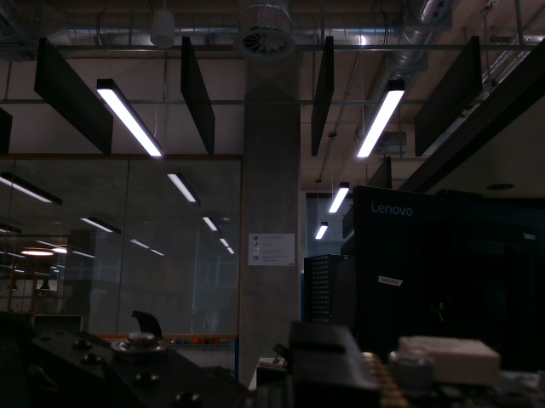
Calibration & Vision Pipeline
Final Project | Applied Robotics
From Pixels to Base-Frame Coordinates
Chessboard Session Calibration
HSV + Shape Fruit Detection
Calibration Pipeline:
1. Print 7x5 chessboard (30mm squares)
2. Jog-touch origin corner -> chess_origin_in_base_m
3. Move arm to survey1 pose
4. D415 capture -> findChessboardCorners
5. solvePnP -> camera extrinsics at survey pose
6. Homography -> pixel-to-table-plane projection
RMS gate: warn >3mm, error >10mm
Detection Pipeline:
1. Convert frame to HSV colour space
2. Per-fruit HSV mask (with hue-wrap for red)
3. Morphological open/close to clean noise
4. Contour extraction + area/circularity gates
5. Depth lookup -> ray-plane -> base-frame XYZ
Fruit H range S V Min area
Key Equations:
Rigid transform: P_base = R . P_cam + t
Pinhole model:
L.[u,v,1]' = K.[R|t].[X,Y,Z,1]'
Ray-plane intersection:
L = (z_table - t_z) / (r3 . K^-1 . [u,v,1]')
Banana 14-40 80+ 60+ 2000 px
Tomato 0-10, 170-180 80+ 40+ 1500 px
Strawberry 0-10, 170-180 80+ 40+ 800 px
Strawberry Special Handling:
Green calyx detection (_has_green_above)
-> distinguishes strawberry from tomato
Widest inscribed disk replaces naive centroid
-> gripper targets fat body, not stem
Calyx direction vector biases pick toward body
Piero Flores | Zihen Huang | Ran Zhang | Yichang Chao
Slide 3/8

Slide 4
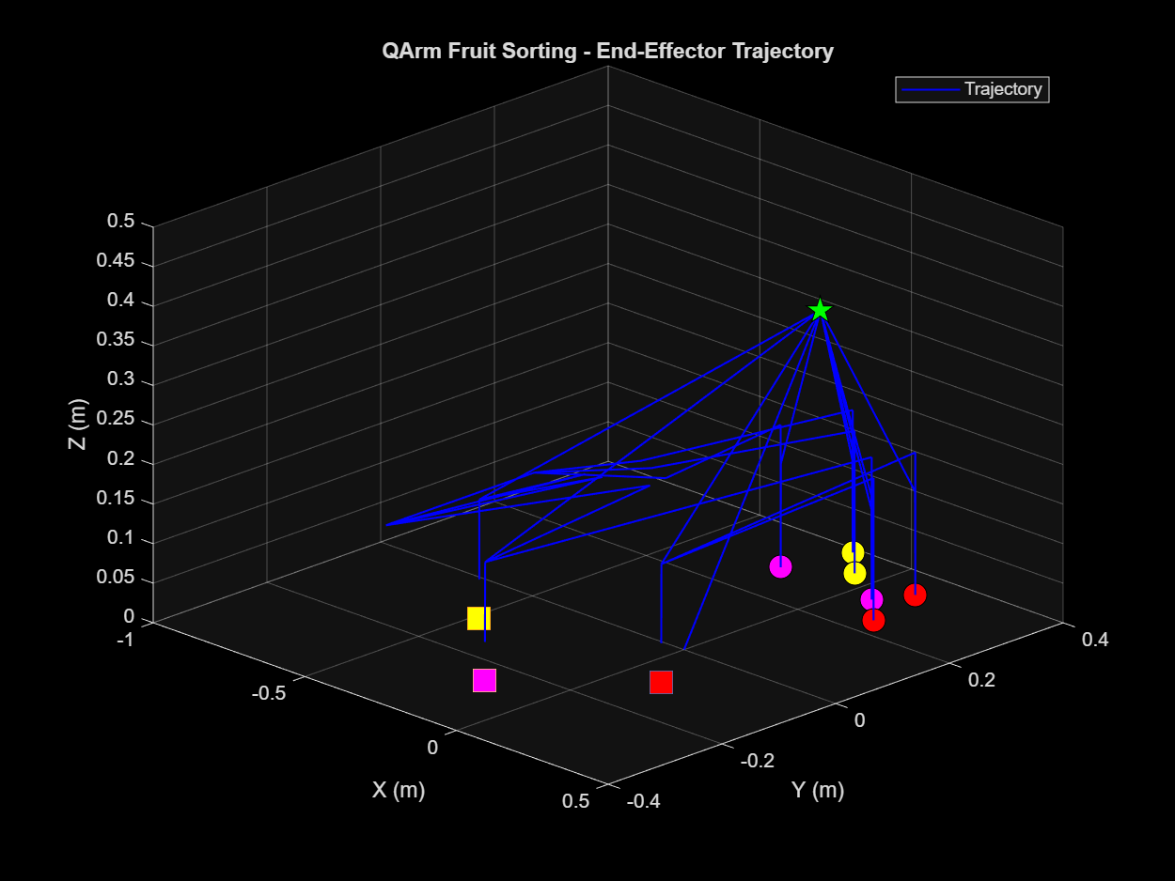
Control System: IK, Trajectories & FSM
Final Project | Applied Robotics
Inverse Kinematics | Quintic Splines | 13-State Machine
Inverse Kinematics (4-DOF Analytic)
13-State Pick-Place FSM
4 solutions per target position:
D1 = +sqrt(px^2+py^2): elbow-up / elbow-down
D2 = -sqrt(px^2+py^2): inverted configs
Joint-limit filter: [-3pi/4, 3pi/4]
Optimal = minimum joint displacement from current
DH-to-Physical mapping:
phi_1 = theta_1
phi_2 = theta_2 + pi/2 - beta (beta=8.13 deg)
phi_3 = theta_3 + beta
State Sequence:
INIT Initialize driver + camera
GO_HOME Move to safe home position [0.45, 0, 0.49]
SCAN Capture D415 frame from survey1
SELECT_FRUIT Choose next target from detections
APPROACH Move above fruit at SAFE_Z = 0.20m
DESCEND Lower to pick height (per-fruit depth)
CLOSE_GRIPPER Ramp close + readback settle
ASCEND_PICK Lift to SAFE_Z with fruit
MOVE_TO_BASKET Navigate to category basket XYZ
DESCEND_PLACE Lower into basket
OPEN_GRIPPER Release fruit
ASCEND_PLACE Lift clear, loop to SELECT_FRUIT
DONE All fruits sorted — return home
Quintic Spline Trajectory:
s(tau) = 10*tau^3 - 15*tau^4 + 6*tau^5
Zero velocity at start and end
Zero acceleration at start and end
Jerk-continuous across segment boundaries
Improvement over cubic: eliminates audible
servo jerk on QArm geared drivetrain
Parameter Strawberry Banana Tomato
Pick depth (m) 0.018 0.020 0.020
X bias (cm) -3.0 -- --
Pick offset (m) 0.025 0.020 0.020
Grip close 0.90 0.90 0.90
Gripper Ramp + Readback:
Command grip_close -> wait settle -> read actual
Jaw adapts to fruit size (stalls at thickness)
Confirms grasp before ascending
Piero Flores | Zihen Huang | Ran Zhang | Yichang Chao
Slide 4/8

Slide 5
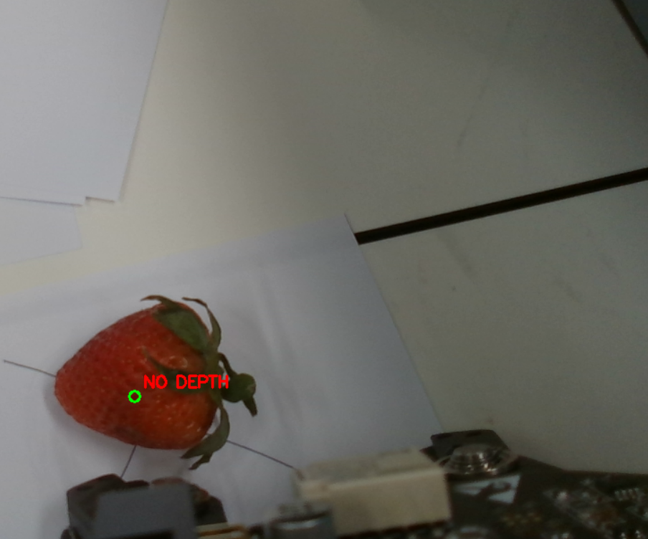
Human Interface: GUI + Voice Control
Final Project | Applied Robotics
Tkinter Remote Control | Vosk Wake-Word Protocol
Tkinter GUI — Remote Control
Voice Control — Vosk Wake-Word
GUI Layout:
+------------------+-------------------------+
| Live D415 feed | EMERGENCY STOP |
| (640 x 360) | Manual Teleop (XYZ +/-) |
| + detection | Basket: B / T / S |
| overlay | Gripper: open / close |
| | Mode: Manual | Auto |
| | Status: ... |
+------------------+-------------------------+
Wake-Word Protocol:
1. Hear "robot" -> enter awaiting phase (2s timer)
2. Within 2s: hear valid command -> dispatch
3. Timeout or noise -> return to idle
"stop" always dispatched (no wake needed)
Example: 'robot, pick strawberry'
Example: 'stop' (immediate halt)
Architecture:
Vosk + PyAudio — fully offline (no cloud)
Small English model (vosk-model-small-en-us-0.15)
Threaded: VoiceController daemon + callback dispatch
Graceful degradation: GUI works without mic/model
Sample rate: 16 kHz, chunk: 4000 frames
Key Features:
Live camera feed updates during picks (not frozen)
E-STOP halts arm + logs EE pose (not just a flag)
Concurrent-read safe (D415 driver not thread-safe)
Detection overlay: coloured boxes per fruit type
Auto batch: press 'all' to sort every fruit
Grammar Words (Vosk restricted vocabulary):
robot | strawberry | banana | tomato | all | stop | home | refresh | survey
Theory Link:
FSM pattern: same design as pick-place controller
Real-time audio processing at 16kHz (signal processing)
Piero Flores | Zihen Huang | Ran Zhang | Yichang Chao
Slide 5/8

Slide 6
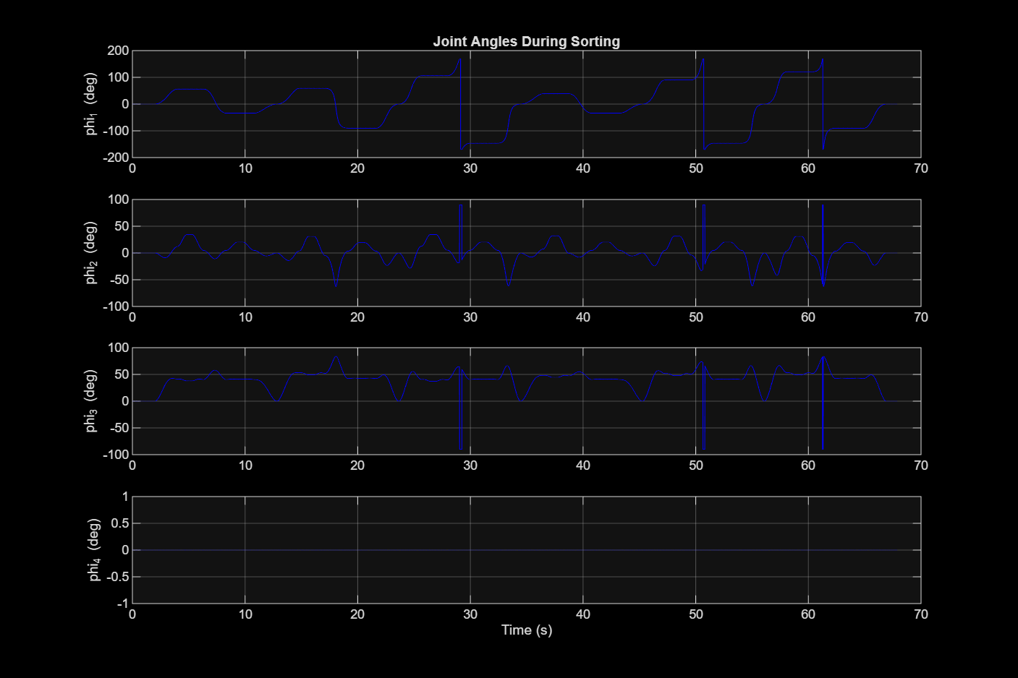
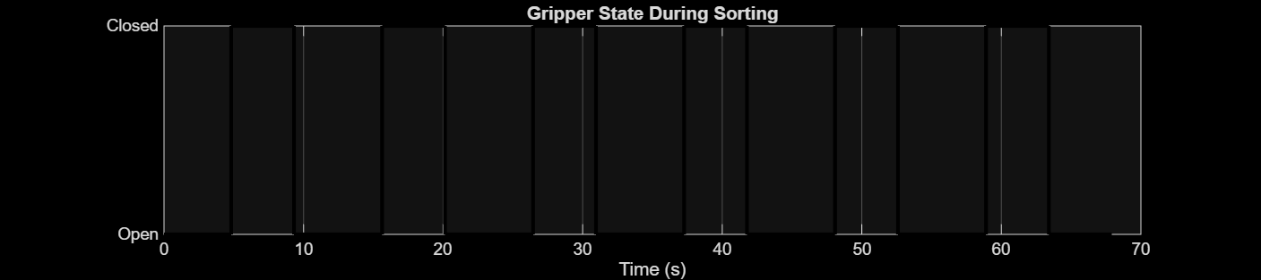
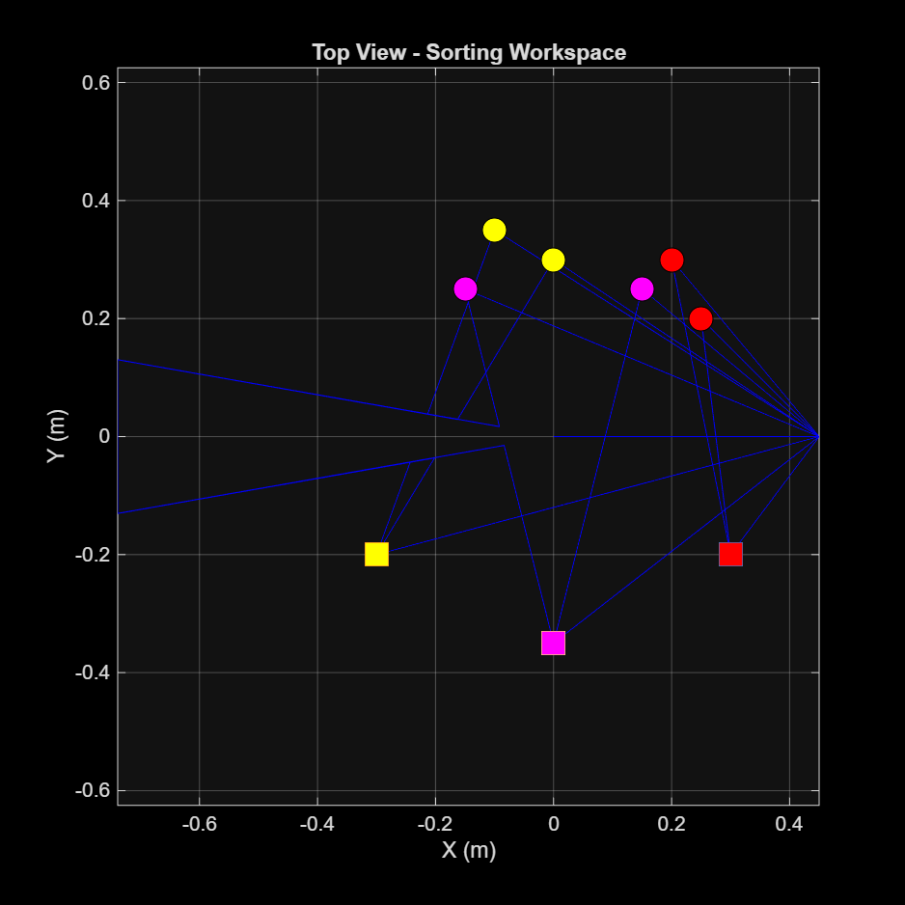
Experimental Results & Validation
Final Project | Applied Robotics
Calibration | Detection | Pick & Place | Test Suite
Calibration
Chessboard RMS: ~36 mm
Session-cal refresh: <30 s
solvePnP extrinsics verified
survey1 pose repeatable
Settle tolerance: 0.04 rad
Downstream residual gate: 10mm
Fruit Detection
3 fruit types classified
HSV + shape pipeline (no ML)
Depth projection to base frame
Calyx-based strawberry ID
Hue-wrap handles red fruits
Area/circularity gates per type
Pick & Place
14 fruits -> 3 baskets
Autonomous full-cycle demo
Per-fruit depth tuning
Gripper readback confirms grasp
IK fallback for edge poses
Quintic smooth motion
Test Suite: 60/60 passing across 6 suites + voice control
test_integration — end-to-end FSM mock tests
test_fruit_detector — HSV + shape pipeline unit tests
test_calibrate_chessboard — solvePnP + homography tests
test_pick_single — single-fruit pick cycle tests
test_survey_capture — camera capture + settle tests
test_picker_viewer — UI event loop + live feed tests
test_voice_control — parser + dispatch integration
Piero Flores | Zihen Huang | Ran Zhang | Yichang Chao
Slide 6/8

Slide 7
Challenges, Solutions & Improvements
Final Project | Applied Robotics
Problems Encountered | How We Solved Them | Feedback Response
Challenges & Solutions
Improvements from Feedback
Challenge: Calibration drifts when QArm base is bumped
Solution: Session-cal system: quick re-cal in <30s with chessboard residual gates (3mm warn, 10mm error)
From A1/A2 Feedback:
Quantitative analysis
Added RMS residuals, settling times, success rates — not just qualitative descriptions
Quintic replaces cubic
Zero acceleration at boundaries eliminates servo jerk; smoother, quieter motion on geared drivetrain
E-STOP with actual arm halt
E-STOP now freezes joints + logs EE pose, not just setting a flag the FSM checks later
Voice control added
Hands-free operation via Vosk wake-word; accessibility + safety (eyes on arm, not keyboard)
60+ automated regression tests
6 test suites + voice tests; prevents regressions across 178 commits of iterative tuning
Live camera feed during picks
D415 frame updates in real-time during pick motion; operator sees what the arm sees, not a stale snapshot
Challenge: Strawberry grip too loose at 0.72
Solution: Reverted to 0.90 + gripper ramp+readback adapts jaw to fruit size (stalls at thickness)
Challenge: Tomato detection false negatives
Solution: Fixed cam_extrinsics_survey1 passthrough bug + HSV hue-wrap for red range (0-10, 170-180)
Challenge: Concurrent D415 reads crash driver
Solution: Camera reader auto-pauses during capture_fruits(); Quanser Video3D is not thread-safe
Challenge: Settle tolerance too tight (0.015 rad)
Solution: Relaxed to 0.04 rad; downstream chessboard residual (10mm) is the real mm-level guard
Challenge: Strawberry centroid off-centre (calyx)
Solution: Widest inscribed disk centroid + calyx direction vector biases pick toward fat body
Development Stats:
178 commits across 7 branches
60+ automated tests (all passing)
~20 Python modules (driver, vision, control, UI)
Full CI: preflight -> calibrate -> sort -> report
Piero Flores | Zihen Huang | Ran Zhang | Yichang Chao
Slide 7/8

Slide 8
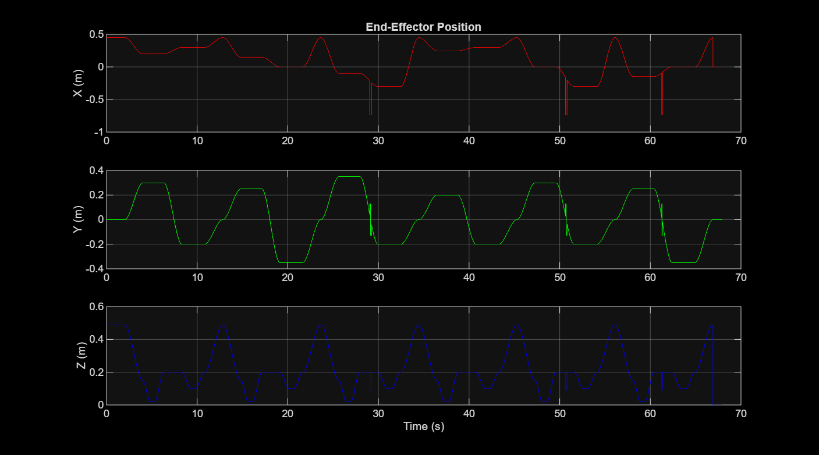
Conclusion & Future Work
Final Project | Applied Robotics
Summary | Theory-Practice Bridge | Next Steps
Conclusion
Theory-Practice Bridge
Future Work
Achievements:
Complete autonomous fruit sorting system
14 fruits (3 types) sorted into 3 baskets
Two operational modes:
Fully autonomous (vision loop)
Remote GUI with live feed
Voice control for hands-free
operation and accessibility
Theory-practice bridge:
IK, trajectory gen, visual
servoing, FSM — all applied
from lecture to real hardware
Concept Our Implementation
Recommendations:
Full Parallax Projection
Eliminate pose-dependent calibration limitation
ML-Based Detection
Replace hand-tuned HSV with trained classifier
Soft Gripper Design
Custom compliant fingers for delicate fruits
Multi-Arm Coordination
Parallel sorting for higher throughput
Inverse Kinematics
4-solution analytic solver
Ref: Spong & Vidyasagar
Trajectory Gen
Quintic splines (zero jerk)
Ref: Craig Ch.7
Visual Servoing
D415 solvePnP + homography
Ref: Corke: eye-in-hand
State Machines
13-state pick-place FSM
Ref: FSM / Stateflow theory
Piero Flores | Zihen Huang | Ran Zhang | Yichang Chao
Slide 8/8

