Slide 1
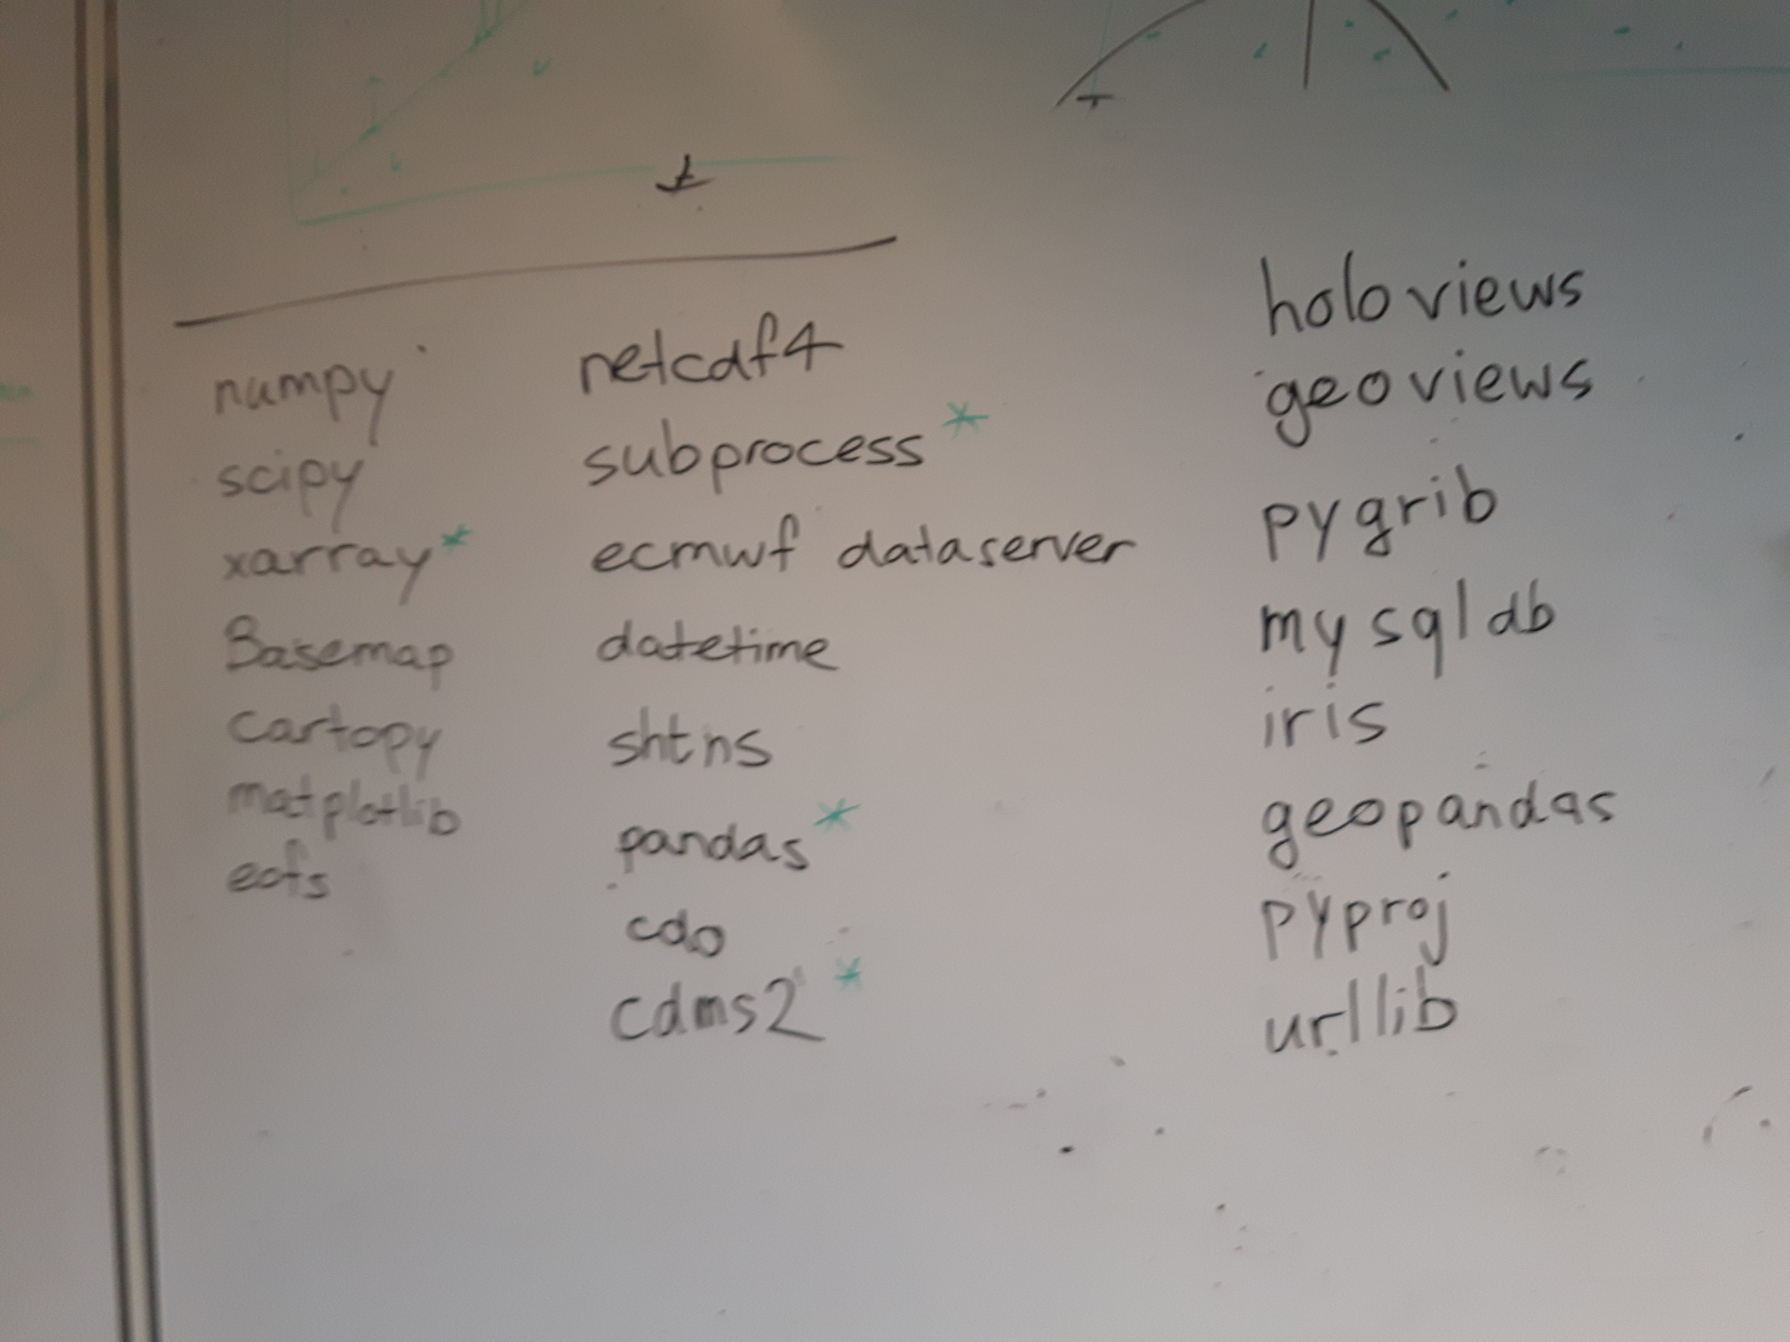
Python Working Group (PWG)

Slide 2
Topics today
Python 2 > Python 3
Introduction to Xarray
Any ideas on topics for PWG
What’s / who’s / when’s next
AOB

Slide 3
Python 2 > Python 3
Xarray drops support for 2.7 in end of 2018
How to switch to 3.6?
2to3 (alias 2to3='/lib64/python3.6/Tools/scripts/2to3')
reindent.py (reindent='/lib64/.. .. /scripts/reindent.py')
‘2to3 -w script.py’ rewrite script.py in python3 and make a backup file (‘script.py.bak’)
Run (i)python by typing (i)python3
Locally installed packages by pip have to be reinstalled (e.g. ‘pip3.6 install xarray –user’)

Slide 4
Xarray | Key features
Open source project and python package
Labelled data analysis on N-dimensional data
Xarray.Dataset is an in-memory representation of a netcdf file
Built on top of Pandas, so lots of functions from pandas available in xarray
Main use in weather and climate research, but also other fields

Slide 5
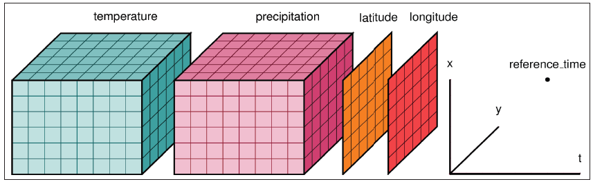
Xarray | Key features
DataArray
DataSet

Slide 6
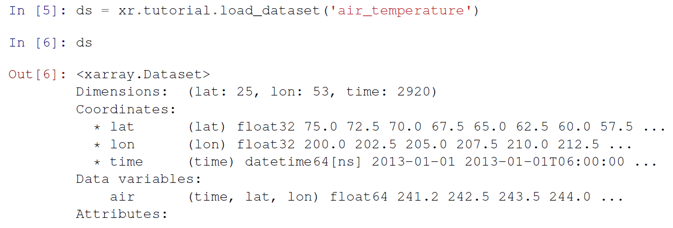
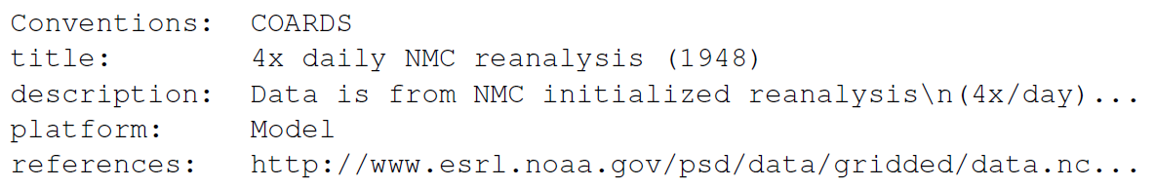
Xarray | open / inspect / select / indexing
Load netcdf file
xr.load_dataset()
xr.to_netcdf()

Slide 7
Xarray | open / inspect / select / indexing
Open netcdf file
  xr.open_dataset(‘dir/data.nc’) > local file
  xr.open_dataset(‘http://somewhere/data.nc’) > opendap
  xr.to_netcdf(‘dir/data_new.nc’) > save to netcdf
  xr.open_datset(‘dir/data.nc’,chunck={‘time’:10})
    If too large for memory, load data in chunks
Open multiple netcdf files
  xr.open_mfdataset(‘dir/data*.nc’) > load multiple files
    Data automatically chunked per file

Slide 8
Xarray | open / inspect / select / indexing
Inspecting dataset / DataArray
  ds.air > dataArray of air
  ds.air.dims > dimensions of ‘air’ [‘time’,’lat’,’lon’]
  ds.lat > dataArray of latitude
  ds.air.values > numpy array of air
  ds.air.attrs > attributes of air

Slide 9
Xarray | open / inspect / select
Selecting / indexing
  Selecting by label:
    ds.air.sel(time=’2007-10-01’)
    ds.air.sel(lat=40.,lon=40.,method=’nearest’)
    ds.air.loc[‘2007-10-01’:’2010-10-01’,45.5,60.]
  Selecting by index: ds.air.isel(time=-1)
    ds.air.isel(time=-1,lat=10,lon=3)
    ds.air.isel(time=slice(None,10)), equivalent to numpy [:10]
    ds.air[:10,5,5:10], similar to numpy
  All returned objects are dataArrays

Slide 10
Xarray | operations and computations
new_ds = ds – 3
All of numpy scipy universl functions (ufunc)
  np.abs(ds), np.sin(ds), etc etc
Aggregation functions
  ds.mean(dim=’time’)
  ds.sum(dim=’lat’)
Rolling window operations (e.g. running mean)
  ds.rolling(time=3,min_periods=2,dropna=True).mean(dim=’time’)

Slide 11
Xarray | Groupby and split-apply-combine
Groupby
  Climatology of monthly data
    clim_mon = ds.air.groupby(‘time.month’).mean(‘time’)
  Seasonal climatology
    clim_seas = ds.air.groupby(‘time.season’).mean(‘time’)
  Monthly anomalies
    anom = ds.air.groupby(‘time.month’) - clim_mon
  groupby_bins (easy binning of data)
    ds.groupby_bins(‘lat’,[-90,-45,0,45,90]).sum()

Slide 12
Xarray | Groupby and split-apply-combine
Groupby and Apply
  Standardize data
    def standardize(x):
      return (x-x.mean()) / x.std()
    ds.groupby(‘time.month’).apply(standardize)
  Apply in combination with lambda, e.g. get anomalies relative to longitudal mean
    ds.groupby(‘lon’).apply(lambda x: x-x.mean(),shortcut = False)

Slide 13
Xarray | Resampling / Regridding
Change time frequency of data
  Daily to monthly
    ds.resample(‘1M’,dim=’time’)
  Many more examples
  Mainly time dimension resampling
Spatial regridding
  Pangeo? Near future..

Slide 14
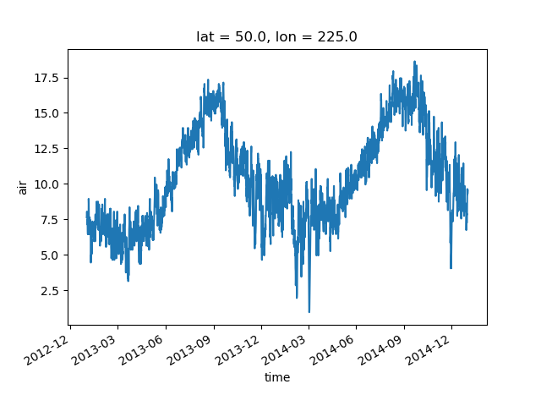
Xarray | Graphics / plotting
Easy plotting, wrapper for matplotlib
air1d = air.isel(lat=10, lon=10)
air1d.plot()

Slide 15
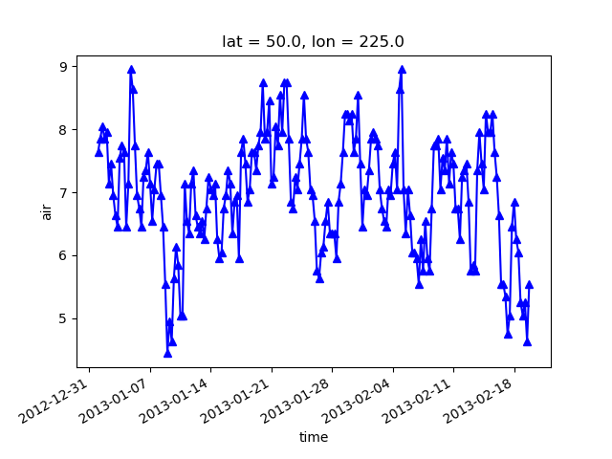
Xarray | Graphics / plotting
air1d[:200].plot.line('b-^')

Slide 16
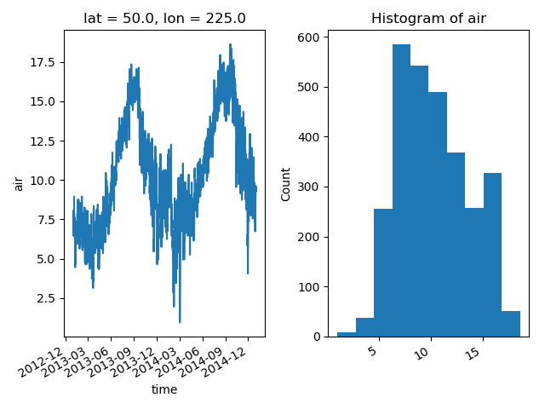
Xarray | Graphics / plotting
fig, axes = plt.subplots(ncols=2)
air1d.plot(ax=axes[0])
air1d.plot.hist(ax=axes[1])
plt.tight_layout()
plt.show()

Slide 17
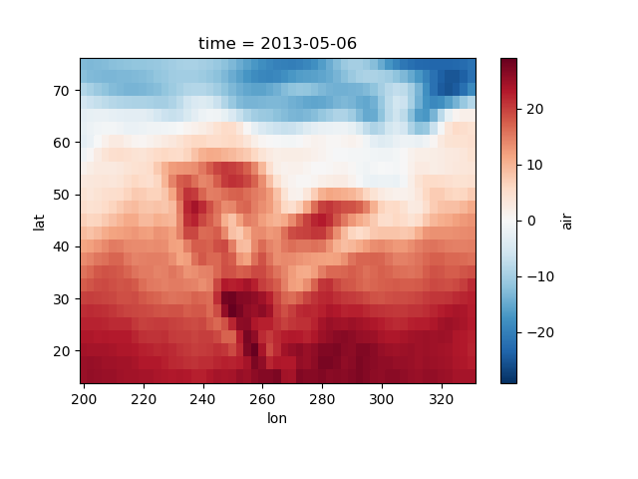
Xarray | Graphics / plotting
ds.air.isel(time=500).plot()
plt.show()

Slide 18
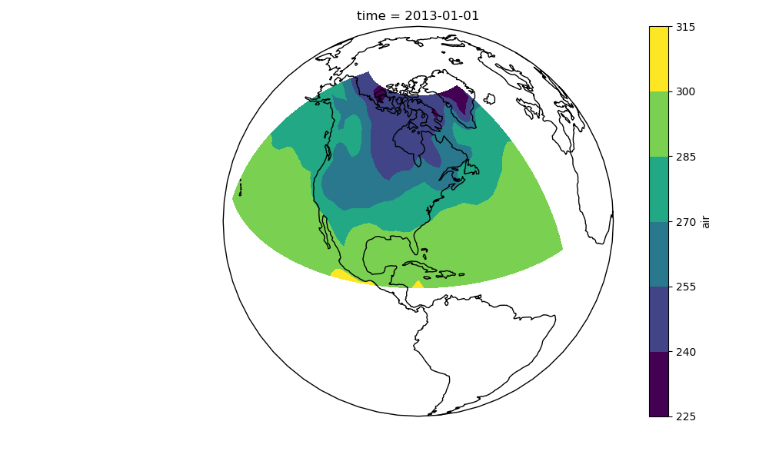
Xarray | Graphics / plotting
import cartopy.crs as ccrs
air = xr.tutorial.load_dataset(
'air_temperature').air
ax = plt.axes(projection=
ccrs.Orthographic(-80, 35))
air.isel(time=0).plot.contourf(ax=ax, transform=ccrs.PlateCarree())
ax.set_global(); ax.coastlines()

Slide 19
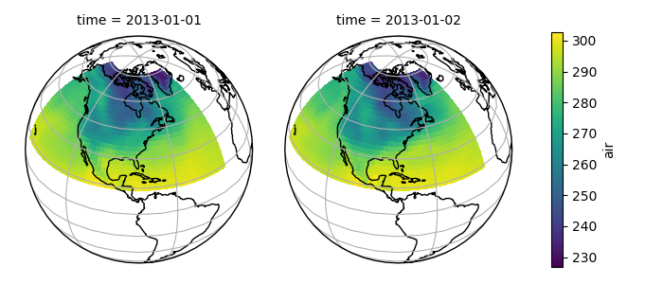
Xarray | Graphics / plotting

Slide 20
Xarray | Compatibility
Eofs (eof analysis), Iris and CDAT (other climate data tools)
Pangeo (climate data tools suitable for ‘big data’)
  Work in progress
Xgcm (easily change from staggered / non-staggered grid)
Seaborn (statistics)
Cartopy (plotting)
Many more, quickly growing

Slide 21
AOB’s?
Any other business?
- How to setup python at your workstation
> Laurens
- …..

Slide 22
Next meeting
When?
What is on the agenda?
Who?

