Slide 1
Means Testing Ozone Levels With Time Series in R
By Maxwell Reeser

Slide 2

Problem - Can we detect a difference in atmospheric pollution levels using time series analysis in R?

Slide 3
Data Acquisition & Cleaning
EPA has daily pollution data
Website: https://aqs.epa.gov/aqsweb/airdata/download_files.html
Chose the period between January 1st 1996 and December 31st 2004
Not all of it is pristine for database insertion
Required some manual cleaning
Used PostgreSQL to further process data
Get county averages
Determine locations with consistent data collection

Slide 4
Fitting Models
Used time series (ts) function in R, and nnetar to train
Tested across a large number of different splits for the data
Performed means test on 51 counties for each of 31 days worth of predicted data
Best splits mostly have last 1-3 years in right group
Significant differences are always negative
If a difference exists, ozone levels dropped
Model Split Name | Proportion Significantly Different | Graphical Representation of split
Even_split | 0.355
25_75 | 0.226
75_25 | 0.516
7_to_1 | 0.935
1_to_7 | 0.387
Even_split_4_year_gap | 0.0645
66_33_2_year_gap | 0.0645
Late_even_split | 0.935
Late_75_25 | 0.935
Late_25_75 | 0.935
Left_625 | 0.484

Slide 5
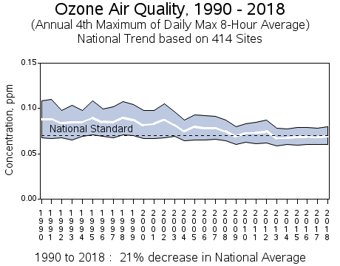
Conclusion
Using time series to conduct means tests was effective
Research online indicates that ozone levels did in fact drop off steeply after 2002
EPA chart at left
Consistent with the results from the models

