Slide 1
Data Augmentation of Low-Resource Languages
By Amelia Brown and Alexander Kahanek
(The A team) + Jared

Slide 2
Outline
Introduction
Project Ethics
Project Background
Data
Baseline Results
Data Augmentation
Conclusion

Slide 3
Introduction
What is morphological inflection?
Examples in English:
chair -> chairs
mouse -> mice
go -> went
Inflecting unknown words

Slide 4

Morphological inflection of an hypothetical English noun

Slide 5
Introduction
SIGMORPHON 2020 Conference Shared Task 0:
Morphological inflection
Conference submissions designed to be massively multilingual
Our work: focus on low-resource languages
What is a low-resource language?
Selected Norwegian Nynorsk (nno) and Middle Low German (gml) as target languages
Small datasets, low accuracy in shared task
Selected English (eng), German (deu), and Icelandic (isl) as source languages

Slide 6
Ethics
Primary ethical concerns of machine learning as a whole and NLP in particular
Privacy
Appropriate collection and use of data
Concerns of this project and potential future research:
Not terribly different from general concerns
Process of acquiring data on low-resource languages
Language is the property of a community, whose wishes should be respected

Slide 7
Background
Summary of baseline model architecture
Transformer (an encoder and decoder with attention to decide which parts of the encoded sequence are most important; does not require an LSTM) (Allard, 2019)
Mono-HMM, or hard monotonic attention transducer (the monotonicity allows an output vector to be produced from an input vector in linear time) (Raffel, 2017)
Research strategy:
Train same model on different data
Why did we do that?

Slide 8
Data and results

Slide 9
What does the data look like?
The data was split into Development Languages and Surprise Languages.
This was done to challenge the multilingual models.
A single language will consist of a plethora of words, each including a lemma, target form, and the associated tags.
lemma | Target form | tags
chair | chairs | N;PL
mouse | mice | N;PL
go | went | V;PST

Slide 10
How does it break down?
Language | # of words | Avg. # of tags
nno | 14,431 | 2.9
gml | 1,272 | 4.3
deu | 142,008 | 3.8
eng | 115,522 | 2.4
isl | 76,915 | 4.1
The target languages we chose were Surprise Languages.
They are also very limited in the amount of data, comparatively.
The average number of tags also varies widely.
Infact, the tags themselves can have different meanings.
Such as language specific details.

Slide 11
Could we get a better baseline?
The models presented from the task were not tuned for low-resource languages.
In-fact they focused on general accuracy across many languages.
So we wanted a baseline for single language models.
We immediately saw an improvement!
Mostly because their models were not well prepared for these languages.
language | Base avg accuracy | Their avg accuracy
nno | 84.7% | 14%
gml | 60.8% | 11%
deu | 97.8% | 88%
eng | 96.5% | 86%
isl | 96.6% | 84%

Slide 12
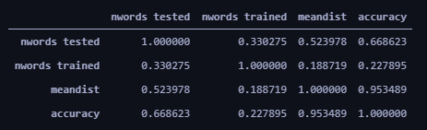
What did we look for?
When performing our Error Analysis, we looked into a few different aspects.
Generalized Language Features
Prefix, Stem, and Suffix Errors
Part of Speech Tags
We also looked into the correlation of the number of tested words, the Leveshtein Distance, and their accuracy.
We found some highly correlated features!

Slide 13
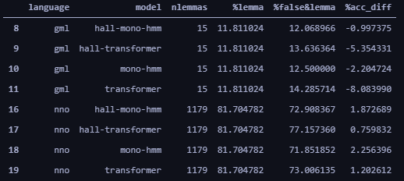
What About Language Features?
When Looking at the results, we noticed that if we subsetted the prediction results to words where the lemma remains unchanged in the prediction, we saw a drop in accuracy for Middle Low German, and a rise in accuracy in Norwegian Nynorsk.

Slide 14
Data Augmentation
Augmentation by inflected word
Target Language + Source Language
Where source language fits the requirement: chair -> chairs
i.e., the unchanged lemma (chair) is in the inflected word (chairs)
Full data augmentation
Multiple Source languages + Target Language
No subsets of data
i.e., used all available data

Slide 15

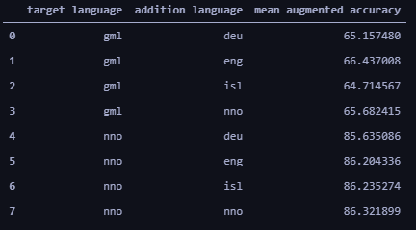
Lemma Implementations
Why this implementation?
We found a disparity of errors in the target languages focused around these types of words.
This is a simple approach to targeting language features.
What did we find?
We found that our this method generally produced better results.
We also found that Middle Low German is generally best paired with English.
While, Norwegian Nynorsk did better on average when paired with itself.

Slide 16
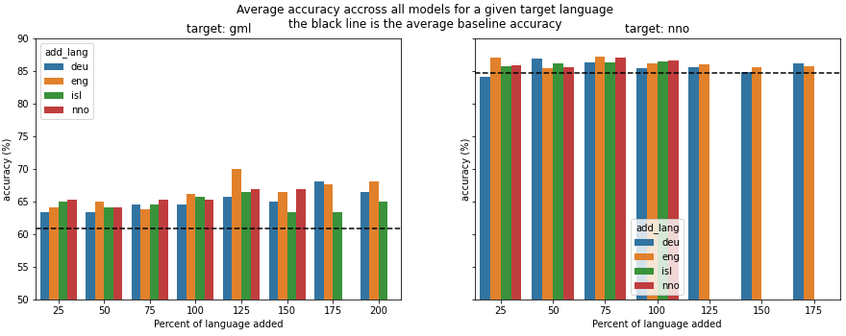
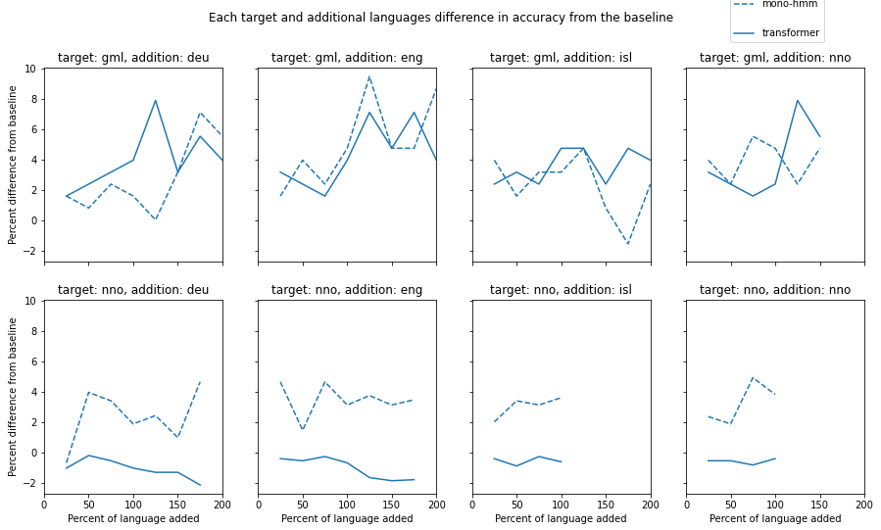
What about the actual models?
We found an increase in accuracy, from the average baseline, for nearly every model trained.
We found that for Middle Low German, the addition of data leads to higher accuracy.
While this isn't as drastic for Norwegian Nynorsk.
We found that the mono-hmm model type generally outperformed the transformer.

Slide 17
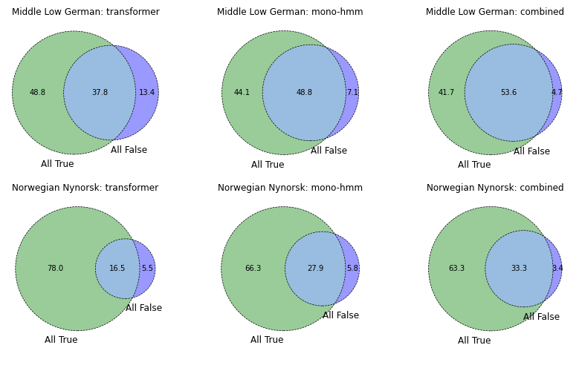
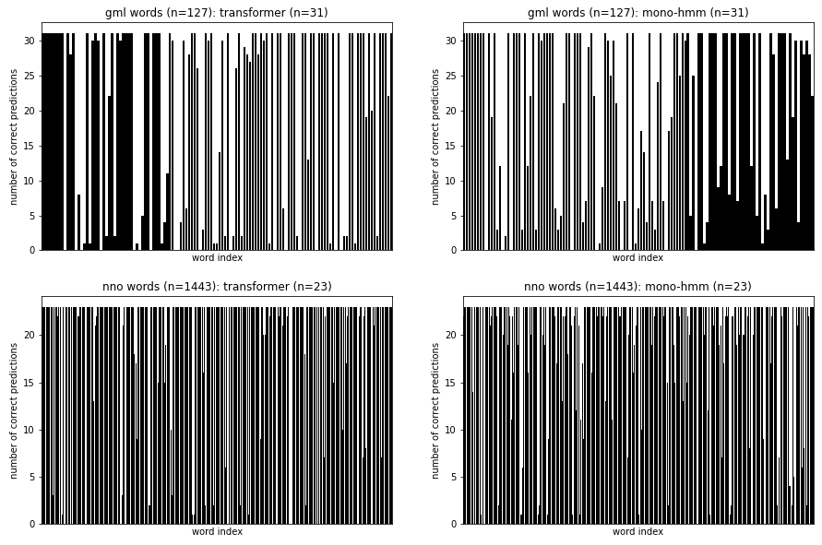
What about individual words?
We found that there might be a small portion of words in both languages that have yet to be correctly predicted.
We noticed that there are large differences in how each model type predicts a word.

Slide 18
Full Language Augmentation

Slide 19
Full Language Augmentation
Trained models on merged data from multiple languages
Trained on a combination of English and German, zero-shot transfer to Middle Low German (eng-deu-gml)
Trained on a combination of German and Icelandic, zero-shot transfer to Norwegian Nynorsk (deu-isl-nno)
Trained on all high-resource languages, zero-shot transfer to both low-resource languages (all-langs)
Then added target language data to training data to gain some benefits of fine-tuning

Slide 20
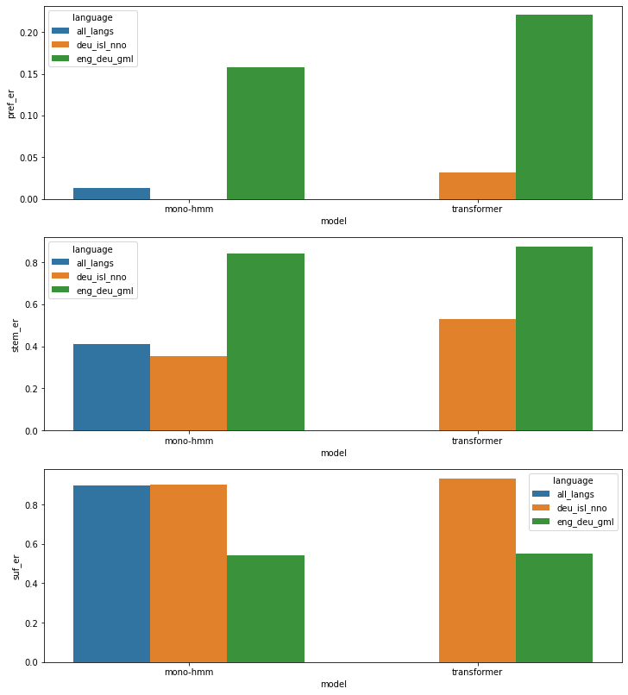
Full Language Augmentation
Why?
Not expecting accuracy - hoping for insights into languages
Results (Zero-Shot)
Very low accuracy (expected)
Interesting error distribution
Potential for future research

Slide 21
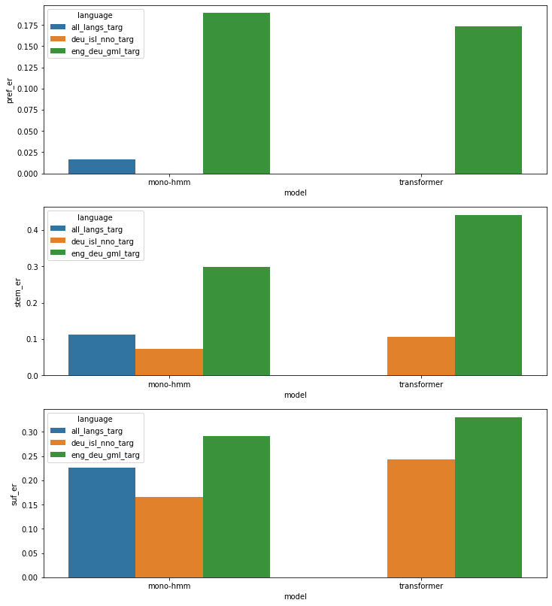
Full Language Augmentation
Why?
Hoping to gain some benefits of fine-tuning
Results (With Target Data Added)
Improvements in accuracy across the board

Slide 22
So, why does all this matter?

Slide 23
Final Results
We found that targeting language features can provide better results.
For Norwegian Nynorsk, although we didn't beat the baselines’ accuracy, our models on average did better.
We found that simply adding the target languages data to multilingual models can help improve accuracy for those target languages.
Language | Our Best Accuracy | Best Baseline | Average From Other Task
GML | 71.7% (gml+125eng) | 65.4% (hall transformer) | 14%
NNO | 88.5% (nno+50deu) | 88.7% (transformer) | 11%

Slide 24
Conclusion
What did we contribute?
We showed that low-resource languages can be effectively trained on and altered for better performance, with the assistance of other languages.
What challenges did we face?
Navigating unknown territory, both of us had minimal knowledge and experience going into this project.
Learning to understand the baseline was challenging as well, as learning to read another person's code always is.
What did we learn?
How to navigate a small-scale research project.

Slide 25
References
Ekaterina Vylomova et al. 2020. SIGMORPHON 2020 shared task 0: Typologically diverse morphological inflection. In Proceedings of the 17th SIGMORPHON Workshop on Computational Research in Phonetics, Phonology, and Morphology, pages 1–39, Online. Association for Computational Linguistics.
Colin Raffel. 2017. Online and Linear-Time Attention by Enforcing Monotonic Alignments, Online. https://colinraffel.com/blog/online-and-linear-time-attention-by-enforcing-monotonic-alignments.html.
Maxime Allard. 2019. What is a Transformer? Online. https://medium.com/inside-machine-learning/what-is-a-transformer-d07dd1fbec04

