Slide 1


Polymorphic Code
Jack, Brian, Andrew
Paid4Winrar
Credits to Kalantari for his sick polynomial art

Slide 2
Conference Paper
CoDisasm: Medium Scale Concatic Disassembly of Self-Modifying Binaries with Overlapping Instructions
Guillaume Bonfante†, Jose Fernandez‡, Jean-Yves Marion†, Benjamin Rouxel†, Fabrice Sabatier†, Aurélien Thierry†
†Université de Lorraine, ‡Ecole Polytechnique de Montréal
CCS '15: Proceedings of the 22nd ACM SIGSAC Conference on Computer and Communications Security October 2015, Pages 745–756

Slide 3
Bullet List
Introduction
Related Works
Self-Modifying Code
  Actually, introduces *formal* definition & algorithms [ ⚠️ MATH ]
Overlapping Instructions
  Applying previously definitions and techniques
Evaluation
  Use technique on some real malware samples

Slide 4
Introduction
Problems in Malware Analysis
  Increased Volume (300,000 malware / day by Google)
  Malware resists automatic analysis
  Current analysis tools not designed for high volumes of code
Disassembly
  Von Newmon Machine ⇒ [distinguishing data vs code] hard
    In this paper focus on self modifying code (SMC) and overlapping instructions
    Almost all malware self modifying
  Anti-debugging, anti-virtualization, anti-disassembly
  Code obfuscation by code + packed code “interleaving” aka slicing

Slide 5
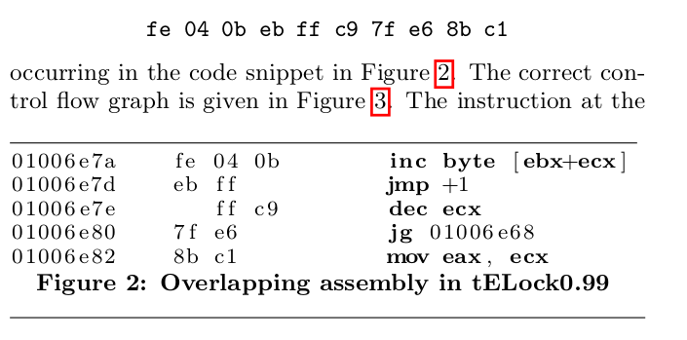
Introduction
Example of overlapping instruction

Slide 6
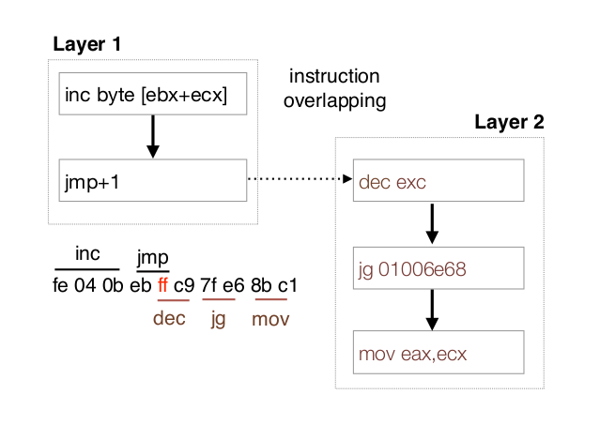
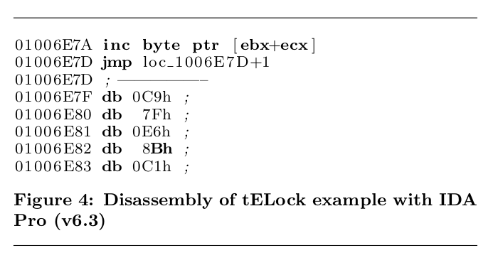
Introduction
IDA IS WRONG
Again, but with IDA Pro failing

Slide 7
Introduction
Code waves
  “Wave” = a sequence
  Waves k + 1 can be generated by previous k waves
Method
  Dynamic analysis by collecting all execution traces of all threads and processes (malware is run and PE is extracted)
  Determine sequence of waves
  Memory snapshots of each wave
  Disassemble each wave + recursive trace (traversal disassembly)
  THIS IS SO CONFUSING
500 malware is analyzed in 20 minutes

Slide 8
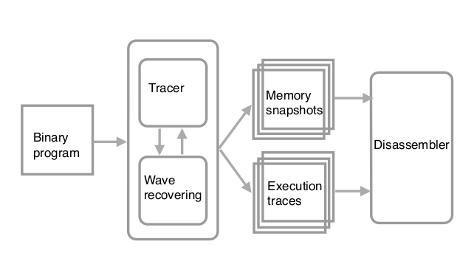
Introduction

Slide 9
Related Works
GNU objdump
  Data may be opcodes, no overlapping
Recursive traversal (during jcc both branches parsed)
  Cannot defeat junk code, indirect jumps
Static analysis of registers
  a.k.a . program slicing, constant propagation, abstract interpretation
  Works well for high-level languages, poorly for machine code
  Generally build “over-approximation” that is “too imprecise” and reports “many false positives”

Slide 10
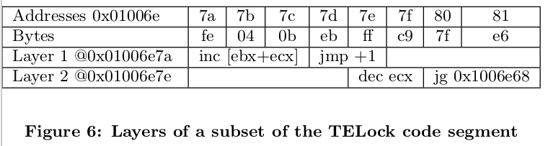
Self Modifying Code
Overlapping code in real unpacker

Slide 11
Self Modifying Code
COLLECT execution traces
  Developed Pin tool (Dynamic Instrument Tool by Intel) pin_tracer
    Automatically trace newly created processes and threads
      Monitors CreateRemoteThread and CreateRemoteThreadEx calls
    Monitors for potential code injections
    Anti anti-debugging measures
      Time check to see if being monitorted
      EIP (instruction pointer) check for instrumentation
      Checksum on parts of code (check for self modification)
      Interrupt table manipulation (checks for VM)
    Not always possible for the above

Slide 12
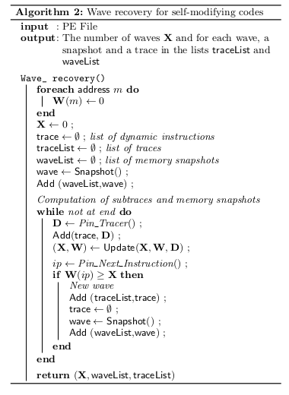
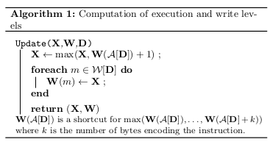
Algorithms
First identify write levels (X,W,D) [ALG 1]
  X is the execution level
  W is the write level table
  D is a line of data (eg code)
Wave Recovery [ALG 2]
  Basically Alg 1 but in practice

Slide 13
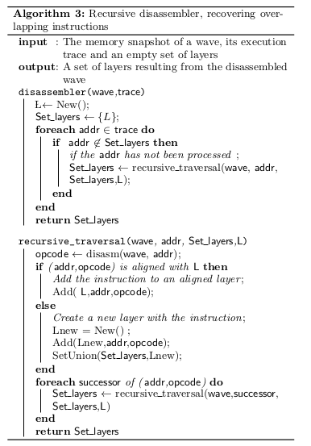
Algorithms
Recursive Disassembler
  Recovers overlapping instructions
  Uses a notion of layers to distinguish between same instruction D and D’
  Must be done in a single wave (no modifying code allowed here)

Slide 14
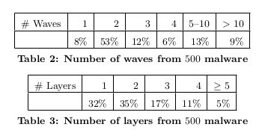
Evaluation
It is difficult
  Need “correct” one to one to original? → maybe impossible
  Use a oracle (not relevant here)
  Let’s just benchmark on known virale library WCET (~500)
Results
  Most waves are 2
    Packer used
  Otherwise generic unpacker useless

Slide 15
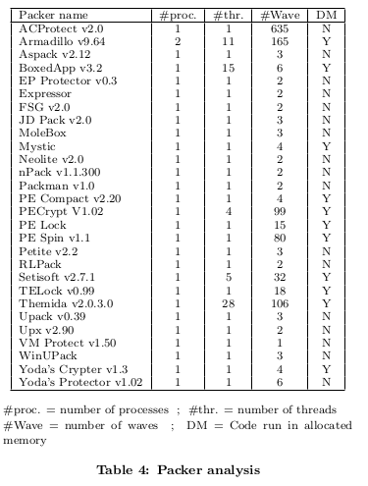
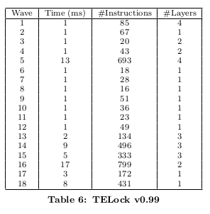
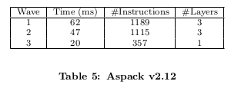
Evaluation
Check ‘em packers
  Heavy use of waves (nested)
  Setisoft detected the Pin_tracer
    Changed its behavior
Packer Classification
  Examined detailed information on waves within some notable packers

Slide 16

Discussion (future works)
Packers
  Rarely depend on input
  2% of malware interact on system in middle waves
  Most payload in the last wave
  Wave structure usually simple
Weakness
  Traces will fail if input is needed
    I.e. in a botnet that waits on external commands, waves may be missed
  Multiple traces, some which “fuzz” inputs may be needed for example on the right

Slide 17
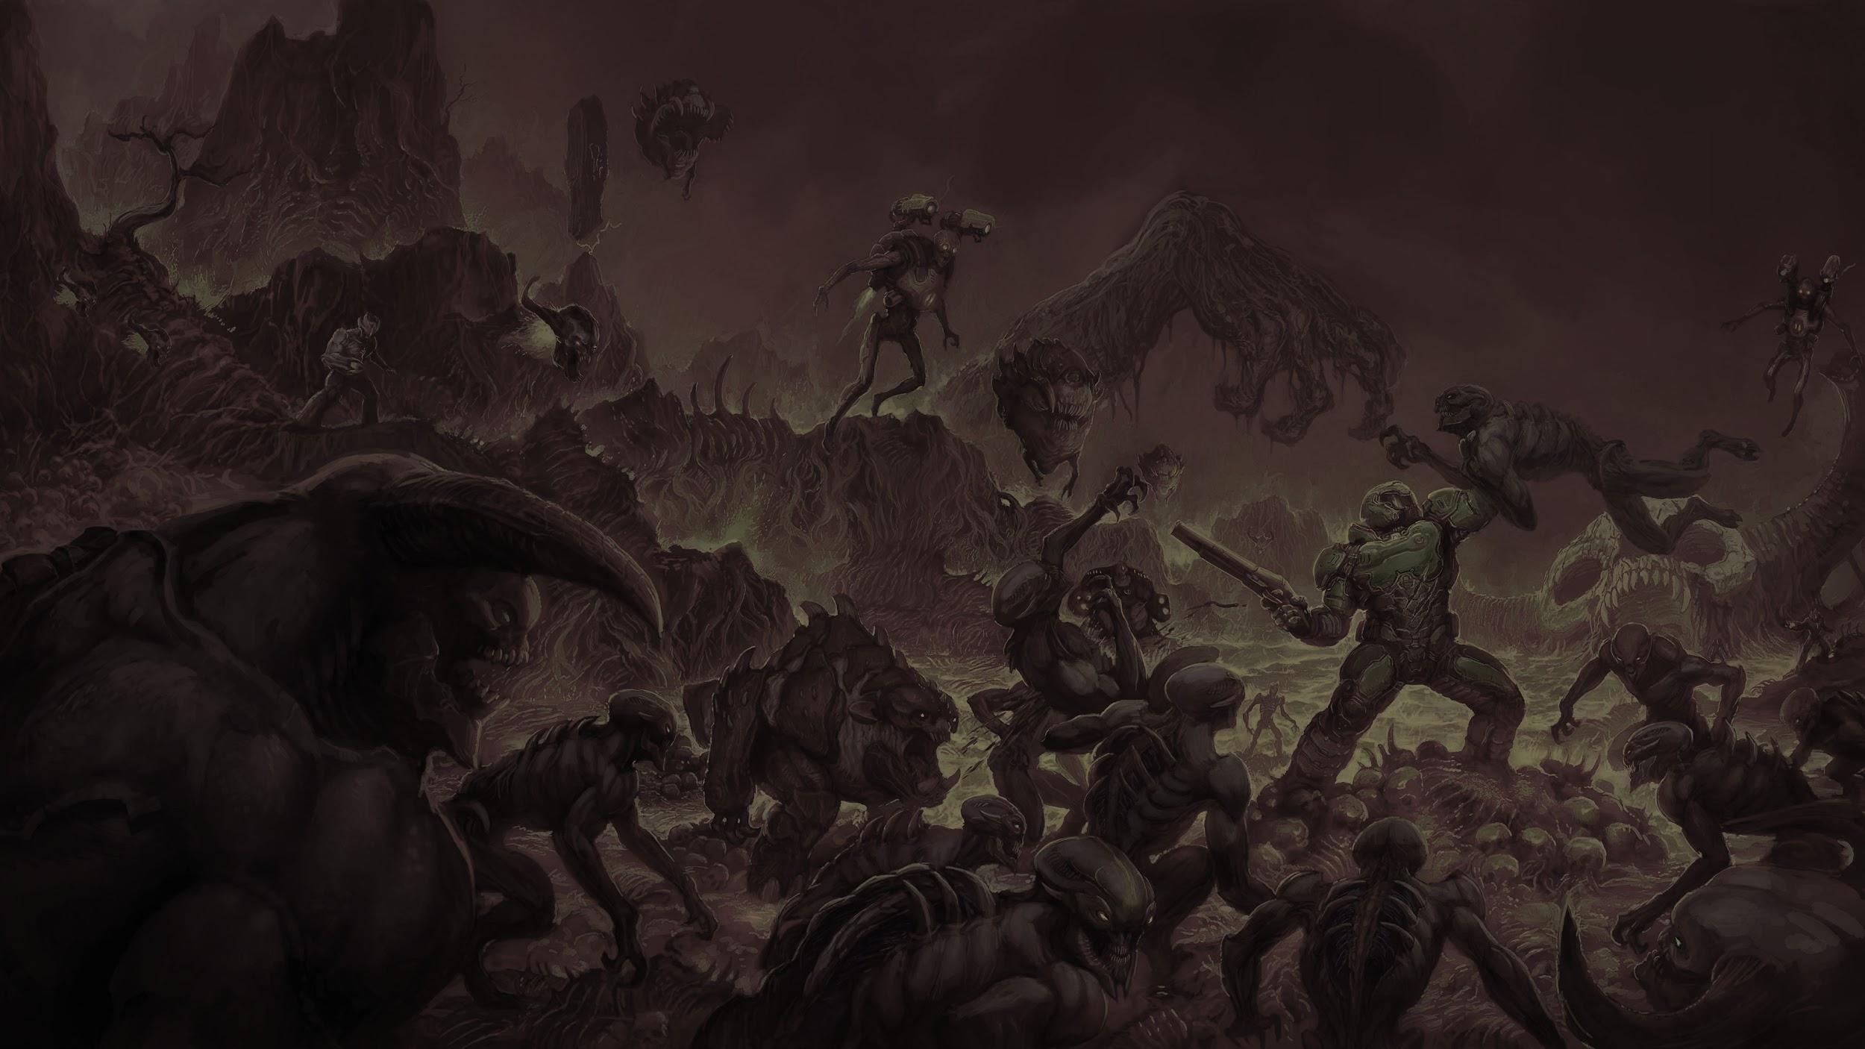
MyDoom
A technical analysis

Slide 18
Bullet List
Introduction
  Background
  Basic Function
Static Analysis
  Data
  Control Flow
  Malicious Functionality
Mitigation
  Detection
  Functionality

Slide 19
Introduction
Background
  MyDoom is a famous virus from early 2004 that is, to this day, the fastest spreading email worm ever
  It is considered the most devastating virus to date, causing in excess of 38 billion in damages
Basic function
  The malware opens a backdoor on the victim’s computer that allows remote code execution
  Executes a time synchronized DDoS attack
  Spreads itself via email and P2P file sharing apps
  No difficult anti analysis techniques used
  Appears to be hand written assembly

Slide 20
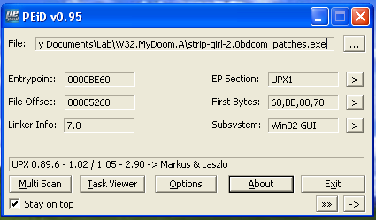
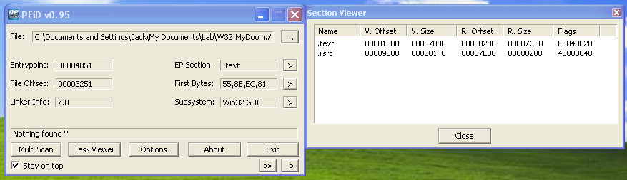
Static Analysis
Unpacking MyDoom
  Initially opening the malware in PEiD, it appears to be packed with UPX
  After unpacking with the UPX tool, we can see the original sections

Slide 21
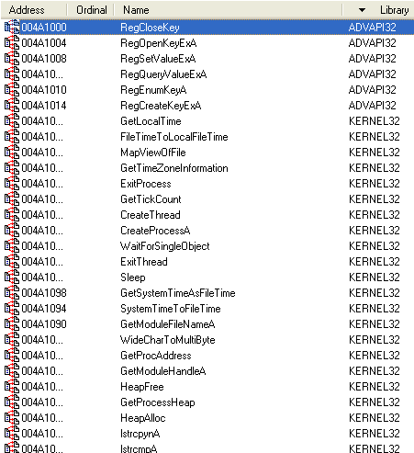
Static Analysis
Imports table
  The malware contains various imports related to
    Modifying the registry
    Reading/writing files
    Managing threads and synchronization
    Mutexes
    DLL Loading
    String handling
    Socket programming

Slide 22
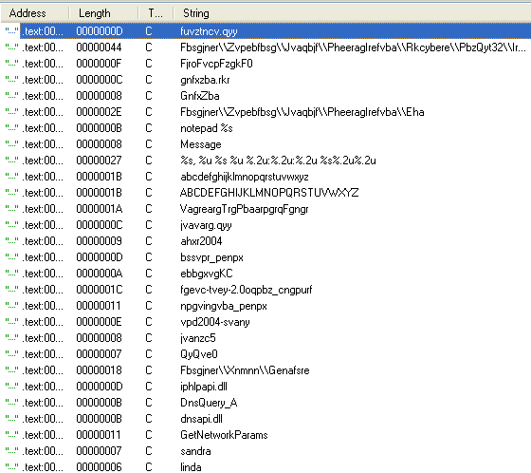
Static Analysis
Strings
  There are many regular strings like names and imports
  Some of the strings are also purely alphanumeric, but seem to be encoded in some way
  Looking in .text section, both of the charsets are used in a single subroutine

Slide 23
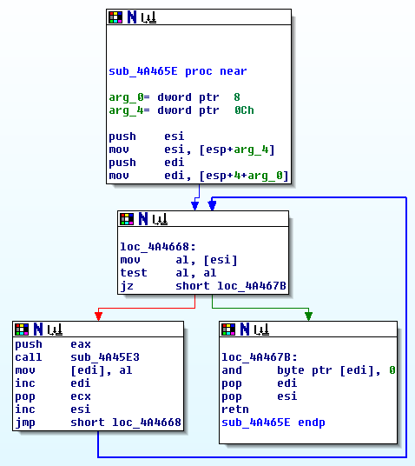
Static Analysis
  Searching for the XREFs to this function, a single function is found that looks like the following
  Seems to be calling the previous function in a loop
  Again searching for XREFs, we find a real “string decoding” function

Slide 24
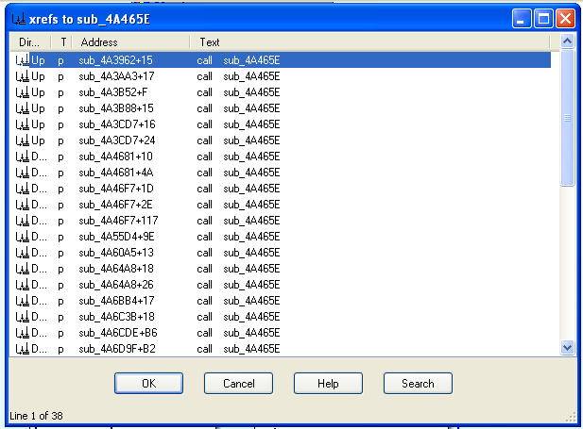

Static Analysis
  After analyzing both functions it is clear that this is a rot13 decoding function

Slide 25
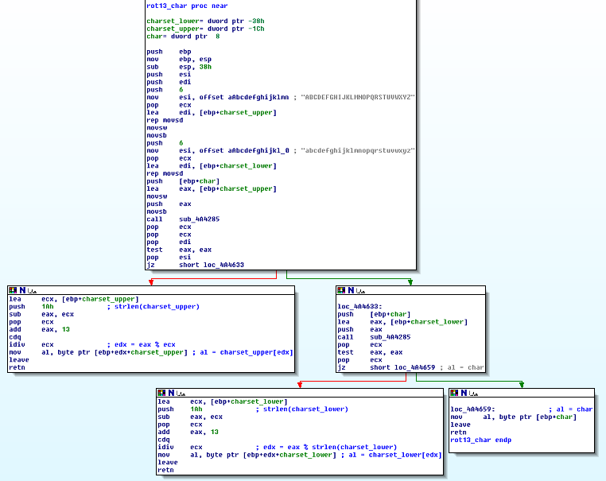
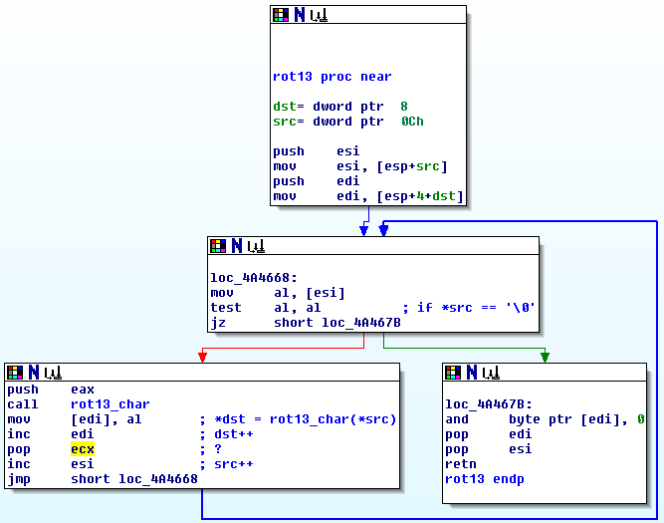
Static Analysis

Slide 26
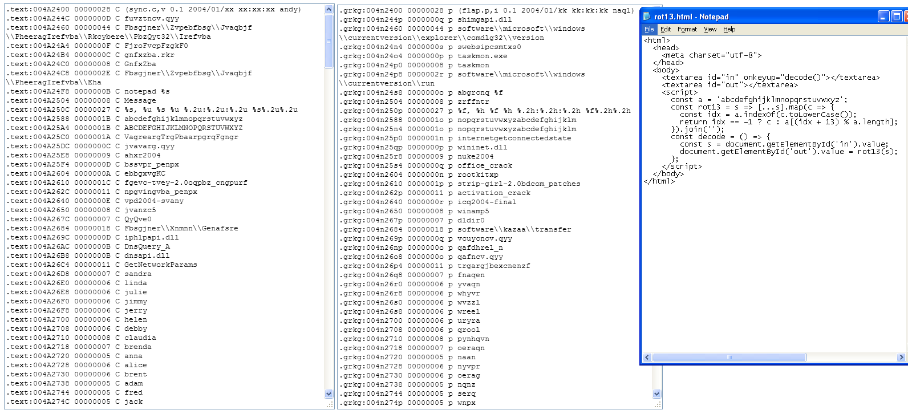
Static Analysis
  We created a quick tool to decode rot13 and dumped all the strings
  Lots of previously garbled file names, registry paths, and more are now clear
  strip-girl-2.0bdcom_patches was the name of the sample file
  References to Kazaa, an early P2P file sharing application

Slide 27

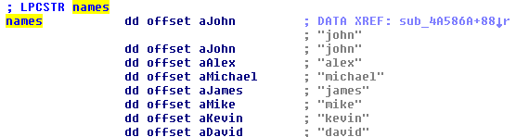
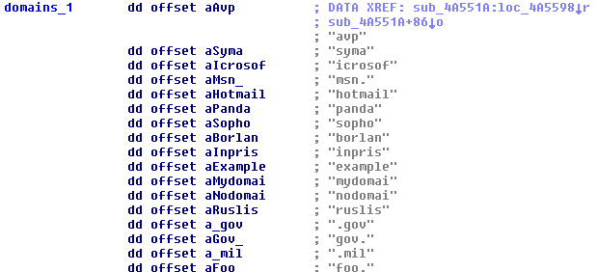
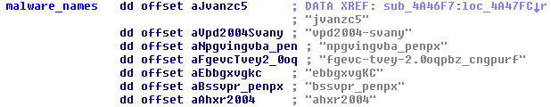
Static Analysis
Arrays
  Looking for XREFs to the strings, we find multiple arrays in .text segment that contain the encoded strings
  We can look at the grouping of the strings for info and follow the XREFs directly to relevant functions to reverse

Slide 28
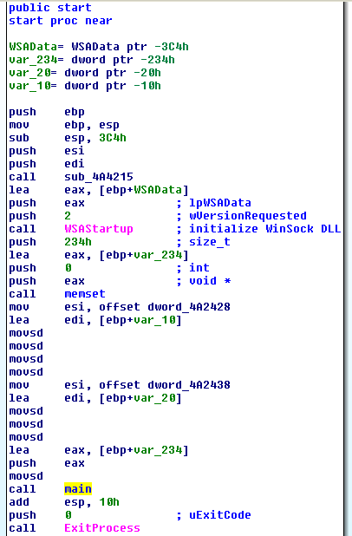
Static Analysis
Control Flow
  Entry Point
    After back-referencing various functions, bunch of random code creating and sleeping threads
    Decided to take it from the top and trace execution starting at the entry point
    Program starts by initializing WinSock DLL and copies two dates into stack variable
    Converting 7D4h to decimal gives 2004
    Hints that these are dates, which turns out to be struct SYSTEMTIME
    When formatted, dates are 02:28:39 UTC on 12 February 2004 and 16:09:18 UTC on 01 February 2004

Slide 29
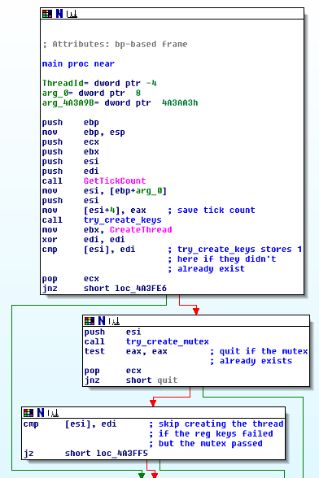
Static Analysis
  Main Function
    Starts after dates are copied into buffer
    Malware checks for existence of 2 registry keys, creates them if they are not present
    After this, malware checks current time against hard coded date in text.
    Quits if date is passed, which stops the spread on February 12th, 2004 at precisely 02:28:39 UTC

Slide 30
Static Analysis
  Malicious Functionality
    Looking at XREFs for string that contain HTTP GET header to www.sco.com
    Find function that appears to execute a denial of service attack by repeatedly opening sockets and sending a GET request
    Function creates 64 threads that send HTTP request to target site
    Before executing attack, malware checks again for current time.
    Will only execute once date has passed February 1st, 2004 at precisely 16:09:18 UTC

Slide 31
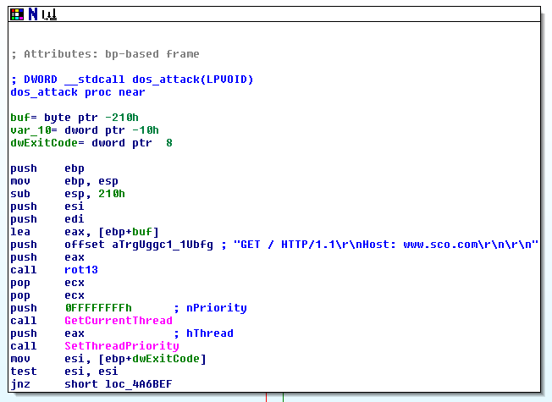
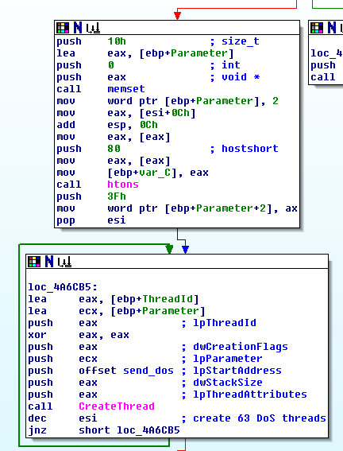
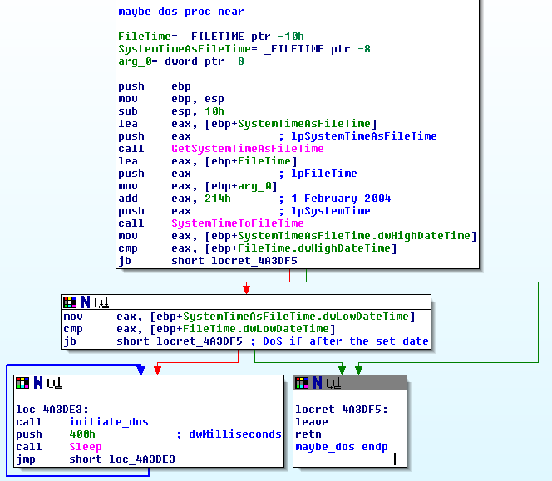
Static Analysis

Slide 32
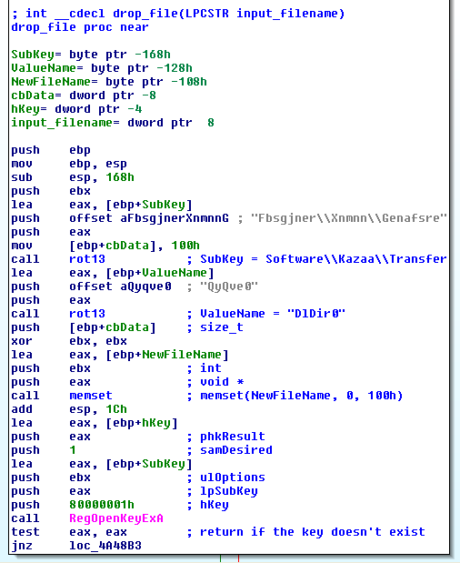
Static Analysis
Replication
  Kazaa
    Looking at the code XREFs to the strings related to malicious filenames and registry paths
    Find functions that seems to create a malicious file
    Function reads the Kazaa shared directory from the registry, makes contained files available to other users on the P2P file sharing platform

Slide 33
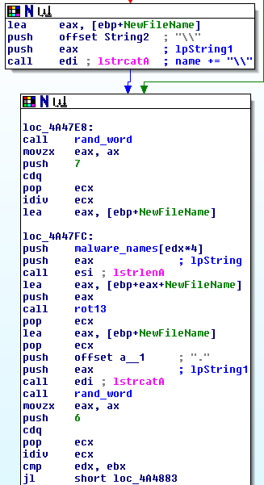
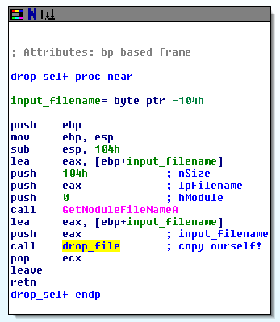
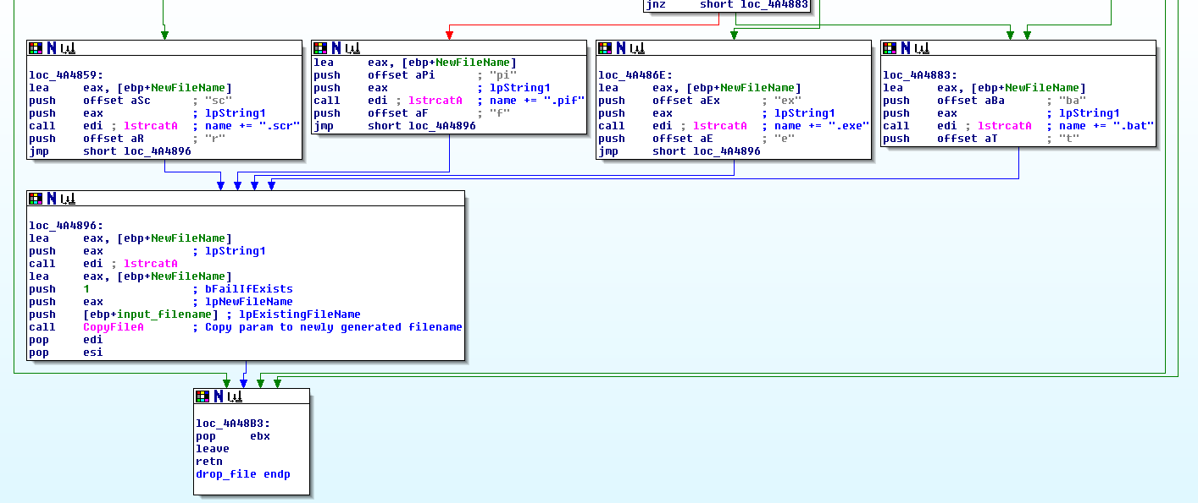
Static Analysis
    Function adds \\ and a random filename from the previously discovered list to the path
    Adds an extension, copies the input file to the shared directory
    Function has a single XREF, where it is called with the module’s own filepath

Slide 34
Static Analysis
  Email
    Looking at the code XREFs to email related strings in the .text section
    Clear that this malware spreads itself by sending malicious emails via SMTP
    Due to the size, complexity, and since we already had a good idea of the purpose of this code, fully reversing the mail based spreading functionality was outside the scope of our initial analysis

Slide 35
Mitigation
Detection
  Mutex
    The virus creates a mutex names "SwebSipcSmtxS0"
  Registry Keys
    The virus creates registry keys in
      HKLM\Software\Microsoft\Windows\CurrentVersion\Run: "TaskMon"
      HKCU\Software\Microsoft\Windows\CurrentVersion\Run: "TaskMon"
      HKLM\Software\Microsoft\Windows\CurrentVersion\Explorer\ComDlg32\Version
      HKCU\Software\Microsoft\Windows\CurrentVersion\Explorer\ComDlg32\Version
  Files
    The virus creates malicious files in
      C:\Windows\System32\taskmon.exe
      C:\Windows\System32\shimgapi.dll
      Kazaa shared directory

Slide 36
Mitigation
  Signature Scanning
    Malware is not self modifying or randomizing
    Code is the same for each variant that is spread by any means
    All an antivirus would need to do to prevent the virus from ever running is to find a combination of instructions and/or data in the executable that uniquely identify it
  Recovery
    In order to completely clean an infected computer after being compromised, each registry key, file, and running process needs to be killed and deleted

Slide 37

QUESTIONS?
You may ask questions
Please ask us question
please pay 4 winrar

