Slide 1
✦ HPCCSS ACADEMIC ENGLISH INNOVATION ✦
LEXIQUEST
Gamified Academic Vocabulary Mastery Powered by Cognitive Science
ACTIVE RECALL · SPACED REPETITION (SM-2) · FOUR HOUSES ARENA · GOOGLE CLOUD
A Pedagogical Introduction for Secondary English Teachers

Slide 2
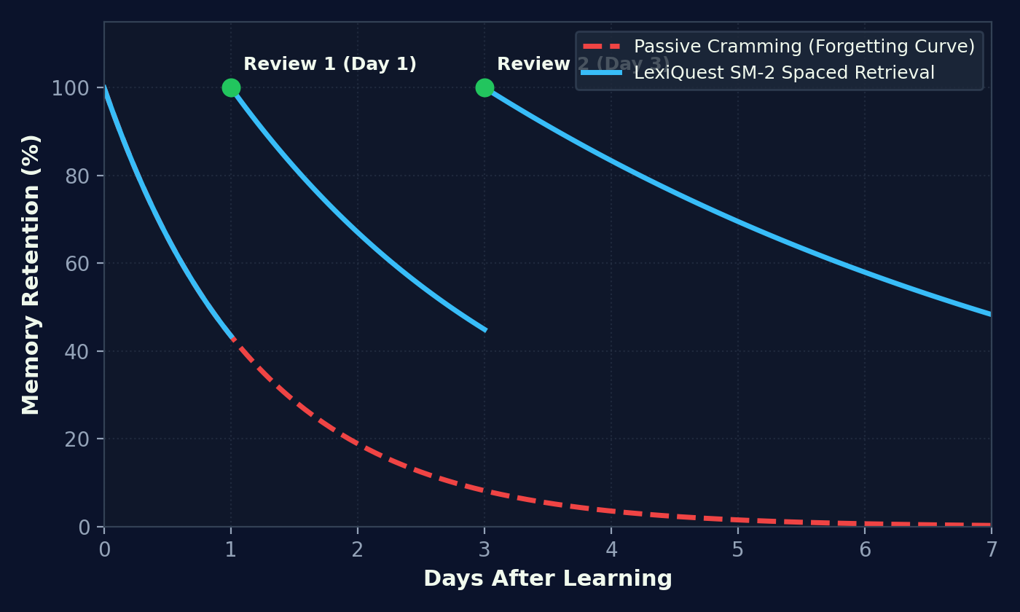
COGNITIVE ARCHITECTURE
Why Traditional Cramming Fails: The Forgetting Curve
Ebbinghaus Cognitive Law: Over 80% of newly learned words are lost within 48 hours without scheduled active recall.
The Cognitive Breakthrough
The Passive Learning Illusion: Reading wordlists creates false confidence. Working memory drops vocabulary rapidly without retrieval stress.
The Ebbinghaus Cliff: Retention falls exponentially to ~10% within 7 days unless intervened by spaced retrieval cues.
Active Retrieval Effect: Forcing the brain to retrieve meaning from memory solidifies neural synaptic strength 300% faster than passive re-reading.
SM-2 Spaced Algorithm: Intervenes at the exact mathematical moment of imminent decay, converting fragile words into permanent long-term storage.

Slide 3
CORE RETRIEVAL ENGINES
Word Vault & Cryptic Rush: Precision & Speed
Balancing deliberate, algorithmically-scheduled study with rapid-fire, high-pressure competitive retrieval.
1. WORD VAULT (Precision SRS)
Adaptive SM-2 Engine: Every vocabulary item maintains an individual Easiness Factor (EF) and interval schedule.
Due Card Curation: Students only review words precisely when their memory interval is expiring—maximizing time efficiency.
Four Self-Assessment Tiers: 'Again' (1d reset), 'Hard' (3d), 'Good' (7d), and 'Easy' (14d) dynamically calibrate review schedules.
Mastery Certification: Words reaching consecutive successful recalls graduate to 'Mastered' status with permanent XP badges.
2. CRYPTIC RUSH (Speed Retrieval)
60-Second Arena Duel: High-intensity timed challenge forcing instantaneous contextual recognition under pressure.
Combo Multiplier Stress: 3x, 5x, and 15x streak combos reward fluency and penalize hesitation, simulating examination conditions.
Automated Remediation Loop: Any word missed during Cryptic Rush is immediately injected into the student's personal Word Vault for reinforcement.
Loss Aversion Timers: Real-time clock benders and countdown tension induce optimal arousal state for rapid synaptic encoding.

Slide 4
MULTI-MODAL CURRICULUM
Beyond Single Words: Alchemy, Blitz & Oracle
Targeting the comprehensive DSE English syllabus: collocations, syntactic structures, and contextual reading.
Word Alchemy
Collocation Compounding: Students fuse academic headwords with authentic collocates (e.g., profound + syntax).
DSE Writing Impact: Directly addresses unnatural phrasing by reinforcing native lexical bundles required for Level 5+ essays.
Arcane Fusion: Visual feedback turns collocation mastery into magical elemental synthesis.
Grammar Blitz
Syntactic Fluency: Rapid-fire structural recognition under speed pressure.
Error Detection: Targets common secondary blunders: verb tense shifts, agreement, relative clauses, and inversion.
Pattern Instinct: Builds automated reflex accuracy rather than tedious theoretical memorization.
Reading Oracle
Contextual Application: Curated passages aligned with HKDSE reading text types and academic themes.
Active Passage Search: Questions demand precise contextual vocabulary inference and comprehension under time limits.
Cross-Device Verification: Passage completions and scores are permanently logged to cloud profile.

Slide 5
FLEXIBLE DEPLOYMENT
Three Battle Arenas: Solo, 1v1 Live & Class League
Seamlessly adapting to autonomous home practice, live interactive classroom duels, and school-wide leagues.
Solo Arena
Autonomous Practice: Ideal for daily homework, morning reading, or commute micro-learning.
Zero Social Pressure: Allows struggling scholars to drill at their own pace without fear of public mistakes.
Self-Paced Mastery: Students focus purely on their personal due cards and daily streak maintenance.
1 vs 1 Live Duel
Instant Room Codes & QR: Two students enter a live peer-to-peer arena in seconds via mobile or laptop.
Synchronized Problem Feeds: Identical question sequences ensure 100% fair, real-time head-to-head competition.
Live Scoreboard Drama: Instant lead changes and combo breaks generate intense classroom excitement and engagement.
Class Honor Roll
Inter-Class Tournament: Classes (4A, 4B, 4C, 4D, 4E) compete collectively on weekly XP totals.
Collective Peer Motivation: High-performing students inspire peers to play, lifting the entire cohort's engagement.
Top Scholar Podium: Weekly recognition of top scorers in morning assembly and school digital displays.

Slide 6
INFRASTRUCTURE & DATA
Zero-Cost Enterprise Cloud: Google Sheets Backend
High-performance architecture built on Google Apps Script Web App: zero server costs, zero maintenance, total data ownership.
Zero Server Cost
Google Web App API: Runs 100% on school's existing Google Workspace. Zero monthly hosting or database bills.
Serverless Reliability: Google Apps Script handles hundreds of simultaneous requests with zero infrastructure configuration.
Full School Privacy: Student names, hashes, and records reside exclusively inside the teacher's protected Google Drive.
Flawless Multi-Device Sync
Cross-Device Handshake: MacBook, iPad, and iPhone seamlessly synchronize with pull-before-push cloud validation.
Data Loss Prevention: Server-side union merging ensures completions on phone never overwrite progress from laptop.
Offline Resilience: Local storage preserves game state and uploads automatically once connection restores.
Teacher Live Dashboard
Real-Time PlayLogs: Every single game session, mode, score, and timestamp is logged automatically.
Cohort Diagnostics: Teachers immediately spot vocabulary items with high error rates across the form.
Export & Report Ready: One-click export to Excel/PDF for term evaluations and student learning portfolio records.

Slide 7

INTRINSIC MOTIVATION
The Academy of Wizardry: Four Houses & Faculty Dragon
Transforming repetitive vocabulary drilling into an epic collective quest steeped in school identity and belonging.
TAK · PEGASUS
Emerald Order
Intuitive wit & skyborne eloquence
Color: #10B981
CHI · PHOENIX
Crimson Order
Tenacity & fiery precision
Color: #EF4444
KIN · GRIFFIN
Amber Order
Steadfast logic & fortified recall
Color: #F59E0B
KAN · SCHOLAR
Sapphire Order
Profound syntax & manuscripts
Color: #3B82F6
FACULTY DRAGON
Shadow Council
Masters of Arcane & Faculty Staff
Color: #C084FC

Slide 8
BEHAVIORAL PSYCHOLOGY
The Habit Loop: Daily Streaks & Loss Aversion
Applying behavioral economics to turn sporadic English study into an automatic, lifelong daily routine.
1. Micro-Commitment
5-Minute Daily Threshold: Students only need to complete 1 quick session per day to secure their daily fire streak.
Low Cognitive Barrier: Removes procrastination friction: 'I just need 5 minutes before leaving for school.'
Compounding Consistency: 5 minutes daily = 35 minutes weekly = 30 hours of focused active recall per academic year.
2. Loss Aversion Trigger
Midnight Streak Expiry: Streaks expire at midnight. The fear of losing a 14-day or 30-day streak drives action.
Urgency Warning System: Dynamic alerts notify scholars when their streak is 'At Risk' in evening hours.
Loss Aversion Over Gain: Behavioral economics confirms people work twice as hard to protect an achievement than to gain one.
3. Social Validation
Visible Flame Badges: Streaks 🔥 are broadcasted on wizard profile cards and class leaderboards.
Teacher Celebrations: Teachers praise top streak holders weekly, reinforcing positive cohort peer norms.
Permanent Mastery Identity: Students view themselves not as 'struggling learners', but as dedicated academic wizards.

Slide 9





TANGIBLE RECOGNITION
Avatar Wardrobe: 5-Tier Character Progression
Visual proof of academic mastery: House Chi scholars evolve dynamically across 5 distinguished wizard ranks.
TIER 1
TIER 2
TIER 3
TIER 4
TIER 5
Apprentice
0+ XP Required
Seeker
1,000+ XP Required
Scholar
10,000+ XP Required
Sorcerer
50,000+ XP Required
Grand Magus
150,000+ XP Required
• Crisp White Shirt: Baseline academy uniform upon enrollment.
• Novice Scholar: Building daily active retrieval habits.
• House Tie & Vest: Earned formal emerald silk tie and knit vest.
• Streak Keeper: Consolidating core high-frequency words.
• Hooded Robes: Junior wizard robe with subtle arcane aura.
• Collocation Fluency: Mastering collocations and syntactic speed.
• Silver Clasp & Crest: Ceremonial robe with House Chi heraldic badge.
• Arena Champion: Consistently victorious in live duels.
• Grand Magus Regalia: Holding glowing elixir in the Great Hall.
• Lifelong Mastery: Permanent retention; legendary status.

Slide 10
IMPLEMENTATION ROADMAP
How Teachers Can Deploy LexiQuest Tomorrow
Ready out-of-the-box: Zero installation friction, immediate pedagogical visibility, and measurable student progress.
1. In the Classroom
Morning Warm-Up (5 Mins): Begin English lesson with a 60-second Cryptic Rush or a live 1v1 duel to activate focus.
Interactive Class Battles: Display leaderboard on projector screen; pit row vs row or class vs class.
Exit Ticket Review: Assign a quick Word Vault session to consolidate the day's target academic collocations.
2. Homework & Holidays
Replaces Passive Wordlists: Assign daily streak maintenance instead of static paper vocabulary copying.
Holiday Retention Shield: Prevents severe holiday learning loss during Christmas and Lunar New Year breaks.
Universal Accessibility: Runs seamlessly on any smartphone, iPad, or Chromebook without App Store friction.
3. Teacher Action Items
Access Live Web App: Launch: folui-code.github.io/lexiquest in your browser.
Inspect Form Leaderboard: Review live Google Sheet PlayLogs and form standings with one click.
Join House Dragon: Teachers automatically receive House Dragon faculty status—challenge your students today!

