Slide 1
Energy Management with AI
Thanathorn Phoka

Slide 2
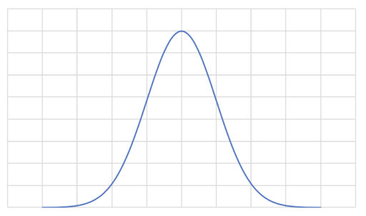
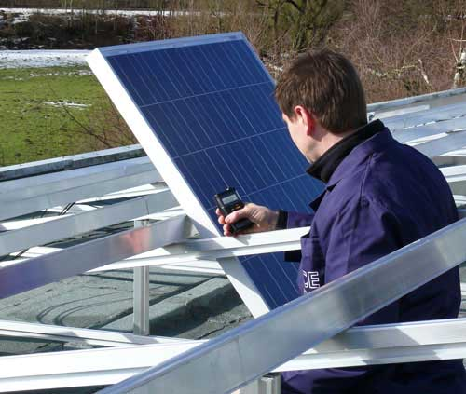
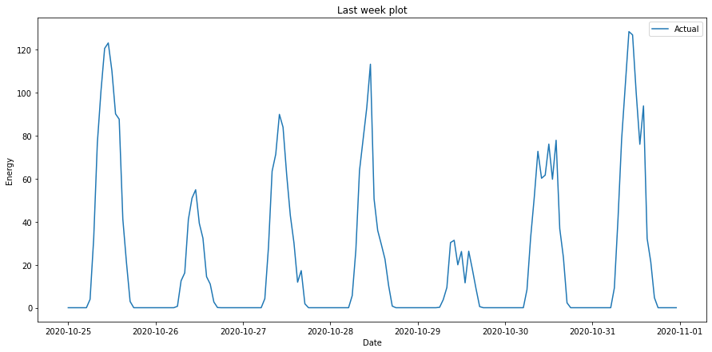
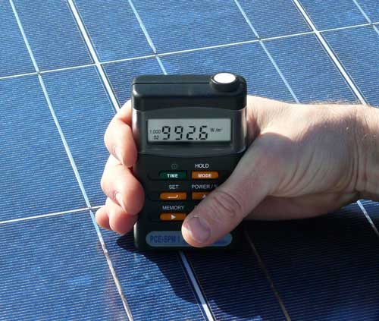
Problems
Energy
12PM
Time
https://www.industrial-needs.com/technical-data/solar-radiation-meter-pce-spm1.htm

Slide 3
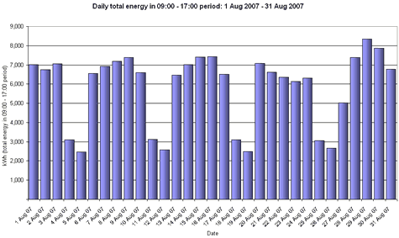
Problems
Unaffordable !!!!
https://www.energylens.com/outputs
https://www.energysage.com/solar/solar-energy-storage/how-do-solar-batteries-work/

Slide 4
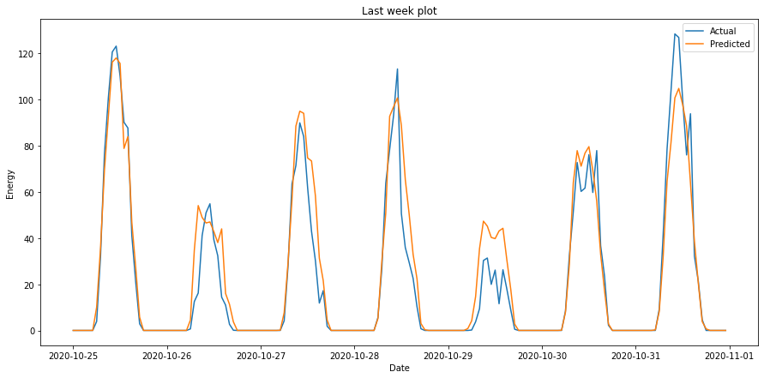
What do we want?
Minimize difference between energy consumption and energy production.
Calculate remaining energy to be stored in an energy storage system.
More precise energy production measurement

Slide 5
How to achieve our goals?
Collecting relevant data
Weather forecast data
Energy production data
Location-based dataset
Fitting models
Regression models
Forecasting models

