Slide 1
Signal

Slide 2
Ohm’s law
V = Voltage in volts
I = Current in amps
R = Resistance in ohms

Slide 4



Slide 5
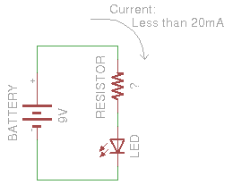



Slide 6
Analog vs digital
Infinite → analog
Finite → digital

Slide 7
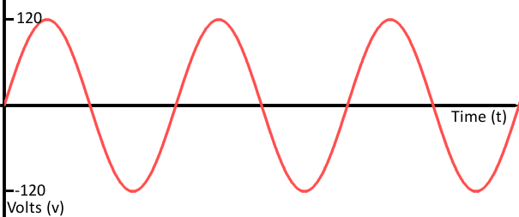
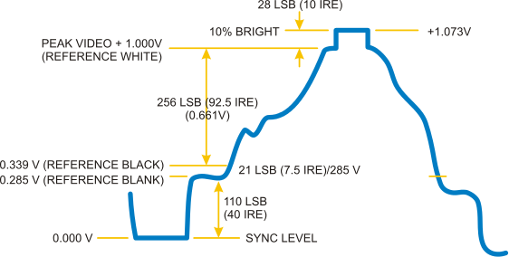

Slide 8
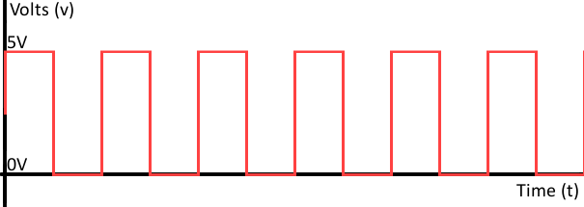
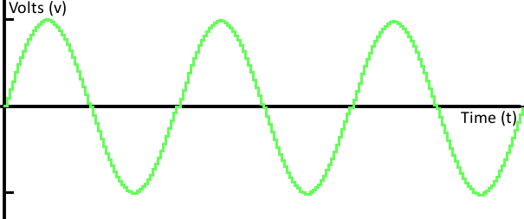

Slide 9
analogRead()
BOARD | OPERATING VOLTAGE | USABLE PINS | MAX RESOLUTION
Uno | 5 Volts | A0 to A5 | 10 bits
Mini, Nano | 5 Volts | A0 to A7 | 10 bits
Mega, Mega2560, MegaADK | 5 Volts | A0 to A14 | 10 bits
NodeMCU | 3.3 Volts | A0 | 10 bits

Slide 10
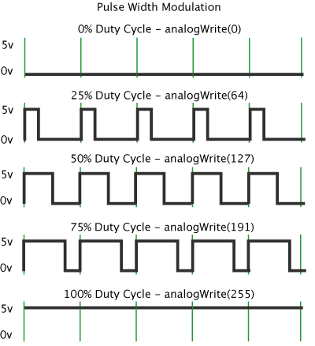
analogWrite()

Slide 11
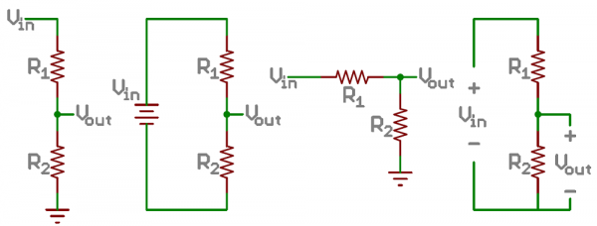
Voltage divider
turns a large voltage into a smaller one

Slide 12

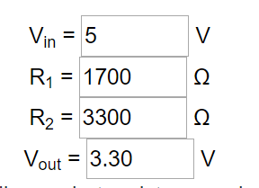

Slide 13




Slide 14
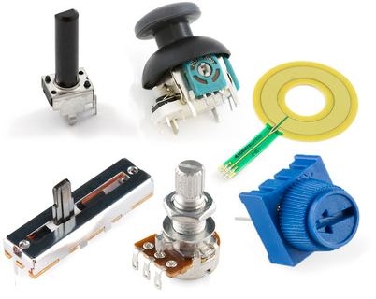
Potentiometers

Slide 15
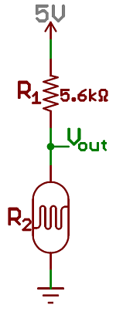
Resistive sensors
Photocell
Light Level | R₂ (Sensor) | R₁ (Fixed) | Ratio R₂/(R₁+R₂) | V_{out}
Light | 1kΩ | 5.6kΩ | 0.15 | 0.76 V
Dim | 7kΩ | 5.6kΩ | 0.56 | 2.78 V
Dark | 10kΩ | 5.6kΩ | 0.67 | 3.21 V

Slide 16
Analog to digital converter (ADC)

Slide 17



UNO

Slide 18
Sampling rate
Frequency of sampling
22,050 Hz
Distance = 1 / 22,050 second = 45.35 µs

Slide 19
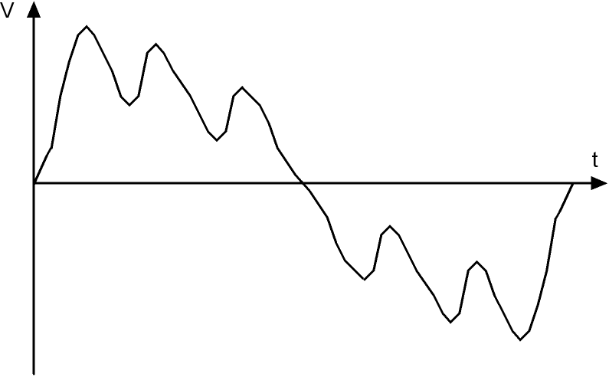
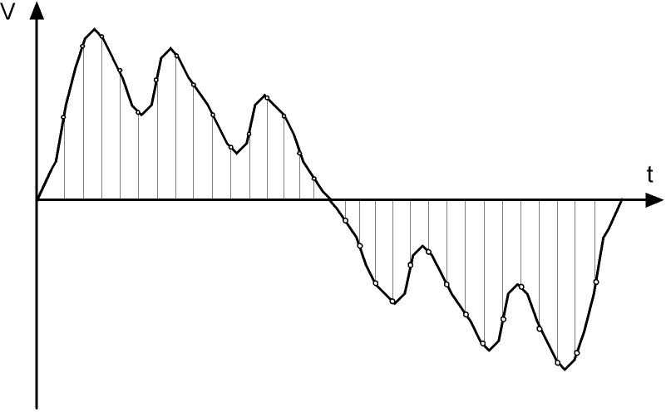

Slide 20
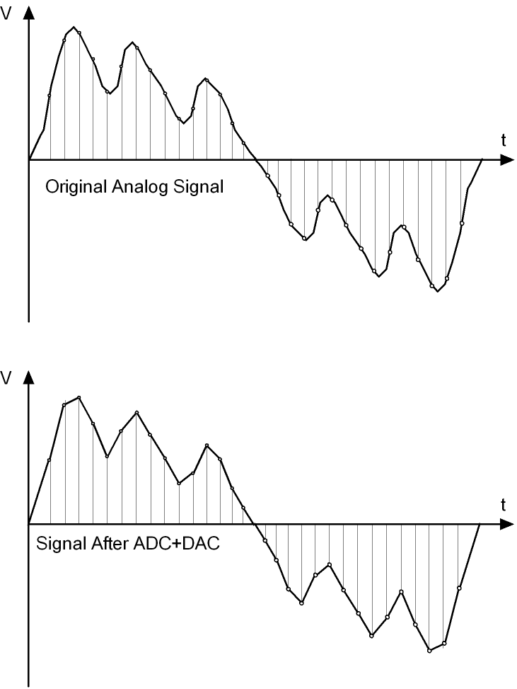

Slide 21
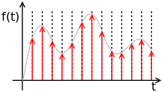
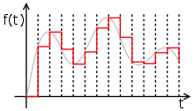
Dilemma
the higher the sampling rate –, the more perfect will be the analog signal produced by the digital-to-analog converter (DAC)
the more samples we capture more storage space is necessary to store the resulting digital data

