Slide 1
Recipe Search Application Project using ASP.NET MVC
ZIFENG YUAN 2022.08.08

Slide 2
CONTENT
01
Recipe
Index, Details, Edit
02
Ingredient
Index, Many-to-Many relationship
03
Search
Filter

Slide 3
01
Recipe
Index
Details
Edit

Slide 4
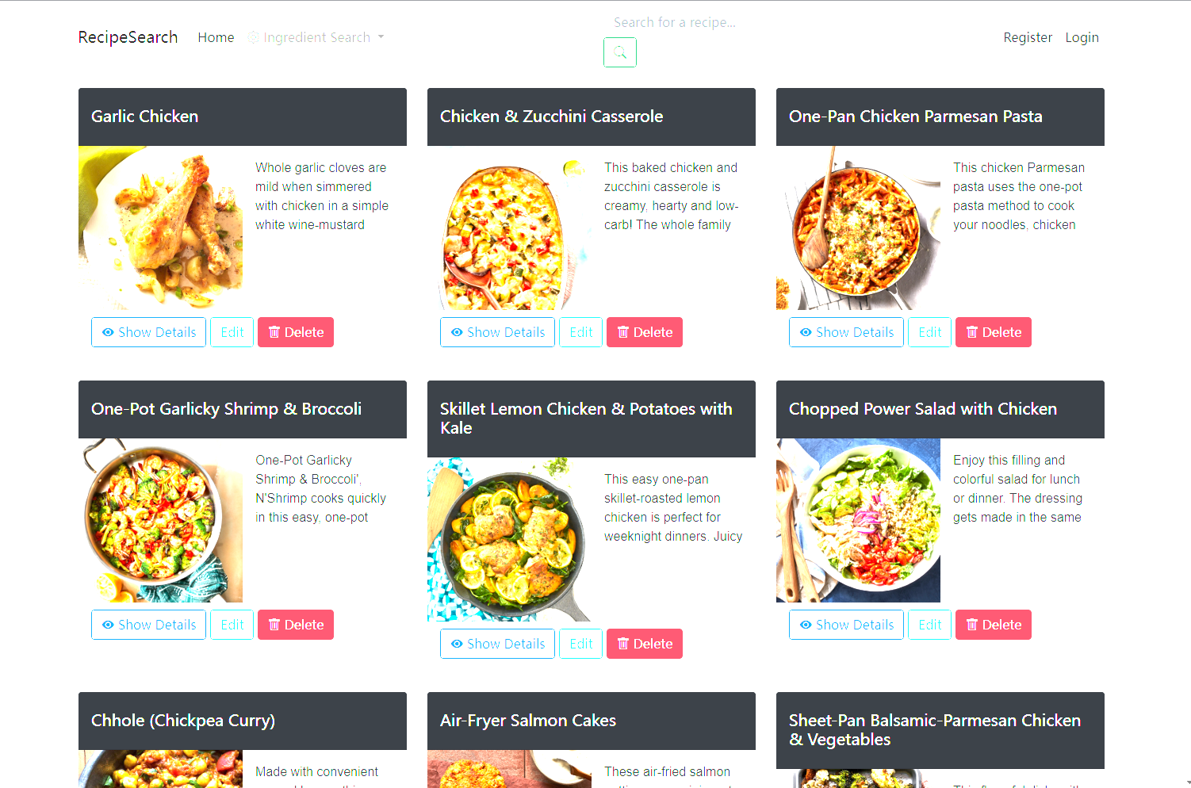
Index
Display all recipes in the database

Slide 5
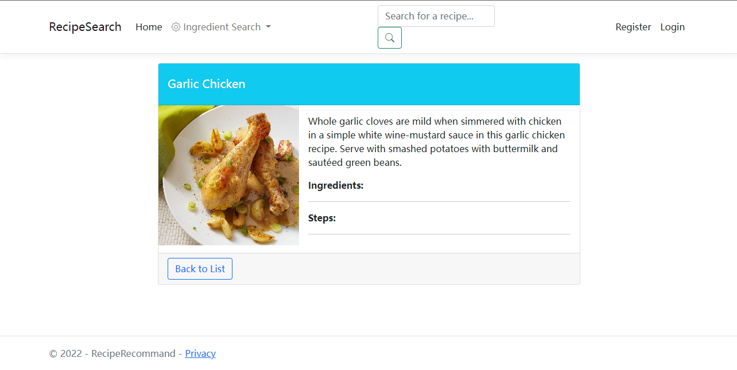
Details
Display the relevant information of the recipe

Slide 6
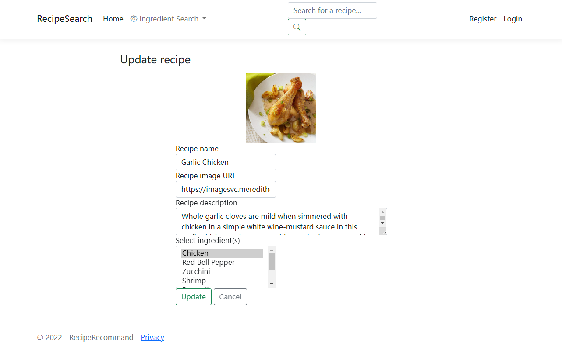
Edit
Allow users to modify and update the data of a recipe

Slide 7
02
Ingredients
Index
Many-to-Many relationship

Slide 8
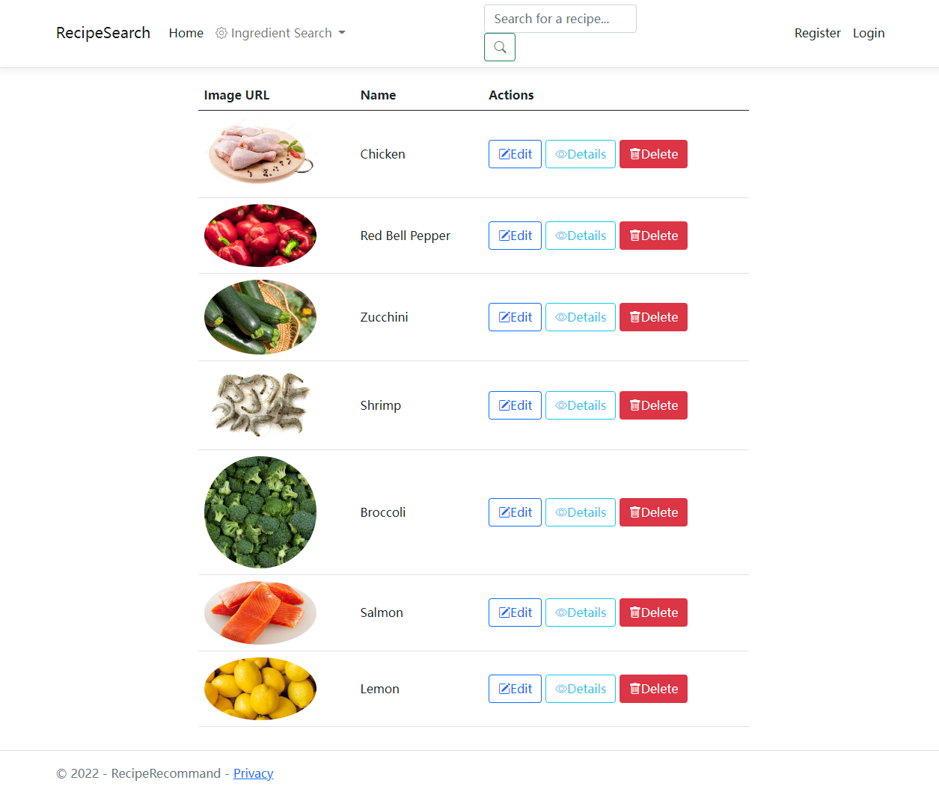
Index
Display all ingredients in database

Slide 9

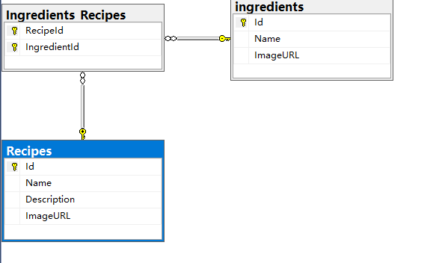


Many-to-Many
Relationship between recipes and ingredients
SQL Database diagram

Slide 10
03
Search
Filter

Slide 11
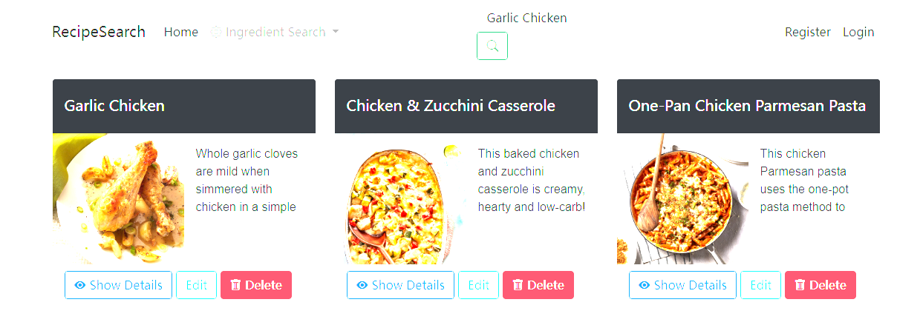
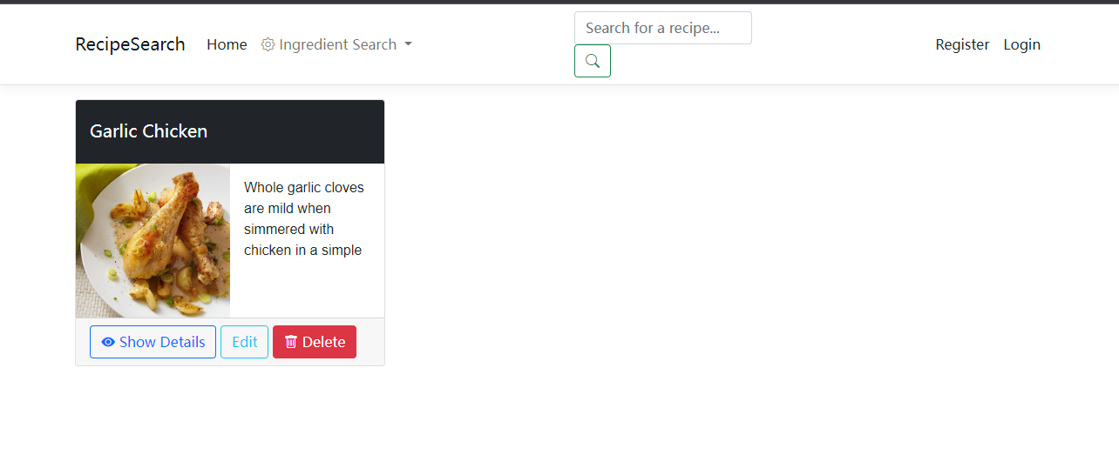
Before search
Filter
Allow user to retrieve and filter recipes
After search

Slide 12
Thank you for watching

