Slide 1
SDD: Object Oriented Programming (Python)

Slide 2
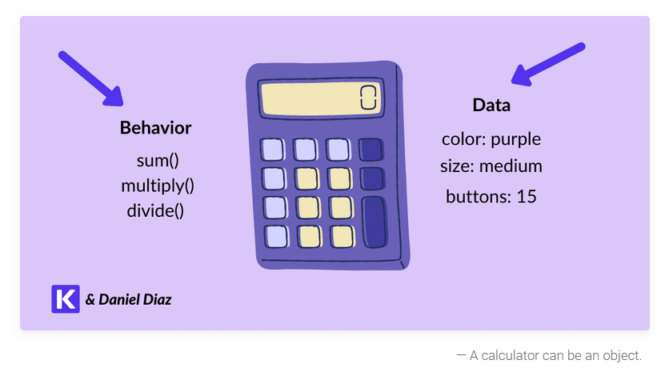
What is OOP?
Object-Oriented Programming (OOP) is a programming paradigm in which we can think about complex problems as objects.
An object in Python is a single collection of data (attributes) and behavior (methods). You can think of objects as real things around you.
For example, consider calculators:

Slide 3
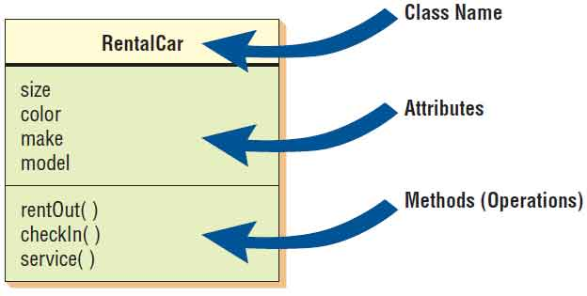
Key Terms
Class - A blueprint to describe a category of similar objects (e.g. cars). Requires a constructor.
Object - An instantiation of a class. Each object is an individual realisation of a class blueprint.
Attribute - A characteristic of an object.
Method - An action/behaviour performed by an object.

Slide 4
Modelling the real world
Almost everything in the world can be represented as an object.
People (students, teachers, parents)
Objects (desk, chair, classroom, building)
A building, a city, the world, the universe
An object is takes the blueprint of a class and makes it comes alive!
Homosapien is a class, John and Jack are objects
Animal is a class, “Fido” the dog is an object
Vehicle is a class, My Kia Seltos is an object

Slide 5
Let’s get into the code
Today we will be using Python to create classes that can be used within a simplified version of Skyrim.
Your classes will be used to represent real world objects used within the game world:
Player
Weapon
Enemy

Slide 6
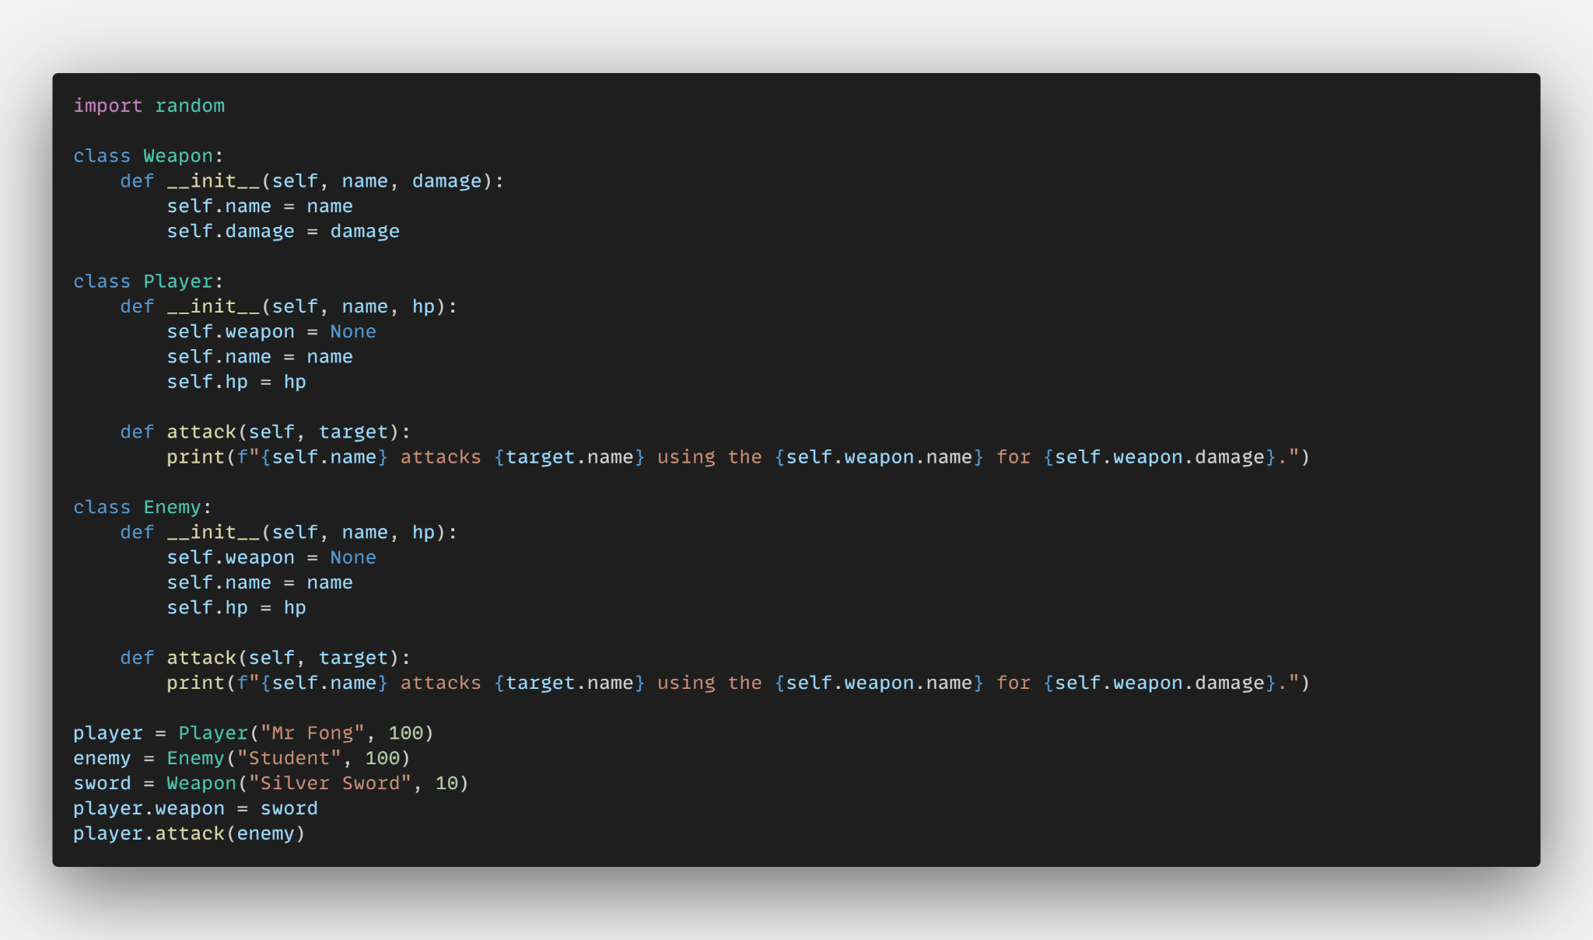
Where we are heading

Slide 7
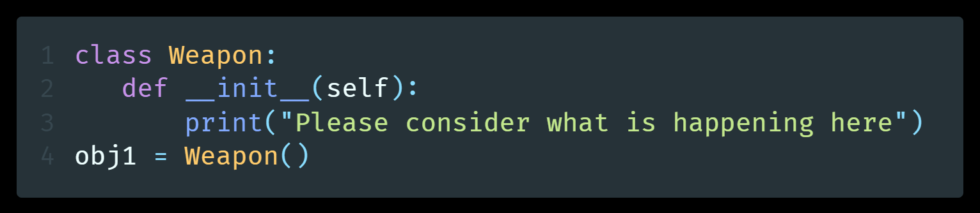
Constructor Method
In Object-Oriented Programming, a constructor method is a special kind of method used to instantiate an object. The primary objective of constructors is to assign values to the attributes of the class when you first set them up (instantiate).
Python automatically invokes the constructor whenever we create an object. Let’s take a look at an example:

Slide 8
TEACHER DEMONSTRATION
Creating Weapon and Player Classes
🧑‍💻

Slide 9
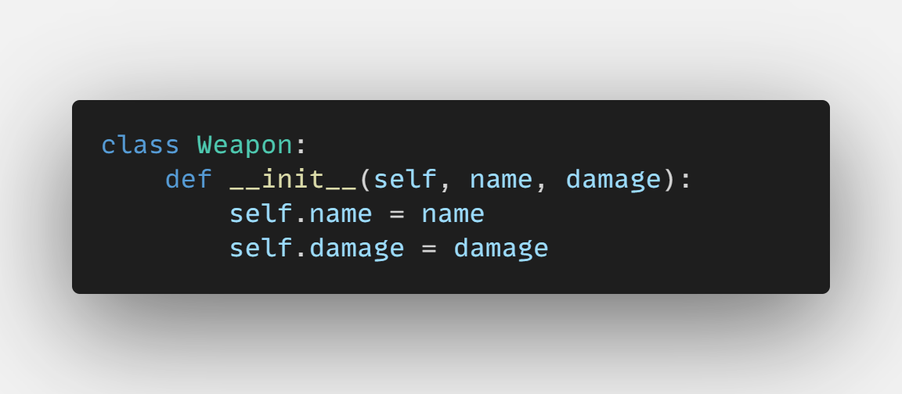
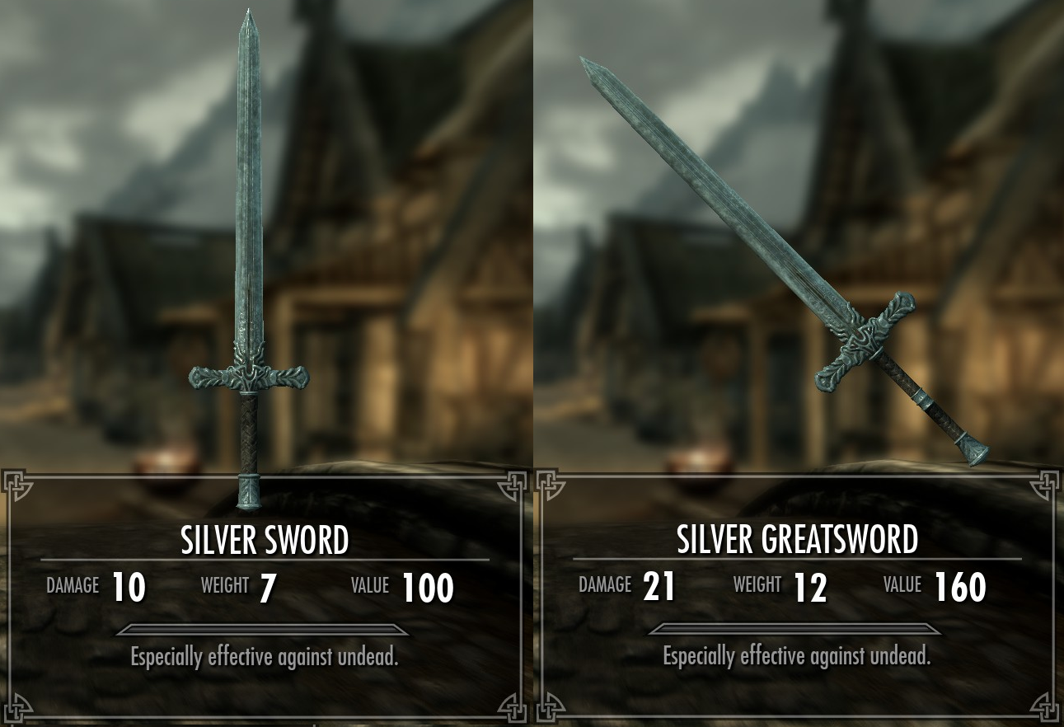
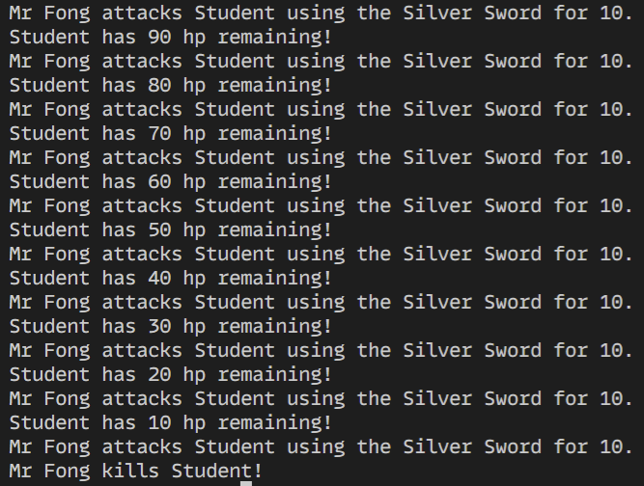
Tasks
Create a Weapon class that has the following attributes:
name
damage
weight
value
flavour text
Create Player and Enemy classes with the following attributes and methods:
Add logic to your program that updates the Player and Enemy objects’ hp attributes when either one attacks the other.
Add logic to your program that will output “{player} kills {enemy}” if a player is able to reduce the enemy health to <= 0
Player
name
hp
attack()
Enemy
name
hp
attack()

Slide 10
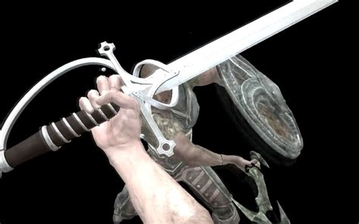
Extension Task
Add RNG to your game!
Give the Weapon a method that will:
Deal damage based on an a RNG dice roll between 1-10

Slide 11
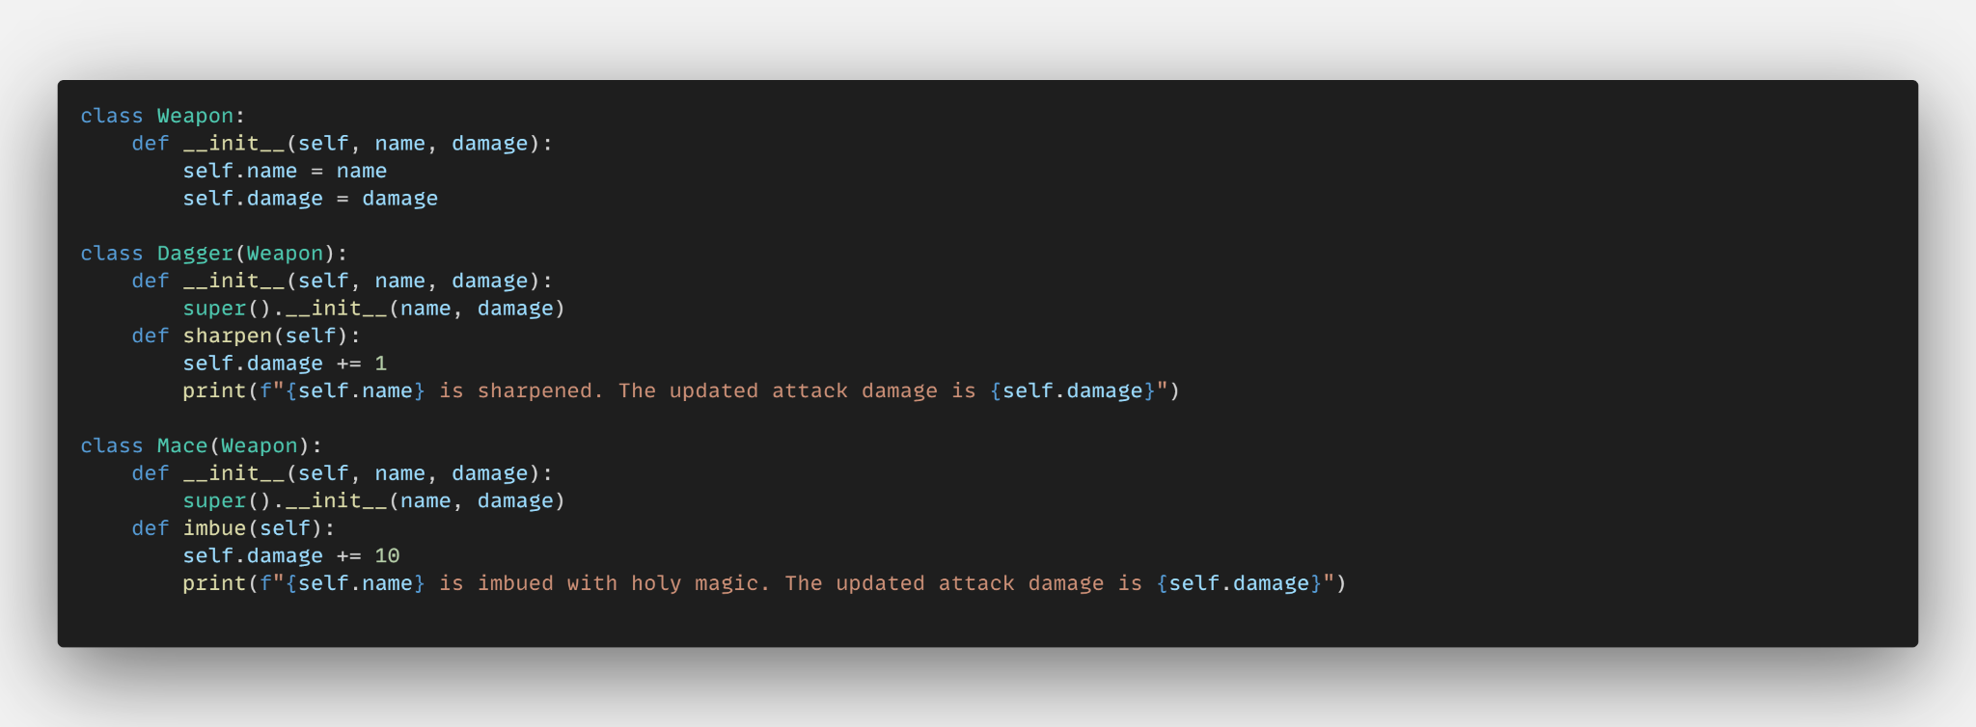
Inheritance
We can create sub-classes of a parent class, ann donly need to define common methods and attributes just the once. This is known as the concept of inheritance.
For example:

Slide 12
TEACHER DEMONSTRATION
Inheritance
🧑‍💻

Slide 13
Tasks
Create class definitions for three subclasses of your Weapon class. For example:
Crossbow
Dagger
Polearm

Slide 14
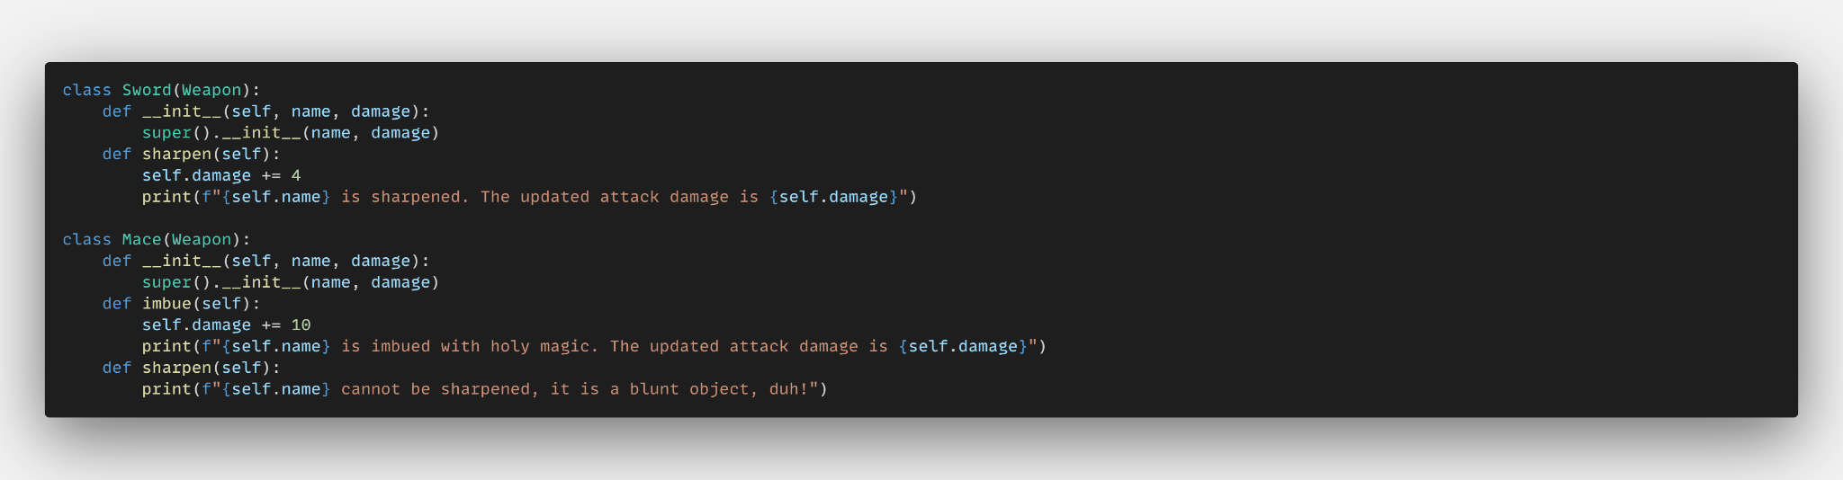
Polymorphism
Using polymorphism, you are able to have similar named methods within different class definitions, which behave differently when called based on the object type.
For example:

Slide 15
TEACHER DEMONSTRATION
Polymorphism
🧑‍💻

Slide 16
Tasks
Create an imbue method for each of your weapon subclasses. Each method should be called imbue, but behave in a slightly different way:
E.g: imbuing a mace may be more effective (add more attack) than imbuing a sword.

Slide 17
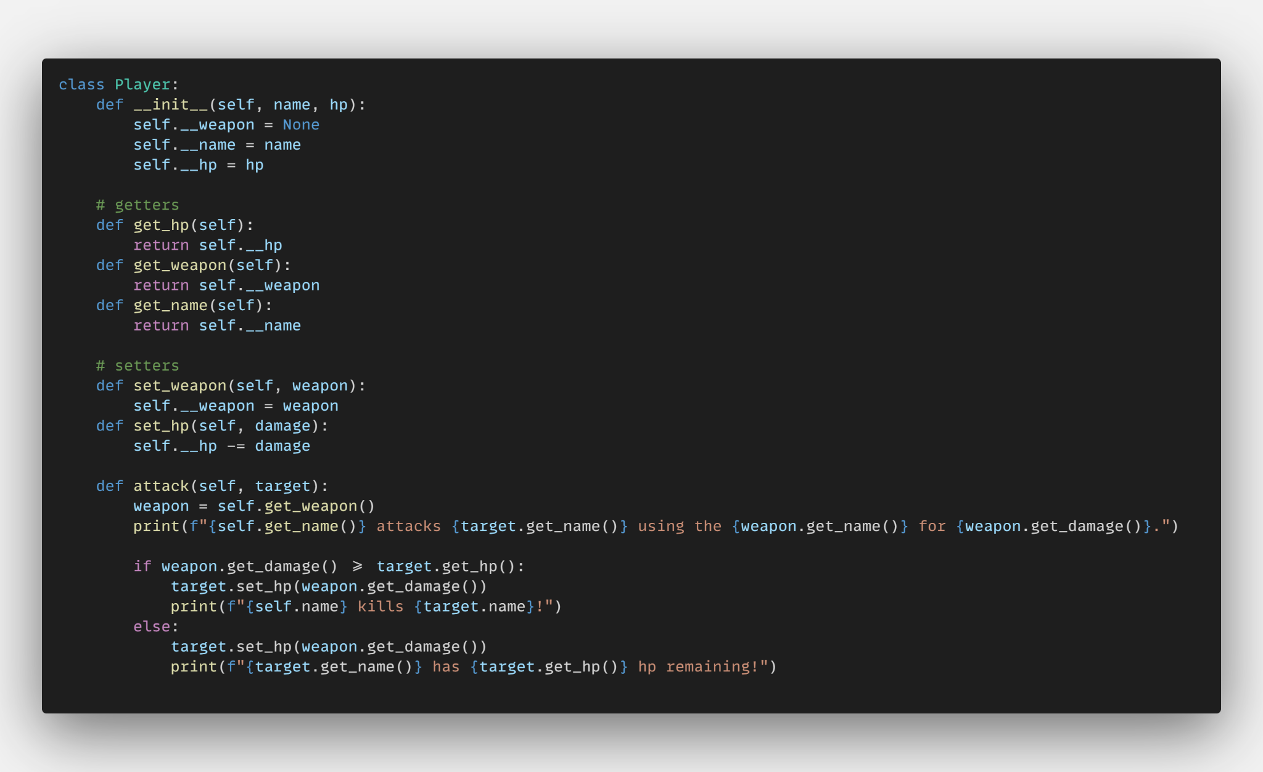
Encapsulation
Being able to update an object’s attributes directly is considered a security risk.
Best practice OOP design states that developers should make attributes private 🔒 by default:
To read an object’s attribute, public ‘getter methods’ should be called;
To update an attribute’s value, public ‘setter methods’ should be called.

Slide 18
TEACHER DEMONSTRATION
Encapsulation
🧑‍💻

Slide 19
Tasks
Lock down your class definitions! Make all attributes private 🔒and add getter and setter methods for each.

