Slide 1
Debt Bunnies
Something something something

Slide 2
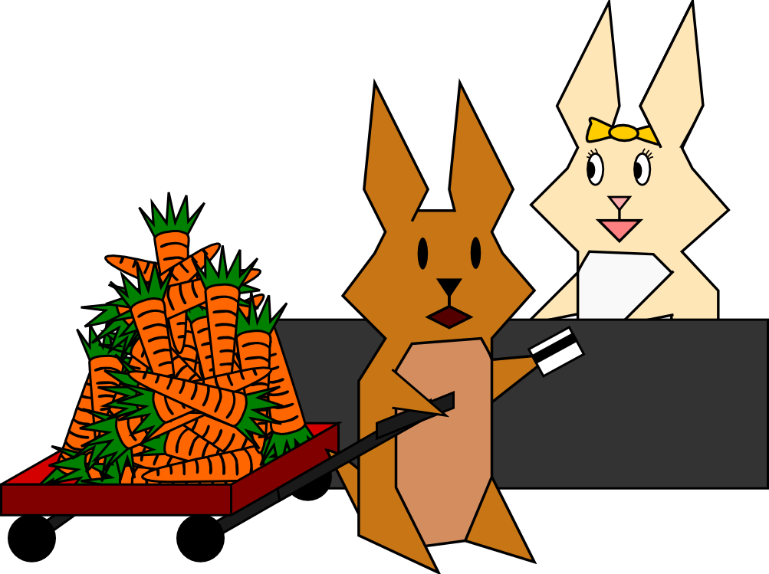
Many bunnies buy things on credit.

Slide 3
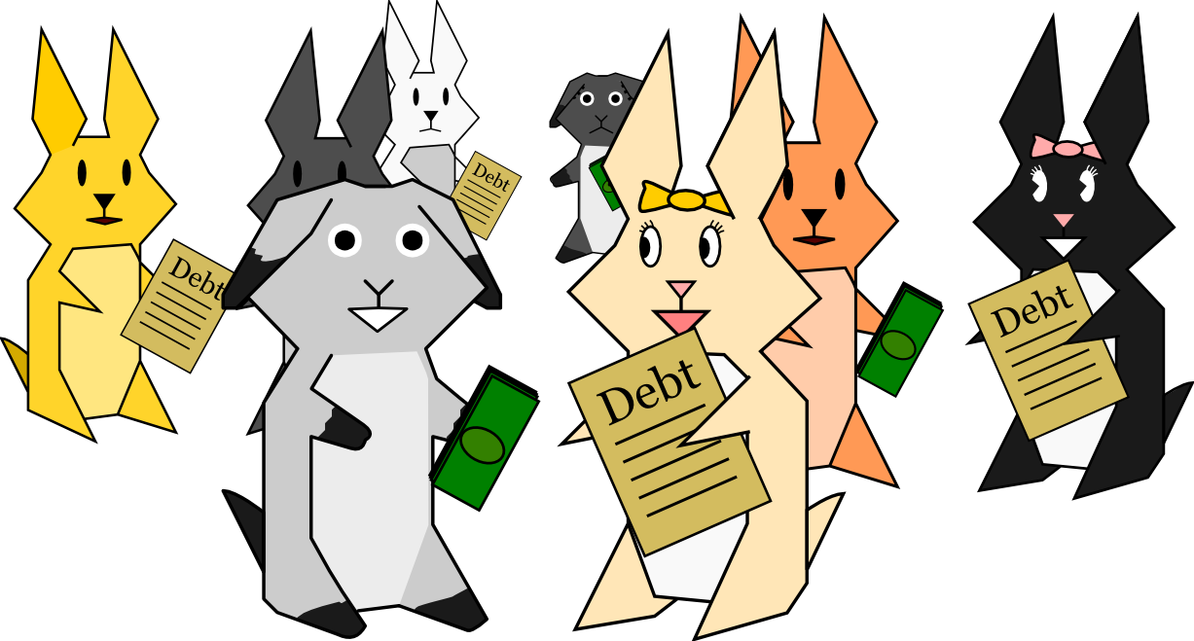
Sometimes lenders resell this debt ... many times over.

Slide 4
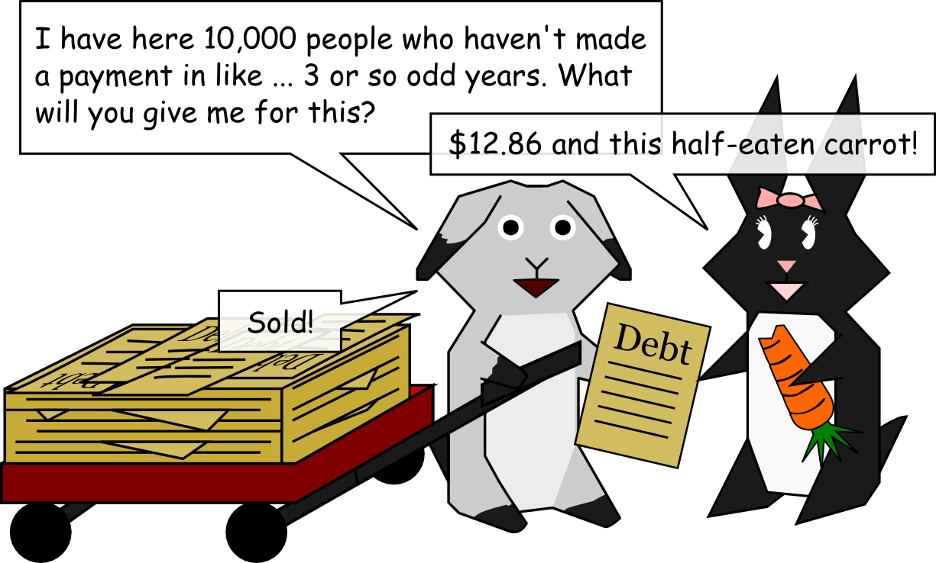
If a debt goes unpaid, or is seemingly unpaid, for a long time, specialized debt collectors will often buy up this now-cheap debt.

Slide 5

Sometimes information gets lost in the course of all these transactions.

Slide 6
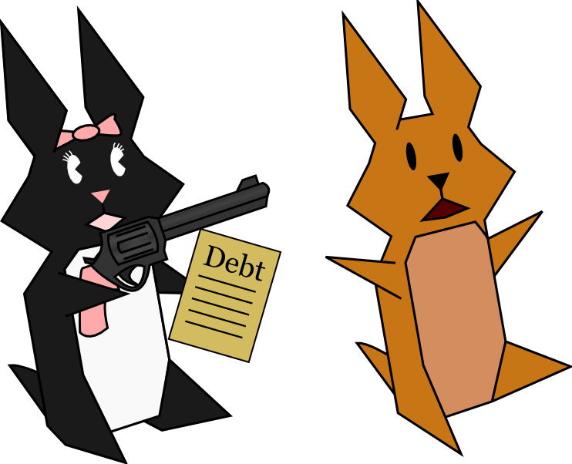
Debt buyers then collect on the debt they've purchased. Sometimes they do this in a legal way ...
Sometimes not ... abusive debt collection practices are prohibited under the FDCPA and CA's Rosenthal Act.

Slide 7

Debt collectors may also file suits to collect on debt. This can be a very effective way of collecting debt, because the court can garnish wages or other assets to pay back the debt. However, there is also the possibility for abuse during the litigation process. That's where we come in...

