Slide 1
Clarifying role and relationships of our internal services with Unity Catalog.
Better together —Unity Catalog governs Databricks execution. Navigator and OMS federates the estate for enterprise.
Data Governance | July 2026 | UC + Business Data Catalog

Slide 2
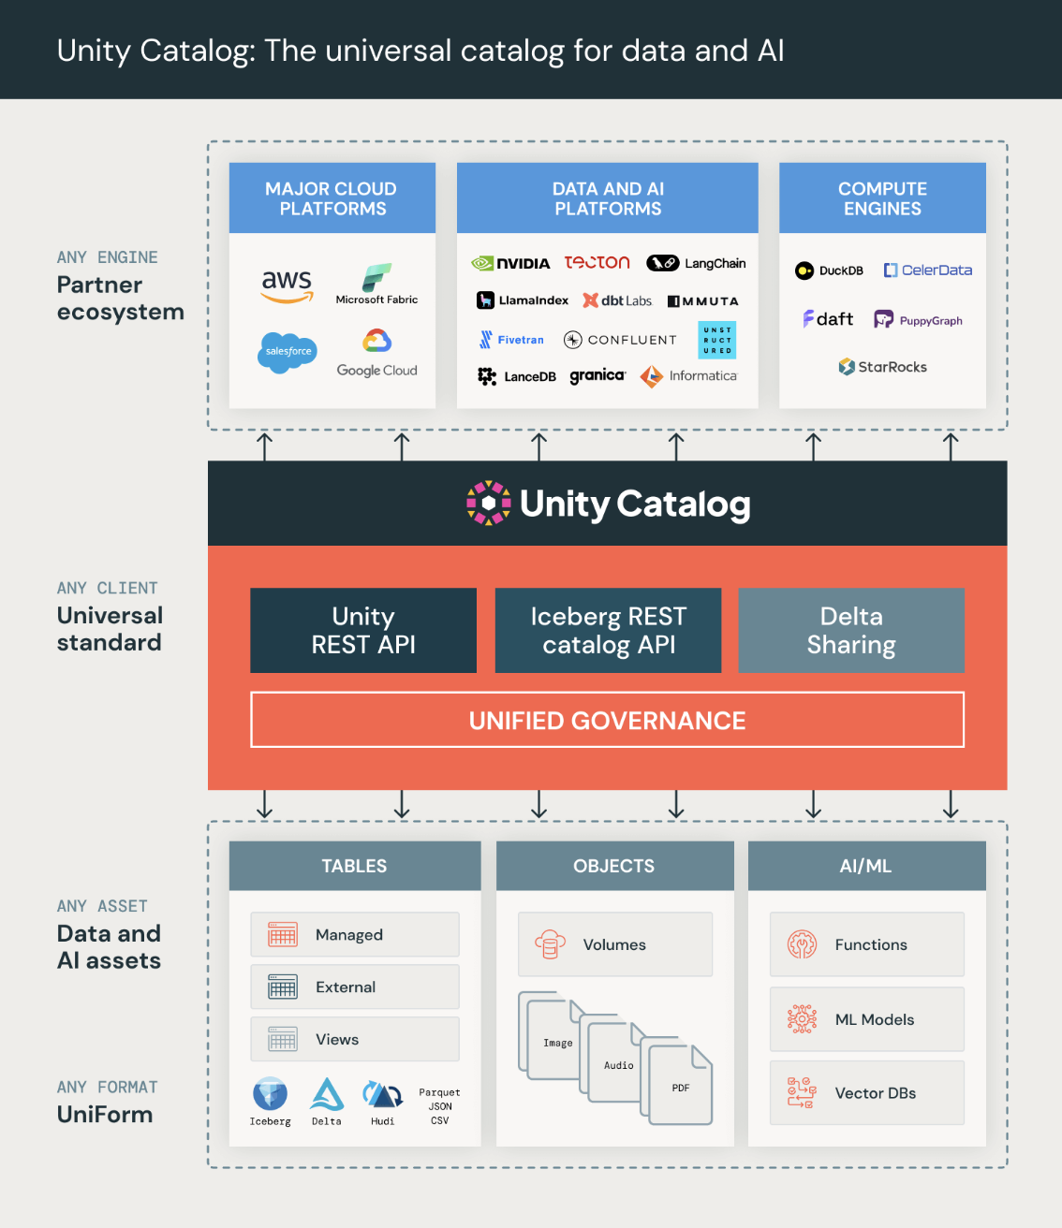
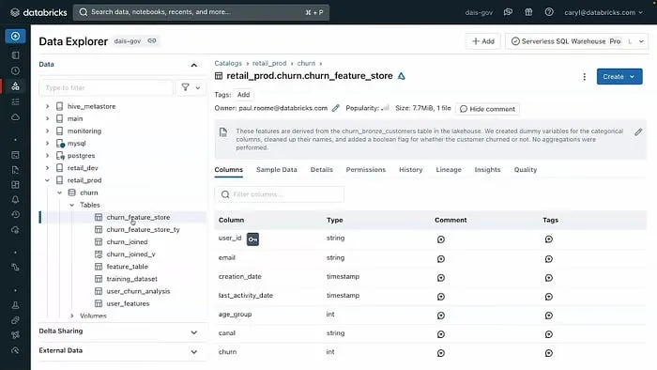
What is Unity Catalog? A Databricks top layer for governance (specifically for Databricks, but also potentially others)
Data Governance | July 2026 | UC + Business Data Catalog

Slide 3
Lineage Metadata
Access Policies
Data Classification
Lakehouse
Pipelines
Data Assets
Search
Glossary
Discovery
DATABRICKS
ALATION /
REPLACEMENT
LEGACY
Manual Wikis
Documentation
Word of Mouth
UNITY CATALOG

Slide 4
Proposed Lens: Two complementary roles — same metadata spine
Unity Catalog (execution plane)
Internal services — OMS + Navigator
• Govern permissions, audit, lineage on Databricks assets
• Metric Views — governed KPIs for SQL, Genie, AI/BI
• Enforce masking, ABAC, classification at query time
• Strongest where data is created & consumed on Databricks
• Single search across Snowflake, pipelines, BI, Databricks
• Business glossary, articles, stewardship workflows
• Bulk governance, domains, endorse/deprecate at estate scale
• Experience for stewards, analysts, compliance
Strategy: UC is essential inside Databricks; our internal services are essential across the enterprise. Integrate both.
Data Governance | July 2026 | UC + Business Data Catalog

Slide 5
Inherent limits of Unity Catalog
Why UC alone cannot replace our Alation replacement or OMS
Platform Boundary
Governance enforcement is coupled to Databricks compute — policies do not automatically apply in Snowflake, Tableau, or internal APIs.
Vendor lock-in
Business semantics, discovery UX, and agent context deepen dependence on the Databricks platform — harder to keep a tool-agnostic governance story across Snowflake and other estates.
Business vocabulary
Glossary announced as preview coming soon; today = Metric Views + agent metadata — not stewarded terms linked across the estate.
Knowledge & docs
No articles, document hubs, or collaborative information architecture equivalent to Alation.
User experience
Discover & Governance Hub are Databricks-native and still maturing — but not Navigator for business consumers.
Estate federation
UC's primary inventory is Databricks-governed assets; full cross-source discovery needs crawlers + OMS supply.
Stewardship at scale
Limited vs mass edit, catalog sets, documentation completion tracking across departments.
Data Governance | July 2026 | UC + Business Data Catalog

Slide 6
Where our internal services deliver more value
Capability | Unity Catalog alone | OMS + Navigator (internal services)
Business glossary & synonyms | Preview only in UC | Core MVP in Navigator / OMS
Cross-platform discovery | Databricks-primary | 626 + OMS federated inventory
Articles & onboarding docs | Not available | Alation parity path
Stewardship workflows | Limited curation | Bulk edit, catalog sets, ownership
Business-user UX | Catalog Explorer / Discover | Navigator — governed, persona-led
Governed KPIs on Databricks | Metric Views — UC strength | Read/sync; federated metrics governance
DBX permissions & lineage | Native — UC strength | Ingest UC → OMS; do not re-implement
Data Governance | July 2026 | UC + Business Data Catalog

Slide 7
Best ways to integrate with Unity Catalog
Architecture principles
Integration patterns (recommended)
• Hub-and-spoke: UC = Databricks System of Record (SoR) for schemas, grants, native lineage, metric views
• OMS = enterprise metadata store; Navigator = collaboration & discovery UX
• One System of Record (SoR) per metadata type — no dual-writing glossary or ownership
• Avoid metadata dual-write — pick where each attribute is authoritative
• Crawl / sync UC → OMS: tables, columns, grants summary, lineage, metric view definitions
• 626 / MCI / etc. provides supply for non-Databricks sources into the same OMS spine
• Navigator surfaces UC-backed assets in unified search with Snowflake & pipeline objects
• When UC Glossary is Generally Available (GA): ingest into OMS — do not fork a second glossary UX
• Optional: propagate select tags (e.g. PII) one direction only — UC or OMS, not both editable
Goal: Databricks assets are first-class in our catalog; UC stays authoritative for Databricks enforcement.
Data Governance | July 2026 | UC + Business Data Catalog

Slide 8
External lineage & BYOL — what it is
What BYOL / external lineage provides
What BYOL is not
• Generally Available (GA) capability to register metadata & lineage from outside Databricks
• Programmatic ingestion via APIs — Salesforce, MySQL, Tableau, etc.
• Extends UC lineage graph with external objects for audit & impact analysis
• Useful for stitching lakehouse assets to upstream/downstream systems
• Not a managed enterprise catalog — you build & operate every integration
• Not automatic crawlers across 20+ sources like Alation / OMS supply model
• Not governance propagation — tags/classifications in BYOL don't enforce in Snowflake/BI
• Not a substitute for Navigator glossary, articles, or stewardship workflows
BYOL narrows the lineage gap; it does not close the business catalog gap.
Data Governance | July 2026 | UC + Business Data Catalog

Slide 9
Problems & limits of BYOL in Unity Catalog
Architectural constraints to plan for before relying on BYOL instead of OMS federation.
Engineering tax
Every source API change, schema drift, or tool upgrade can break your BYOL pipelines — ongoing maintenance, not one-time setup.
Incomplete coverage
Hard to match Alation-grade depth: column lineage, dataflows (Airflow/dbt), BI reports, usage analytics without significant custom work.
Latency & freshness
External metadata often polled or batch-loaded — not the same live operational picture as native UC or managed crawlers.
Governance silos
Domains, certifications, and PII tags in UC don't translate to Snowflake Horizon or other platforms automatically.
Double governance risk
Snowflake + Databricks = two permission models unless you explicitly sync — BYOL doesn't unify enforcement.
Vendor lock-in via BYOL
Deepening UC as the lineage hub ties more governance context to Databricks — without delivering enterprise catalog or glossary in Navigator.
Cost shift
Savings from not building Navigator can become headcount for integration teams maintaining BYOL graphs.
Cost shift
Savings from not building Navigator can become headcount for integration teams maintaining BYOL graphs.
Data Governance | July 2026 | UC + Business Data Catalog

Slide 10
Strategy, talking points & asks
How to talk about it
Asks
• “We're not choosing UC or our internal services — we're integrating both.”
• “UC governs the lakehouse; Navigator lets business users find and trust data everywhere.”
• “BYOL helps lineage inside UC — it doesn't replace glossary, articles, or cross-platform search.”
• “We maintain connectors once in OMS — not N custom BYOL pipelines per source.”
• Endorse dual-platform strategy: UC + OMS/Navigator for Alation exit (2027, likely one-year extension)
• Charter UC → OMS integration (crawl, lineage, metric views)
• Define System of Record (SoR) matrix — prevent dual-write on glossary & ownership
• Track UC Glossary & integrate into agreed upon glossary process for ingestion into OMS — not a standalone UC-only program
Both platforms, one story: federated discovery and stewardship on internal services; governed execution on Databricks.
Data Governance | July 2026 | UC + Business Data Catalog

Slide 11
Proposed Integration playbook — service focus
UC focus
Table/column grants, row/column filters, native Databricks lineage, Metric Views SQL
OMS focus
Federated asset graph, cross-source lineage stitch, business descriptions projection for Navigator business data catalog
Navigator focus
Glossary, articles, search UX, stewardship signals, bulk business metadata operations
Sync direction
UC → OMS (technical metadata, lineage, metrics); governance repo → OMS (classifications)
Engineering charter: UC → OMS connector + reconciliation reports. Not a second catalog UI inside Databricks.
Engineering charter: UC → OMS connector + reconciliation reports. Not a second catalog UI inside Databricks.
• Reconciliation: periodic diff reports (UC vs OMS asset counts, stale lineage)
• Metric Views: expose in Navigator as governed KPI objects with link to UC definition
• When UC Glossary reaches Generally Available (GA): ingest into OMS — one glossary UX, not two
• Reconciliation: periodic diff reports (UC vs OMS asset counts, stale lineage)
• Metric Views: expose in Navigator as governed KPI objects with link to UC definition
• When UC Glossary reaches Generally Available (GA): ingest into OMS — one glossary UX, not two
Data Governance | July 2026 | UC + Business Data Catalog

