Slide 1
Data Governance Portal — Architecture Q&A
Personas · Separation from DFP · Integration · Dev ownership
June 29, 2026 · INTERNAL
DEET Data Governance | June 2026 | Data Gov Portal Architecture Q&A

Slide 2
1 — Which personas does the Portal serve?
Primary = govern, triage, attest. Secondary = discover via Navigator. Engineers → OMS UI.
Privacy & compliance
DSR, consent, tracker queues, compliance reporting
Governance leads & execs
Overview indices, metrics gov, evidence export
Data stewards / DPMs
Classifications, tag & policy workflows, review
Access & GIS / security
Access manager, data-use approvals
Partner & inventory owners
Partner API mgmt, business inventory, DLM
Audit & legal
Evidence packages, auditor view
Not primary Portal users: business/analyst consumers (Navigator MVP) · data engineers (Foundations OMS UI)
Portal IA = Privacy · Platform · Security · Regulatory — how DEEPT runs governance
DEET Data Governance | June 2026 | Data Gov Portal Architecture Q&A

Slide 3
2 — Separate from Data Foundation Platform?
Logically yes. One product family in a shared shell — not one monolith owned by Foundations.
• Different jobs — posture & triage vs technical metadata & pipelines
• Different SoR — Governance Postgres vs OMS operational store
• Different personas — stewards ≠ daily OMS operators
• Program independence — not captive to Foundations OMS UI roadmap
• Federated execution — unify story; keep specialist tools authoritative
“Separate” does NOT mean
• Second metadata store — one spine: 626 → OMS → governance repo
• Five URLs forever — shared shell, deep links, same asset IDs
• Duplicating Navigator — Portal = govern & prove; Navigator = discover & steward
Risk if merged: Navigator becomes “the OMS app” — Foundations owns our Alation exit scope
DEET Data Governance | June 2026 | Data Gov Portal Architecture Q&A

Slide 4
3 — How to incorporate: dual product, single spine
Unified experience · federated execution
Governance Console
Portal + workflow UIs
Gov App Services
Gov services
Backend, evidence, integrations
APIs for Portal & Navigator
Governance repo
Postgres — policies, tags, taxonomies
SoR (not OMS)
OMS + platforms
Catalog APIs, SF/DBX, Horizon
Navigator reads; engineers use OMS UI
Compliance services
Scanning, DSR, anonymization
Portal aggregates; tools stay deep
Phasing: Now = Navigator/BDC MVP · Phase 2 = Portal hub · Phase 3 = metrics gov + evidence automation
DEET Data Governance | June 2026 | Data Gov Portal Architecture Q&A

Slide 5
4 — Which dev team builds which parts?
Clear RACI protects Alation exit scope and prevents scope collision with Foundations
Data Governance (DEET)
Governance Portal, Navigator/BDC UX, program delivery
OMS Foundations (DFP)
OMS store, APIs, connectors, engineer OMS UI
SISU + DG program
Governance Postgres repo, Gov App backend
Data 626 / MCI
Metadata supply — feeds OMS; Navigator surfaces
Privacy / compliance eng
Consent, DSR, tracker tools — Portal integrates
Inventory program
Kronos UI on SISU Postgres
Compliance / security eng
Scanning, policy engines, monitoring services
Escalation: metadata WG when Foundations & Navigator scope collide · Open: OMS reads governance repo directly or via Gov API?
DEET Data Governance | June 2026 | Data Gov Portal Architecture Q&A

Slide 6
Summary — four answers in one view
1 Personas
Privacy, stewards, access, partners, inventory, audit — plus exec overview. Consumers & engineers use Navigator / OMS.
2 Separate?
Yes logically — different job, SoR, persona, and program ownership. No second metadata store.
3 How?
Shared shell + deep links + API boundaries. 626 → OMS → governance repo. Portal phase 2.
4 Dev teams
DG = Portal & Navigator UX · Foundations = OMS · SISU = gov repo/backend · pillar teams own specialist tools.
DEET Data Governance | June 2026 | Data Gov Portal Architecture Q&A

Slide 7
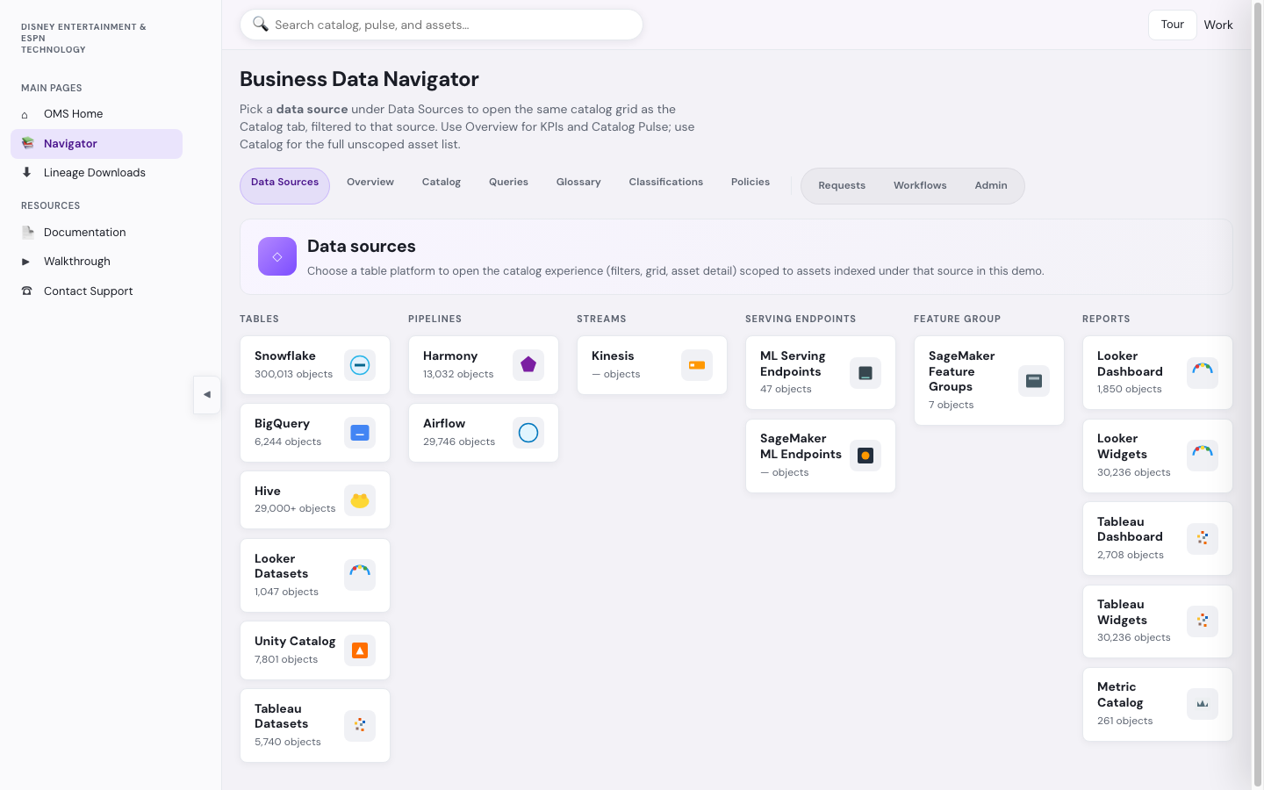
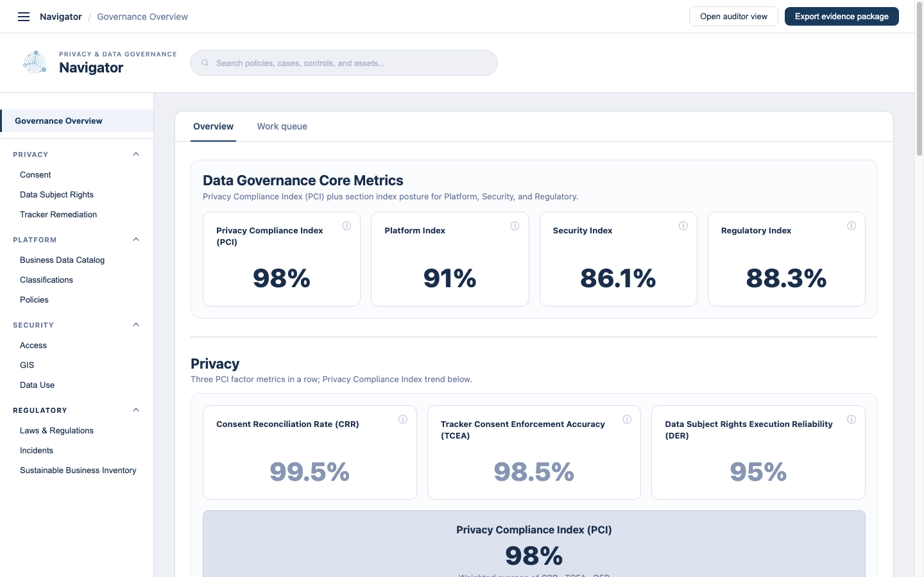
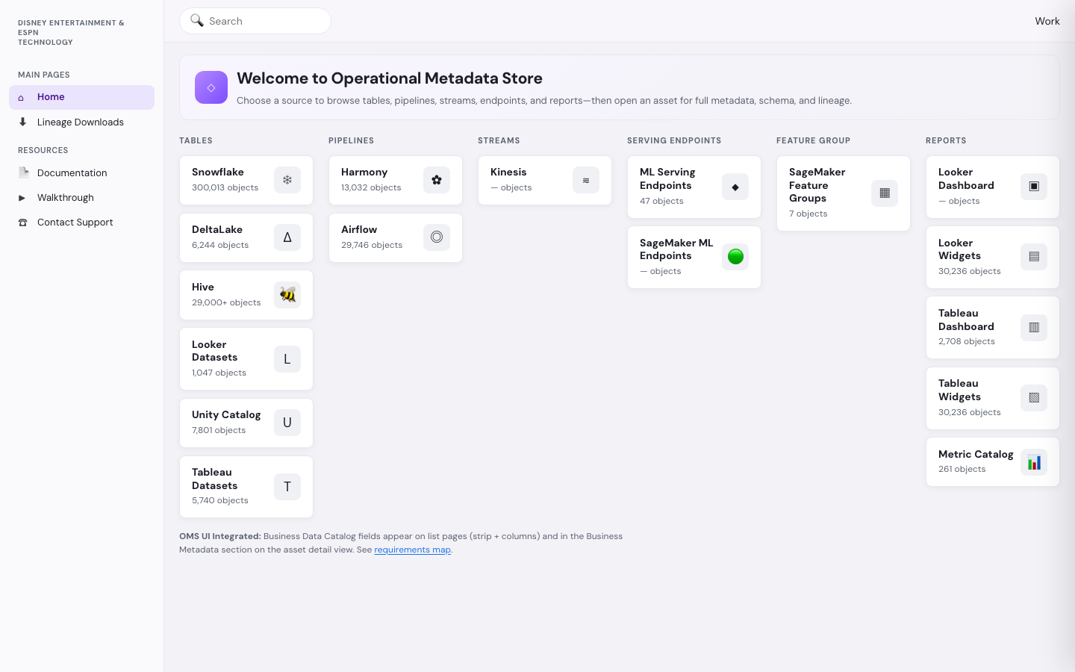
UI walkthrough — three doors, one shell
Same chrome and asset IDs · different default landing by persona · specialist tools open on demand
Navigator / Search / User
BDC
Main content swaps by mode
Portal
Catalog grid / asset detail
— or —
Governance Overview + queues
— or deep link —
OMS technical tabs
OMS →
Business Data Catalog
Discover & steward · Catalog · Glossary
Data Governance Portal
Govern & prove · Overview · Queues
Foundations OMS UI
Engineer path · SQL · Lineage
Deep link chain: Portal exception → Catalog asset → Open in OMS (one asset ID end to end)
DEET Data Governance | June 2026 | Data Gov Portal Architecture Q&A

Slide 8
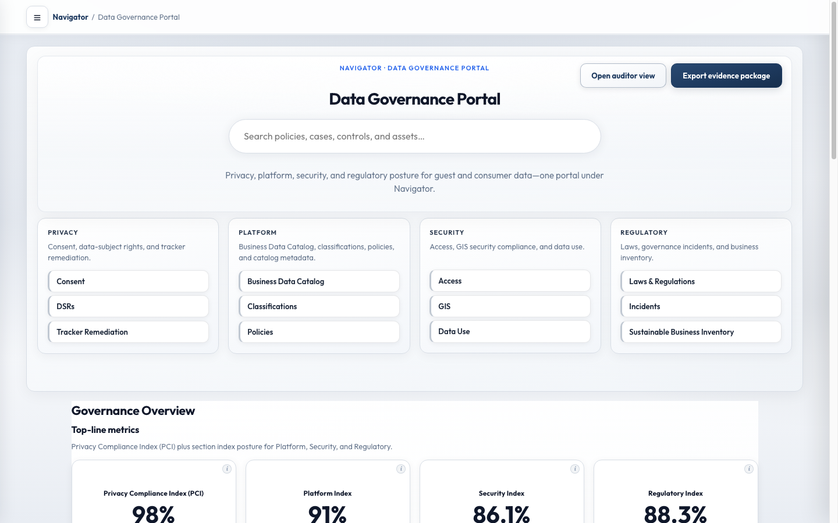
Navigation IA — v1 vs v2 (recommendation)
Both use the same shell and APIs · choice is default landing and left-rail structure
v1 — Two top-level tabs
Simpler MVP · clear mode switch
v2 — Governance-first (recommended for Portal)
Privacy/compliance default · exec posture first
• Left rail: Business Data Catalog | Data Governance Portal
• Click tab → entire main panel swaps
• Best for: catalog-first users during Alation exit
• Prototype: data-navigator-governance/index.html
• Left rail: Overview + Privacy / Platform / Security / Regulatory
• BDC under Platform → opens nested catalog shell
• Best for: governance program operators & leadership
• Prototype: navigator-version-2/index.html
Recommendation: v1 for Navigator MVP (catalog) · v2 for Governance Portal phase 2 · shared search, breadcrumbs, and deep links in both
DEET Data Governance | June 2026 | Data Gov Portal Architecture Q&A

