Slide 1
> // hashFunctionsAndUseCases.cpp
> // By Donovan Lay > public class CSCI24000{ > professor = Andy Harris; > project = final; > }

Slide 2
> What is hashing?
> To hash something is to put data through a hash function. A hash function is a mathematical formula that > performs a series of operations many times over, sometimes hundreds or thousands of times, on a > piece of data of any length, and converts it to a fixed size hash value, where the hash value is just a > hexadecimal representation of the data that has been jumbled into an unrecognizable state. > Hash values usually get stored in a hash table/hash map. A way of thinking of this is as an array with > many slots. Hash values get stored at the location array[hash value] or array [(hash value)%x], > so a hash table will have a lot of empty slots, but if we put in a hash value, we will know exactly > where this is. An example is the dictionary in Python, the dictionary itself is a hash table.

Slide 3
> What makes a good hash function?
> A good hash function is a function that creates seemingly (not actually) random hexadecimal values > based on a given input. Any small change, such as a capitalization, or removal or addition of a character, > should result in drastically different results, and should avoid as many collisions as possible. > This is a really complex problem that people get paid lots of money to try to solve. > In fact, there are many different algorithms for hashing out there such as: MD5 (deprecated), SHA series > (SHA-1, SHA-32, SHA-256, etc.), Tiger, and many more. For our purposes we’ll be working with SHA-1. > > Collisions: A collision occurs when a new value is trying to be added to a hash table, but there is already > a value at the location (meaning two or more things have the same hash value) and this causes > problems. There are ways to address this though, such as having a good algorithm, > separate chaining (each value in the hash table is a node that can be a linked list, so when two values > have the same hash, they create a linked list). > Collision probability can be reduced low, but not to 0 due to the pidgeonhole principle

Slide 4
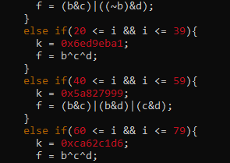
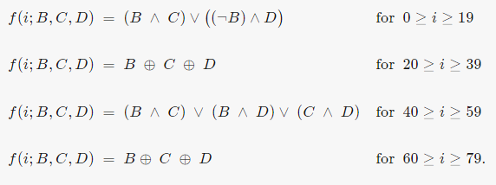

> How Hashing Works
> Hashing works by performing set mathematical formulas over many loops to scramble a word. > This is usually achieved with initial states and performing bitwise operations (and, or, exclusive or, not; > performed on binary numbers) and left/right rotations. An example is seen in Fig. 1. > Left or right rotations are performed on binary numbers, and it can be seen as a ‘sliding’ of > the digits, or more simply it is a multiplication of $2^{n}$ where n is how many times you want to rotate. > A shift can be written as $S^{n}(x)$ where n again is how many digits to shift, and x is the number being > rotated. Example: $S^{3}(0b00001111)$ becomes 0b01111000 which is 56 in base 10, exactly $7∗2^{3}$.
A left rotation of 30 on the variable b, in C++
Figure 1
C++ code of the formulas on the left

Slide 5
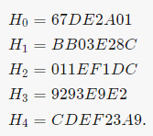
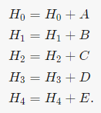
Initial States example
Adjusting states at end of loop

Slide 6
> Salting and Padding
> Another topic to address is a technique called salting. Salting, usually used when storing passwords, > adds a random number to the beginning of the text, which is our data in this case, in order to create > more randomness and reduce the likelihood of collisions. > Padding is used to make chunks of data that we hash the same size, because as we know not all words > are of the same length. Example, say we’re looking at 16-bit chunks, and the chunk we have is the word > password. One common way of padding this out to 16-bits is to add a 1 and then the binary > representation of the original word’s length. So password would become password10001000. > This ensures all chunks are processed as the same size, since we want a fixed size return from the > hash function.

Slide 7
> Hash Use Cases
> So why go through all of this trouble? Turns out hashing is very important and useful. > One use case is passwords: passwords stored on an online server cannot be stored as plain text, as > this would make it very easy for hackers to steal your passwords. Why hashing over encryption? > Encryption requires a key, and with a key, encrypted things can be decrypted, so if a hacker could > get the key, they could get a plain text version of your password. For hashing, there is no backwards > mapping. This means your password is a lot safer. > So how are your credentials checked? When you create your account with your own username/email, > you are given a random salt and all of that is hashed and stored in a hash table. In the hash table, the > values stored are your hash value (a hex number), your salt, and your username. Therefore all 3 need > to be correct in order to log in. > In general, we hash when you want to verify values but can’t store as plain text due to security issues. > Example: suppose your friend sends you a file, and you want to verify that no data was lost, or that > it wasn’t corrupted after being sent. They can hash their file and give you the hash value, and then > you can hash your file, and if the values match, then you know that you have the correct file.

Slide 8
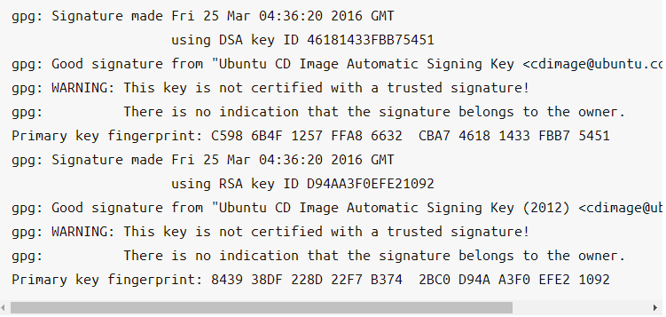
> Verifying Ubuntu Download via Hashing

Slide 9
> Did my implementation work? Sort of…
> //test harness > public std::string hashFunction(std::string username, int salt, std::string password) > hashFunction(dlay, 12345, password) returns 0xfffff7ff58c043a1 > hashFunction(ajharris, 42345, password) returns 0xfffff7ff58c0c3dc > hashFunction(dlay, 12345, Password) returns 0xfffff7ff58c04381 > hashFunction(dlay, 12345, drowssap) returns 0xfffff7ff58c043a8 > hashFunction(ajharris, 0x4f23ac, GlitterCritter) returns 0xfffff7ff590f5e84 > As you can see the values are different, even with just a capitalization or rearrangement > of characters, though only the last few characters differ. So while there is differentiation, > the implementation isn’t great. Though, the goal here was really just to understand > hashing, hash functions, and hash tables, the implementation was more trial and error > to see if I could.

Slide 10
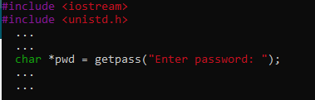

> Closing Notes > You can hide a users password as they type with one simple line of code from the unix library > See figure below > C++ understands ints in forms other than base 10 as long as you specify, ie if you have a hexadecimal > int f35acbbd7, as long as you put 0x in front of it (int number = 0xf35acbbd7) C++ understands what you > mean. > Hashes are an important data structure, so I hope that some of you learned at least a little bit > from this today. Now if you plan on building a website or app and require user log-in, you know > a little bit more about how you can store user data safely using a hashing algorithm. Just don’t use > deprecated (out of use algorithms) such as MD5, as vulnerabilities have been found in them. > ~25%(!!!) of content management systems in 2019 still used MD5 hashing algorithm despite it being > deprecated, according to zdnet.com > As you can see below, there is a website dedicated to cracking MD5 Hashes, many of which are known.

Slide 11
Sources
> MD5Decrypt Logo: https://www.md5decrypt.org/ > Zdnet article: https://www.zdnet.com/article/a-quarter-of-major-cmss-use-outdated-md5-as-the-default-password-hashing-scheme/ > SHA-1 Wiki: https://en.wikipedia.org/wiki/SHA-1 > SHA Brilliant: https://brilliant.org/wiki/secure-hashing-algorithms/ > Computerphile Video on SHA: https://www.youtube.com/watch?v=DMtFhACPnTY > Ubuntu Verification: https://ubuntu.com/tutorials/how-to-verify-ubuntu#5-verify-the-sha256-checksum

